Slide 1
The Brown Act, Parliamentary Procedures, and You! – Open Meeting Laws and Robert’s Rules for Local Senates and Curriculum Committees

Slide 2
Presenters
Stephanie Curry, ASCCC Curriculum Chair 2021-2022
Mark Edward Osea, 5C, Bakersfield College
Erik Reese, 5C, Moorpark College
David Williams, 5C, Solano College, VP- Academic Affairs

Slide 3
Breakout Description
As legislatively created bodies, local academic senates are required to comply with open meeting requirements of the Ralph M. Brown Act. What does this mean for local academic senate leaders? Is it just about posting agendas by deadlines, or is there more to consider? Not to complicate things, but how does Governor Newsom’s Executive Order N-29-20, which relaxes some of the public meeting requirements of the Brown Act in response to COVID-19 stay-at-home orders affect local academic senates? This session will help local academic senate leaders understand the basics of the Brown Act and provide effective practices for ensuring a commitment to openness that meets both the letter and the spirit of the law. We will talk about how to ensure your meetings run effectively, efficiently and equitably.

Slide 4
Breakout Overview
Why are Curriculum Committees Under the Brown Act? (Stephanie)
What does the Brown Act Require? (Mark)
What was the impact of COVID 19 on the Brown Act? (Erik)
What is the role of Parliamentary Procedure in running and effective and equitable meeting? (David)
What is the role of the chair in meetings? (Stephanie)
What types of professional development can be shared about the Brown Act and Parliamentary Procedures? (Mark/Erik)

Slide 5
Why the Brown Act?
“In enacting this chapter, the Legislature finds and declares that the public commissions, boards and councils and the other public agencies in this State exist to aid in the conduct of the people’s business. It is the intent of the law that their actions be taken openly and that their deliberations be conducted openly.”
Courts and the CA Attorney General have sided in favor of greater public access and narrowly view exceptions
“There is more to be gained than lost by conducting business in the open”
Notes:
Why in quotes? What is source?
Stephanie will add citations.

Slide 6
Intent of the Brown Act
“The people of this State do not yield their sovereignty to the agencies which serve them. The people, in delegating authority, do not give their public servants the right to decide what is good for the people to know and what is not good for them to know. The people insist on remaining informed so that they may retain control over the instruments they have created.”
- Government Code Section 54950

Slide 7
LEGISLATIVE BODIES
“All meetings of the legislative body of a local agency shall be open and public, and all persons shall be permitted to attend any meeting of the legislative body of a local agency, except as otherwise provided in this chapter.” -Government Code Section 54953(a)

Slide 8
“Appointed Bodies”
General Rule: A commission, committee, board, or other body of a local agency, whether permanent or temporary, decision-making or advisory, created by charter, ordinance, resolution, or formal action of a legislative body.
Bottom Line: Committees created by formal action of a legislative body are subject to the Brown Act.

Slide 9
Why are local Senates and Curriculum Committees subject to the Brown Act?
“The legally mandated joint action to be taken by the faculty of a community college and a district board in establishing an academic senate constitutes the requisite “formal action” contemplated by [the Brown Act].” - Attorney General Opinion No. 83-304 (1983)

Slide 10
What About Local Academic Senates?
A “legislative body” includes “a commission, committee, board, or other body of a local agency, whether permanent or temporary, decision-making or advisory, created by charter, ordinance, resolution, or formal action of the legislative body.”
Is a local academic senate an advisory body of the community college district board of trustees?

Slide 11
What About Local Academic Senates?
Title 5, section 53200(b) defines academic senate:
“an organization…whose primary function is, as the representative of the faculty, to make recommendations to the administration of a college and to the governing board of a district with respect to academic and professional matters.”
By definition an academic senate is an advisory body to the district board of trustees

Slide 12
What About Local Academic Senates?
Title 5, section 53202 establishes the procedures for the formation of an academic senate
The steps include a vote of the faculty, plus certain actions by the district board after the faculty vote (recognition of the senate, authorization for faculty to establish structures and procedures, etc.)

Slide 13
What committees are under the Brown Act?
Standing Committees of a legislative body are ALWAYS subject to the Brown Act.
Standing committees, irrespective of composition, which have either: (1) a continuing subject matter jurisdiction, or (2) a meeting schedule fixed by resolution or formal action of the legislative body.
Examples: long-term committees on professional development or curriculum.

Slide 14
What does the Brown Act Require?
Effective Notice for Regular Meetings
Government Code §54954.2
Key Points
Regular Meeting Agendas must be posted 72 hours
Must state meeting location and time
Must be “freely accessible to the public”
Cannot be posted solely on internet website

Slide 15
What does the Brown Act Require?
Effective Notice for Special Meetings
Government Code §54956
Key Points
Special Meeting Agendas must be posted 24 hours prior to meeting
Must state meeting location and time
Must be “freely accessible to the public”
Must be posted “on the local agency’s Internet Web site, if the local agency has one.”

Slide 16
What does the Brown Act Require?
Emergency Meetings
Government Code §54956.5
Key Points
Limited in nature, and will more than likely not apply to most Curriculum Committees and Local Academic Senates.
“An emergency, which shall be defined as a work stoppage, crippling activity, or other activity that severely impairs public health, safety, or both, as determined by a majority of the members of the legislative body.”

Slide 17
What does the Brown Act Require?
Only agendized items may be discussed during Regular Meetings, except for the following:
Government Code §54954.2(b)
Key Points
“...a majority vote of the legislative body [determines] an emergency situation exists, as defined in Section 54956.5.”
An agenda item requiring immediate action came to the attention of the “local agency” after the agenda was posted, if:
⅔ of the committee has voted to the addition of the item, or
Unanimous approval if quorum is less than ⅔ of committee membership

Slide 18
What does the Brown Act Require?
Only agendized items may be discussed during Special Meetings.
Government Code §54956
Key Point
“The call and notice shall specify…the business to be transacted or discussed. No other business shall be considered at these meetings by the legislative body.”

Slide 19
What does the Brown Act Require?
The public must be provided an opportunity to address the “legislative body” on any item “that is within the subject matter jurisdiction.”
Government Code §54954.3
Key Points
Comment can be made “before or during the legislative body’s consideration of the item.”
Public need not be provided an opportunity to address an agendized item if the public was allowed the opportunity at another public meeting composed exclusively of members of the legislative body, and the item was not substantially changed.
Special meetings must allow the public the opportunity to address the legislative body “concerning any item that has been described in the notice...before or during consideration of that item.”

Slide 20
What does the Brown Act Require?
Closed Session may not necessarily apply to Local Academic Senates or Curriculum Committees, unless the following items are under consideration:
Government Code §54954.5
Key Points
Litigation - Existing, Initiating, or Anticipated
Real Estate Negotiations
Personnel - Public employee appointment, employment, evaluation, discipline/dismissal/release
Labor Negotiations
License Applicants with Criminal Records
Liability Claims
Threat to Public Services or Facilities
Health Trade Secrets
Multijurisdicitional Drug Law Enforcement Agency Case Review/Planning
Notes:
Almost all topics discussed by local senates and committees must be discussed in open meetings, no matter how contentious.

Slide 21
What does the Brown Act Require?
A majority of members of the legislative body may not “discuss, deliberate, or take action”, outside of an agendized meeting, “any item of business that is within the subject matter jurisdiction of the legislative body.”
Government Code §54954.2
Key Points
Members may congregate outside of committee, “provided that a majority of the members do not discuss among themselves, other than as part of the scheduled program, business of a specific nature that is within the subject matter jurisdiction of the legislative body of the local agency.”
The Brown Act does not prevent a member to confer with their constituents through individual contact. A series of contacts that lead to a discussion with a majority of the membership may constitute a violation of the Brown Act.
Any communication/contact that reveals or may reveal the positions of other members of the legislative body may constitute a violation of the Brown Act.
Notes:
Almost all topics discussed by local senates and committees must be discussed in open meetings, no matter how contentious.

Slide 22
COVID-19 and the Brown Act: Pre-COVID
Ever wonder why legislative bodies largely meet in person?
Teleconferencing requires (§54953b):
All votes by roll call
Agendas posted at all teleconference locations
Each teleconference location is identified in the agenda and notice of meeting
Each teleconference location is accessible to the public
Members of public may address the legislative body at each teleconference location

Slide 23
COVID-19 and the Brown Act: Mid-COVID
Governor’s Executive Order N-25-20 (March 12, 2020)
Suspension of teleconference requirements
Governor’s Executive Order N-29-20 (March 17, 2020)
Clarified accessibility and notice requirements
Enabled legislative bodies to conduct business online
Agenda and notice of meetings 72 hours in advance
Must also include info how public may observe and offer public comment
All votes by roll call; other teleconference requirements suspended

Slide 24
COVID-19 and the Brown Act: Coming Soon
Governor’s Executive Order N-08-21
Teleconference requirements suspensions apply through September 30, 2021
Fall is going to be an interesting transitional semester!

Slide 25
Role of Parliamentary Procedure
Parliamentary procedure allows for effective meeting management.
It allows a committee to arrive at the will of the majority with the greatest number of questions in the shortest amount of time.
This is accomplished regardless of whether the committee is in total harmony or if there is impassioned division of opinion.

Slide 26
Purpose/Principles of Parliamentary Procedure
Maintenance of order
All voices are heard
Look to see whose voices are missing in the discussion or debate
Ability for each member to provide input on a topic
All members have equal rights, privileges and obligations
Full and free discussion with a diversity of ideas
Quorum must be present for business to be conducted

Slide 27
Role of the Chair
Remain impartial during the debate; if the chair wishes to engage in debate, s/he/they must assign a temporary chair, usually the Vice President or next in line
Votes only to break a tie (subject to local rules; in some small committees the chair has a vote)
Introduces the agenda items and provides factual context to the item
Recognizes speakers
Determines if a motion is in order (relevant to the topic and within the scope of the Senate)
Keeps the discussion centered on the current item or motion
Maintains the order of the process
Puts motions to vote and announces the results

Slide 28
Role of the Parliamentarian
A Robert's Rules of Order Newly Revised, enable groups to efficiently and fairly discuss and determine actions to be taken.
The Parliamentarian does not rule! Parliamentary law gives to the chair alone the power to rule on questions of order and on the proper application of the rules.
The role of the parliamentarian during a meeting is purely an advisory and consultative one, helping the presiding officer to respond to points of order and parliamentary inquiries

Slide 29
Processes for Handling Motions
Senator must obtain recognition of the chair (the chair will go in order of who asks for recognition first, within reason)
Senator makes a motion (best motions are simple and direct)
Motion must be seconded by a committee member
Chair restates motion and opens debate
Maker of the motion has the right to speak first in the debate
Motion and any secondary motions are debated
Debate closes when debate has ended (no more in line or time has ended), question has been called (requires 2/3 vote)
Chair restates motion and synthesizes debate (online may be placed in chat so everyone can read the motion)
Vote and announcement of results
The Brown Act requires all votes be listed (roll call) in the minutes

Slide 30
Strategies for Motions
How to state a motion: “I move to….”
Make sure there has been time to discuss the issue before a motion; once a motion is on the floor it must be addressed and action taken.
Make your motions clear and direct: “I move that X be changed on the document.”
Do not make complex motions; instead, consider multiple motions. Not – “I move that we change X, and X and X in the document.”

Slide 31
Debating the Idea not the Person
Collegiality and supporting students - our common goal
In the debate you are debating the idea, not the person
Keep debate focused on the motion or amendment on the table
Personal statements or attacks are not tolerated
All debate should be in the context of the meeting only; there should be no “serial meetings” or “daisy chain agreements”
Interruptions in debates are only allowed in specific instances, e.g., point of information, point of order (see chart)

Slide 32
General Rules of Debate
No committee member may speak unless recognized by the Chair. Only members are allowed to speak.
All discussion must be relevant to the immediate motion.
No member may speak more than twice to each debatable motion. They may speak the second time only when everyone else wishing to speak has had the opportunity.
No member can speak for more than 10 minutes total (or whatever the local decision is).
Debate can be extended if the body makes a motion and agrees through majority vote.
All remarks must be addressed to the Chair.

Slide 33
General Rules of Debate (cont.)
Debate must address issues, not personalities
When possible, chair should let the floor alternate between those speaking in support of and in opposition to the motion.
It is not permissible to speak against one’s own motion (but you can vote against it)
Senators may not disrupt the assembly unless to make a complaint about a rules violation or the relevance of the discussion to the motion. (see chart in a few slides)
If a member/attendee is disruptive or is not allowing the business of the group to continue, they may be removed from the meeting by the chair.
Rules of debate may only be changed by a 2/3 vote or consensus without objection.

Slide 34
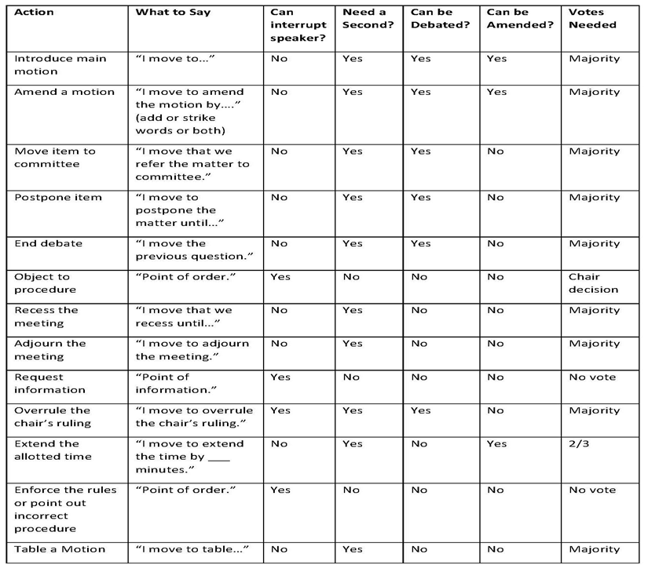

Slide 35
Points of Order
If a member thinks there is rule violation they can ask for Point of Order
If they ask for a Point of Order, the Chair may consult with the Parliamentarian on the point of order questions.
If no point of order is called and a procedural concern is raised later the action stands since it was not done in a timely manner.

Slide 36
Importance of Synthesizing
At the end of debate, the Chair should summarize/synthesize the debate and the motion before the vote is taken.
This grounds the vote and ensures that senators are making an informed vote.
May ask for consensus.

Slide 37
Alternatives to Robert’s Rules of Order
Consensus Decision-Making: A Virtual Learning Center http://consensusdecisionmaking.org/
Democratic Rules of Order (this has to be purchased) http://democraticrules.com/
Simplified Rules of Order https://www.counseling.org/docs/default-source/Branches/simplified-roberts-rules-oforder.pdf?sfvrsn=0
Atwood’s Rules http://robertsrules-team1.weebly.com/alternatives.html
Comparison of Robert’s Rules, Consensus Process and Dynamic Facilitation http://www.co-intelligence.org/I-comparisonRR-CC-DF.html
Martha’s Rules of Order http://camblog.topssoft.com/coming-to-consensus-marthas-rules-of-order

Slide 38
Professional Development: Few Thoughts
Senate/Standing Committee retreat and/or training
Good ideas to orient committee members to Brown Act requirements and parliamentary procedures each year
Senates can request training on Brown Act from ASCCC
Work with your local district counselor on questions about the Brown
Work on the intent of Brown Act (Open and Transparent)

Slide 39
Professional Development/Resources
Open and Public V: A Guide to the Ralph M. Brown Act
The Brown Act and Local Academic Senates- ASCCC Faculty Leadership Institute 2020
Webinar/Resources- Governor’s EOs and the Brown Act for Academic Senates During a State of Emergency
The Brown Act and your Curriculum Committee -Rostrum Article
CA Attorney General Opinion 33-304 (1983)
Brown Act- Relevant Sections (CALCITIES)
Brown Act

Slide 40
Questions?
Thank you for joining us
Contact information
Stephanie Curry stephanie.curry@reedleycollege.edu
Mark Edward Osea mark.osea@bakersfieldcollege.edu
Erik Reese ereese@vcccd.edu
David Williams David.Williams@solano.edu

