Slide 1
Supplemental Instruction, Learning Centers, and Tutoring Programs
Notes:
Ted

Slide 2
Agenda
Introductions
Icebreaker activity with Title 5 Regulations
Discussion with Dr. LeBaron Woodyard
Pedagogy and the regulations
Keeping students at the center of the regulations
Embedded Tutoring, SI, and Tutoring online
Leveraging online with the student in mind
Q&A

Slide 3

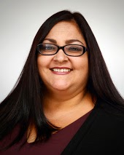

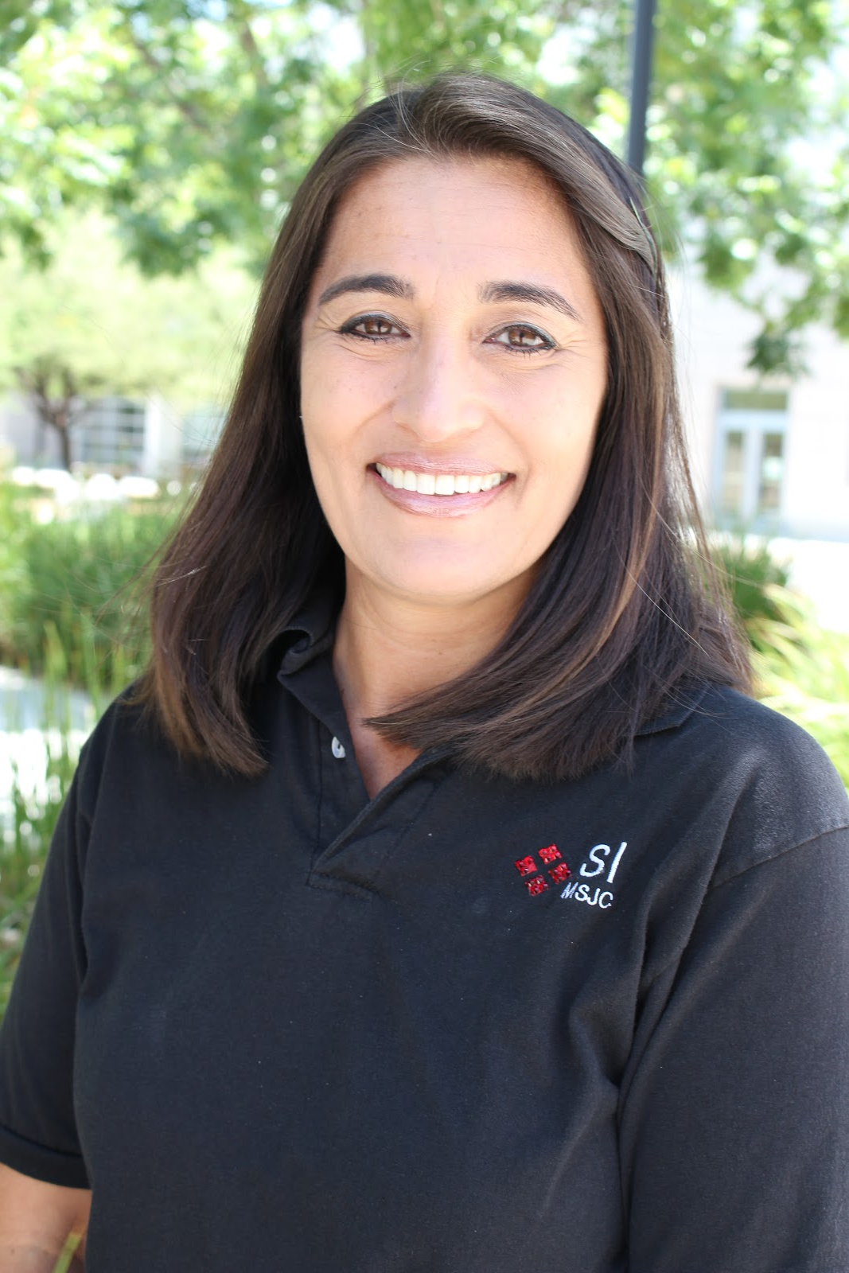
Introductions
Dr. Vandana Gavaskar
Faculty Director, Learning Support Services
Santa Barbara City College
Fun Fact: Encountered wild tiger, and elephant
Kathalena Rios
SI Specialist
Mt. San Jacinto College
Fun Fact: Won 3rd Place in a Lip Sync Contest for Student Success!
Janice Levasseur
SI Coordinator
Mt. San Jacinto College
Fun Fact: Still thinking . . .
Ted Blake
Learning Center Coordinator
Mt. San Jacinto College
Fun Fact: Once taught a class with 70,000 students in it!

Slide 4

Opening Activity
In your Breakout Rooms, you will have 10 minutes total for introductions and completion of the activity:
  Using the Title 5 Regulations and Tutoring handout and the activity handout, first type the section title in the appropriate boxes in row 3
  Drag the textboxes of Title 5 Regulation examples to their appropriate Title 5 Sections
  Save your group’s completed document
  Email the document to tblake@msjc.edu
Notes:
Activity: “Jumble” Take several problems or procedures and break apart the steps on a board, mixing them up and placing them all over the board, Then require the students to grab different steps and put them in order with their appropriate problems

Slide 5
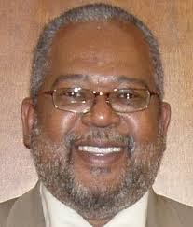

Discussion with Dr. LeBaron Woodyard
Dean of Academic Affairs
CCC Chancellor’s Office

Slide 6
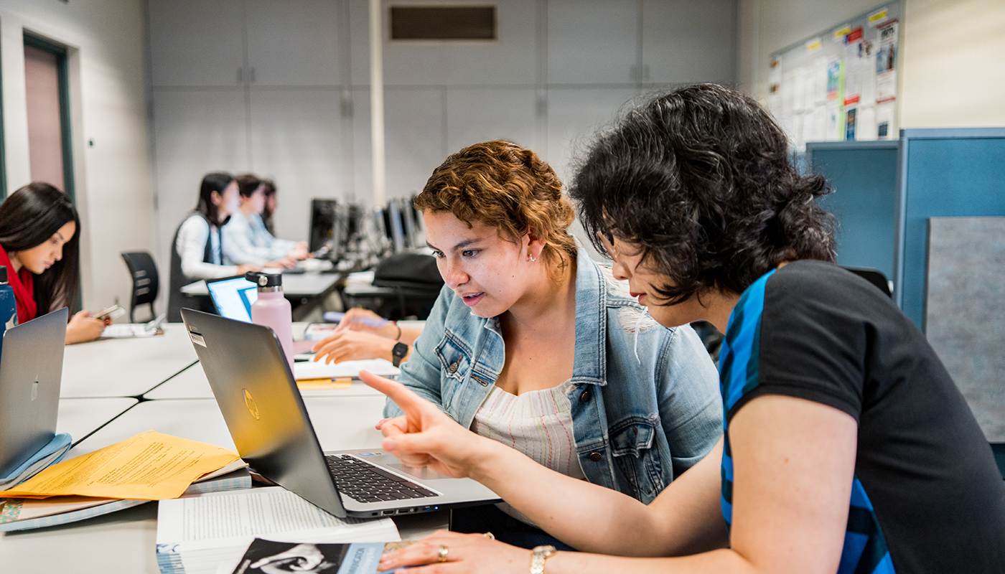
Definition of Tutoring
§ 58168. Tutoring
A method of instruction in credit and noncredit that involves a student tutor who has
been successful in a particular subject or discipline
who has demonstrated a particular skill
who has received specific training in tutoring methods
who assists one or more students in need of special supplemental instruction in the subject or skill.

Slide 7
Title 5: Credit vs. Noncredit
§ 58172. Learning Assistance
Apportionment for supplemental learning assistance in credit and noncredit dependent on whether:
it’s required for all students (Credit)
or
or it’s optional and is provided through an open entry/open exit course (Noncredit)
Notes:
Title V is federal gov, Title 5 is CA ed code interpretation
https://govt.westlaw.com/calregs/Document/ID2435320D48511DEBC02831C6D6C108E?originationContext=Search+Result&listSource=Search&viewType=FullText&navigationPath=Search/v3/search/results/navigation/i0ad7140a0000016476b46b3d9d4392b7?startIndex%3d1%26Nav%3dREGULATION_PUBLICVIEW%26contextData%3d(sc.Default)&rank=1&list=REGULATION_PUBLICVIEW&transitionType=SearchItem&contextData=(sc.Search)&t_T1=5&t_T2=58172&t_S1=CA+ADC+s

Slide 8
Noncredit Open Entry/Open Exit Course
§ 58164. Open Entry/Open Exit Courses
refers to courses in which students enroll at various times, and complete at various times or at varying paces
one unit of credit shall be awarded for approximately 48 hours of recitation, study, or laboratory work
to provide support for another course or courses, the COR for the OE/OE must identify the other course(s) it supports and the specific learning objectives and competencies

Slide 9
To Collect Non-Credit Apportionment for Tutoring, Colleges need to meet the following criteria
§ 58170. Apportionment for Tutoring
(a) The individual student tutoring is conducted through a designated learning center.
(b) The designated learning center is supervised by a person who meets the minimum qualifications prescribed by section 53415.
(c) All tutors successfully complete instruction in tutoring methods and the use of appropriate written and mediated instructional materials, including supervised practice tutoring. This requirement may be waived by the chief instructional or student services officer on the basis of advanced degrees or equivalent training. Academic credit and apportionment for coursework in tutoring methods for purposes of this section shall be limited to two semester or three quarter units of credit, or 96 noncredit hours. All tutors shall be approved by a faculty member from the discipline or disciplines in which the student will tutor.
Notes:
From Memo AA 19-05 “Tutoring Apportionment” January 14, 2019
Tutoring methods belongs to an academic discipline. It is also a practice which is supervised in the context of what is considered “appropriate” or authorized help. The student does the work of learning in the context of specific learning strategies. The role of faculty is to recommend students as tutors.

Slide 10
Section 58170 Criteria cont’d
(d) All students receiving individual tutoring have enrolled in a noncredit course carrying Taxonomy of Programs number 4930.09, which is entitled “Supervised Tutoring.”
(e) Students enroll in the Supervised Tutoring course, through registration procedures established pursuant to section 58108, after referral by the student, a counselor, or an instructor on the basis of an identified learning need. (Revised as of September 2018 by the Board of Governors and being considered by the Department of Finance. Finalized November 2019.)
(f) An attendance accounting method is established which accurately and rigorously monitors positive attendance.
(g) Student tutors may be remunerated but may not be granted academic credit for tutoring beyond that stipulated in (c) above.
(h) The district shall not claim state apportionment for tutoring services for which it is being paid from state categorical funds.

Slide 11
Important Revision to Ed Code - Nov. 2019
Effective November 9, 2019, California Community College students are no longer required to be referred for supervised tutoring by a faculty or a counselor based on a student’s identified learning need, but are able to self-refer for supervised tutoring. The approved revisions to California Code of Regulations, title 5, section 58170, will expand access to supervised tutoring because faculty or counselor referral was a barrier for students who are reluctant to request the referral.

Slide 12
Impact of AB705 on Tutoring & Apportionment
“the Chancellor’s’ Office has determined that colleges may collect apportionment for non-credit supervised tutoring hours in which students are strengthening basic skills even if they are seeking support for such skills in transfer-level courses. However, the apportionment can only be claimed for the following: communication/literacy skills, quantitative reasoning skills, and critical thinking skills.”
~ From Memo AA 19-05 “Tutoring Apportionment” January 14, 2019

Slide 13
Online Tutoring
Per Title 5, section 58170, individual student tutoring must be conducted through a designated learning center that is supervised by an individual that meets the established minimum qualifications. This memo serves to clarify that the policy does not require the designated learning center to be housed in a brick and mortar facility or that supervision occur in-person. A virtual tutoring center may offer supervised tutoring assistance through synchronous technologies such as videoconference, web conference, audio conference, or other technology resources. Therefore, colleges transitioning to virtual, online tutoring should establish protocols and online infrastructure to support continued tutoring services that meet the requirements of this policy.
~ Memo ES 20-11 March 27, 2020

Slide 14
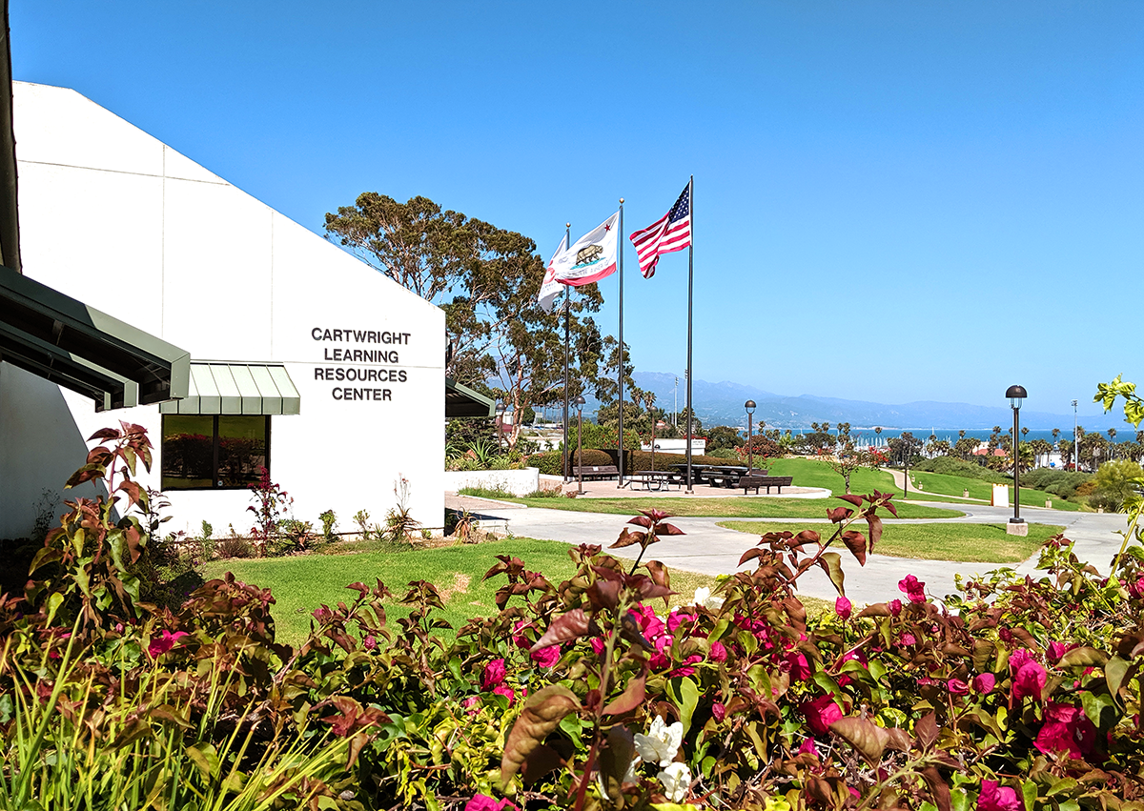
Pedagogy of Title 5 Regulations
Near Peer “Instructional Method”
Extending the Classroom
Making Thinking and Learning Visible

Slide 15

Theory of Learning: Experiential Education
Affective Dimensions
Cognitive Dimensions
Psychomotor Dimensions
Is learning something new emotional?

Slide 16
Faculty Perspective: Struggle Points Activity
Classroom
Learning
1.What is a struggle point in the course for your students?
2. What attitudes and beliefs do students bring to the struggle?
3. Tutors share processes for success, design activities to engage students and provide active mentoring.
1.Related to Threshold Concepts
2. Know who your students are--relate success data to the students you know.
3. Tutors bring the immediacy of learning, making learning visible.

Slide 17

Student Experience of Belongingness is Equity
How do we build spaces that look like they are made for students
Who are our students-- as people, as members of their communities?
How do they learn in every class, and in every modality?
What are the Disproportionate Impacts at your school?
What are your leading and lagging indicators?
Tutors know our students’ stories

Slide 18

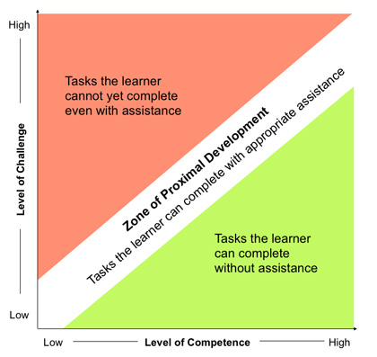
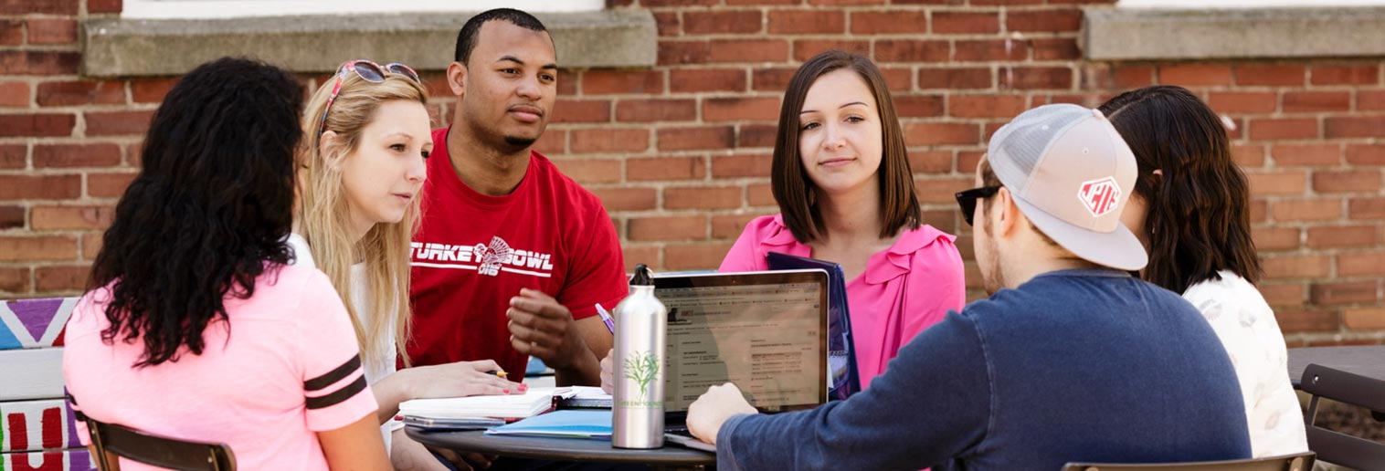
Theory of Learning: Zone of Proximal Development

Slide 19
Considerations as we Move Online
Student Access & Barriers
Technology & Barriers
Supervision
Training of student tutors and Leaders
Training students to learn online
Maintaining the student-focused perspective
Tutor compensation & budget
Reorganization
Barriers we are facing

Slide 20


Three F2F/Online Modes
Embedded Tutoring
Santa Barbara City College
Supplemental Instruction (SI)
Mt. San Jacinto College
Tutoring
Mt. San Jacinto College

Slide 21
Why Embedded Tutoring ?
PROXIMITY | CONTINUATION | INTEGRATION
Tutors are a part of the learning community of the class. Faculty/tutor relationship is key to the continuity. Tutoring is focused on skills in a specific disciplinary context. Focus is on the success of a particular course and discipline. Activities related to the skills and assignments of the course.
Learning Assistance: Role of Tutor vis a vis students and faculty. Create and share tutoring philosophy, conduct group tutoring activities, participate in continuous training.

Slide 22
Faculty Involvement | Tell the Data Story | Challenges
Faculty Recommend and Mentor Tutors and Tutoring Activities-both groups of students learn on different levels Faculty make the learning in the class visible, if not the focus of the class. Creates concrete opportunities for peer collaborative learning networks | Why and how innovative programs work Student Success and Belongingness Data. Equity Data-reducing disproportionate impact | Collaboration for Budgets and Growing/Changing Needs. Developing and Maintaining Best Practices. Organization and Continuous Consensus Building
not Exceptionalism but Intentionalism
Creating a Culture of Innovative Learning

Slide 23
A Key Philosophy:
Faculty Innovations in Learning
Campus-Wide Initiative
Tutoring is Norm for Learning on Campus
Peer-Embedded
Tutoring Models
Outcomes and Measures
Create New Initiatives
How do faculty partnerships impact your peer embedded tutoring program?

Slide 24
Embedded Tutors: Experiential Learning
Near peers or peers who have successfully taken the course with a specific instructor
Identified by faculty and hired and trained by the tutoring program.
Students who demonstrate an interest in helping students and competence in a subject area.
Tutors who provide tutoring with the context and understanding of a learner (not an expert). They model learner strategies.
Support AB705 and equity initiatives.

Slide 25
Creating an Intentional/Visible Culture
Tutoring seen as intrinsic to affective learning and Growth Mindset strategies
Ongoing professional development
Tutor Training and Mentoring
Share Effective Faculty Practices with Gateway Tutors

Slide 26
How is Embedded Tutoring Different from SI?
Embedded Tutoring
SI
UMKC Model
Non-cognitive and affective learning support from Faculty and tutors.
Work flexibly in and out of the classroom.
Part of the planned learning and activities.
Differentiated Learning
SI not as successful for Basic Skills
SI leaders observe and model being a student in class.
Design group learning activities for outside the class.
Don’t facilitate “homework” but rather focus on study skills and content.
Students who went to SI sessions are anonymous
Which model works for your context? What culture is created by each of these models?

Slide 27


Supplemental Instruction (SI) at MSJC
In existence since Fall 2006
Follows the UMKC model, earned accreditation in January 2018
Started with grant funding (Basic Skills Initiative, 2010-2015 Title V Grant, 2011-2016 Title V STEM Grant)
Fully institutionalized beginning the Fall 2017 through the MSJC Program Review and Resource Allocation Proposal process
  Non-Teaching Full-Time Faculty Coordinator
  Part-Time Classified Specialist
  Full-Time Classified Clerical Assistant
Typically 45 - 55 SI Leaders supporting 50 - 65 sections of historically difficult courses in about a dozen disciplines

Slide 28
Online Supplemental Instruction (SI) at MSJC
Microsoft Teams | Cranium Café | Pisces | Zoom
Capabilities: Breakout rooms File sharing & storage Video Chat Recording feature with closed captioning Team page management Device compatibility | Capabilities: Meeting rooms Document sharing Video Chat Interactive whiteboard Closed captioning | Capabilities: Meeting rooms Chat rooms Document sharing Interactive whiteboard Automatic capture of reporting data | Capabilities: Breakout rooms File sharing & storage Interactive whiteboard Video Chat Recording feature with closed captioning Device compatibility
Limitations: Unavailable to link with student email account Limited compatibility with iPads Time restriction for account set up | Limitations: Limited space in each meeting room Not intuitive Fixed roles of students Staff must be present for full “host” functions | Limitations: Not intuitive Must toggle between video chat and access to shared whiteboard Necessary device set up | Limitations: Basic account time restrictions Chromebook limited functionality No automatic capture of reporting data
Choice: already in use for committee meetings, faculty online office hours,
“real-time” classes (linked through Canvas)

Slide 29
Online Supplemental Instruction (SI) at MSJC
Transition Timeline
Friday, March 13, 2020
March 16-20, 2020
March 23-27, 2020
Friday, April 3, 2020
Final In-Person Training
Debriefed Leaders on current status and plans moving forward
Encouraged Leaders to communicate with Instructors for class plans
Campus Closed
Offered five intro to zoom trainings (3/16-3/20)
100% of leaders attending trainings
Each raining was monitored
General best practices were highlighted as the result of the training
Spring Break
Leaders continued practicing on zoom
Hosted meetings with other leaders to “play” on zoom
Program leadership explored other platforms to ensure best fit for online session facilitation
Final Training prior to Virtual Reopening
Zoom Pro Accounts issued
Training utilized Zoom facilitation features
Demonstrated virtualized activities
Emphasized team building through fluff

Slide 30
Online Supplemental Instruction (SI) at MSJC
After Transition Support
Leader Assistance for two weeks: assigned an SI Leader assistant to each session to assist with technology issues during session so the SI Leader can focus on facilitating
Leaders office hours for two weeks: SI Leader held office hours for the first to weeks to focus on technology issues for student (no content covered during these meetings)
Restart of Mentor Observations beginning the third week: Provided support and feedback on virtual sessions. Assisted with planning and tech support
Ongoing Virtual Training: Trainings emphasized the virtualization of session activities and team bonding (fluff)

Slide 31


Online Supplemental Instruction (SI) at MSJC
Preparation for fully online program Fall 2020
Student led Design Teams:
Amber F.
David R.
Dylan F.P.
James C.
Jessica G.
Joshua S.
Marissa C.
Nathaniel R.
SI Program Team:
Janice
Kathalena
Vanesse H.

Slide 32
SI Summer 2020 Design Teams
Electronic Paperwork & Submission
  Streamlined electronic paperwork process
  Enhanced learning outcomes measurement on observation and evaluation forms
Virtualization of Strategy Cards
  Modified activity cards to fit online platform
  Created a document with examples and resources for each activity
Online Orientation
  Redesigned three day SI Leader Orientation for virtual delivery
  Build in team bonding virtually
Pre-Orientation Zoom Training
  Designed a zoom training that emphasized zoom features used in orientation
  Ensures new leaders are acquainted with zoom prior to orientation
Team Bonding
  Generated ideas of how to build in team bonding virtually
    Helps provide support and engagement
  Developed Virtual Escape room challenge for Orientation
    Introduces growth mindset & Habits of Mind strategies
Online Resources
  Vetted over 75 online resources that offer teach and learning activities
  Reduced list to showcase most functional, free of charge, and device friendly resources

Slide 33
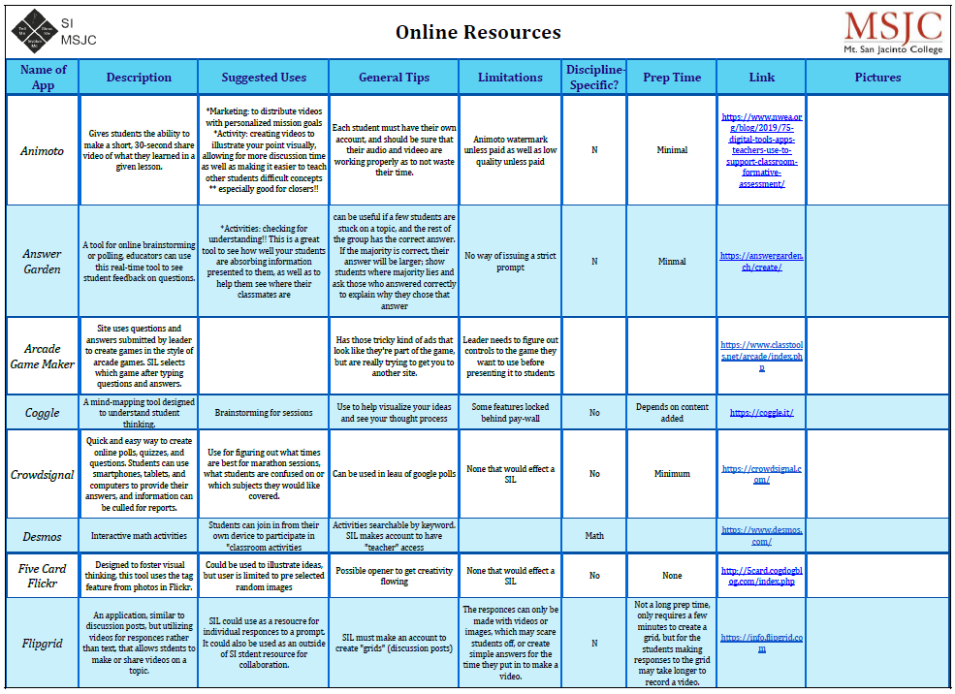
Online Supplemental Instruction (SI) at MSJC
Online Resource Team Final Product

Slide 34
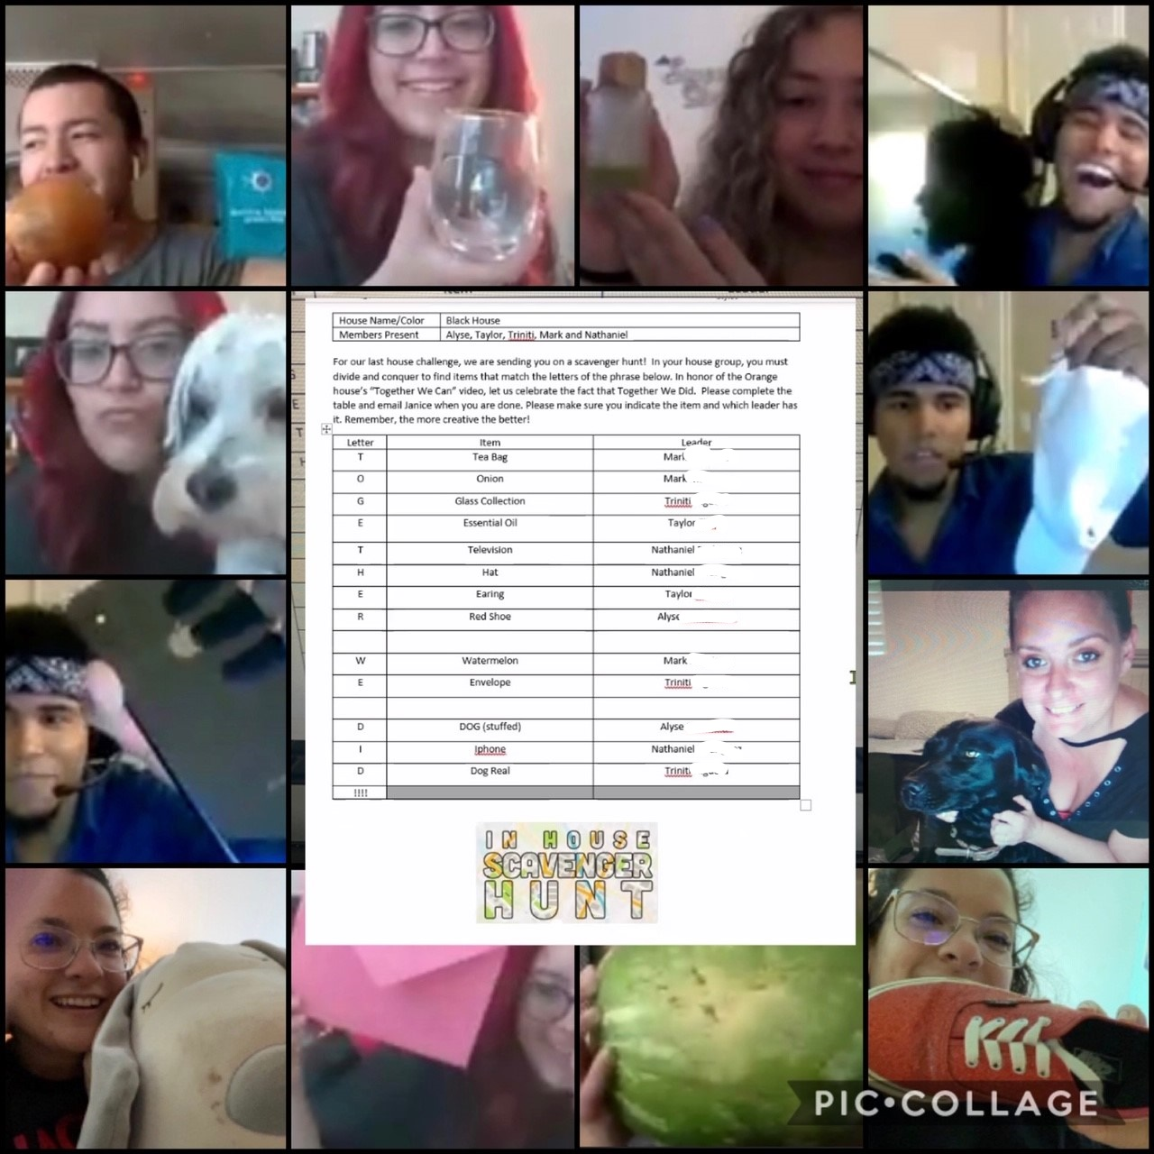
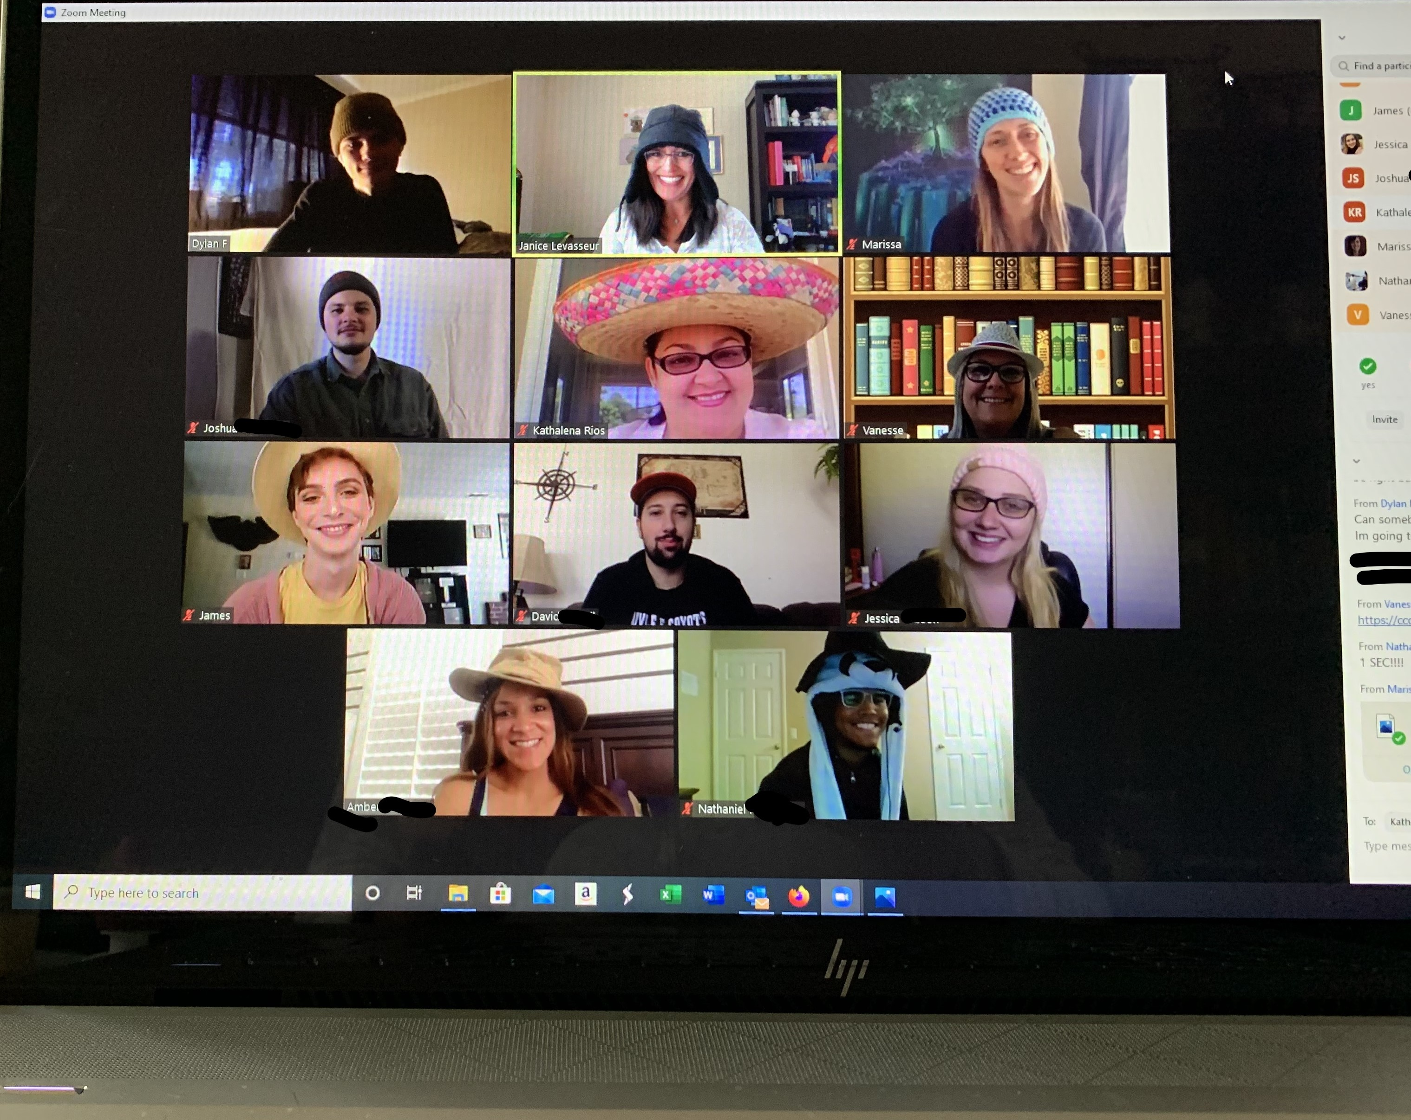
Online SI
Scavenger Hunt Activity
Summer 2020 SI Team

Slide 35
Supplemental Instruction (SI) at MSJC
Next Steps
Remembering the model
  SI targets “historically difficult courses” rather than students: per SI Supervisor Training Manual from the International Center for Supplemental Instruction
Data -- continues to show, “if we build it, they will come”
  2018-2020 data reveals that, when looking at ethnic groups individually, the group with the highest participation rate is our African American students (our highest priority students)
  African American students who participate in SI have higher success rates and lower withdrawal rates than the general population of African American students
  The opportunity gap is smaller for African American students who participate in SI than the opportunity gap for the general population of African American students

Slide 36

Tutoring at MSJC

Slide 37
Tutoring Online at MSJC
Student Support HUB
  All services on one page (https://www.msjc.edu/hub/)
  Crosses Divisions
  Counseling, Financial Aid, Library, Tutoring, etc.
Pisces
  MSJC Peer Tutors available through Canvas
NetTutor
  NetTutor tutors available through Canvas
  Math support 24/7
  Online Paper Drop Off with 48 hour turnaround

Slide 38
Timeline
Circa 2010: Online Tutoring Launched at MSJC with Smarthinking
August 2014: OEI Pilot School designation
Fall 2015: Switched to NetTutor
Summer 2017: Online Peer Tutoring begins at San Jacinto Campus of MSJC
Spring 2020: Full transition to fully online peer tutoring April 2020 due to COVID-19 Pandemic

Slide 39
Transition to Online: March 2020
All Academic Tutoring moved forward as One Group. This gave us an opportunity to see just how “scalable” our program was.
  Two Campuses into one program
  Fully online
Directed to use only One Technology Platform
  Chose Pisces (Considered Zoom, Cranium Cafe)
  Integrated into Canvas
Peer/Faculty Tutors Ability to Continue Tutoring Online
  Do they have the technology and wifi at home to continue tutoring?
  Do they want to continue tutoring online?
Out of 151+ Peer/Faculty Tutors
  Approximately 114 were trained to continue tutoring online
  24.5% of original Peer/Faculty Tutors did not transition to online tutoring

Slide 40
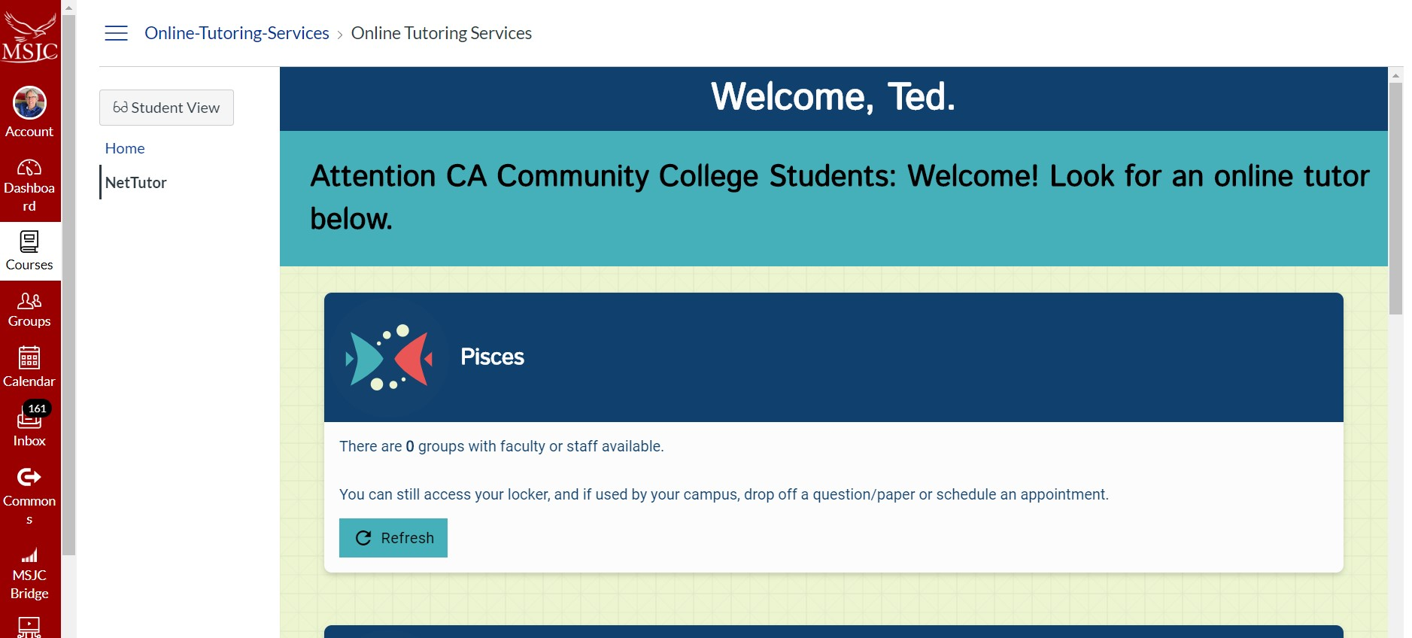
Pisces (Linksystems Technology Platform)

Slide 41
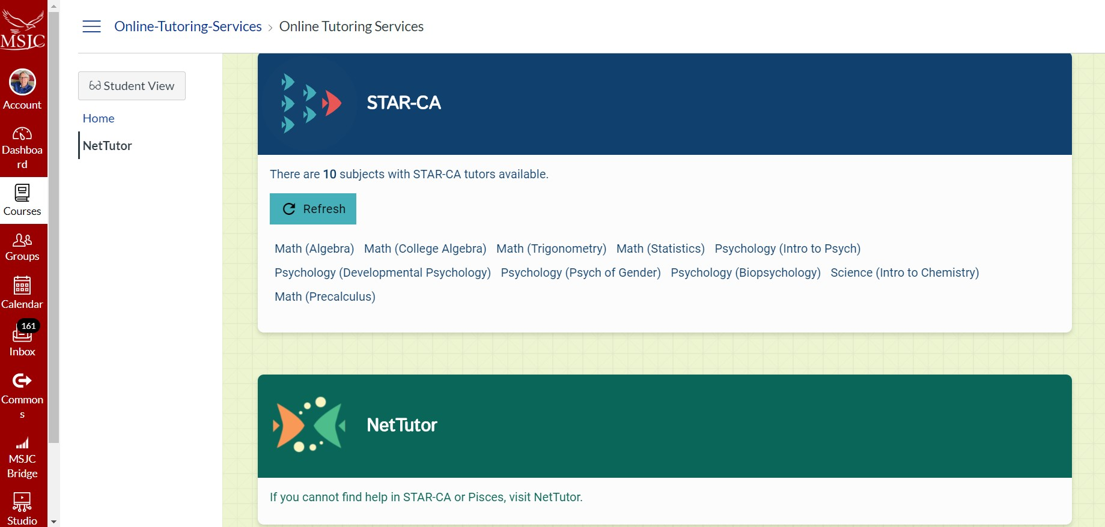
STAR-CA and NetTutor

Slide 42
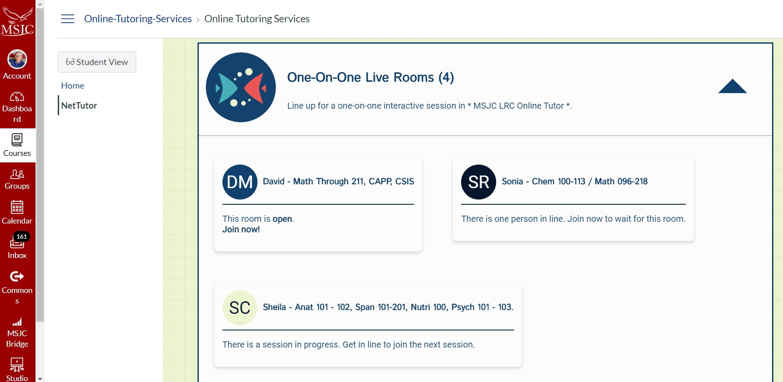
Pisces: One-on-One Rooms

Slide 43
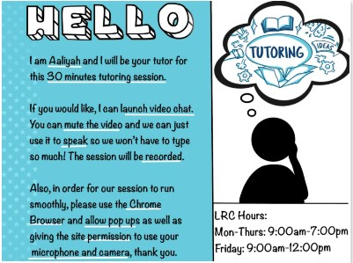
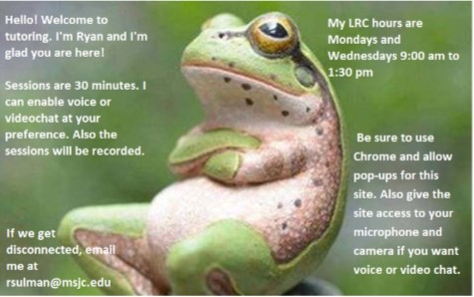
Being Welcoming Online

Slide 44
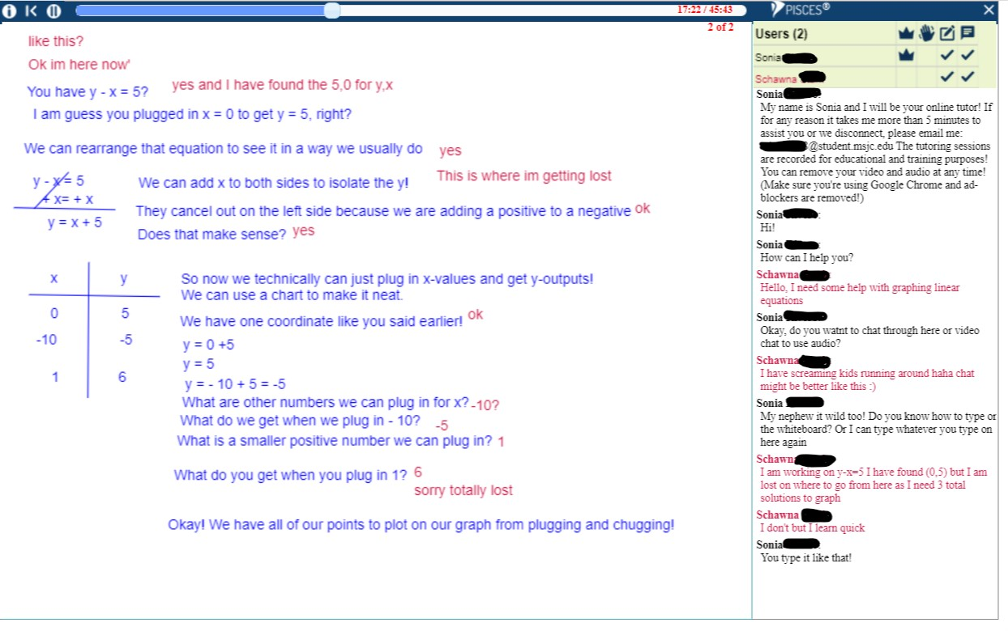
Math Tutoring in Pisces

Slide 45
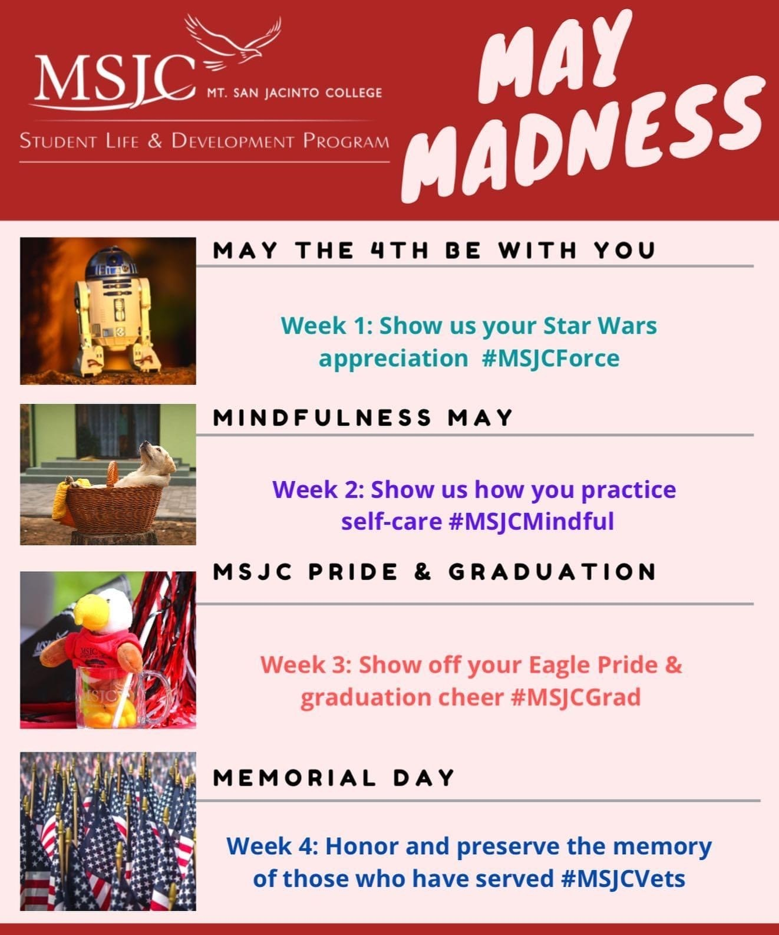
Getting the Word Out
Preparing and training students to learn and get tutored in the online environment
Four seminar sessions during different times of the day
Shared on social media and invited classified staff
Faculty email with outline to add to their Canvas shells
Provided NetTutor tutorials and tutor session demo
Marketing
MSJC May Madness
Hashtags, Hashtags, Hashtags

Slide 46
Data Collection and Apportionment
All sessions are archived automatically and accessible at any time.
  Whiteboard images and session chat is archived.
Peer Tutors login and logout times are recorded.
  Shared on a weekly or daily basis with Classified Professional Staff
Separate Reports
  NetTutor Tutor Sessions
  Local Peer Tutor Pisces Tutoring Sessions
Reports can be shared with anyone (Faculty, Deans, etc.) as an exported CSV or Excel file
  Reports for apportionment
  Live Minutes converted to Positive Attendance Hours
Students have full access to all their tutoring sessions

Slide 47
Leveraging Online with the Student in Mind
How do we leverage what we do to keep students in the center and our programs complementary (all online!)?
Anti-Territorialism
Complementary Programs
  Students need multiple points of sympathetic contact to feel connected, especially men of color (see Wood & Harris, Teaching Men of Color)
Connections to Affinity Groups (Umoja, Puente, Etc.)
Personalize online learning spaces with peers from all programs
  PLACE - Peer Learning Alliance for Collaborative Education (Academic Student Workers Group)

Slide 48
Questions?
Contact Us:
Dr. LeBaron Woodyard, LWOODYAR@CCCCO.edu
Dr. Vandana Gavaskar, vsgavaskar@sbcc.edu
Janice Levasseur, jlevasseur@msjc.edu
Kathalena Rios, krios@msjc.edu
Ted Blake, tblake@msjc.edu

