Slide 1
Accounting Methods for Credit and Noncredit
Thu Jul 13, 2023
12:45pm-2:00pm

Slide 2
Presenters
Erik Shearer, Butte College, Vice President of Instruction
Erik Reese, Moorpark College, ASCCC Area C Representative

Slide 3
Session Description
This session will take a deep dive into the mysterious waters of attendance accounting, focusing on the confluence of credit hour calculations, curriculum, course scheduling, and apportionment. We will cover the history and regulations behind attendance accounting, including more recent developments in noncredit and alternative attendance accounting, and discuss how choices in curriculum can affect scheduling and apportionment under the new Student-Centered Funding Formula.

Slide 4
In this presentation:
A look at the history of funding and attendance accounting in the CCC system.
From curriculum to scheduling: how the COR affects scheduling decisions.
Overview of course scheduling practices and procedures
Attendance accounting fundamentals, including noncredit, hybrid, and distance education
Recent changes to attendance accounting

Slide 5
A Quick History of CCC Funding

Slide 6
Early History of CC Funding
CCCs begin in early 1900s; outgrowth of secondary education.
1917 legislation authorized high school districts to create junior colleges.
Financing mechanism consistent with primary and secondary education: Average Daily Attendance (ADA)
ADA – counting enrollment based on hours attended rather than headcount. In reality, a measure of workload. Dollar amount per ADA funds the cost of the workload.
Notes:
Translating enrollment to workload via ADA: If one ADA was funded at $1000, a college with an enrollment of 4,000 ADA would receive $4,000,000 in funding.

Slide 7
Evolution of Funding Structure
1917 – 1988:
State funding established, based on Average Daily Attendance (ADA)
Consistent with K-14 practices
Introduction of 15 hrs p/week as FT student, first use of 525 hours.
1988 – AB 1725
Establishes FTES mechanism
Program-based Funding
2006 – SB 361
Funding “equalized”
Enrollment growth capping
FTES dependent on how a course is scheduled: Weekly, daily, actual hours of attendance.
2018 – SCFF
Introduced 70/20/10 funding formula that reduces weight of FTES in overall funding.
Notes:
Upward Extension law passed in 1907 allowing High Schools to create Junior Colleges. Fresno College is first out of the gate!

Slide 8
The Credit Hour and Scheduling

Slide 9
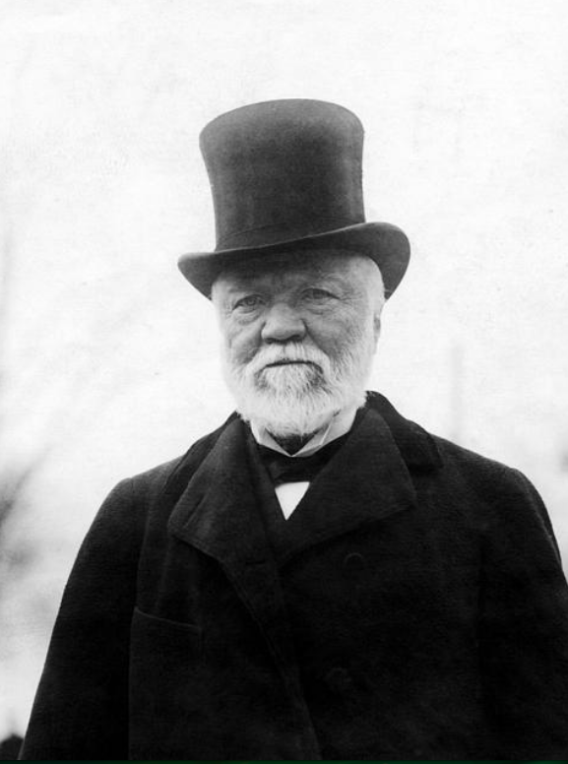
Some History
Carnegie Unit? Not in Higher Education; CU a measure of progress in secondary education.
Standard unit or “student hour” a response to shift towards modular, elective curriculum and student mobility in the late 19th century.
Seat time vs. summative assessments of student learning.
Defined by common practices, not by law.
Widely decried as further industrialization of education and part of the degradation of education into measuring student learning through “…counting by courses...” rather than holistic assessments.
Notes:
Carnegie Unit for Secondary Education was equal to 120 hours of instruction, broken into five, one-hour sessions per week over 24 weeks. Colleges who accepted the Carnegie retirement system (TIAA/CREF) were required to uphold the secondary standard as an entry requirement.

Slide 10
COR – Credit Hour Calculations
Standard Formula
Derived from title 5 §§55002-55002.5, the PCAH, and from 34 CFR 600.2
Applies to most credit course types (lecture, recitation, lab, activity, etc.)
Cooperative Work Experience
Title 5 §55253 (new number)
Substantial change last year. (54 hours or local equivalent for minimum hours for one unit of credit. Between 48 and 54)
Clock Hour Programs
34 CFR §668.8(k)(2)(i)(A) and 668.8(l)
Rarely used as most of us convert clock to credit hour
Ask Financial Aid director about PPA

Slide 11
Standard Formula
Units of Credit =
$$\frac{\left[Total Contact Hours + Outside of class Hours\right]}{Hours per unit Divisor}$$
Round the result down to the nearest increment of credit awarded by the college. Colleges may award units of credit in increments smaller than .5. Courses under .5 units may use other increments, e.g. .1, .125, .15, .25, etc. This is because units of credit operate on minimum thresholds, just like a grading system. A student doesn’t earn the unit or partial unit until they cross the minimum threshold of hours for that increment.

Slide 12
Typical Ratios
The standard formula includes typical ratios for contact- to homework hours that are not specified in law but are drawn from standard practices in higher education. The three most common ratios, expressed in weekly hours, are as follows:
Academic Activity | Weekly Contact Hours | Weekly Outside-of-class Hours
Lecture (Lecture, Discussion, Seminar, and Related Work) | 1 | 2
Activity (Activity, Lab/w Homework, Studio, and Similar) | 2 | 1
Laboratory (Traditional Lab, Clinical, and Similar) | 3 | 0

Slide 13
Hours on the COR and Scheduling
COR hours are ideal hours; Schedules are actual hours
Can’t schedule beyond COR hours (some wiggle room)
Individual course sections vary in terms of total contact hours and FTES generated based on a variety of factors:
Length of section vs. length of term
Regularity of class meetings
Scheduled days of the week.
Let’s move on to scheduling!

Slide 14
Class Scheduling & Attendance Accounting

Slide 15
What is an Hour?
Clock Hour
A 60-minute time frame
May start any time, e.g. 08:10 – 09:10
Class Hour
A period of not less than 50 minutes of scheduled instruction within a clock hour
There can be only one class hour in each clock hour, except as provided for multiple-hour classes
A class hour is commonly called a “student contact hour”

Slide 16
Passing Time
The other ten minutes of the clock hour:
Each clock hour is composed of one class hour segment, and a segment referred to as “passing time” or “break time”
No additional attendance may be claimed for the 10-minute segment except for multiple-hour classes
The 10-minute break time permitted in each clock hour may not be accumulated during a multi-hour block scheduled class to be taken at the end of the session and be counted for FTES purposes

Slide 17
The Partial Class Hour
A "partial class hour" – fractional part of hour in a section scheduled for more than one clock hour.
Schedule in five-minute increments, 15 minute minimum in partial class hour
Converts to contact hours based on 50-minute hour.
PCH Computation:
(partial class hour minutes / 50) = contact hour

Slide 18
Contact Hour Calculation Table - Excerpt
Notes:
Link on the resources slide.

Slide 19
Multiple Hour Classes
Any period of instruction scheduled continuously for more than one clock hour
Each 50 minutes exclusive of breaks is a class/contact hour
A fractional part of a class hour beyond the last full clock hour is counted from the 51st minute of the last full clock hour
No class break is allowed in the last full clock hour or the partial class hour
The divisor for this fractional part of a class hour is 50.

Slide 20
Multiple-hour Class Example
7:00 pm to 10:05 pm
7:00 to 9:50 = 3 hours
Partial Class Hour 9:51 – 10:05 = 15 min
15/50 = 0.3
Total Contact Hour = 3.3
Includes 20 min of “break” time
Breaks may not be accumulated and taken at the end. However, when a section is scheduled over a full day, breaks can be combined for a ”lunch” break w/o change in attendance

Slide 21
Scheduling and Attendance Accounting
Apportionment funding via FTES (70% in SCFF) is based on attendance accounting methods tied to HOW a section is scheduled.
Each class section uses one attendance accounting method in calculating FTES
How the instruction is provided for a particular class determines the attendance accounting method that may be used for that section.
Scheduling must follow rules that are more complicated than the COR. Goal in scheduling is to maximize return in FTES.

Slide 22
Attendance Accounting Primer

Slide 23
What is Attendance Accounting?
Where curriculum and scheduling turn into funding.
Measurement of college workload/expense through the proxy of Full-time Equivalent Students (FTES). Reported to the state for funding on the annual 320 report.
Per section count of how many FTES can be claimed for state funding. Dependent on how a section is scheduled.
Concept based on origin of CCC as an extension of high school and ADA
Complicated!

Slide 24
Concept: Full-time Equivalent Student
1 FTES =
1 student enrolled in
15 hours per week, for
2 semesters of 17.5 weeks each (175 days)
= 525 student contact hours (SCH)
This concept of what constitutes a full-time student in this calculation is an artifact from our creation as a system in the early 1900s!

Slide 25
Concept: Term-length Multiplier
TLM is the number of weeks in a primary term with at least three days of instruction or examination.
The Chancellor’s Office sets the TLM for each college based on the college’s approved academic calendar.
Maximum TLM:
17.5 for semesters
11.67 for quarters
Compressed calendar considerations
Do you know your college’s approved TLM?
CCC Chancellor's Office 2022-23 Approved TLMs

Slide 26
Concept: Census
How many students can we claim for apportionment?
Census Week – for WSCH Attendance Accounting
The week nearest to 20% of the number of weeks in the primary term
Monday of census week, unless a holiday, then following day.
Census Day – for DSCH Attendance Accounting
The day of the class meeting nearest 20% of the number of days the section is scheduled.
If 20% is day one, then census is day two.

Slide 27
Attendance Accounting Categories
Weekly Student Contact Hour (T5 58003.1(b))
Daily Student Contact Hour (T5 58003.1(c))
Actual Hours of Attendance (Positive Attendance) (T5 58003.1(d))
Alternative Attendance Accounting Method (Independent Study/Work Experience/Online)
Alternative Attendance Accounting Method- Weekly Census or Daily Census (T5 58003.1(f)(1))
Alternative Attendance Accounting Method- Noncredit (T5 58003.1(f)(2))

Slide 28
Choosing the Correct Method
For classes with synchronous instruction:
Weekly Student Contact Hour
Daily Student Contact Hour
Actual Hours of Attendance (Positive Attendance)
For classes with ANY asynchronous instruction:
Alternative Attendance Accounting Method
Noncredit Distance Education

Slide 29
Weekly Student Contact Hour Method
Primary terms only; synchronous instruction only
Course coterminous with primary term
Must meet regularly every week of the term
Same number of contact hours each week including TBA hours
No deductions for holidays
FTES Calculation:
(Census Enrollment x Weekly Hours) x TLM)) / 525

Slide 30
Daily Student Contact Hour Method
Synchronous instruction only
Course meets five or more days
Meets the same number of hours on each scheduled day, including any TBA hours
NOT coterminous with the primary term
No hours counted for holidays
FTES Calculation:
((Census Enrollment x daily hours) x number of scheduled days) / 525

Slide 31
Actual Hours (Positive Attendance)
Based on the actual count of enrolled students present at each class meeting,
Synchronous instruction only
Courses meeting fewer than five days
Courses irregularly scheduled with respect to the number of days per week or the number of hours on scheduled days
All in-person noncredit courses
FTES Calculation:
(Total Hours of Actual Attendance for All Students) / 525

Slide 32
Alternative Attendance Accounting
Alternative Attendance Accounting Method- Weekly Census and Daily Census
Used for credit distance education courses if any portion of instruction is offered Asynchronously
Calculation: FTES= (Number of students actively enrolled at census) X (Number of units) X (17.5)* / (525)
Example: 30 students X 3 units X 17.5 = 1575 / 525 = 3 FTES
Unit Value is used instead of the number of hours per week since there are no regularly scheduled class meetings. For Lab, substitute WCH
Calculation is the same for both. Only difference is the census date.

Slide 33
Alternative Attendance – Noncredit (Asynch)
Step 1: Determine the WSCH Factor
Example
3.0 hours/week instruction
6.0 hours/week outside study
.5 hours/week meeting with instructor
9.5 hours/week
9.5 hours x 17.5 weeks (length) =166.25 total hours
WSCH factor = 166.25 hours / 54 (instructional measure) = 3.079
Step 2: Calculate FTES
Example
24 students actively enrolled at First Census (20% point)
First Census Student Contact Hours = 3.079 x 24 x 17.5 = 1,293.18
20 students actively enrolled at Second Census (60% point)
Second Census Student Contact Hours = 3.079 x 20 x 17.5 = 1077.65
The FTES is the average of the Students Contact Hours at First and Second Census, divided by 525:
FTES = [(1293.18 + 1077.65) / 2] / 525 = 2.258

Slide 34
Hy-Flex Sections
HyFlex sections scheduled as face-to-face synchronous instruction, with option for students to attend scheduled class sessions virtually.
May use a synchronous instruction attendance accounting procedure (Weekly, Daily, PA)
Instructor must document attendance as required for the procedure.
If any portion of the course is offered asynchronously, then the entire section must use the Alternative Attendance Accounting Method

Slide 35
Changes on the Horizon?

Slide 36
Modernizing Attendance Accounting
Some problems with current processes:
Overly complicated and take significant college resources to track and report. Errors abound.
Proxy values for cost/revenue are not accurate. How a class is scheduled does not affect how much it costs to run it.
SCFF has changed the role of FTES. Greater emphasis on student success and support.
Current system favors traditional schedules and stifles innovation in meeting student needs through flexible, creative scheduling practices.
An artifact of early 1900s thinking about how to fund education.
CIO Executive Committee is working with the Chancellor’s Office and forming a workgroup to tackle these issues and develop a better system. More to come soon!

Slide 37
Q & A

Slide 38
Resources
Student Contact Hour Computation
Student Attendance Accounting Manual 2022
Questions: info@asccc.org

