Slide 1
Brown Act Basics
Guillermo Castilla
San José City College
Eric Narveson
Evergreen Valley College
Eric Wada
Folsom Lake College

Slide 2
Description
Academic Senates have the opportunity to promote transparency and inclusion by complying with the Brown Open Meeting Act, as well as a legal obligation to do so. The Brown Act requires local government business to be conducted at open and public meetings, except in certain limited situations. It is based upon state policy that the people must be informed when a government agency takes action on their behalf. This session will provide an introductory overview of the Ralph M. Brown Act with a focus on how to remain in compliance as we prepare for the return to in-person meetings, and consider the impact of the new rules regarding teleconferencing.

Slide 3
BROWN ACT OVERVIEW
“In enacting this chapter, the Legislature finds and declares that the public commissions, boards and councils and the other public agencies in this State exist to aid in the conduct of the people’s business. It is the intent of the law that their actions be taken openly and that their deliberations be conducted openly.”
Courts and the CA Attorney General have sided in favor of greater public access and narrowly view exceptions.

Slide 4
LEGISLATIVE BODIES
“All meetings of the legislative body of a local agency shall be open and public, and all persons shall be permitted to attend any meeting of the legislative body of a local agency, except as otherwise provided in this chapter.” -GC Section 54953(a)

Slide 5
Is Your Senate a Legislative Body?
The Brown Act applies to all “Legislative Bodies”
“Legislative Bodies” include:
“Governing Bodies”
“Appointed Bodies”
Certain private entities

Slide 6
What is a Governing Body?
A group of people that has the authority to exercise governance over an organization.
Examples: Community College District Board of Trustees, City Council, School Board.
Education Code 70902: “Every community college district shall be under the control of a board of trustees…”
Education Code 72674: Community College Foundation Boards are subject to the Brown Act
Bottom Line: If created by state or federal statute, the governing body of a local agency is covered by the Brown Act.

Slide 7
What are Appointed Bodies?
General Rule: A commission, committee, board, or other body of a local agency, whether permanent or temporary, decision-making or advisory, created by charter, ordinance, resolution, or formal action of a legislative body.
Example - Academic Senates: Are the District Academic Senate (if any) and College Academic Senates advisory bodies created by formal action of the board of trustees? Are the meetings of our Senates subject to the Brown Act?

Slide 8
Appointed Bodies - The Waterfall Effect
Subcommittees: What about subcommittees created by the District Academic Senate (if any), Student Senates, Foundation Board, or College Academic Senates?
Bottom Line: Committees created by formal action of a legislative body are subject to the Brown Act.

Slide 9
What About Our Academic Senates? (1)
Board Policy 34XX:
The Board of Trustees recognizes the District Academic Senate…for the purpose of making recommendations on developing district-wide educational policies and procedures in accordance with this Policy. The primary responsibility of the District Academic Senate is to make recommendations to the Board of Trustees, or designee, with respect to academic and professional matters.
By definition the District Academic Senate (if any) and College Academic Senates are advisory bodies to the Board of Trustees.

Slide 10
What About Our Academic Senates? (2)
Title 5, section 53202 establishes the procedures for the formation of an academic senate.
The steps include a vote of the faculty, plus certain actions by the district board after the faculty vote (recognition of the senate, authorization for faculty to establish structures and procedures, etc.).
“The legally mandated joint action to be taken by the faculty of a community college and a district board in establishing an academic senate constitutes the requisite “formal action” contemplated by [the Brown Act].”
- Attorney General Opinion No. 83-304 (1983)

Slide 11
Appointed Bodies – Standing Committees
Standing Committees of a legislative body are ALWAYS subject to the Brown Act.
Standing committees, irrespective of composition, which have either: (1) a continuing subject matter jurisdiction, or (2) a meeting schedule fixed by resolution or formal action of the legislative body.
Examples: long-term committees on budgets, professional development, or curriculum.

Slide 12
Appointed Bodies – Temporary Advisory Committee Exception
Ad Hoc: “Made or happening only for a particular purpose or need.”
A temporary advisory committee composed solely of less than a quorum of the legislative body that serves a limited or single purpose, that is not perpetual, and that will be dissolved once its specific task is completed is not subject to the Brown Act.

Slide 13
Case Scenario: Technical Review Committee
Nearly all Curriculum Committees have a Technical Review Committee made up of specialists who may not be members of the CC.
Are the meetings of this Tech Review committee subject to the Brown Act?
Local structures will differ.
Questions?
NO!

Slide 14
MEETINGS
“All meetings of the legislative body of a local agency shall be open and public, and all persons shall be permitted to attend any meeting of the legislative body of a local agency, except as otherwise provided in this chapter.” -GC Section 54953(a)

Slide 15
What is a “Meeting?”
“Any congregation of a majority of the members of a legislative body at the same time and location to hear, discuss, deliberate, or take action upon any item that is within the subject matter jurisdiction of the legislative body.”
- GC Section 54952.2(a)
The Brown Act is not limited to “meetings” where a final decision is made!
“HEAR”
“DISCUSS”
“DELIBERATE”

Slide 16
Serial Meetings
“A majority of the members of a legislative body shall not…use a series of communications of any kind, directly or through intermediaries, to discuss, deliberate, or take action on any item of business that is within the subject matter jurisdiction of the legislative body.”
- GC Section 54952.2(b)(1)
Common Types of Serial Meetings:
”Telephone Game” or transmission chain
Hub and Spoke
Email

Slide 17
Meetings – Exceptions to the Rule
Individual Contacts
But beware of the serial meeting!
Social or Ceremonial Occasions
So long as business of the state body is not discussed
Conferences
So long as they are open to the public and involve subject matter of general interest to the public
Meetings of Another Legislative Body
The meeting must be open to the public and properly noticed

Slide 18
Brown Act “Eras”
Jan 1, 2023 – Dec 31, 2023
Traditional Brown Act, AB361, and AB2449
Governor ended the state of emergency on Feb 28, 2023 (relevant to AB361)
Jan 1, 2024 – Dec 31 2025
Traditional Brown Act and AB2449
Jan 1, 2026 - ?
Traditional Brown Act
Unless more legislation comes
Fossils from the Precambrian Era

Slide 19
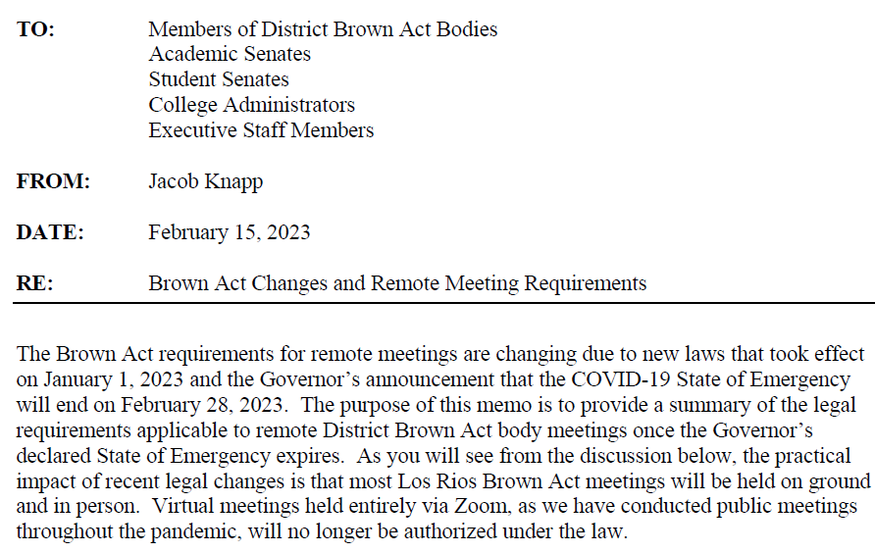
New Rules on Remote Meetings

Slide 20
Teleconference Meetings (Brown Act Classic Rules)
Agendas must identify each teleconference location and be posted at each location.
Each location must be open and accessible to the public and allow for public participation.
Example: Hospital bed
Example: No participation by cell phone in car
Agenda must provide an opportunity for public comment from each teleconference location.
At least a quorum of the legislative body must participate from locations within the local agency’s jurisdiction.
All votes must be audible and taken by roll call.

Slide 21
AB 2449 – Limited Remote Participation for Members
AB 2449 does not allow for fully virtual Brown Act meetings.
At least a quorum must be participating from a singular physical location identified on the agenda and open to public.
No need to post remote locations and open them to the public (“classic” Brown Act teleconference rules).
Remote member must use a two-way audiovisual platform, or phone-in plus webcast (public must have same ability to access the meeting virtually).

Slide 22
AB 2449 – Limited Remote Participation for Members (1)
An individual member must notify the full membership of the body that either “just cause” or “emergency circumstances” exit for their remote participation.
Just Cause includes caring for a family member, contagious illness, a need related to a physical or mental disability, or travel while on business of the legislative body.
Emergency Circumstances require the member to provide a description of the circumstances, and the body must take action to approve (a vote of the membership).

Slide 23
AB 2449 – Limited Remote Participation for Members (2)
Limitations:
An individual member may only utilize the just cause exception up to two meetings per calendar year.
An individual member may not participate in meetings remotely under AB 2449 for more than three consecutive months, or 20% of the body’s regular meetings in a calendar year.
If there is an internet disruption to an AB 2449 meeting, no further action may be taken on an agenda item until the issue is resolved.

Slide 24
AB 2449 – Limited Remote Participation for Members (3)
AB 2449 Takeaways:
Complicated rules, and not very helpful
Does not allow for fully remote meetings
Still requires a quorum of members to meet in person
Requires additional tracking of member participation to ensure members don’t go over the established limit
Big Picture - Three options:
Fully in-person meetings
Classic Brown Act teleconference posting
Complicated AB 2449 structure

Slide 25
Basics for Regular Meetings Notice and Agendas
The agenda must be posted at least 72 hours in advance of the meeting in a location “freely accessible to members of the public.”
The legislative body must mail a copy of the agenda to any person who has filed a written request for such materials. The copies may be mailed at the time the agenda is posted.
The notice, agenda and supporting documents are public records and must be made available to public
Writings, when distributed to a majority of the body by any person in connection with a matter subject to consideration at a public meeting, are public records that must be made available to the public “upon request without delay.”
-GC Section 54957.5

Slide 26
AGENDAS
Agenda must contain a brief description of the items of business to be transacted or discussed in either open or closed session.
In general, agenda descriptions need not exceed 20 words per item.
Agenda descriptions should provide sufficient information to allow members of the public to decide whether or not to attend the meeting or participate in the agenda item.
Closed session items must include reference to specific statutory authority for the closed session.

Slide 27
The Public’s Place at the Table (1)
The legislative body must provide an opportunity for members of the public to directly address the body on each agenda item before or during the legislative body’s discussion or consideration of the item.
Every agenda for a regular meeting must also allow members of the public to speak on any other item of interest within the subject matter jurisdiction of the legislative body (even if not on the agenda).

Slide 28
The Public’s Place at the Table (2)
The legislative body may not prohibit criticism of policies, procedures, programs or services of the legislative body/agency.
Reasonable regulations on public comment may be adopted (example: time limits for individual speakers).
The legislative body may remove individuals from a meeting who willfully interrupt proceedings.
-GC Section 54957.9

Slide 29
The Public’s Right to Attend
All meetings must comply with the ADA (Americans with Disabilities Act).
Any person may record the proceedings via audio recorder, video recorder or still motion camera.
No conditions may be set for attendance at or participation in a public meeting:
Sign-in not required
Self-identification not required as a prerequisite to speak
No fees may be charged for providing notice

Slide 30
Don’t Forget
We are public servants who represent our colleges, and our communities.
We are conducting the public’s business and expending public funds.
The open meeting laws were adopted with full knowledge that many efficiencies would be lost.
The court of public opinion – this is about the public’s perception of how its business is conducted.

Slide 31
Thank you!
info@asccc.org

