Slide 1
Competency Based Education & Credit for Prior Learning
ASCCC Curriculum Institute 2023

Slide 2
Presenters
Leticia Barajas, East Los Angeles College
Randy Beach, Southwestern College
Stephanie Curry, ASCCC Area A Representative
Dr. Sigrid Williams, Norco College
Terence Nelson, (via Zoom) CA MAP Initiative

Slide 3
Breakout Description
Career technical education (CTE) has been given a boost by legislation and funding to close both the skills and employment gaps anticipated in California’s future. While classroom instruction is a critical component of programs that prepare students for the general and job-specific demands of occupations, work-based learning through credit and noncredit work experience education, apprenticeships and competency-based education (CBE) are equally critical. Join this session to learn about proposed legislative updates and how your college may provide students an opportunity through Credit for Prior Learning (CPL) to be well-equipped to enter the workforce as aspiring employees by gaining on-the job experience through both credit and noncredit work-based learning and learning through direct assessment of mastery.

Slide 4
Direct Assessment CBE: Who Will Benefit?
Current students:
More than 800,000 currently enrolled students over age 25 of 2.1 million.
Potential students:
6.8 million California workers aged 25-54 with high school diploma or some college but no degree
79% work 31 or more hours per week

Slide 5
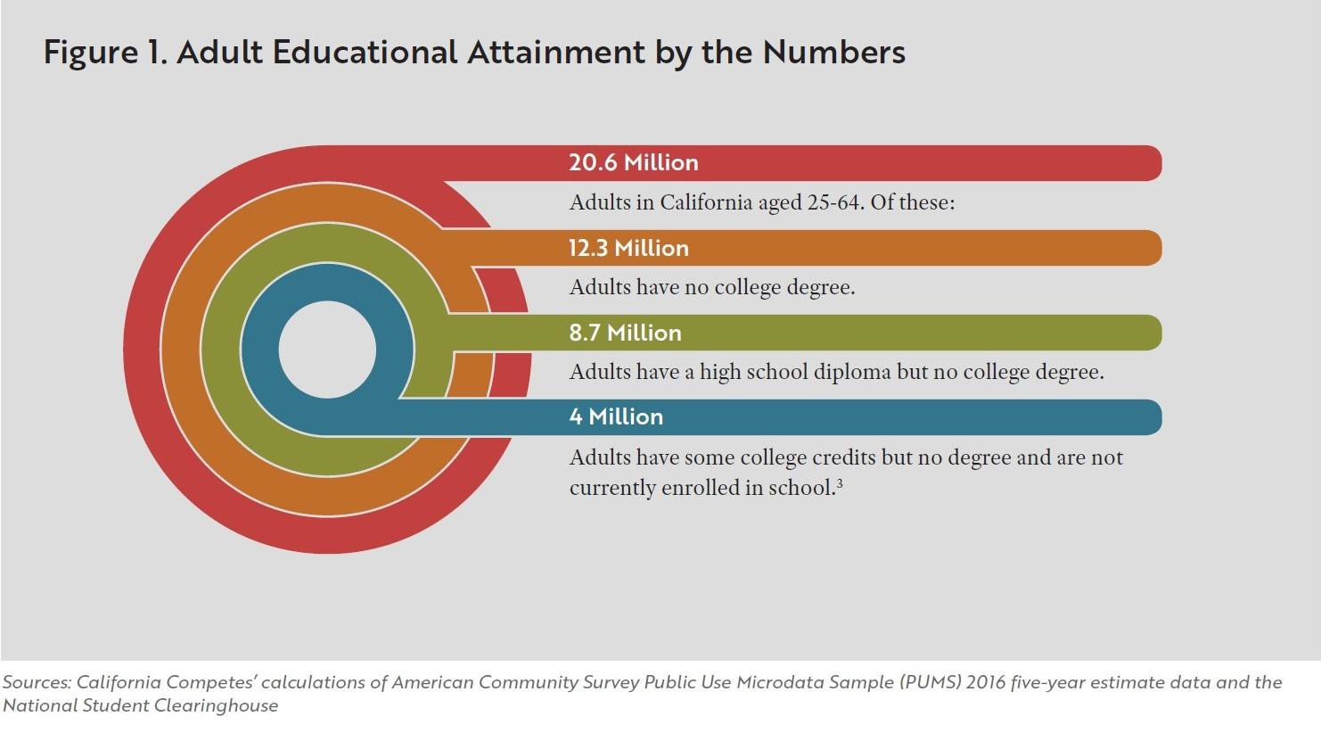
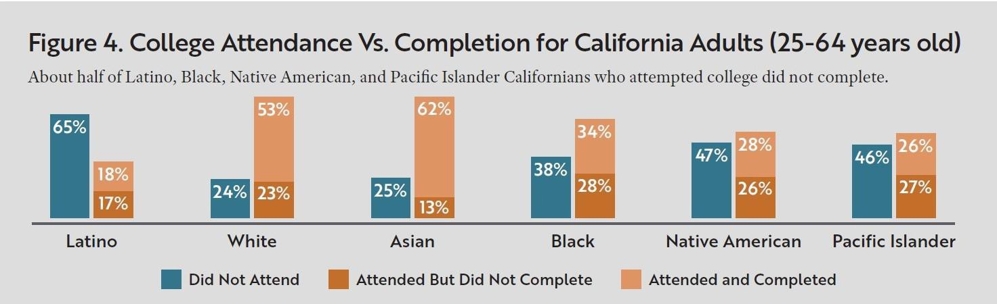
Direct Assessment CBE: Who Will Benefit?

Slide 6
What’s the Why?
Our students need freedom and flexibility ​from the rigidity of the Carnegie hour demands and arbitrary use of time as a measure of learning
Direct assessment leads to more personalization​ of instruction at the student’s pace
Student self-pacing leads to more affordability​ for students
Direct assessment promises more personalized student support from faculty and staff (case management approach)​
Students work with a trusted local institution rather than national provider ​
CBE programs are developed with the local community workforce needs and the institution’s equity mission in mind

Slide 7
The Direct Assessment CBE Pilot
Eight colleges participating in design and implementation of a direct assessment CBE program since Summer 2021
  Bakersfield College
  Coastline College
  East LA City College
  Madera College
  Merced College
  Mt. San Antonio College
  Shasta College
  Southwestern College
Support from Jobs for the Future; Competency-Based Education Network (C-BEN); Volta Learning Group; Various CBE SMEs and practitioners, others

Slide 8
How Does Direct Assessment Work?
Students enroll in a program of competencies, not courses
Competencies are faculty-written statements of knowledge, skills, and abilities relevant to the discipline, often industry-recognized
Learning is defined by demonstration of knowledge, skills, abilities and not seat time
Demonstration of “Mastery” level of achievement of summative assessments for each competency is the required proof of learning
Rigor is increased because mastery (or higher) is required for ALL competencies
Students move as quickly or slowly as needed; moving quickly through content they understand, slower when more support is needed
Students receive a competency transcript and a traditional course transcript

Slide 9
What’s different in CBE for Learners?
Student Success Consideration | Traditional | DA CBE | Impact on the Learner
Equity: Access | Synchronous | Asynchronous (though program-dependent) | Expanded (24/7) services and support
Equity: Agency | Faculty-centered | Student/faculty partnership | More clear expectations
Pace of learning | Deadlines driven by syllabus | Self-directed with “guide on the side” | Realistic milestones integrated with life
Assignments | Primarily summative | Formative/summative | Emphasis on feedback as teaching”

Slide 10
What’s different in CBE for Learners?
Student Success Consideration | Traditional | DA CBE | Impact on the Learner
Term Length | Semester/quarter | Student paced and self-regulated | Honors knowledge, emphasizes planning
Grading/Rigor | Traditional | Mastery (Y/N) or higher | Learning is ensured at a higher level
Progress (Dual Transcripts) | GPA or course completion | # of competencies mastered | Learning more concrete/visualized
Belonging | Arbitrary groups in courses | “Day One” access to like-minded peers | Networking and social connections

Slide 11
Title 5 Regulations around CBE
Series of regulations specifically for CBE (§55270 - § 55270.13)
Considered “Alternative Instructional Methodologies” but much more…
Regulations define the following:
  CBE direct assessment definitions and standards of “course-to-competency” equivalence
  Program approval requirements
  Academic standards for local curriculum approval
  Faculty selection and workload
  Expectations for regular and substantive interaction
  Standards of student support for direct assessment instruction
  Grading and recordkeeping symbols
  Student repetition of instructional work
  Academic calendar requirements

Slide 12
Faculty Roles and Competency-Based Education
CBE offers opportunity for new instructional models
Faculty duties can be split across a team of faculty; referred to as “unbundled faculty”
  Faculty curriculum designers (writing competency statements)
  Faculty instructional designers (creating instructional content)
  Assessment faculty (formative and summative assessment)
  Coaching faculty (student progress monitoring and relationship-building)
  Others…?
Requires reimagining of traditional approaches to faculty compensation and extensive professional development that supports collaborative work
Notes:
Randy

Slide 13
Responsibilities of the Academic Senate
Senates or Curriculum Committees, when delegated, develop standards for instruction and approval processes
  Competency approval (competencies are crosswalked to traditional credit-bearing courses)
  Documentation of program competencies
  Professional development needs
  Standards of regular and substantive interaction
  Program evaluation
Senate involvement in general education conversation and graduation requirements expected in CBE programs
Faculty leadership involved in conversations regarding transfer and the required “CBE Transcript”

Slide 14
Major Conversations for Your College
Technology infrastructure for instruction (Canvas), tracking student enrollment, competency completion, and MIS reporting for funding
Financial aid policies and processes for tracking satisfactory academic progress, aid disbursement and Return to Title IV policies (R2T4)
“Redirection” policies to support students who decide to return to traditional courses without losing credit for the competencies they’ve completed (requires curriculum crosswalks between competencies and traditional courses)
Student supports for the nontraditional CBE student who works at their own pace
Metrics for measuring success and impact will differ from traditional program evaluation

Slide 15
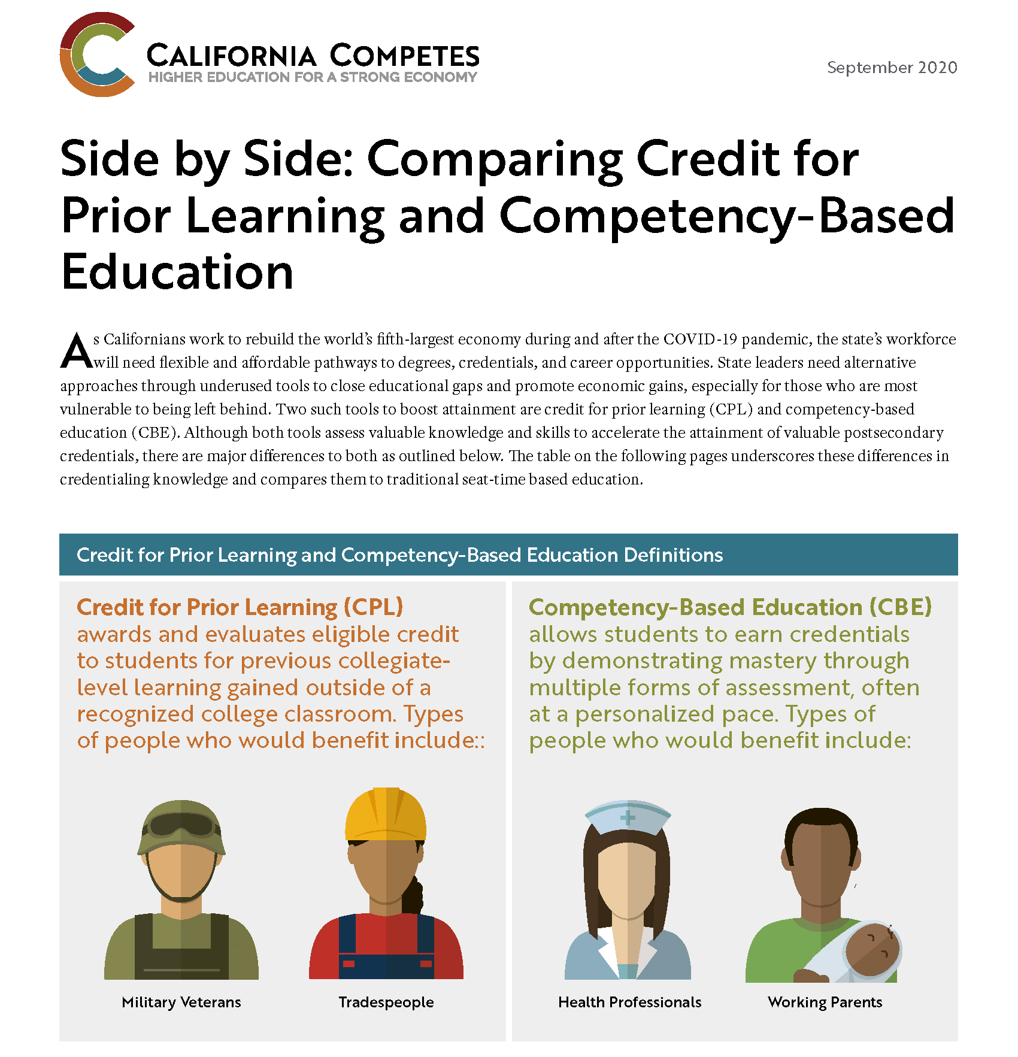
Infographic

Slide 16
Resources
What is Competency-Based Education? (C-BEN, 1:35 video)
Title 5 Regulations for CBE § 55270 - 55270.13
Competency-Based Education Network
Canvas CBE Hub
CBE vs. CPL Infographic and Article

Slide 17
BREAK
Between CBE and CPL for Slide Purposes Only

Slide 18

Credit for Prior Learning
(CPL)
Photo: https://www.freepik.com/premium-photo/students-friends-meeting-discussion-studying-concept_4404556.htm
Dr. Sigrid Williams, Ed.D., MPA
CPL Coordinator, Norco College
Associate Professor in ADJ
Terence Nelson, MEd., MS
Director of Academic Programs & Inst. P‘ships
CA MAP Initiative
Notes:
SW - Introduction
Intro. Terence
Ask Q - How many already know about and are utilizing CPL?

Slide 19
California Ed. Code, Title 5, Section 55050
(a) The governing board of each community college district shall adopt and publish policies pertaining to credit for prior learning. The policies shall be transparent and accessible to all stakeholders, published at least in college catalogs…
Notes:
SW
Title 5 Reads:
RCCD BP 2235
CCCCO - AP 2235 Credit for Prior Learning
CCCCO - AP 2236 Advanced Placement Credit

Slide 20
California Ed. Code, Title 5, Section 55050
(d) Credit may be awarded for prior experience or prior learning only for individually identified courses with subject matter similar to that of the individual's prior learning, and only for a course listed in the catalog of the community college.
Notes:
SW
(c) The nature and content of the assessment shall be determined solely by faculty in the discipline who normally teach the course for which credit is to be granted in accordance with policies and procedures approved by the curriculum committee established pursuant to section 55002.

Slide 21
CSU CPL Policy - Article 3.A.
”Students shall be granted credit toward the degree for the following types of learning acquired outside of traditional higher education:
Completion of learning acquired outside traditional higher education, such as recommended by American Council on Education’s National Guide.
Successful completion of other learning outside of traditional higher education that utilizes prior learning assessment methods such as portfolio assessment, attempted independently or as part of a course.”
Notes:
SW

Slide 22
SCO Handbook Language/Title 38
(VA Benefits)
"One of the criteria for approval of any school for Veterans' training is that it reviews prior credit and grant credit as appropriate to a VA student's current program. This is found in Title 38, Code of Federal Regulations, Sections 21.4253(d)(3) and 21.4254(C)(4). In essence, this requires every approved school to have and enforce a policy with regard to transfer courses, credits, and previous experience."
Notes:
SW
School Certifying Official

Slide 23
UC CPL Policy (Credit by Exam Preferred)
“UC may award lower-division (freshman/sophomore level) units for military courses completed if the courses are consistent with University policy on awarding transfer credit when there is an equivalent course taught at a UC campus. UC will consult the ACE recommendations for information regarding course content and as a guide to the awarding of credit. Credit for military courses is determined after matriculation at UC.”
Notes:
SW
UC does not include vocational education.

Slide 24
How CPL is Awarded
Advanced Placement Examination (AP)
International Baccalaureate Examination
College-Level Examination Program (CLEP)
Industry-Recognized Credential
Student-Created Portfolio
Credit by Examination in lieu of…
Assessment Approved
Notes:
SW
•Advanced Placement (AP) examination administered by the College Entrance Examination Board
•High-level International Baccalaureate (IB) examination
•College-Level Examination Program (CLEP) examination
•Evaluation of industry-recognized credential
•Evaluation of a student-created portfolio
•Evaluation of Joint Services Transcripts
•Exam administered by the college in lieu of completion of a course listed in the college catalog
•Exam administered by other agencies approved by the college
•Assessment approved or conducted by proper authorities of the college.
State/federal government training
Military training (JST Transcripts)
Volunteer and civic activities (e.g. Peace Corps)
Apprenticeships, internships, work-based learning, or other industry-based experiential learning

Slide 25
Impact on Students
Equity Bump: Latinx +24%, Black +14% , Enrolled in community college +25%, Pell recipients +19%
Reduced time to degree: 9-14 months
Savings: $1,500 to $10,200. $68K for Vets.
Completion Bump: 49% vs. 27%
When analyzed in isolation, CPL increases the likelihood of higher ed completion by more than 17% in adult learners.
Validation and Motivation!
Notes:
SW
Recognizing Prior Learning in the COVID Pandemic Era:
Helping Displaced Workers and Students
One Credit at a Time
Twice the higher ed completion rate for adult learners: 49% vs. 27%
24,512 adult students (ages 25 and older) who earned
PLA credits had a credential completion rate of 49
percent over the seven-and-a-half-year observation
period, compared to 27 percent of adult students with
no PLA credits. This includes completion of bachelor’s
degrees, associate degrees, and certificates.

Slide 26
CCCCO Vision for Success
Core Commitments Alignment
Focus relentlessly on students’ end goals.
Always design and decide with the student in mind.
Pair high expectations with high support.
Foster the use of data, inquiry, and evidence.
Take ownership of goals and performance.
Enable action and thoughtful innovation.
Lead the work of partnering across systems.
Notes:
Prelude to CPL for re-entry adults
Turn over to Terence

Slide 27
MilCPL- The Ideal Start for CPL
American Council on Education (ACE) Recommendations from Discipline Faculty
Faculty Driven
Proven Track Record
Validation and Review Process
Clear Recommendations
Notes:
TN

Slide 28
Equity and MilCPL Veterans
Half of post-9/11 veterans say it was “somewhat or very difficult” for them to re-adjust to civilian life after military service.
Only 25% of veterans believe they receive the college credits they deserve.
Notes:
TN
100,000 post-secondary completions expected each year, it is projected that at least 40,000 of them will be at the bachelor’s level; 25,000 at the associate level; 17,000 master’s degrees; 10,000 vocational education certificates; and 1,500 doctorate or post-doctorate degrees.

Slide 29
CA MAP Initiative and CPL Workgroup Efforts
Broad group of CPL professionals from various systems including faculty, staff and administrators
Meeting since Summer 2022
Recommendations and sharing of best practices
Guide in CA MAP Initiative direction and trainings
Recommend and advise on workgroups for policy and CPL crosswalks
Notes:
TN

Slide 30
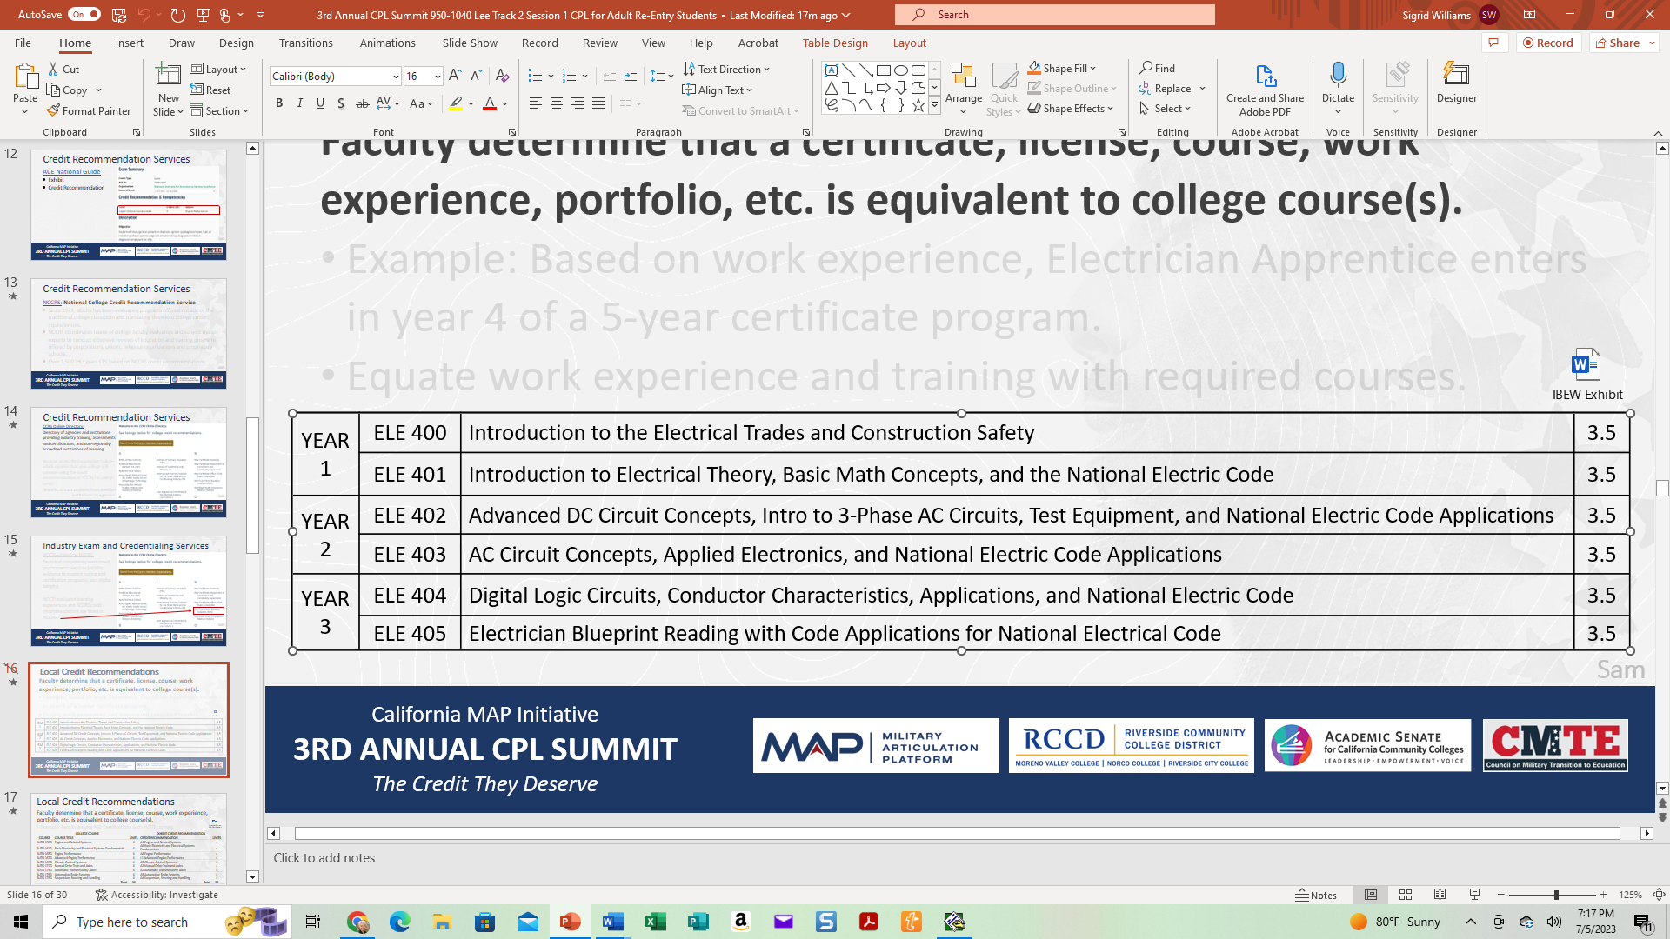
Example: IBEW Electricians and Norco College
Faculty determine that a certificate, license, course, work experience, portfolio, etc. is equivalent to college course(s).
Based on work experience, Electrician Apprentice enters in year 4 of a 5-year certificate program.
Equate work experience and training with required courses.
Notes:
TN

Slide 31
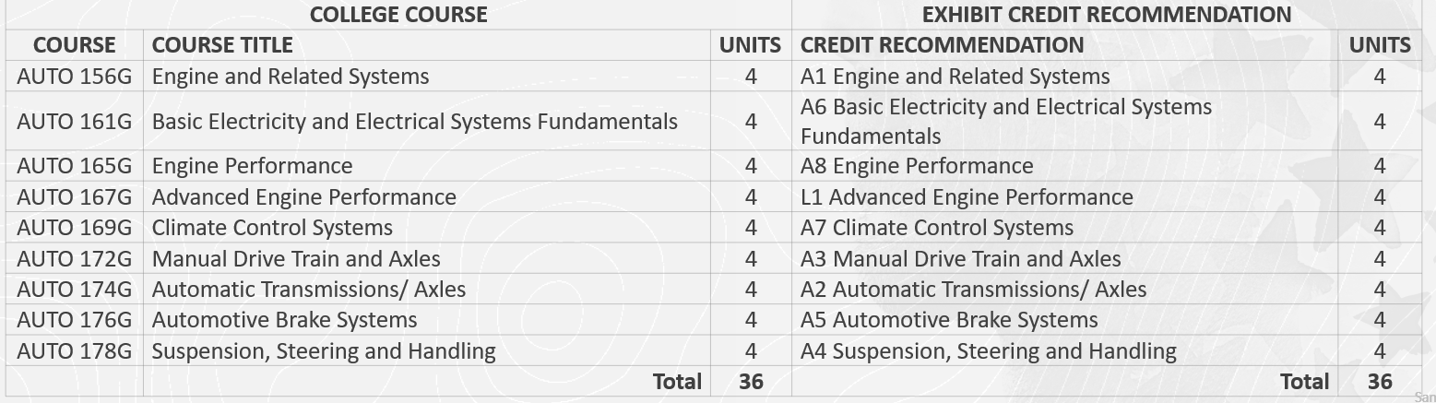
Example: ASE & Automotive Tech Pathways
Faculty determine that a certificate, license, course, work experience, portfolio, etc. is equivalent to college course(s).
Notes:
TN

Slide 32
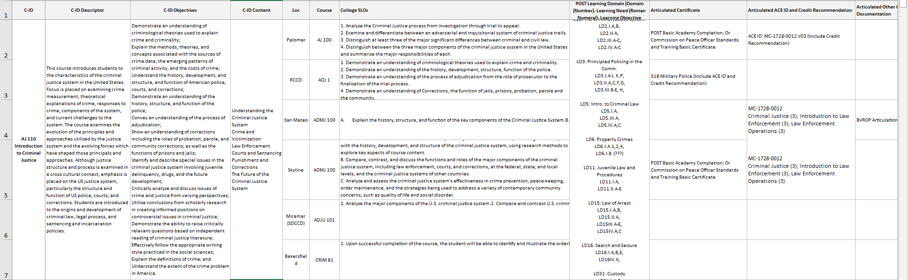
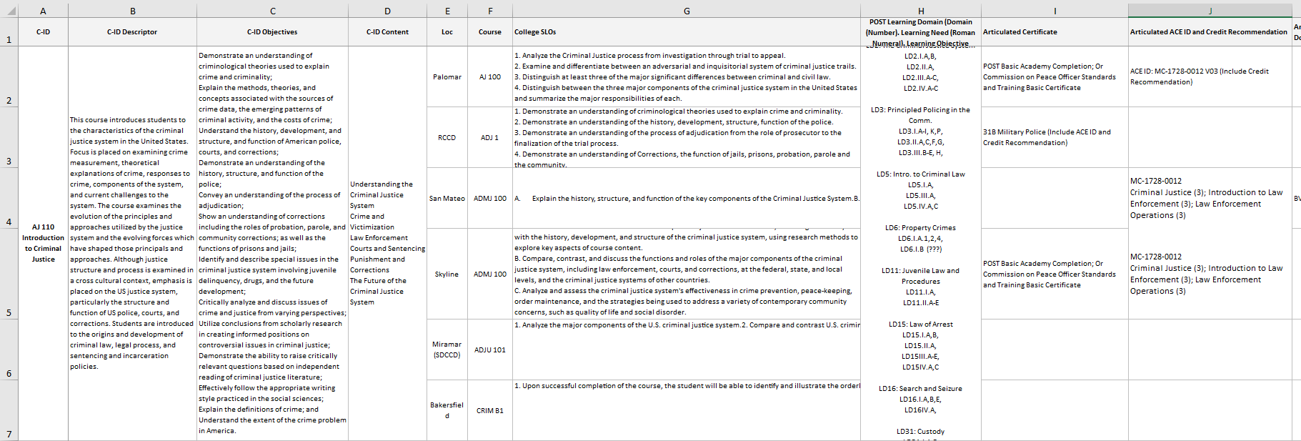
Example: POST Cert/ADJ-110 Intro. to ADJ
DRAFT
Notes:
SW

Slide 33
Example
DRAFT

Slide 34
1
Course | College SLOs
AJ 100 | 1. Analyze the Criminal Justice process from investigation through trial to appeal. 2. Examine and differentiate between an adversarial and inquisitorial system of criminal justice trails. 3. Distinguish at least three of the major significant differences between criminal and civil law. 4. Distinguish between the three major components of the criminal justice system in the United States and summarize the major responsibilities of each.
ADJ 1 | 1. Demonstrate an understanding of criminological theories used to explain crime and criminality. 2. Demonstrate an understanding of the history, development, structure, function of the police. 3. Demonstrate an understanding of the process of adjudication from the role of prosecutor to the finalization of the trial process. 4. Demonstrate an understanding of Corrections, the function of jails, prisons, probation, parole and the community. 5. Critically analyze and discuss current issues and trends in crime from the perspective of the police, prosecutors, courts, corrections and the community.
ADMJ 100 | A. Explain the history, structure, and function of the key components of the Criminal Justice System. B. Describe theories of crime and victimization, and discuss their overall costs. C. Discuss the future of the Criminal Justice System
ADJU 101 | 1. Analyze the major components of the U.S. criminal justice system. 2. Compare and contrast U.S. criminal court systems 3. Identify the processes by which a criminal case progresses from investigation to appeal.
ADMJ 100 | A. Summarize and describe the fundamental aspects of justice administration, including familiarity with the history, development, and structure of the criminal justice system, using research methods to explore key aspects of course content. B. Compare, contrast, and discuss the functions and roles of the major components of the criminal justice system, including law enforcement, courts, and corrections, at the federal, state, and local levels, and the criminal justice systems of other countries. C. Analyze and assess the criminal justice system's effectiveness in crime prevention, peace-keeping, order maintenance, and the strategies being used to address a variety of contemporary community concerns, such as quality of life and social disorder.
CRJU 1108 | 1. Upon successful completion of the course, the student will be able to identify and illustrate the orderly processing of cases through the justice system from investigation through appeal and exoneration; 2.Upon successful completion of the course, the student will be able to demonstrate a fundamental understanding of the core concepts of statutory criminal law as applied to case scenarios from both a prosecutorial and defense perspective. 3.Upon successful completion of the course, the student will be able to analyze the vital role that American constitutional values of due process, equal protection, and fundamental fairness play in policing, courts and corrections; 4. Upon successful completion of the course, the student will be able to identify and demonstrate a fundamental understanding of different cultural perspectives as they apply to the American Criminal Justice System.
DRAFT

Slide 35
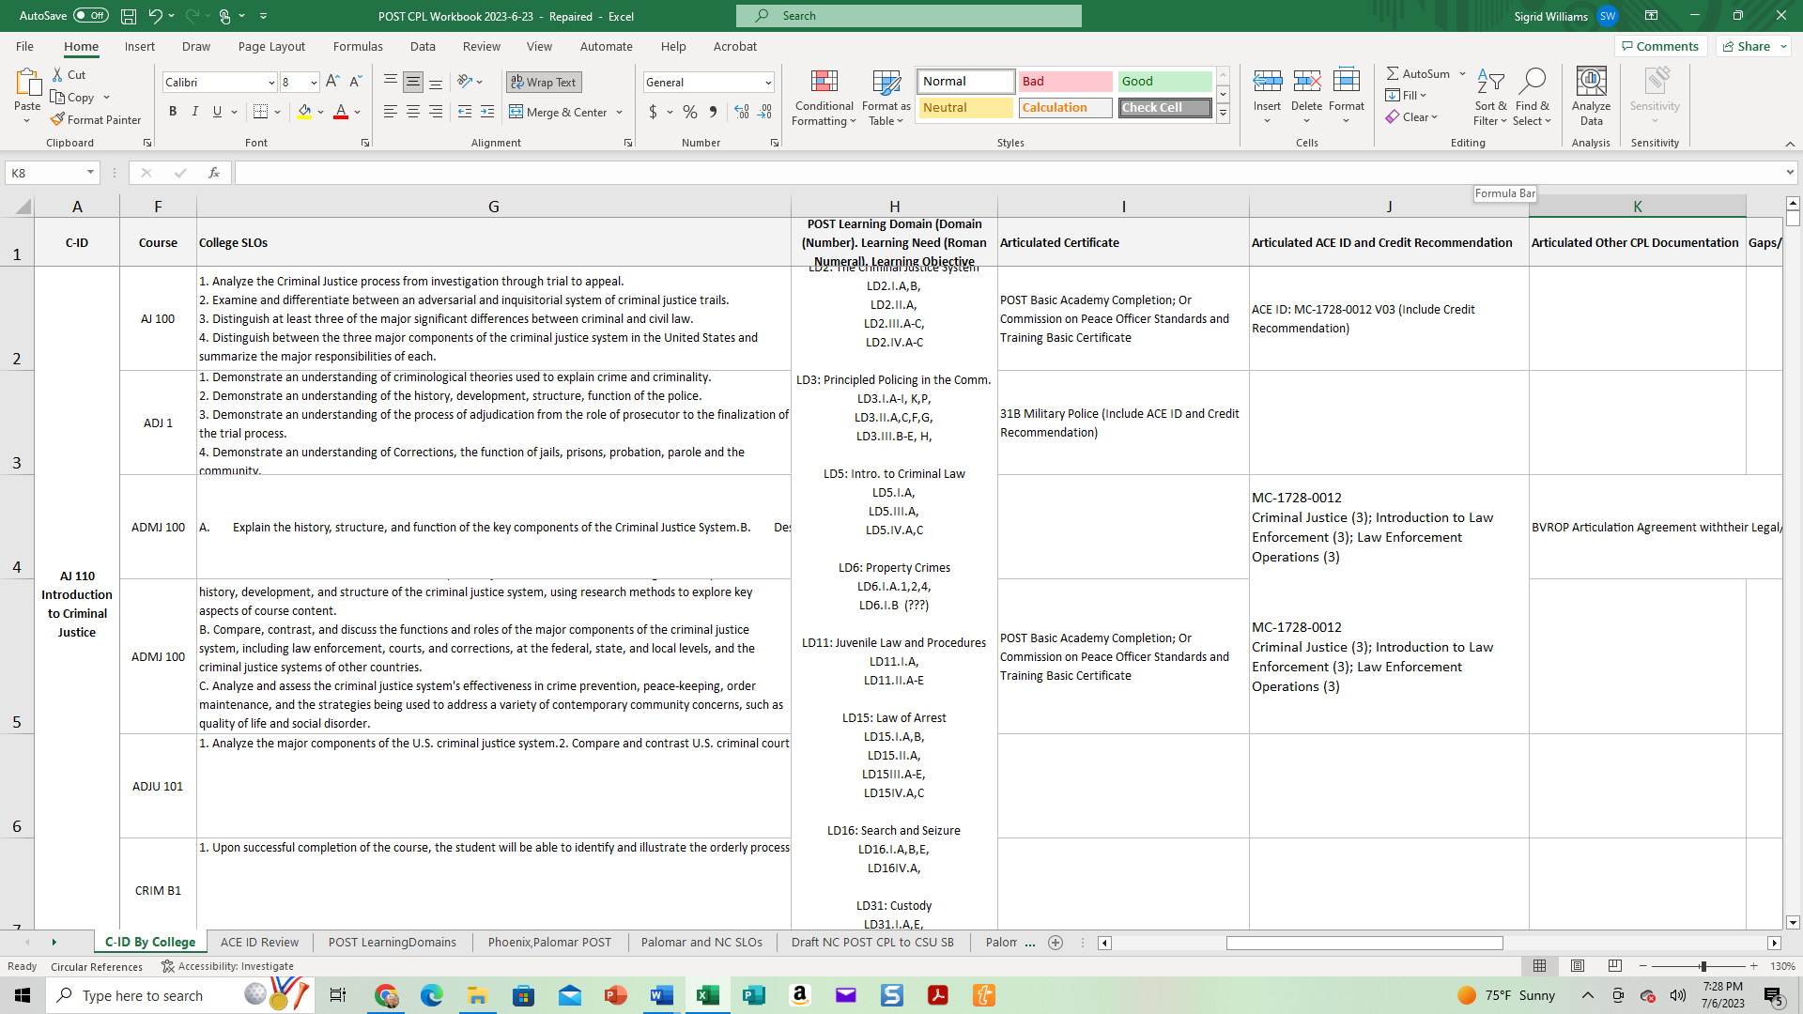
2
DRAFT

Slide 36
Example: POST Cert/ADJ-110 Intro. to ADJ
DRAFT
Notes:
SW

Slide 37
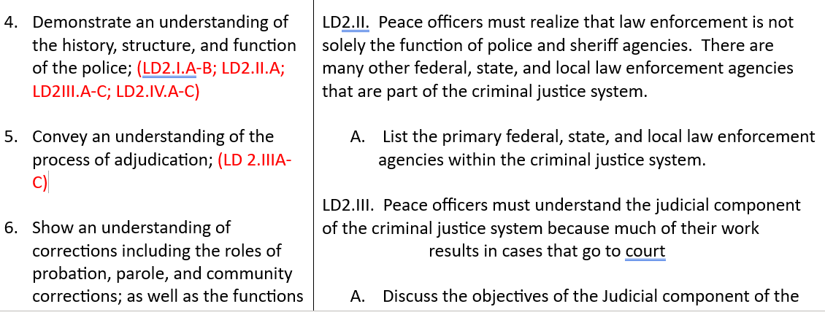
Example: POST Cert/ADJ-110 Intro. to ADJ
Notes:
SW

Slide 38
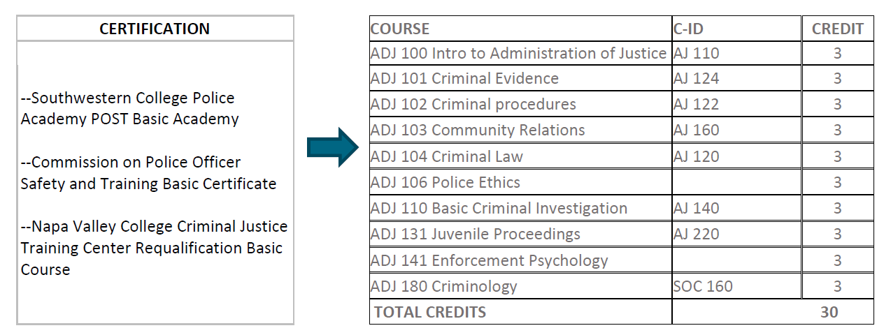
Example: POST Certificate/CPL Possibilities
DRAFT

Slide 39
Example: POST Certificate/CPL Gaps
DRAFT
Community Colleges with POST academies are not offering transferable credit classes for POST graduates.
Community colleges with POST academies are offering non-transferable AA degrees.
Four Academies are not tied to any community college
42 CA CCs offer POST while 99 CA CCs offer ADJ/CJ ADTs
For Profit and Non-Profit Universities offer pathways for POST to transfer credit in for BA/BS degrees
Notes:
Need more

Slide 40
Example Outcomes & Activities
1000+ JSTs in MAP Student Intake​
41 of 76 colleges uploaded JSTs since May 2023​
650+ ACE Courses Articulated or Pending Approval​
150+ College Courses Articulated​
Statewide first responder credit recommendations underway​
Non-military CPL exhibit building underway
Notes:
Need more

Slide 41
Upcoming Professional Development and Support from the CA MAP Team
Check our MAP Webpage: https://map.rccd.edu
Contact us via email
Terence Nelson: terence.nelson@norcocollege.edu
Dr. Sigrid Williams: sigrid.williams@norcocollege.edu
4th Annual CPL Summit- November 3rd 9am-1pm (zoom & no cost)
Notes:
TN

Slide 42
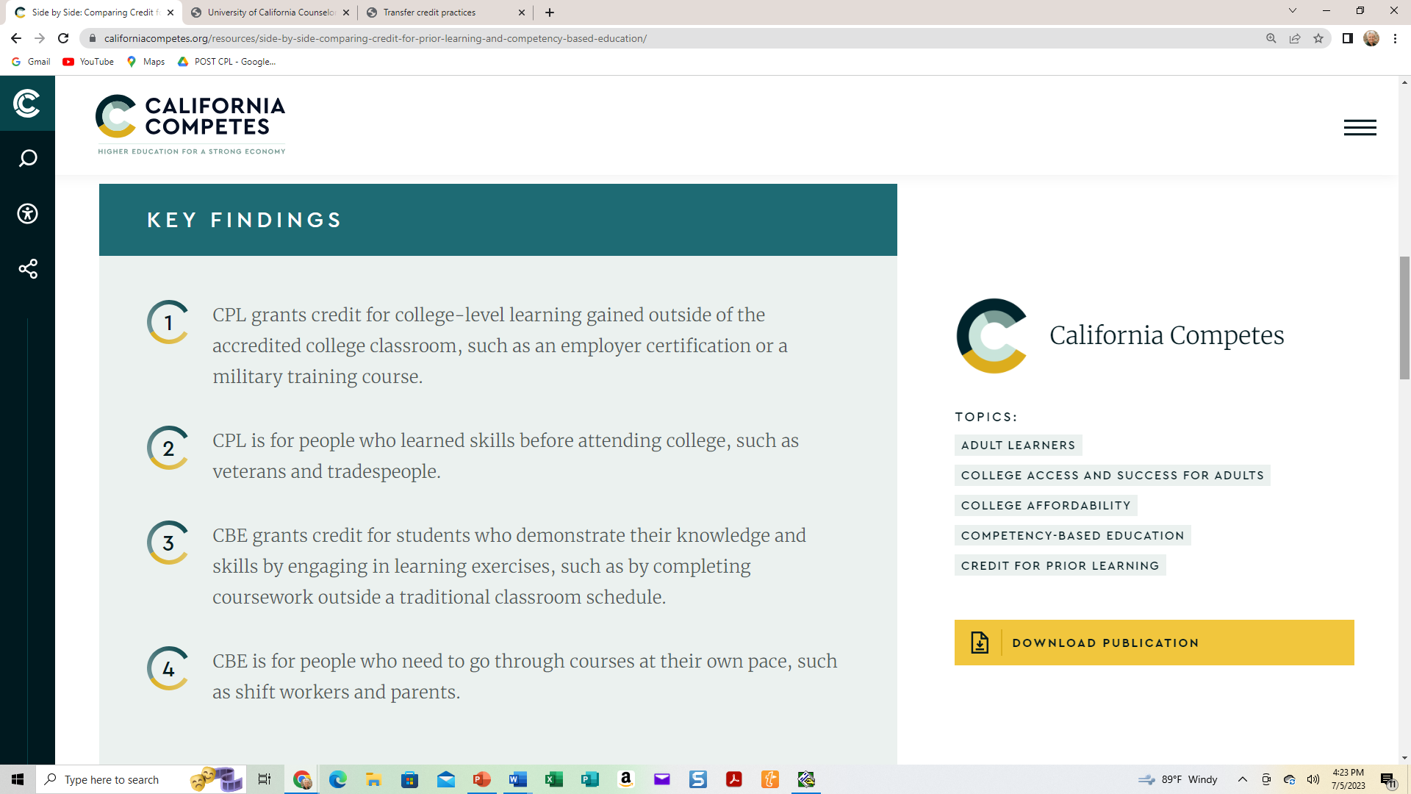
Key Findings
Notes:
SW
https://californiacompetes.org/resources/side-by-side-comparing-credit-for-prior-learning-and-competency-based-education/

Slide 43
CCC Mission and CPL Mandate
Mission: Educate for a Prosperous Citizenry
At the “Forefront in combating income inequality” Are we maximizing CPL so adult re-entry students will access higher education and higher opportunities at a higher rate?
“Trailblazers in supporting social and economic mobility” Are we recognizing prior learning and using it for an equitable and earned boost?
“Leading the way…on workforce development by partnering with industry and labor to create innovative skills-building initiatives” Are we integrating work-based learning and certifications in college pathways to save time, money, and improve ties to industry?
Notes:
Should this be the CCCCO Goals page?

Slide 44
CPL Resources
California Code of Regulations, Title 5, Section 55050 Credit for Prior Learning, Cal. Code Regs. tit. 5 § 55050 | Casetext Search + Citator
California Community College (CCC) Chancellor’s Office Memo on CPL: https://www.norcocollege.edu/services/enrollment/vrc/cpl/Documents/ESS-20-300-001-Credit-for-Prior-Learning.pdf
California Community Colleges MilCpl Resource - Credit for prior learning California Community Colleges - MilCpl Resource - Credit for prior learning
California State University (CSU) CPL Policy: https://calstate.policystat.com/policy/9817841/latest
Statewide CCC CPL Board Policy Links: https://www.norcocollege.edu/services/enrollment/vrc/Documents/map/CCC-MilCPL-Resource-CPL.pdf
University of California (UC) CPL Policy: https://admission.universityofcalifornia.edu/counselors/files/Transfer_Credit_Practice.pdf

Slide 45
CPL Resources
Association of Community College and Junior Colleges (ACCJC) Policy on CPL: https://www.norcocollege.edu/services/enrollment/vrc/cpl/Documents/ACCJC-Policy-on-Credit-for-Prior-Learning-June-2020.pdf
MAP Training Resources and FAQ: https://www.norcocollege.edu/services/enrollment/vrc/Pages/map.aspx
Norco College CPL Policies and Resources: https://www.norcocollege.edu/services/enrollment/vrc/cpl/Pages/policy.aspx
Academic Sentate of the California Community Colleges (ASCCC) Advocacy for CPL (Christopher Howerton): https://youtu.be/xXdJSFY5JPU
Credit for Prior Learning: Leveraging Past Learning to Close Present-Day Equity Gaps: https://californiacompetes.org/resources/credit-for-prior-learning-leveraging-past-learning-to-close-present-day-equity-gaps/
Side by Side: Comparing Credit for Prior Learning and Competency-Based Education Side by Side: Comparing Credit for Prior Learning and Competency-Based Education | California Competes
Noncredit Instruction: Opportunity and Challenge: https://files.eric.ed.gov/fulltext/ED602047.pdf

Slide 46
CPL Resources
California Legislation Supporting CPL and MILCPL:
2012 Block AB 2462: Specified that by July 1, 2015, the Chancellor of the California Community Colleges (CCC), using common course descriptors and pertinent recommendations of the American Council on Education, shall determine for which courses credit should be awarded for prior military experience. This has not happened because of the complexity and enormity of the task, which must rely on discipline faculty experts at each of the 115 California Community Colleges to make articulation decisions for courses paired with ACE Recommendations one at a time—and there are tens of thousands of combinations at each college.
2018 Cervantes AB 1786 Academic Credit for Military Experience: Specified that by March 31, 2019, the CCC Chancellor is to establish an initiative to expand military Credit for Prior Learning (CPL). The initiative was supposed to identify best practices for CPL, locate and collect available resources and provide professional development. The initiative also sought to identify the best practices for potential pilot programs and provide recommendations for internal system wide policy changes to expand CCC CPL. By January 1, 2020, the chancellor was to report to the Legislature on the initiative.

Slide 47
CPL Resources
2018 Roth CA S 1071 Community Colleges Uniform Policy to Award Credit: Requires CCC Chancellor to work with Academic Senate for California Community Colleges (ASCCC) to develop a consistent policy to award military personnel and Veterans who have an official Joint Services Transcript course credit for Intersegmental General Education Transfer Curriculum, State University General Education Breadth or local community college general education requirements.
ASCCC Resolution 18.04 (2011): Urges local academic senates to apply credit for educational experiences during military service toward the associate degree – including the fulfillment of general education, major coursework, certificates, and other degree requirements – in accordance with the recommendations listed in the American Council on Education (ACE) Guide to the Evaluation of Educational Experiences in the Armed Services.

Slide 48

Questions

