Slide 1
State of Curriculum
Cheryl Aschenbach
ASCCC President

Slide 2
Academic and Professional Matters Title 5 §53200(c) The “10+1”
Curriculum including establishing prerequisites and placing courses within disciplines
Degree and certificate requirements
Grading policies
Educational program development
Standards or policies regarding student preparation and success
District and college governance structures, as related to faculty roles
Faculty roles and involvement in accreditation processes, including self-study and annual reports
Policies for faculty professional development activities
Processes for program review
Processes for institutional planning and budget development
+1 Other academic and professional matters as mutually agreed upon between the governing board and the academic senate

Slide 3
So Much Curriculum!
Transfer Reform
Placement Reform
General Education Reform
IDEAA in Curriculum
Ethnic Studies
Innovation and Curricular Expansion
Notes:
Dual Enrollment
AB 288 (Holden, 2015)
Transfer Reform
SB 1440 (Padilla, 2010)
SB 440 (Padilla, 2013)
AB 928 (Berman, 2021)
AB 1111 (Berman, 2021)
Placement Reform
AB 705 (Irwin, 2017)
AB 1805 (Irwin, 2018)
AB 1705 (Irwin, 2022)
BDPs
SB 850 (Block, 2014)
AB 927 (Medina, 2021)

Slide 4
Transfer Reform
ADTs
Cal-GETC
Cal-GETC Standards 1.0
Common Course Numbering
Transfer Alignment Project
Proposed Legislation: AB 1749 (McCarty) - UC ADTs
CCC Baccalaureates
AB 928 Primer – Fri @ 9:00
Articulation: Supporting Effective Transfer – Fri @ 10:30
AB 1111 – Sat @ 9:45
Addressing CCC Baccalaureate Degrees – Sat @ 8:30

Slide 5
Placement Reform
Guided Pathways
AB 705/1705 Implementation
Planning for Student Success – Fri @ 10:30
Equitable Placement – Sat @ 8:30

Slide 6
General Education Reform
Cal-GETC
Title 5 Updates: Associate Degree Requirements and General Education
Updates to Baccalaureate Degree General Education (Upper & Lower Division)
AB 928 Primer – Fri @ 9:00
General Education General Session – Fri @ 12:45
Student Panel – GE & Student Perspectives – Fri @ 2:30

Slide 7
IDEAA in Curriculum
Curriculum Audits
Inclusion of IDEAA in Course Outlines of Record
Culturally Inclusive and Responsive Teaching & Learning
Trauma-Informed Teaching & Learning
Academic Freedom in Curriculum – Th @ 10:30
DEI in Curriculum: Model Principles & Practices – Th @ 10:30
Trauma Informed Curriculum – Fri @ 9:00

Slide 8
Ethnic Studies
Title 5 Associate Degree General Education
CSU GE Breadth Area F
IGETC Area 7
Cal-GETC Area 6
CCC Core Competencies – Th @ 12:45
Assigning Courses to Disciplines, Cross-Listing – Fri @ 10:30

Slide 9
Innovation and Curricular Expansion
Noncredit
Workforce Prep / CTE
Dual Enrollment
Open Educational Resources
Competency Based Education
Credit for Prior Learning
Distance Education
Baccalaureate Degrees
Noncredit Basics – Th @ 10:30
Work Experience Updates – Th @ 10:30
Modern Policing Degree – Th @ 10:30
Accounting Methods – Th @ 12:45
OER – Th @ 12:45
Experiential Learning – Th @ 12:45
Advanced Noncredit – Fri @ 9:00
CBE & CPL – Fri @ 10:30
Distance Education in the COR – Sat @ 8:30
State Updates to CTE Plans – Sat @ 8:30
CCC Baccalaureate Degrees – Sat @ 8:30

Slide 10
Improving What We Do & How We Do It
Curricular Processes – Local & Statewide
Legal Compliance – Education Code, Title 5
Effective Practices
Legislation & Curriculum – Th @ 10:30
Brown Act Basics – Th @ 12:45
Accounting Methods – Th @ 12:45
Updates to the PCAH – Th @ 12:45
Curricular Accreditation Requirements – Fri @ 9:00
Governance and the Curriculum Committee – Fri @ 9:00
Strategic Enrollment Management – Fri @ 9:00
Parliamentary Procedure – Fri @ 10:30
CCCCO COCI Session – Fri @ 10:30
Leveraging Curriculum Processes to Improve the Student Experience – Sat @ 8:30

Slide 11
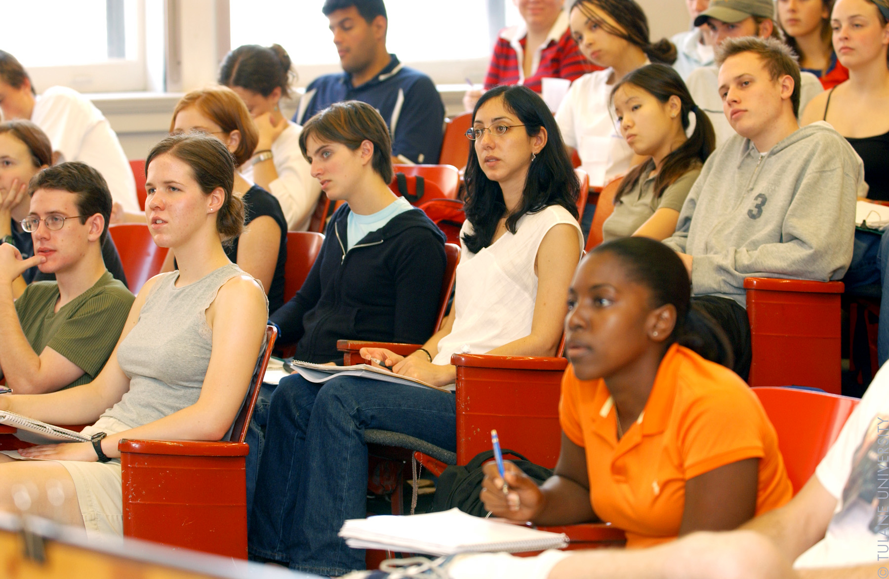
How Can We Do This?
Center Students – our WHY
Learn, Access Resources, Share with Others
Communication
Collaboration
Round Table/Mixers
CCCCO Training – Th @ 2:15
Reception – Th @ 5:00
This Photo by Unknown author is licensed under CC BY.

Slide 12
THANK YOU!
ASCCC Curriculum Committee
ASCCC Staff
ASCCC Executive Committee
Presenters
Sponsors
Attendees
Image Thank You by Nick Youngson CC BY-SA 3.0 Alpha Stock Images

Slide 13
QUESTIONS?

