Slide 1
Leveraging Curriculum Processes to Improve the Student Experience
Shireen Awad, Curriculum Specialist, Chaffey College
Angela Burk-Herrick, Curriculum Chair, Chaffey College

Slide 2
Leveraging Curriculum Processes to Improve the Student Experience:
Outline:
Overview of Chaffey College Curriculum Process
Leveraging Academic Senate
Integrating DEIA into the Course Outline of Record (COR)
Advocating for Zero Cost and Low-Cost Resources
Encouraging Distance Education Flexibility
Navigating DEIA Curriculum Conversations
Building Pathways & Academic Maps
Connecting Curriculum to Student Career Goals
Celebrating the Work!

Slide 3
Overview of Chaffey College Curriculum Process
Curriculum Submission Timeline
Curriculum Committee Review Process

Slide 4
Leveraging the Academic Senate: What is the role of Academic Senate in curriculum design and review processes?
ASCCC 10 + 1
Curriculum & Faculty Purview
Curriculum, including establishing prerequisites and placing courses within disciplines
Degree & Certificate Requirements
Grading Policies
Educational Program Development
Standards & Policies regarding Student Preparation and Success
College governance structures, as related to faculty roles
Faculty roles and involvement in accreditation process
Policies for faculty professional development activities
Processes for program review
Processes for institutional planning and budget development
Other academic and professional matters as mutually agreed upon.
Notes:
Angela 3-6
First level: Academic Senate has role in Educational Program Development & Program Review. Second level: Curriculum Committee approves Course Outline of Record (COR) according to Academic Senate policy & Administrative Procedures. Third Level: Departments design COR & department guidelines. Fourth Level: Individual faculty design instruction, but must adhere to Course Outline of Record. (Evaluations)

Slide 5
Example: Academic Senate Resolutions
Chaffey College Academic Senate Resolution on Equity, Diversity, Inclusion, and Anti-racism (April 27, 2021) excerpt:
"...Resolved, That the Faculty Senate adopt the following diversity statement: As the voice of the faculty at Chaffey College, the Faculty Senate acknowledges its responsibility to actively cultivate a safe, courageous, and inclusive climate where hate speech is not tolerated and where equity and mutual respect are honored in both precept and practice. The Senate is committed to a campus where students, faculty, and classified professionals can not only survive, but thrive. To ensure that the voices of all members of the campus community are heard, the Faculty Senate will actively promote equity mindedness and diversity in all areas within its purview. Diversity may include but is not limited to race, ethnicity, sex, gender identity, sexual orientation, disability status, age, cultural background, veteran status, political affiliation, religion, and discipline or field..."
The same resolution, included a specific directive to the Curriculum Committee:
"...Resolved, That the Faculty Senate support faculty and the Curriculum Committee in prioritizing culturally responsive curricular redesign within disciplines, courses, and programs..."
Notes:
Shireen (7-13)

Slide 6
Integrating DEIA into the Course Outline of Record (COR)
DEIA Consultant training of Curriculum Committee during Fall 2021 annual retreat (see final slide for consultant information)
Re-evaluate Curriculum Committee Scope and Purpose:
Added to Curriculum Committee Scope: Commendations of faculty and departments that make exemplary use of the curriculum process to foster institutional goals including institutional learning outcomes, student success and completion, sustainability, and DEI (diversity, equity, and inclusion).
Organize presentations (FLEX or workshops) to discuss DEIA and Curriculum to Deans, Faculty, and any impacted Classified Professionals.
DEIA and Curriculum Presentation
Notes:
Establishing Expectations

Slide 7
Integrating DEIA into the Course Outline of Record (COR) 2
Curriculum Office: Establish processes for DEIA
Leverage department curriculum updating
Develop Instructional Guide for Faculty
Curriculum Committee: Establish opportunities to integrate DEIA directly into the Course Outline of Record (COR)
Faculty Guide for Courses
Curriculum Office: Program DEIA Opportunities into the Curriculum Management System
Use established faculty guide to incorporate DEIA opportunities throughout the Curriculum Management System for easier inclusion

Slide 8
Integrating DEIA into the Course Outline of Record (COR) 3
Notes:
Goal: Decolonize the curriculum
Curriculum Process: Provide suggestions (aka DEIA Opportunities) to faculty for each section/page in the CMS to facilitate inclusive content and activities. Here is an example of the DEIA Opportunity statement for the Content section of the COR.

Slide 9
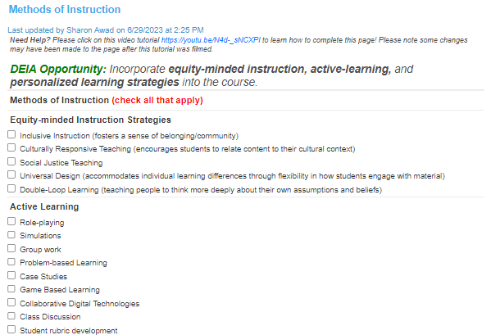
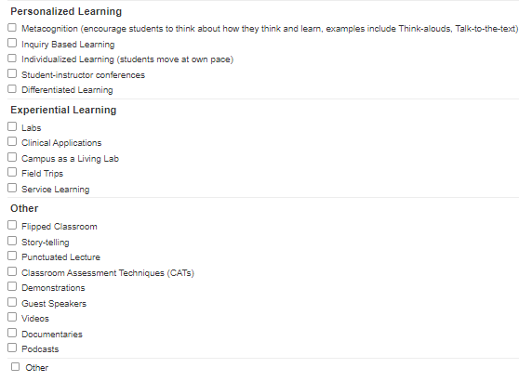
Integrating DEIA into the Course Outline of Record (COR) 4
Methods of Instruction Changes Directly into CMS
Notes:
Goal: Raise awareness and increase use of instructional strategies successful at decreasing equity gaps
Curriculum Process: Collaborate with Faculty Success Center Leadership to create a checklist for Methods of Instruction in CMS.

Slide 10
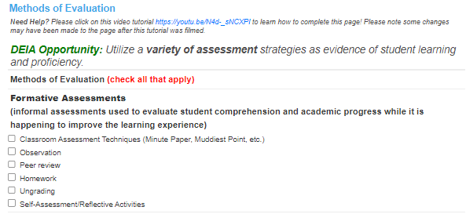
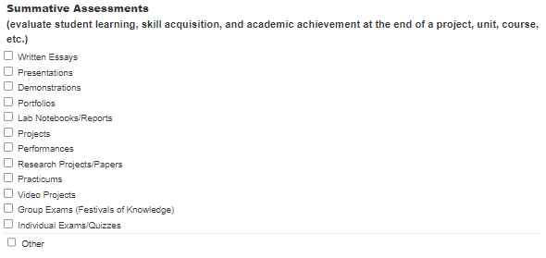
Integrating DEIA into the Course Outline of Record (COR) 5
Methods of Evaluation Changes Directly into CMS
Notes:
Corrected Read order arranged—OK now if reads bottom to top
Goal: Increase the use of Formative assessments
Curriculum Process

Slide 11
Integrating DEIA into the Course Outline of Record (COR) 6
Notes:
Goal: Increase intentional use of inclusive, culturally responsive assignments.
Curriculum Process: Include DEIA suggestions regarding class assignments in CMS.

Slide 12
Advocating for Zero Cost and Low-Cost Resources:
Goal:
Decrease resource costs for students.
Curriculum Process:
Librarian on Curriculum Committee
Faculty resource for finding OERs
Searches for OERs and reaches out to faculty to discuss options during Technical Review process
Notes:
ANGELA (14-17)

Slide 13
Advocating for Zero Cost and Low-Cost Resources: 2
Goal:
Decrease resource costs for students.
Curriculum Process:
Ask faculty to explain why they are not listing an OER and to describe departmental efforts to lower costs to students in curriculum management system
Notes:
ANGELA

Slide 14
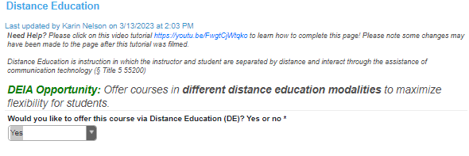
Encouraging Distance Education Flexibility
Goal:
Maximize access and scheduling flexibility for students
Curriculum Process:
Utilize curriculum management system to encourage thoughtful consideration of DE modalities.
Notes:
Angela

Slide 15
On the Distance Education page, faculty are asked, "Would you like to offer this course via Distance Education (DE)?"
If they answer "Yes"
If they answer "No"
Notes:
ANGELA (Read order checked and is OK now IF reads bottom to top)
If Yes,
Faculty are asked to indicate the online modalities they are proposing.
Then they are asked to complete a user-friendly checklist to indicate the different types of "regular and substantive interactions" that will be used in the course.
If No,
Faculty must provide an explanation/rationale for why they are not offering the course via DE.
Specifically, faculty are asked which objectives/learning outcomes cannot be achieved in an online modality.
ALSO ask about
Adaptations to class assignments for DE modalities

Slide 16
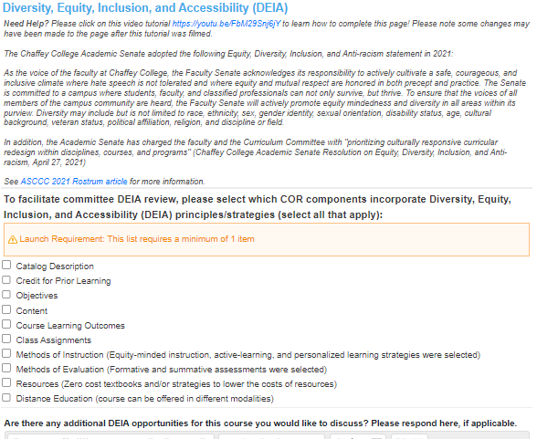
Integrating DEIA into the Course Outline of Record (COR)
Allow an opportunity in the CMS for faculty to reflect/identify DEIA integration into their COR.
Additionally, design the DEIA reflection to:
Help the Curriculum Committee review DEIA easier
Help generate data on DEIA integration
Notes:
Shireen

Slide 17
Navigating DEIA Curriculum Conversations
Ask for committee volunteers to review for DEIA as a focus of their review
Ask committee members to leave review comments in CMS as suggestions/recommendations
Example: A member recommended that Accounting faculty incorporate LGBTQIA+ couples in the tax preparation course and laws that have impacted married folks during this process.
Curriculum Office (Chair and Specialist) meet directly with faculty to go over suggestions before the Curriculum Committee Meeting
Alleviates the committee from the responsibility of engaging in difficult DEIA conversations and minimizes the committee "policing" DEIA.
Avoids questioning discipline faculty in a public space that may make faculty feel cornered.
Everyone is on a different step in their DEIA journey. Some folks may need an opportunity to learn a bit more about DEIA and should be provided a comfortable environment for that learning. Having a smaller group work with the faculty is less intimidating than addressing the faculty in front of the entire committee.
Report back to committee what DEIA changes were made, and which ones were not based upon their suggestions.
Discipline faculty are the ultimate deciders of where to incorporate DEIA. Approach this as a collegial conversation and guidance
Notes:
Shireen: Respect and autonomy of where to do it, but not whether or not to do it.

Slide 18
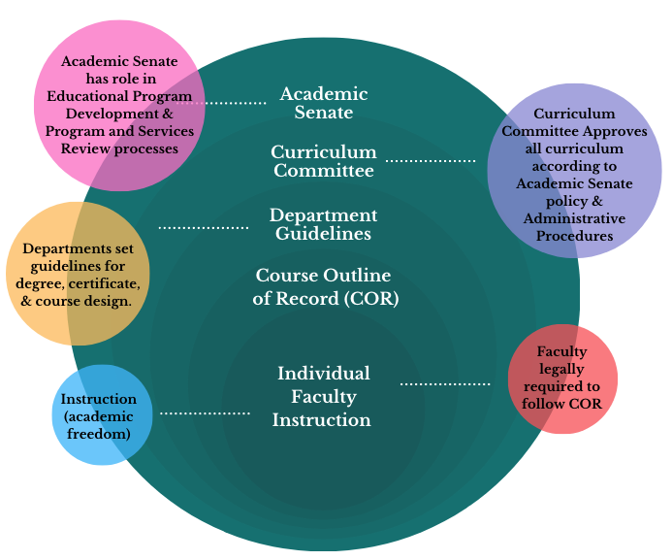
What happens now that DEIA is integrated into CORS?
Notes:
Angela

Slide 19
Building Pathways & Academic Maps: How can the curriculum committee facilitate degree & certificate pathway guidance for students?
Goal:
Provide students an ideal, representative pathway to achieve their educational goal.
Curriculum Process:
Incorporate pathway building and review into existing program development and modification processes.
Notes:
Angela
Image of degree update page in CurriQunet Meta software that describes guidelines for designing academic map pathway. If map updates are needed, faculty are asked to upload the proposed map changes.
Include: Chair review during tech review; Counselor representatives focus on ensuring map integrity.

Slide 20
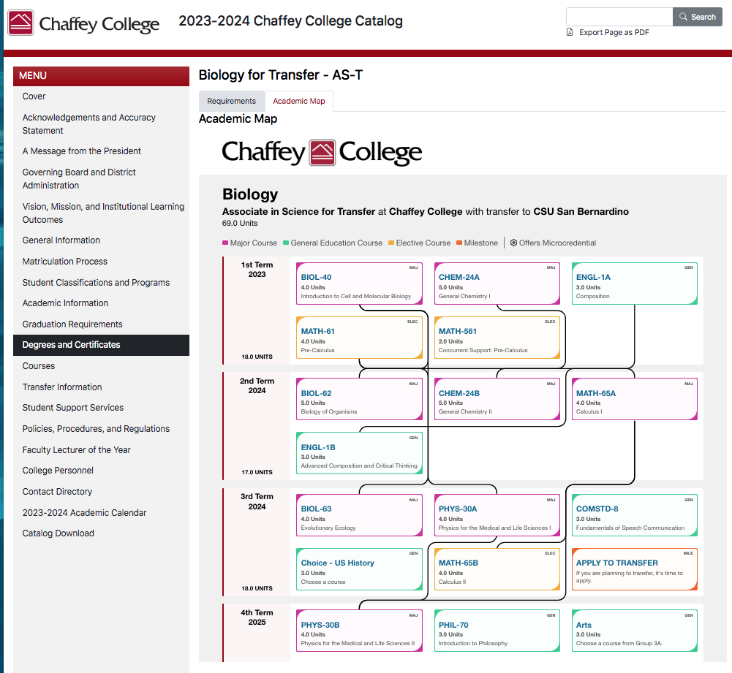
Getting maps to students: Curriculum office provides copies of academic maps to student services so they can be viewed in Catalog and as a digital tool in Student Planning to create Ed Plans.
Notes:
The Curriculum office provides copies of academic maps (generated by faculty during degree/certificate modification & approval process) to student services so they can be viewed in Program Mapper and as a digital tool in Student Planning to create Ed Plans.

Slide 21
Connecting Curriculum to Student Career Goals: Academic Community Employability Skills (ACEs)
Goal:
Increase student engagement in both discipline and general education classes
Curriculum Processes (in development):
Connect department curriculum with institutional learning outcomes and associated ACEs microcredentials
Notes:
Connections between curriculum and ACES are highlighted in the presentation that occurs when a department's curriculum is on the agenda for a comprehensive holistic review. As the implementation of ACES assessment is brought to scale at Chaffey, the Curriculum Committee will explore how to integrate department recommended ACES skills into the local version of the CORs that is available to guide syllabus development of both FT and PT faculty.

Slide 22
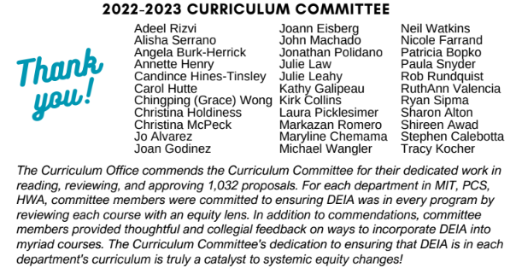
Celebrating the Work!
At the end of the year, highlight the work of faculty and the Curriculum Committee during this process: 2022-2023 Curriculum Outcomes and Accomplishments
Present to Curriculum Committee, Academic Senate, and Governing Board, if possible.
Notes:
Shireen

Slide 23
THANK YOU!
Angela Burk-Herrick, Chaffey College Curriculum Chair
Angela.burk-herrick@chaffey.edu
Shireen Awad, Chaffey College Curriculum Specialist
Sharon.awad@chaffey.edu
All items linked in this presentation can also be found on Chaffey College's Curriculum Office Website.
Additional Resources:
ASCCCC DEI in Curriculum: Model Principles and Practices (2022)
DEIA Consultant:
Dr. Christine Umali Kopp, drumalikopp@gmail.com
Cultural Psychologist
Professor of Psychology, Santiago Canyon College
IG: @drumalikopp

