Slide 1
Planning for Student Success: Guided Pathways, Strategic Planning, and the Curriculum Committee
Sarah Harris, College of the Sequoias
Jeffrey Hernandez, East Los Angeles College

Slide 2
Session Description
By clarifying the path, helping students to find the path, supporting students to stay on the path, and ensuring student learning, the Guided Pathways framework serves as a guide to institutional redesign with equity and the student experience at the core. Colleges are situated to institutionalize their Guided Pathways frameworks by integrating the guided pathways elements into existing and redefined college structures. Our curriculum committees and academic senates have a central role in leading this next stage of institutional redesign. Join this session to learn and discuss what a Guided Pathways integration looks like across different colleges and how your curriculum committee can play a central role.

Slide 3
Pathways 1.0 (2017-2022)
Initial college pathways work has included but not been limited to:
Create: Completion of tools like Meta-Majors and Curriculum Maps
Enter: Updated onboarding centered on meta-majors and other initiatives
Stay: Student success teams, data-coaching, integration efforts with student services and support
Ensure Learning: Classroom and instructional redesign focused on equity, data coaching and assessment initiatives, professional development focused on student success.
Many colleges focused on initial creation or redesign of college structures.

Slide 4
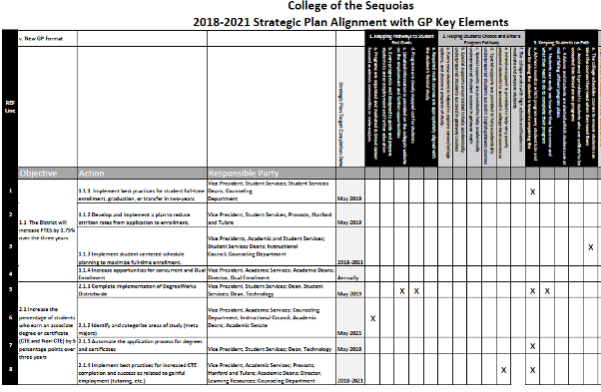
Example: College of the Sequoias
COS uses its integrated planning process to embed various initiatives into ongoing work.
Initiatives referenced in COS Strategic Plans include:
Strong Workforce
Vision for Success
Student Centered Funding Formula
Basic Skills/ AB705
Initial pathways key elements mapped to Strategic Plan for reporting
Notes:
Sarah

Slide 5
IDEAA and Guided Pathways
Major Objectives of Guided Pathways Institutional Redesign:
Close equity, achievement, and opportunity gaps
Clear alignment with Student Equity Plans
English, English as a Second Language, and Mathematics Pathways
Streamlined student journey so that financial aid is not wasted on unnecessary course taking
Student Self-Agency: students are provided with clearly defined pathways and program maps to choose their self-determined educational goals
Curriculum that is culturally responsive as well as relevant to students’ career and future educational goals
Consider – where do these goals fit in your institution?
Notes:
Jeffrey

Slide 6
Pathways 2.0 (2022-2026)
GP 2.0 Work Plan Metrics
Successful Enrollment and Entering Students
Persistence
Completion of Transfer-Level Math and English
Transfer and the Student Journey
Completion and Student Success
These metrics were the very same used for measuring progress on Student Equity Plan 2022-2025
The metrics align with the CCC Vision for Success
Work Plan looked at integration between Guided Pathways and specific program areas:
Student Equity and Achievement (SEA) Program Integration
ADT Integration
ZTC Program Integration
CA Adult Education Program Integration
Strong Workforce Program Integration

Slide 7
Example: College of the Sequoias Part Two

Slide 8
Institutionalizing Guided Pathways
Questions to Ask: Has your College:
Created a sustainability plan for supporting students and faculty in continuing the framework and addressing equity goals
Changed structures to align with the Guided Pathways framework: governance, planning, budgeting, hiring
Aligned outcome and program review assessments to ensure ongoing assessment of the framework
Identified a continued role for the academic senate and curriculum committees in Guided Pathways re-design
Incorporated the framework into institutional plans

Slide 9
Aligning the Mission and Vision with Equity and Guided Pathways
Ensure your college vision and mission statements are aligned with Guided Pathways efforts
Support faculty in:
leading change
serving students
embracing inclusion
engaging in anti-racism
Curriculum Committee efforts aligned with Mission and Vision through the development criteria, particularly appropriateness to mission and need
Notes:
Sarah
leading change--ownership of redesign and authentic practices (grassroots efforts and engagement)
serving students--intentional involve and invite student voices (look to left and right of every meeting--if you don’t see a student, ask for one)
embracing inclusion--address and actively discuss practices of inclusion that support all lived experiences
engaging in anti-racism--interrogate systems of status quo that create racial barriers
When colleges actively seek to redesign in a GP framework, the mission and thus outcomes should intentionally work toward these aims.

Slide 10
Curriculum Committee Role in Program Integration in Guided Pathways 2.0 Work Plan
Program and course approval by the Curriculum Committee pertains to:
Associate Degree for Transfer (ADT) – programs and courses
Strong Workforce – CTE programs and courses
CA Adult Education – noncredit programs and courses
For these program areas, curriculum committee approval may require academic program maps and/or placement into meta-majors
Additionally, the Curriculum Committee course approval pertains to:
Zero Textbook Costs – COR element under Representative Textbooks/Content Resources
Notes:
Sarah
leading change--ownership of redesign and authentic practices (grassroots efforts and engagement)
serving students--intentional involve and invite student voices (look to left and right of every meeting--if you don’t see a student, ask for one)
embracing inclusion--address and actively discuss practices of inclusion that support all lived experiences
engaging in anti-racism--interrogate systems of status quo that create racial barriers
When colleges actively seek to redesign in a GP framework, the mission and thus outcomes should intentionally work toward these aims.

Slide 11
Aligning Committee Work: COS Example
Governance committee work is aligned to planning through annual initiative setting and reporting
Each committee is encouraged to set initiatives aligned to institutional goals and objectives where appropriate
Initiatives are timely and tracked throughout the year
Annual committee surveys evaluate committee work and progress

Slide 12
Reflecting on Curriculum Committee Role in Program Integration at Your College
Is your curriculum committee approving these programs as expected or are there challenges?
Are students equally supported whether they are pursuing transfer or CTE?
Are noncredit offerings available?
Does your process include maps and meta-majors?
Are there sufficient courses that allow for zero textbook costs so that a student can complete an entire program, including their GE?
Does your curriculum committee lead program and course development in a manner that facilitates alignment with guided pathways and institutional planning goals for equity? (servant leadership)
Does your curriculum committee create the conditions for disciplines to seamlessly create and modify curriculum that will advance progress on equity?
Notes:
Sarah

Slide 13
Discussion!
What are you doing to integrate Guided Pathways work at your college?
Share Your Examples
Notes:
All

Slide 14
Resources
Survey on Collegial Consultation During Guided Pathways Implementation: An Agenda for Professional Development
CCCCO Launchboard – Student Success Metrics
ASCCC Guided Pathways Taskforce (GPTF) Webinars:
Integrating Guided Pathways to Institutional Structures PPT and Recording
Using the SOAA as a Tool of Guided Pathways Reflection, Planning, and Collaboration PPT and Recording
Integrated Planning, Guided Pathways, and Sustainability PPT and Recording
All ASCCC GPTF Webinars and Resources

