Slide 1
Curriculum and the Schedule: Strategic Enrollment Management to Support Student Success
Sarah Harris, College of the Sequoias
Tram Vo-Kumamoto, Saddleback College, CCCCIO President
Eric Wada, Folsom Lake College
Notes:
Sarah (1-9)

Slide 2
Session Description
This session focuses on effective practices and deliberative discussions in strategic enrollment management to support student success and program completion. This breakout will focus on how curriculum impacts the schedule, the data needed to make scheduling decisions, various methods and approaches to scheduling, improving collaboration in building schedules and how to get started or revamp your strategies at your college.

Slide 3
Session Learning OUtcomes
At the conclusion of the session, participants will understand:
The relationship between curriculum and scheduling
Principles and practices for data-informed schedule decisions, including principles of equity-mindedness
A basis definition of strategic enrollment management and how it integrates scheduling with other college initiatives and processes
Collaborative strategies for balancing student access, faculty needs, and contractual compliance

Slide 4
Scheduling Basics
What is the relationship between curriculum and scheduling?
This Photo by Unknown Author is licensed under CC BY-NC

Slide 5
IDEAA and Student Success
Vision for Success Goals:
Goals 1 & 2: increase the number of California Community College students annually who acquire associate degrees, credentials, certificates, or specific skill sets that prepare them for an in-demand job & increase transfers to CSU & UC
Goal 3: Decrease the average number of units accumulated by California Community College students earning associate degrees,
Goal 5: Reduce equity gaps across all goals through faster improvements among traditionally underrepresented student groups

Slide 6
Scheduling and Curriculum Basics
Elements of the COR that may impact scheduling:
Units/hours
Requisites and Advisories
Modality
Elements of the COR that may also impact your class search:
Course title and description
ZTC and LTC
GE and Transfer information
Course Number
Elements of Programs that may impact scheduling:
Program requirements
General education and transfer requirements
Course sequencing/mapping

Slide 7
Scheduling and Curriculum Currency
Ensuring accurate and timely curriculum information is critical to the scheduling process.
Start by asking:
Are there courses in your catalog that are never offered?
Are there programs in your catalog that no longer exist?
Are there certificate and/or degree options that have never been awarded?
Who is responsible for curriculum “clean-up” decisions?
How do you engage in campus-wide clean-up of curriculum/catalog?

Slide 8
Example: COS Courses Not Offered Report

Slide 9
Curriculum Cleanup – What Does it Mean?
Curriculum and discipline experts examine data across the institution
Asking questions – lots of questions – across programs
Not jumping to conclusions
May (or may not) mean discontinuing certain awards, programs or classes
May (or may not) mean creating new awards, programs, classes
May (or may not) mean re-designing
Question/focus on the end goal of the program – employment, transfer, local needs
Be sure data analysis and context include your IDEAA goals
Working with faculty and departments to assess course and program viability - who has the conversation and at what level

Slide 10
Building the Schedule
How are scheduling decisions made?
Notes:
Eric (10 – 13)

Slide 11
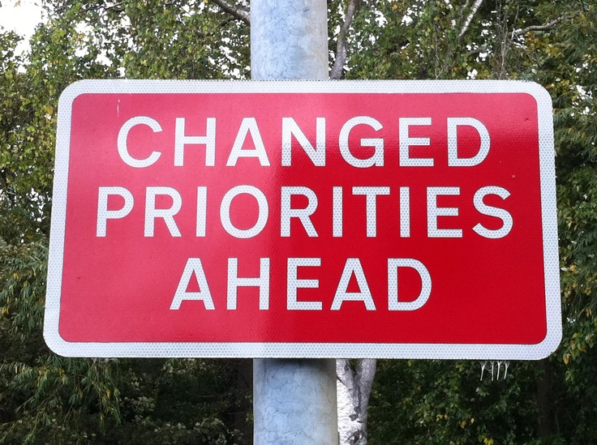
Priority Enrollment
Ed Code 66025: priority registration for CalWORKs; EOPS; and current/former military, foster youth, homeless youth. (Also see Title 5 58108)
AB2881 (Berman, 2022) adds students who are parents
Measure impact & outcomes to assess student need.
Are courses available after the first enrollment window(s)? Are those students with priority enrollment able to access the courses they need?
Local enrollment priority
Categories: honors programs, athletes, learning communities, defining first-time students and local processes/criteria for first-time students to get priority registration. Others?
Are local priorities IDEAA-focused?
Notes:
Eric will add content

Slide 12
Data Mart: State FT/PT Report from F'21-S'22 Guided Pathways program maps that serve student needs
Notes:
All students, all districts

Slide 13
Data and Program Mapping
Why are students taking fewer than 15 units?
What are the consequences of taking fewer than 15 units per term?
Transfer, financial aid, other supports with limited terms
How do we destigmatize part-time status?
Managing multiple timelines for students in schedule building
Review and revise (as necessary) program maps that are student-facing.
Notes:
Eric will add datamart screenshot
Add example of PT schedule map

Slide 14
Scheduling Basics: Know Your Stuff!
Multi-variable (days, times, locations, modality, …)
Connection to Program maps
Are students able to follow the maps based on the schedule?
Are these maps accessible to students?
Know the connections between courses and programs
Prerequisites, sequences, and more!
Realities
Limited classrooms
Student preferences for modality
Budget constraints
Notes:
Tram (14– 17)

Slide 15
Strategic Enrollment Management
Strategic Enrollment Management (SEM) is a holistic concept and a process that enables the fulfillment of an institution’s mission and its students’ educational goals. […] SEM includes a future-oriented vision and is adaptable to the changing environment. (Definition from the Vision Resource Center Introduction to SEM)
Follows a student from pre-enrollment through completion
Incudes recruitment, student support services, and various interventions

Slide 16
Why Does a Course Belong in a Specific Semester?
Is the course a prerequisite for other courses?
Does the course rigor require preparation?
Does the course represent a milestone in student progress?
Can students use the course to pursue other majors within a meta major if they change major?
Is the course a hook course meant to engage student interest or vet suitability?
Does the course provide an important contribution to campus equity initiatives?
How does the timing/sequencing of the course address equity gaps?

Slide 17
Course Scheduling: Points to Consider
Where does the class fall in the sequence on the program map?
How many students does the program have?
How many sections of the class will you need and in which semester?
What times/days is student demand high for this specific program?
What are the equity needs of students who will take the courses for this degree/certificate?
Have you considered having this certificate/degree as part of a night-time or weekend program?
Do you have the full student support services available to the students if you put the courses in the evenings and weekend?
How many courses in this area are offered at the same days/times?
Are GE courses offered at varying days/times for all student access?

Slide 18
Scheduling Example 1
STEM students largely take a similar set of core courses
Many of which are sequences
Many also involve laboratories
Are lecture and lab schedules student friendly?
For example, Engineering
Calculus, Physics, Statics (& Chemistry!)
Courses can be scheduled at same time if one is a prerequisite for the other, for example scheduling Calculus 1 and 2 at the same time can also add some predictability for students continuing to the next term.
STEM Courses
Notes:
Eric

Slide 19
Scheduling Example 2
Sequencing Social Sciences
Does the course represent a milestone in student progress?
Can students use the course to pursue other majors within a meta major if they change major?
Is the course a hook course meant to engage student interest or vet suitability?
For example: Social Sciences GE
Variety of dates, times, modalities
Some students are hooked into majors in GE pathways
Capacity for student completers
Social Sciences
Notes:
Tram

Slide 20
Focus on Students
Emphasis on equity – vision for success, call to action principles
How do we use scheduling, sequencing, and pathways to create inclusive classrooms and anti-racist curriculum?
How can these be used to decrease equity gaps and increase students' success?
Proper sequencing/scheduling can be used to decrease the number of overall units students need to complete their academic goals
Transparency and open access for all students is an equity goal!
Scheduling and sequencing with student goals and the college mission in mind means making sure courses are available in time for students to achieve their goals.
Notes:
Sarah (20 – 22)

Slide 21
Other Considerations & Questions
Scheduling dual enrollment (how are faculty involved in programming, course offerings, and scheduling) – focus on scheduling
Modality and Calendar
Block Scheduling
Other Questions and Challenges?
Notes:
Eric and Tram will add content

Slide 22
Resources
Questions? Contact: info@asccc.org
CCC Vision Resource Center Strategic Enrollment Management Training
Vision for Success
Attendance Accounting Manual

