Slide 1
Updates to the PCAH
Madelyn Arballo, Mt. San Antonio College
Amber Gillis, Compton College
Mark Edward Osea, Mendocino College
Omar Torres, College of the Canyons

Slide 2
Session Description
Join members of the 5C Program and Course Approval Handbook (PCAH) workgroup to learn more about updates and changes to the 8th Edition of the PCAH. The presentation will also review proposed changes for the 9th Edition as well as the potential future of the PCAH as it potentially evolves into an online document.

Slide 3
8th Edition PCAH
Updates to the 8th Edition
Introduction of the California Community Colleges
Curriculum Submission and Approval Technical Manual
for the field
Publication timeline information

Slide 4
Updates to the 8th Edition PCAH
Credit Course Standards Updates - Correspondence Education
Not found in the 7th edition of the PCAH.
Title 5 § 55260 defines correspondence education as instruction provided through one or more courses by a community college or district under which the college or district provides instructional materials, by mail or electronic transmission, including examinations on the materials, to students who are separated from the instructor. interaction between the instructor and student is limited due to separation, is not regular and substantive, and is primarily initiated by the student.
Title 5 §§ 55260-55264 specifies that course quality standards apply to correspondence education in the same manner as standards for regular classroom courses.

Slide 5
Updates to the 8th Edition PCAH 2
General Baccalaureate Degree Standards
Not found in the 7th edition of the PCAH.
Upper and lower division units must equal a minimum of 120 semester (180 quarter) units.
lower division requirements: Minimum of 60 semester (90 quarter) units with 36 semester (54 quarter) lower division GE. A minimum of 18 semester (or 27 quarter) units must be in the declared major.
upper division requirements: Minimum of 40 semester (60 quarter) units with 9 semester (13.5 quarter) upper division GE.

Slide 6
Updates to the 8th Edition PCAH 3
Addition of Ethnic Studies Requirement
General Associate Degree Requirements
Satisfactory completion of a transfer-level course (minimum of three semester units or four quarter units) in ethnic studies. This requirement may be satisfied by obtaining a satisfactory grade in a course in ethnic studies taught in or on behalf of other departments and disciplines.

Slide 7
Updates to the 8th Edition PCAH 4
Baccalaureate Degree Criteria for Approval
Program Narrative (Goals, Objectives, Administrative Plan, Resources, Student Interest, Catalog Description, Program Requirements, Master Planning, Enrollment/Completer Projections, Program Inventory “Fit”, and Service Area Need).
CORs for all courses included in the major.
Evidence of unmet workforce need including: LMI, employer need, higher wages for workers with baccalaureate, regional consortium approval.
Advisory board recommendation.
Consultation with regional employers and workforce development boards.

Slide 8
Updates to the 8th Edition PCAH:
Noncredit Highlights
Added “credit and noncredit” throughout edition
Minimum Conditions (p.109) replaced with title 5, §55150, Approval of Noncredit Courses and Programs that more adequately describes the responsibility of the college and the board for establishing curriculum policies, submission, and approval
Annual Course and Program Certification (new section p. 110) with additional title 5 references relating to apportionment
Updated title 5 and Ed Code reference listings by substituting more current citations

Slide 9
Updates to the 8th Edition PCAH
Noncredit Highlights
Apportionment and Noncredit Courses section (p.130) significantly expanded and strongly emphasizes and outlines the conditions for claiming attendance in a noncredit course
Distance Education section (p.131) strikes language for separate local curriculum approval for DE courses and adds substantive interaction title 5 §55204
Supplemental learning assistance courses new (p. 133) adds language on collecting apportionment, title 5 §58172 (primary/parent course, open-entry/exit)
Community Services Offerings (new section p.135): Education Code section 78300 states fee-based courses are ineligible for apportionment and not included in the CCCCO’s curriculum inventory system.

Slide 10
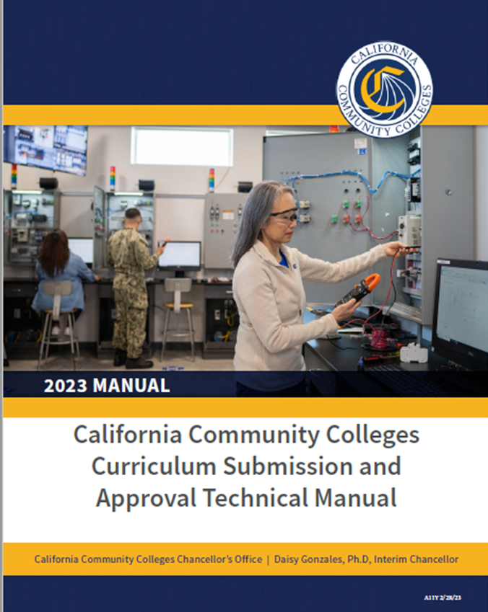
Technical Manual – Clarifying the Process
Clarifies information regarding course and program submissions to the CO including:
Acronyms listing
Explanation of CB Codes
Flow charts of curriculum process with timelines
Relevant title 5 information
Provides concrete examples for course and program submissions including:
Curriculum templates
Narrative Examples
Baccalaureate submission information

Slide 11
2022-2023 5C Reimagining the PCAH Workgroup
Workgroup membership
Workgroup goals:
Change the name of the PCAH (proposed: Curriculum Handbook of California Community Colleges).
Transform into a living electronic document with edited date (like attendance model).
Simplify and streamline (ex. combine credit and noncredit so not distinct and repetitive. Note only specific differences.)

Slide 12
Other PCAH Workgroup Goals/Tasks: 2022-2023
Add section/language for WE.
Review and update Credit Hour Description area.
Adding headers to the PCAH to distinguish between sections in the document (i.e. Credit vs. Noncredit).
Revisit language to make the PCAH more user friendly (not so technical).
Checklist for course or program submission to alleviate possible errors. Also to include any Title 5 language changes.
Making the PCAH more accessible online - perhaps moving into sections on the CO’s website.
Other Goals (Time Pending)
More technical or clearer areas around process (yay for technical manual).
Appendix - CB Codes.
Examples/best practices for submissions (noncredit areas in particular).
How to submit for cross listing in COCI (not mirrored content).
Credit for Prior Learning (CPL) and Credit by Exam - some suggestions for COR?
Articulation Considerations: Do’s and Don’ts (HS Articulation).

Slide 13
Workgroup Accomplishments
Began revisions on PCAH language to reflect recent or pending title 5 language changes in the following areas: work experience, credit hour, distance education, and other miscellaneous sections.
The noncredit subgroup revised the noncredit section of the PCAH with attention to readability and content clarifications.
Discussed and considered changing the title of the PCAH.
Began discussions on the transition of the PCAH into an online format: organization and formatting
Began discussions on the integration of IDEAA language into the PCAH.
Worked with the DEI in Curriculum Workgroup to begin drafting language suggestions

Slide 14
Noncredit Subcommittee Accomplishments
Noncredit curriculum specialist and faculty from Glendale, LA Mission, and Mt. SAC reviewed PCAH 7/8. Some suggested revisions for future PCAH updates:
Add to History and Philosophy of adult education the history of the GED for those serving in the military, DEI language, and more on student characteristics.
Add language that the adult high school diploma/secondary program may also include courses in the sciences, social sciences, and arts.
Remove in HS Diploma section the reference to the California HS exit exam (CAHSEE).
Remove some of the repetitive references to supervised tutoring and learning assistance, CCCCO’S MIS Data Element Dictionary (DED).
Add DEI framework language to Standards for Approval of Noncredit Curriculum.

Slide 15
Suggestions for the 2023-2024 PCAH Workgroup
Continue transition of the PCAH into an online format.
Continue integration/synthesis of IDEAA language into the entire PCAH, including a revised introduction demonstrating the commitment of the California Community Colleges in developing culturally-relevant, culturally-responsive curriculum processes and classroom andragogies.

Slide 16
Let’s Chat
What questions to you have for the workgroup?
Now that you’ve had a chance to look at the 8th Edition and Technical Manual, what suggestions do you have to make the PCAH easier to navigate that we can pass along to next year’s team?
What are your thoughts on an online PCAH and Technical Manual?

Slide 17
Resources
8th Edition PCAH, PDF
Summary of Substantive Changes: 8th Edition PCAH, PDF
California Community Colleges Curriculum Submission and Approval Technical Manual, PDF
California Community Colleges Curriculum Committee Webpage
California Community Colleges Chancellor’s Office Curriculum and Instruction Unit Webpage
ASCCC Curriculum Committee Webpage/Resources Page

Slide 18
Thank you!
Please send additional questions to info@asccc.org

