Slide 1
Responsive Curriculum and Collective Impact: Inclusion and Social Justice
Thursday, July 9, 2020 10:45 a.m.--12:00 p.m.
Dr. La Tonya Parker, ASCCC Area D Representative
Dr. Jennifer Taylor-Mendoza, Skyline College Vice President of Instruction
Michelle Velasquez Bean, ASCCC At-large Representative

Slide 2
Session Description
As educational leaders, we have the collective responsibility to lead the design of curriculum that supports our students and celebrates their diverse perspectives and lived experiences. Discipline faculty need to assess and revamp their curriculum through an antiracist lens and ensure teaching methods are inclusive. In this session, the presenters will share effective practices and actions that leaders can take to review and design culturally responsive curricula, support services, and instruction.

Slide 3
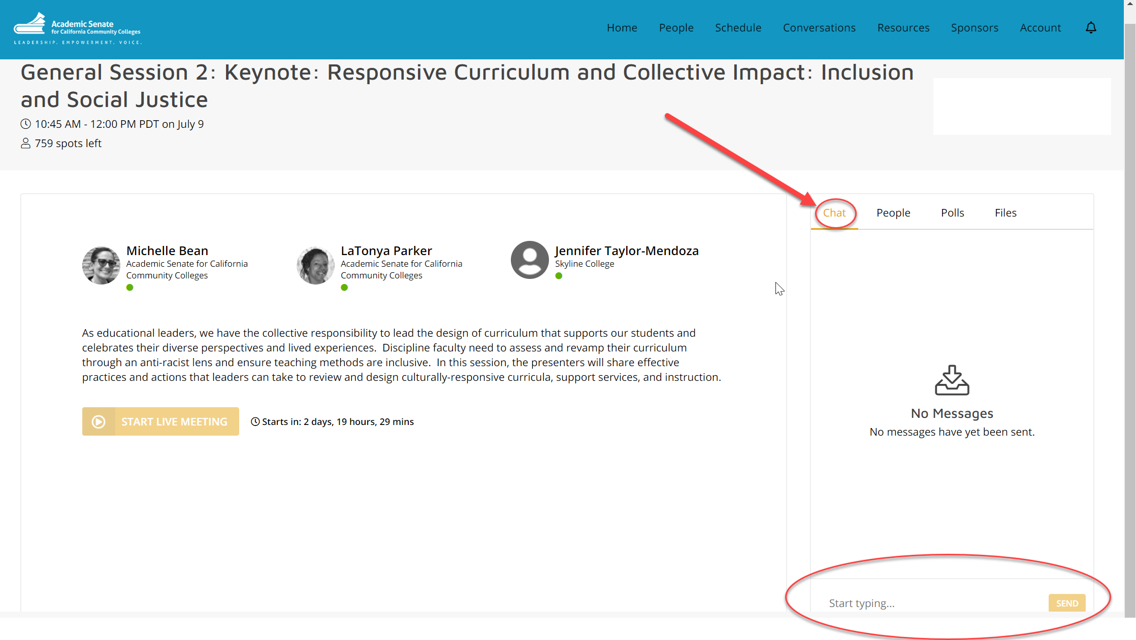
Use the CHAT for QUESTIONS
Notes:
Michelle--Housekeeping (3 minutes)
Use the chat for Q&A
Closed Captioning available--click to turn on
Files--PowerPoint available for download
Poll at the end with comments section

Slide 4
Today, we will
Reflect on perspective
Discuss the architecture of education
Define racist and antiracist
Apply concepts to curriculum design
Provide effective practices and models of transformational leadership
Respond to questions and answers
Notes:
Michelle (2 min)
Review objectives of the day
Introductions:
My name is Michelle Velasquez Bean, ASCCC At-Large Representative (LA area)
Dr. Jennifer Taylor-Mendoza, Skyline College Vice President of Instruction
Dr. La Tonya Parker, ASCCC Area D Representative
Dr. Parker will be opening us with a fun exercise on perspective.

Slide 5
PERSPECTIVE: What do you see? Answer in CHAT
Notes:
La Tonya (15 seconds)

Slide 6
Did you see the other picture?
Notes:
La Tonya (3 minutes)
REMEMBER: It is about perspective.

Slide 7
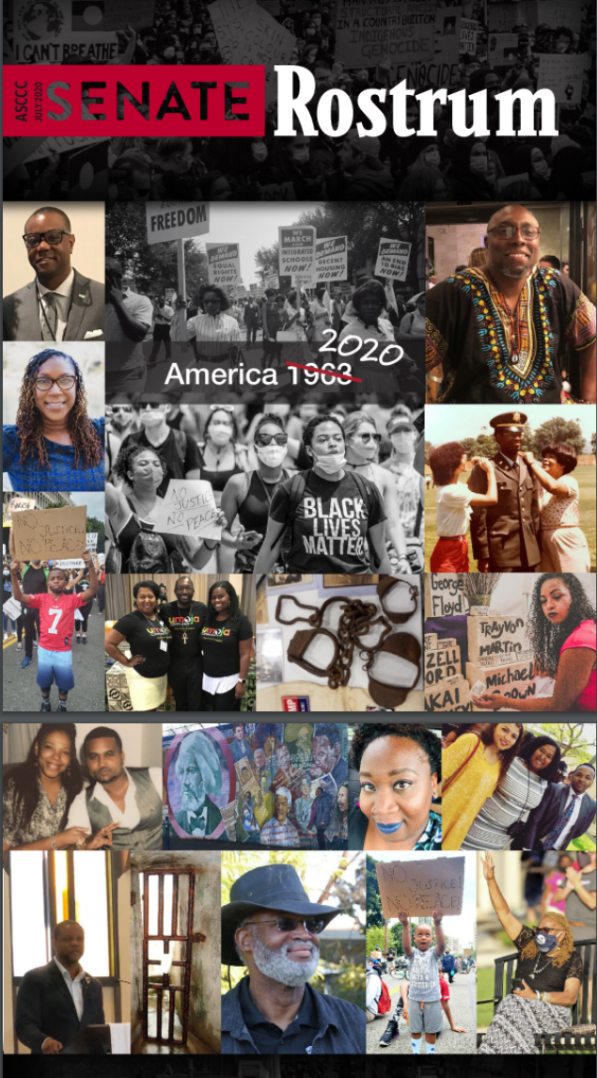
“In academia, we are forced to learn and read about white, European history and literature, while the wider community is not forced to read African American scholars. How do I know? That was my educational experience. If I had no interest in learning about Black history or Black scholarship, then I would know less than nothing because it is simply not assigned.”
--Elizabeth Craigg-Walker
“All throughout our developmental years, schooling helps to inform our ideologies of race, gender, sexuality, power structures, relationships, bonds, etc. Therefore, our educational experiences play a crucial role in our worldview, including how we see ourselves as citizens in the world. However, when student experiences are not considered in curriculum, it invalidates their identity. One of the manifestations of this type of curriculum-inflicted trauma is the erasure and neglect of cultural capital in the classroom.
--Abdimalik Buul, Keisha Quesada, Ebony Tyree
“Over the years, I learned how to verbally spar against the gaslighting and microaggressions from classmates and colleagues. I navigated the hidden curriculum of how to teach your teachers—and bosses, to respect all of who you are. And smile. I battled against personal acts of student and collegial aggression . . . My intellectual journey has served me many battle wounds.”
--Rachel Hastings
Notes:
Michelle (3 minutes)
These are the collective stories of our colleagues!
Are we ready to hear them?
The challenge is: No matter where you are in your journey in anti-racism and equity-minded work, we must keep moving!

Slide 8
KEY QUESTIONS for REFLECTION
Who designed our education system?
Whom did it benefit? Whom does it harm?
What are you doing to work toward anti-racism?
Education is activist work.
Decide to enter this space.
--Dr. Regina Stanback Stroud
Notes:
Michelle (5 minutes)
Let’s ground ourselves and anchor to the space: Deep breathe. Notice the space. Release the jaw. Relax the shoulders. Deep breathe.
Today--this hour, as we delve into courageous conversations, remember to return to this moment--a safe space to engage. GIVE YOURSELF PERMISSION today to be open and raw.
Let’s move into critical conversations from a place of love and empathy.
Ask yourself:
Who designed our American education system?
For whom is was it designed? Whom did it benefit?
If we acknowledge the architecture of education:
Structural racism
Need to acknowledge systems of oppression in our society (white supremacy and anti-blackness)
Who was left out?
Institutional racism
Need to interrogate our policies and practices including curriculum development and program review
Are we conditioned and socialized to see and celebrate one dominant lens or perspective?
Privilege--consider, do we
Weaponize our roles by holding onto status quo or do we celebrate diversity and holding each other accountable
Self-reflection and sitting with the discomfort is needed
Education is activist work.
Do you want to do this work?
Dr. Regina Stanback Stroud said in a webinar with Dr. Luke Wood and Dr. Frank Harris on anti-blackness: DECIDE TO ENTER THIS SPACE.

Slide 9
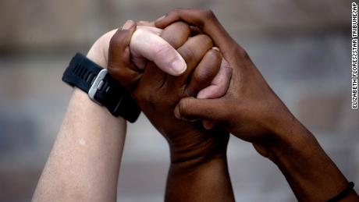
DEFINITIONS
Racist: One who is supporting a racist policy through their actions or inaction or expressing a racist idea.
Antiracist: One who is supporting an antiracist policy through their actions or expressing an antiracist idea.
“The only way to undo racism is to consistently identify and describe it—and then dismantle it.”
(Ibram X. Kendi, 2020)
Notes:
Jennifer (3 minutes)

Slide 10
Epistemological Disruption
Institutions must see themselves as “cultural texts”
Rethink and evaluate curriculum, policies, and practices to take into account how institutional knowledge is constructed, as individuals engage with and within the organization
Notes:
Jennifer (7 minutes)

Slide 11
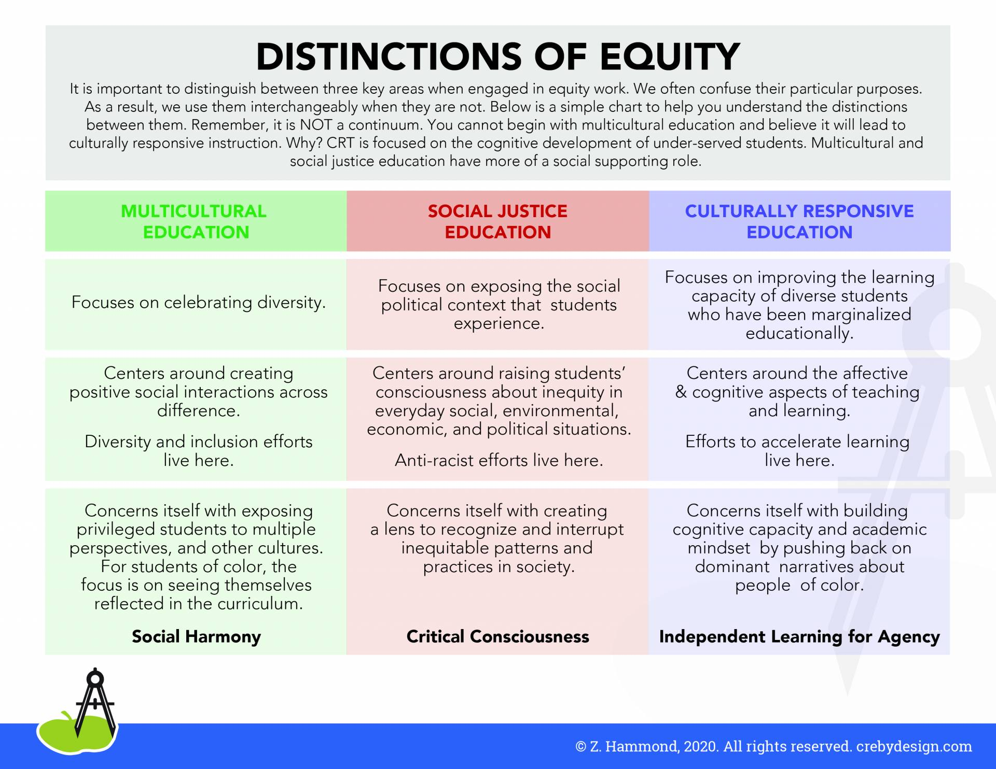
Anti-Racist Culturally Responsive Design
The reduction of injustice is not freedom.
--Ella Baker
Notes:
Michelle (5 minutes)
Ella Baker: The reduction of injustice is NOT freedom. Check off a DEI list for compliance is NOT enough.
Liberation: Requires humans to work with humans collectively to eliminate all manifestations of oppression (Love, et al., 2007)
Multi-cultural--exposing privileged with multiple perspectives: Using images and representative readings.
Social justice--anti-racism; disrupting systems, practices, patterns: Curriculum policies and practices.
Culturally responsive teaching--creates agency by celebrating and providing space for learning in a collective, a community that is interdependent on each other.
Marginalized communities thrive in villages and familias! But have rarely been given that in the ed system.
Our students know a lot! Build on that! Allow them to teach you!
Center on collectivism and culturally responsive--builds community
Not individualism and Eurocentricity--emphasizes individual achievement
Celebrate and allow for diverse lived experiences: Exposure is not experience!
Create space and time for building agency and acknowledges schemata and diverse backgrounds
Provide rigor that intentionally builds by scaffolding
Become a learning partner with students
Push back on the dominant culture and narratives that demonize people of color
Interrogate your curriculum design
Do not just cut and paste into your COR!
Use your academic freedom when designing curriculum: such as the
Methodologies
textbook and material selections
types of assignments
types of assessments
interrogate the need for excess units and pre-reqs that may create barriers
consider your outcomes and objectives--how do they support students?

Slide 13
Culturally Responsive:
Transformational Leadership
Looking forward, the most revolutionary influence on the equity and inclusion evolution of online learning and student services in the California community college (CCC) system will not only include equipping faculty with the latest technology tools, but professional transformational leadership development.
~LaTonya Parker
Notes:
La Tonya (5 minutes)
Transformational leadership is the extent to which one is able to serve, and influence change across disciplines.
~ Basham, 2012

Slide 14
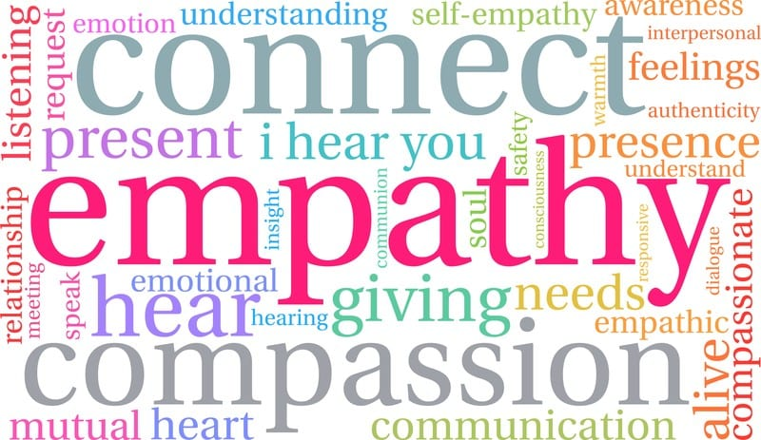
Principles of Transformational Leadership
Engagement of Stakeholders to Implement Change
Authenticity of Communication
Empathy
Relationship Management
Maintaining a Sense of Stability in the Chaos
Notes:
La Tonya (5 minutes)
Principles of Transformational Leadership
· Engagement of Stakeholders to Implement Change:
Creating positive change is a complex undertaking. It involves implementing many aspects of transformational leadership in order to be successful. An important component of change is the engagement of all stakeholders in the transformation. It is essential to design a process that engages all those involved early in the change. Convincing stakeholders that working together is far better and more successful than battling over details(McKee, Boyatzis, Johnstone, 2008).
· Authenticity of Communication:
Always a key component to any type of change is effective communication. Ensuring that communication is candid improves leader credibility. Change tends to bring about employees that are extra sensitive to tone, candor. And concern. (Anderson, Anderson Ackerman, 2010). Through effective communication a change leader, as Positive Emotional Attractor can express energy and excitement that lends itself to the building of momentum that is essential to successful change in an organization (McKee, Boyatzis, Johnstone, 2008).
· Empathy:
Compassion is empathy in action (McKee, Boyatzis, Johnstone, 2008). Hope and compassion bring about a feeling of renewal. This form of social awareness can help us as leaders to enhance our understanding of others as we develop better communication, perspective of those we work with and improvement of communication (Bradberry, Greaves, 2009). As organizational leaders we need to understand what the impact of our ability to empathize has on those that we work with.
· Relationship Management:
Relationship management relates to social competence as well. Relationship building coincides with the management of the bonds that are built with constituents over time. Collaboration lends itself to a strong relationship which in turn makes it easier to implement change. Social competence is one of the primary competencies of emotional intelligence. It involves social awareness as well as relationship management. The key to this competence is the ability to “read the room” and understand the mood, motives and behavior of those around you with the goal of improving relationships (Bradberry, Greaves, 2009).
· Maintaining a Sense of Stability in the Chaos:
It is important to maintain stability even through the course of change. It is imperative to reflect on the question, “What is our core purpose?” (Anderson, Anderson Ackerman, 2010). Core purpose stabilization and shared values provide the purpose for alignment. It is important for change leaders to embrace their responsibility in understanding and collaborating with all those in their organization that will be affected by the change that is being implemented.

Slide 15
Culturally Responsive:
Transformational Leadership
“...those who stimulate and inspire followers to both achieve extraordinary outcomes, and in the process, develop their own leadership capacity. Transformational leaders help followers grow, and develop into leaders by responding to individual follower’s needs, by empowering them, and by aligning the objectives and goals of the individual followers, the leader, the group, and the larger organization."
Resource: Bass, B. M. & Riggio, R. E. (2006). Transformational Leadership, (2nd Ed.). (pp. 3). Mahwah, New Jersey: Lawrence Erlbaum Associates, Inc. Retrieved from http://ehis.ebscohost.com.libproxy.chapman.edu/eds/detail?vid=7&sid=b17b20e9-7469-4407-a3e4-a0fd186d1ace%40sessionmgr12&hid=115&bdata=JkF1dGhUeXBlPWlwLHVpZCZzaXRlPWVkcy1saXZl#db=edsebk&AN=167375

Slide 16
Culturally Responsive:
Transformational Leadership
An Effective Practice: Culturally Responsive Concept Map process
Concept Map process presents challenging questions for the review of personal thoughts that prevents commitments from being fully realized.
Develop a framework around leadership practices that moves from blaming indicators that blocks movement into action.
The guided learning experience will help individuals realize the lack of commitment to creating a culturally responsive organization and orient individuals towards collaboration and effective leadership development.
The process facilitates understanding, and helps individuals realize they have control and influence over personal development by focusing on things that are not getting done.

Slide 17
1 Commitment | 2 What I’m doing or Not Doing That Prevents My Commitment from Being Fully Realized | 3 Competing Commitment | 4 Big Assumptions
Generating collaborative conversations surrounding servicing students Modeling behavior I desire in others Value Anti-Racism | I am not identifying specific task oriented towards collaborating with co-workers to create a culturally responsive learning environment I am not consciously engaging in effective collaboration efforts | I am committed to not enhancing my leadership skills Fear of taking on leadership roles and responsibilities I am not committed to being seen as a leader | I assume that if I were to be seen or identified as a leader, then I become ultimately responsible for results both good and bad I assume that if I go against the grain I will experience rejection or viewed as an outcast I am comfortable with current systemic practices, because if I did not then my ideas or different working strategies would be met with resistance I assume that if I confront responsibility then I would be held accountable and people would see my weaknesses

Slide 18
Questions for the Panelists
How have you decided to enter the space and work toward change?
What does anti-racism mean to you?
What resources and effective practices do you most lean on?
How does anti-racism fit into curriculum design?
What could be the first step or something for faculty to do?
What could be something administration and staff can do?
Notes:
Michelle--facilitator (15 minutes)
Michelle--#1, 4
Jennifer--#2, 6
LaTonya--#3, 5

Slide 19
Chat
Questions
Notes:
Selina and Michelle--15 minutes

Slide 20
Thank you!

Slide 21
Resources
Hammond, Zaretta. (2014). Culturally Responsive Teaching and the Brain: Promoting Authentic Engagement and Rigor Among Culturally and Linguistically Diverse Students. Thousand Oaks, CA: Corwin.
Kendi, Ibram X. (2019). How to be an Antiracist. New York: One World.
Love, Barbara, Dejong, Keri, and Hughbanks, Christopher (2007). Critical Liberation Theory. Social Justice Education. Amherst: University of Massachusetts.
Major, Amielle. (2020, May). How to Develop Culturally Responsive Teaching for Distance Learning. Mindshift. KQED. https://www.kqed.org/mindshift/55941/how-to-develop-culturally-responsive-teaching-for-distance-learning.
Sims, Jeremiah J., Taylor-Mendoza, Jennifer, Hotep, Lasana O., Wallace, Jeramy, Conaway, Tabitha. (2020). Minding the Obligation Gap in the Community College. New York: Peter Lang. http://www.mindingtheobligationgap.com/
Wood, Luke and Frank Harris, III. (2020). Addressing Anti-Blackness on Campus: Implications for Educators and Institutions. CORA Learning. https://www.youtube.com/watch?v=XLfJME7gnKk&t=2910s.

