Slide 1
Jennifer Zellet, Modesto Junior College, VP Instruction Josefina Gomez, San Joaquin Delta College, Library Erik Shearer, Napa Valley College, Art, 5C Erik Reese, Moorpark College, Physics/Astronomy, 5C
Scheduling: A Student-Centered Approach

Slide 2
Housekeeping
Please use the chat feature in Pathable
Use “Raise Hand” feature to speak or ask questions when called
Reminder to please mute mic when not speaking
Pro tip: maneuver your windows to have both Zoom and Pathable visible
Notes:
ER

Slide 3
Session Description
This session focuses on effective practices and deliberative discussions in strategic enrollment management to support student success. This breakout will focus on the data needed to make scheduling decisions, various methods and approaches to scheduling and identifying the best method, the ways that guided pathways should impact scheduling decisions, approaches to improving collaboration in building schedules and how to get started or revamp your strategies at your college.
Notes:
ER

Slide 4
Session Learning Outcomes
At the conclusion of the session, participants will:
…understand healthy process for student centered scheduling
…understand strategies for balancing student access, faculty needs, and contractual compliance
…understand how budget morphs into Access for Students
…understand how Student Support Services (e.g. library, tutoring, etc) enhance strategic efforts in student centered scheduling
Notes:
Josefina

Slide 5
Introduction: Context for Student-centered Scheduling
Core Commitments to the Vision for Success Goals:
Focus Relentlessly on students’ end goals
Always design and decide with the student in mind
Pair high expectations with high support
Foster the use of data, inquiry, and evidence
Take ownership of goals and performance
Enable action and thoughtful innovation
Lead the work of partnering across systems
Guided Pathways Connection…
Who are the scheduling partners at your institution? (Put in pathable chat)
Notes:
ES

Slide 6
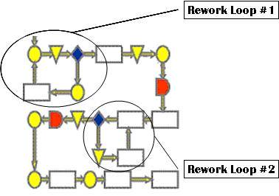
Scheduling Basics

Slide 7
Scheduling Basics: Know Your Stuff
Multi-variable (days, times, locations, modality, …)
Program maps
Are students able to follow the maps based on the schedule?
Know the connections between courses and programs
Prerequisites, sequences, and more!
Realities
Limited classrooms
Student preferences for modality
Budget constraints
Notes:
ER

Slide 8
Scheduling Basics: STEM Example
STEM students largely take a similar set of core courses
Many of which are sequences
Many also involve laboratories
Are lecture and lab schedules student friendly?
For example, Engineering
Calculus, Physics, Statics (& Chemistry!)
Courses can be scheduled at same time if one is a prerequisite for the other, for example
Notes:
ES

Slide 9
Scheduling Basics: Talk and Make New Friends
Communication is key
Must continually be re-visited
Notes:
ER

Slide 10
Administrivia
Shakespeare on Administrative Responsibilities…

Slide 11
Icky Administrative Stuff! (or is it???)
Compliance
Budget
$ = People
Productivity = Student Access
Boundaries
Rules/Regs
Contracts
Opportunity
Access
Quality Assurance
Shakespeare on the semantics of Scheduling
Notes:
JZ

Slide 12
Scheduling Start to Finish
Faculty Originates Proposal
Division Review
Technical Review
Curriculum Committee Approval
Board Approval
State Curriculum Inventory
Active in Catalog
Placed in Schedule
Actual Offering
Start Here!
Notes:
JZ

Slide 13
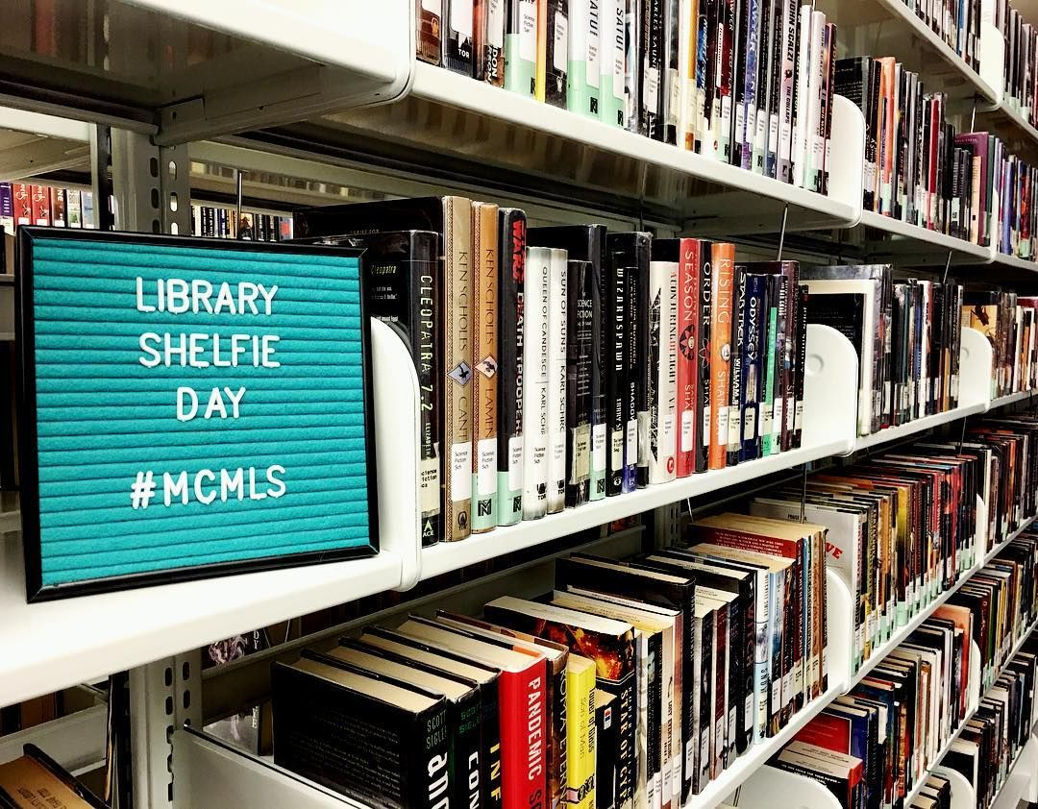
Library and Student Support Services Perspective
Campus-wide implications
Notes:
Josefina

Slide 14
Library as "Place" vs. Library as "Service"
Legal requirements for library staffing
Services and collections- access
Capacity Challenges due to scheduling
Encouraging students to STAY on campus
Fewer evening classes = fewer students that have critical NEED
Students like late night/weekend options
Notes:
Josefina

Slide 15
Impacts on other services/departments
Tutoring – at Delta, Tutoring on First Floor and Library on Second Floor of “Goleman Library”
different Deans/TrACs
potential conflicts of space needs
student confusion
Instructional Departments
requests for "embedded instruction"
library tours
Other student services including Counseling and Financial Aid
Notes:
Josefina

Slide 16
Solutions at Delta College utilizing Guided Pathways Framework
District restructuring into TrACs (meta-majors) with Success Teams
Library Services responded with new service model – Librarians assigned to individual TrACs as members of Success Teams
Increased implementation of digital resources
24/7 access to digital content
increased virtual reference “LibChat” hours
Pandemic-inspired new services
Notes:
Josefina

Slide 17
Other Considerations in Scheduling
Student Inputs: how are student needs / ideas incorporated into your local processes?
Covid Keeps?
Big Picture Considerations in Scheduling:
Balanced scheduling across time blocks
Gen Ed as Program? Who monitors balance of GE scheduling on your campus? Is it monitored?
Locations and modalities?
Notes:
ES

Slide 18
Scenarios
Notes:
Erik S

Slide 19
Scheduling Scenario: Course Offerings on Rotation
Local College’s English Department offers specialty literature courses in spring semesters on a three-year rotation.
All specialty lit courses count toward GE requirements.
Each specialty lit course has college composition listed as a prerequisite.
Student enrolls at the college in spring and enrolls in composition the same semester.
Student is interested in the Chicana lit course in the spring schedule 2022 schedule, but the course will not be available again in the rotation until spring 2025, when student plans to have graduated.
How might the student’s local community college adjust its scheduling of the course to meet the student’s need?
Notes:
Erik S

Slide 20
Scheduling Scenario: Departmental Course Ownership
Students transferring to CSU are required to complete courses in multiple GE categories.
Using Guided Pathways framework, Local College increased the number of A2 (Written Communication) courses available to meet student needs.
Bottleneck remained in A1 (Oral Communication) and A3 (Critical Thinking). Departments at Local College offering courses in A1 and A3 are small, and number of sections in each area is less than 50% of those in A2 each semester.
Analysis of comparable offerings at other colleges found both more choice and more sections in these areas.
Department faculty have protested that other departments are not qualified to teach Critical Thinking options, despite the analysis. They also have too few faculty members to provide additional sections.
What conversations need to occur? Who needs to be part of these conversations?
Notes:
ES

Slide 21
Scheduling Scenario: Low Enrollment Impacting Academic Maps
Offered only in Spring, Feminist Philosophy is one of two core courses required for the AA in Women/Gender Studies at Local College.
Due to low enrollment at census, the College’s VPI directed the Dean to cancel the course for the second year in a row.
Academic Map for this AA directs students to take the course in the second semester of a two-year plan.
Cancelled course will mean students in a new cohort cannot plan on completing their degree in two years.
How might the college adjust its course offerings to help students complete their program?
Notes:
ES

Slide 22
Scheduling Scenario: Courses Available do not meet Degree Requirement
Student took Math for Business Majors because a friend recommended it and it was offered in evening, which fit their schedule.
Student’s major is Allied Health, and this course is not on their Ed Plan and will not count toward degree.
The Counsellor the student met assured them that though it will not meet degree requirements, it will transfer.
How might the college better serve this student?
Notes:
ES

Slide 23
Questions
Thank you all for attending
Contact information:
Jennifer Zellet zelletj@yosemite.edu
Josefina Gomez josefina.gomez@deltacollege.edu
Erik Shearer erik.shearer@napavalley.edu
Erik Reese ereese@vcccd.edu
Notes:
all

