Slide 1
Inclusive Governance: Challenges and Opportunities Saturday, May 14 | 10:40-12:00
Notes:
Manuel

Slide 2
Presenters
Agenda
Overview of College Governance
Challenges for faculty in Career, Technical, and Noncredit Educational Fields
Finding Opportunities:
academic senate (senator, liaison, open meetings)
curriculum committee
other college/district committees, task forces, and workgroups
Statewide work
Juan Arzola, ASCCC At-Large Representative
Amber Gillis, ASCCC South Representative
Ginni May, ASCCC Vice President
Manuel Vélez, ASCCC South Representative
Notes:
Juan starts then we each introduce ourselves - Manuel covers the agenda

Slide 3
Preliminary Questions to Consider…
How can faculty in CTE and noncredit fields eliminate barriers to governance when they are so engaged with students?
What strategies does your campus use to ensure faculty in CTE and noncredit fields are engaged in college governance conversations?
Are these strategies codified in your local college governance structures?
Where are the gaps in your local college governance structures?
How does your local college support CTE and noncredit champions?
What made it possible for you to be here at this conference?
What about pay and minimum qualifications disparities on campuses? How does this affect faculty in CTE and noncredit fields?
Notes:
~Amber - go over keep these questions for thought throughout the presentation and then to generate discussion at the end

Slide 4
Effective Representation
Requires IDEAA:
Inclusivity
Diversity
Equity
Anti-racism
Accessibility
Notes:
Ginni

Slide 5
A Governance Primer
Board of Trustees: High Level Policy Decisions
Administrators: Manage and Oversee Day-to-Day Functions
Faculty
The Academic Senate: Collegial Consultation
Collective Bargaining: Working Conditions
Staff and Students: Effective Participation
Notes:
Manuel

Slide 6
AB 1725 (Vasconcellos, 1988)
Landmark Legislation
Senate: passes 38-0 | Assembly: passes 74-1
Prior to passing there was a lot of opposition.
Signed by Governor Duekmejian on September 19,1988.
Decoupled the California Community Colleges from the K-12 system.
Changed the number of tenured faculty members on the Board of Governors from 1 to 2.
Provided for governance structures in place today.
Notes:
Ginni

Slide 7
History
Norbert Bischof and Ted Staniford founded the ASCCC and established it in 1969.
In 1978, the Board of Governors recognized the ASCCC as the representative of Community College academic senates – Title 5 §53206.
The local academic senate is the representative of the faculty in all “academic and professional matters” or the “10+1” and makes recommendations to the governing board of a college/district in these areas – Title 5 §53200.
Notes:
Ginni

Slide 8
Academic Senate
Title 5 §53200
(b) “Academic senate,” “faculty council,” and “faculty senate” means an organization formed in accordance with the provisions of this Subchapter whose primary function, as the representative of the faculty, is to make recommendations to the administration of a college and to the governing board of a district with respect to academic and professional matters. For purposes of this Subchapter, reference to the term “academic senate” also constitutes reference to “faculty council” or “faculty senate.”
Notes:
Juan

Slide 9
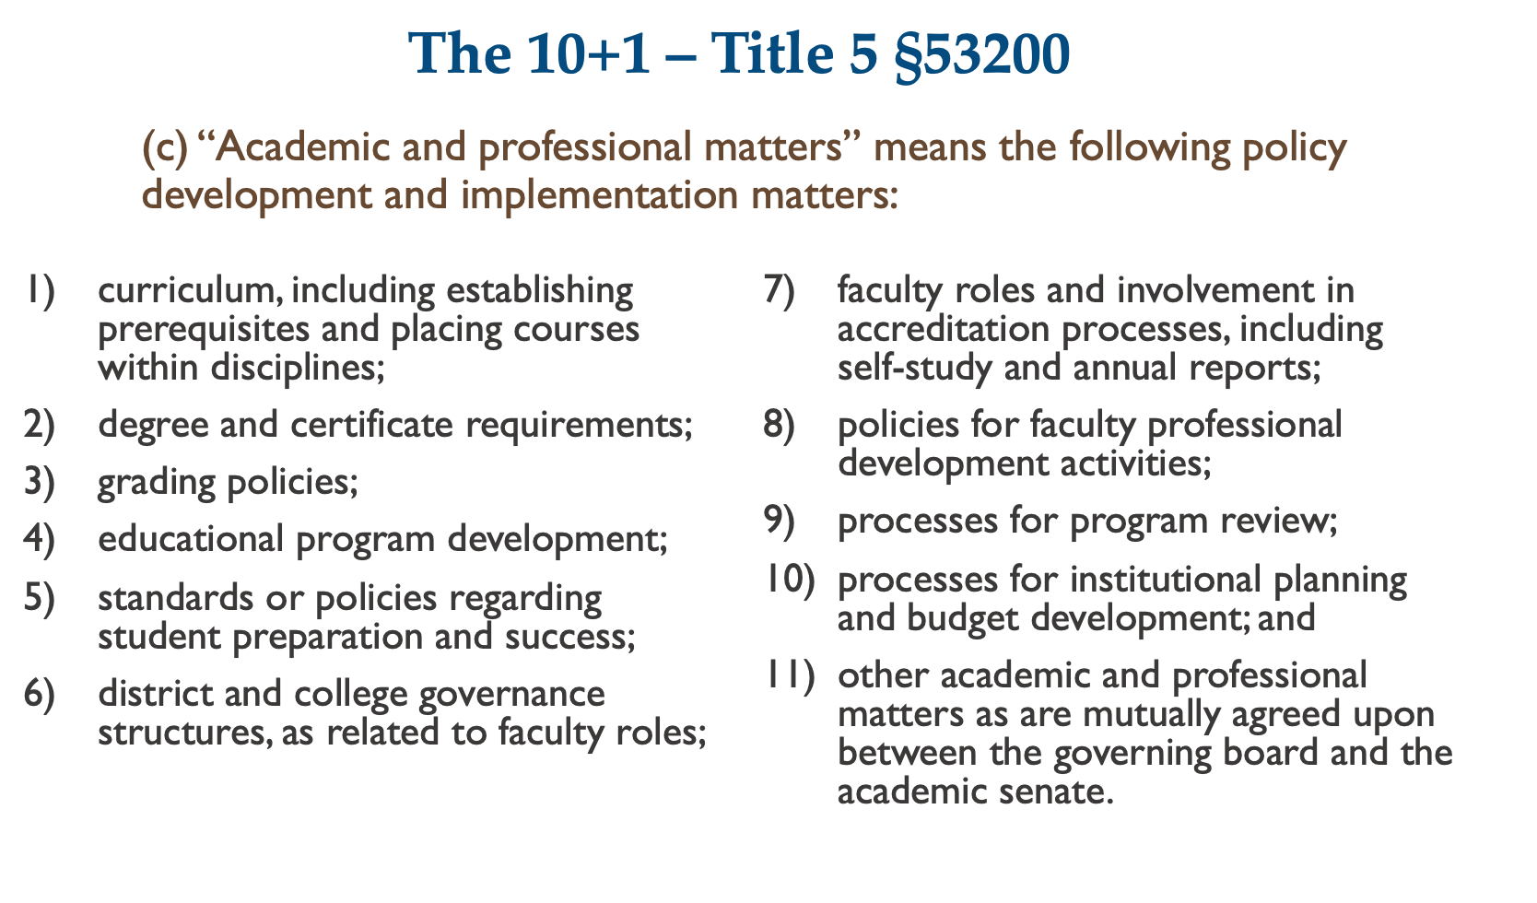
Notes:
Juan

Slide 10
The 10+1 – Title 5 §53200
d)“Consult collegially” means that the district governing board shall develop policies on academic and professional matters through either or both of the following methods, according to its own discretion:
relying primarily upon the advice and judgment of the academic senate; or
agreeing that the district governing board, or such representatives as it may designate, and the representatives of the academic senate shall have the obligation to reach mutual agreement by written resolution, regulation, or policy of the governing board effectuating such recommendations.
Notes:
Amber

Slide 11
Title 5 §53203 – Powers
Governing Board shall adopt policies delegating authority and responsibility to its Academic Senate and requires collegial consultation.
Policies in (a) shall be adopted through collegial consultation with the Academic Senate.
Guarantees the Academic Senate the right to meet with or appear before the board while in the process of consulting collegially.
Notes:
Manuel

Slide 12
Title 5 §53203 – Powers
d) The governing board of a district shall adopt procedures for responding to recommendations of the academic senate that incorporate the following:
in instances where the governing board elects to rely primarily upon the advice and judgment of the academic senate, the recommendations of the senate will normally be accepted, and only in exceptional circumstances and for compelling reasons will the recommendations not be accepted. If a recommendation is not accepted, the governing board or its designee, upon request of the academic senate, shall promptly communicate its reasons in writing to the academic senate.
Notes:
Juan

Slide 13
Title 5 §53203 – Powers
2) in instances where the governing board elects to provide for mutual agreement with the academic senate, and agreement has not been reached, existing policy shall remain in effect unless continuing with such policy exposes the district to legal liability or causes substantial fiscal hardship. In cases where there is no existing policy, or in cases where the exposure to legal liability or substantial fiscal hardship requires existing policy to be changed, the governing board may act, after a good faith effort to reach agreement, only for compelling legal, fiscal, or organizational reasons.
Notes:
Juan

Slide 14
Title 5 §53203 – Powers
e) An academic senate may assume such responsibilities and perform such functions as may be delegated to it by the governing board of the district pursuant to Subsection (a).
f) The appointment of faculty members to serve on college or district committees, task forces, or other groups dealing with academic and professional matters, shall be made, after consultation with the chief executive officer or his or her designee, by the academic senate. Notwithstanding this Subsection, the collective bargaining representative may seek to appoint faculty members to committees, task forces, or other groups.
Note: In f), this is NOT collegial consultation.
Notes:
Ginni

Slide 15
Other Areas which
Require Academic Senate Role
Equivalence to the minimum qualifications (Equivalency) - Ed Code §87359
Faculty hiring processes – Ed Code §87360
Administrative retreat to faculty (determining minimum qualifications areas) – Ed Code §87458
Establishment of the curriculum committee – Title 5 §55002
Notes:
Ginni

Slide 16
Effective Participation - Staff
Title 5 §51023.5 (a)
The governing board of a community college district shall adopt policies and procedures that provide district and college staff the opportunity to participate effectively in district and college governance.
Title 5 §51023.5 (a)(4)
Staff shall be provided with opportunities to participate in the formulation and development of district and college policies and procedures, and in those processes for jointly developing recommendations for action by the governing board, that the governing board reasonably determines, in consultation with staff, have or will have a significant effect on staff.
Notes:
Amber

Slide 17
Effective Participation - Students
Title 5 §51023.7 (a)
The governing board shall adopt policies and procedures that provide students the opportunity to participate effectively in district and college governance.
(b) For the purposes of this Section, district and college policies and procedures that have or will have a “significant effect on students” includes the following:
Notes:
Amber

Slide 18
Effective Participation - Student’s “9+1”
1.Grading policies
2.Codes of student conduct
3.Academic disciplinary policies
4.Curriculum development
5.Course/program initiation or elimination
6.Processes for institutional planning and budget development
7.Standards and policies regarding student preparation and success
8.Student services planning and development
9.Student fees
10.Any other district or college policy… that will have a significant effect on students
Notes:
Ginni

Slide 19
Promising Practices for Collegial Consultation and Effective Participation
Establish and agree upon Guiding Principles or Community Norms
Practice Forgiveness
Hear your colleagues and avoid a rush to Judgment
Remind yourselves of the Guiding Principles or Community Norms when/if conflict surfaces
Notes:
Ginni

Slide 20
Calling All Voices…
Based on the tenets of Inclusivity, Diversity, Equity, Anti-racism, and Accessibility (IDEAA) Consider the questions in governance spaces:
Who is missing?
Who isn’t participating? And why?
Is there space to share diverse viewpoints?
Notes:
Manuel

Slide 21
Let’s Talk!
Questions to Consider…
How can faculty in CTE and noncredit fields eliminate barriers to governance when they are so engaged with students?
What strategies does your campus use to ensure faculty in CTE and noncredit fields are engaged in college governance conversations?
Are these strategies codified in your local college governance structures?
Where are the gaps in your local college governance structures?
How does your local college support CTE and noncredit champions?
What made it possible for you to be here at this conference?
What about pay and minimum qualifications disparities on campuses? How does this affect faculty in CTE and noncredit fields?
Notes:
Juan

Slide 22
Thank You!
.
Notes:
Juan and Manuel - close the institute

