Slide 1
Curriculum Development for Noncredit and CTE Through an Equity Lens
Saturday, May 1, 2021
2:00 p.m. to 3:00 p.m.
Breakout Session 6

Slide 2
Presenters
Dr. M. Leonor Cadena, NOCCCD Diversity & Inclusion Faculty Fellow
mcadena@fullcoll.edu
Raine Hambly, NOCE Director Career Technical Education
rhambly@noce.edu
Dr. LaTonya Parker, ASCCC Equity and Diversity Action Chair
latonya.parker@mvc.edu
Dr. Kimberley H. Stiemke, ASCCC Noncredit & Basic Skills Committee
kstiemke@noce.edu

Slide 3
Session Description
Through an equity lens, participants will explore curriculum approaches that build student agency and address teachers' beliefs and mindsets in Noncredit and CTE courses.

Slide 4
Take Aways
Greater understanding of equity
Reflect on current practices
Spark conversation
Develop and advance DEIA and social justice in the classroom
DEIA - Diversity, Equity, Inclusion, and Anti-Racism

Slide 5

Icebreaker
What color is the dress?
Please type your response in the chat.

Slide 6

This is Equity
Share at least one take away, “aha moment”, from the video by writing it in the chat.

Slide 7
What is equity?
Equity is the fair treatment, access, opportunity, and advancement for all people, while at the same time striving to identify and eliminate barriers that have prevented the full participation of some groups.
Improving equity involves increasing justice and fairness within the procedures and processes of institutions or systems, as well as their distribution of resources.
Tackling equity issues requires an understanding of the root causes of outcome disparities within our society.
https://independentsector.org/resource/why-diversity-equity-and-inclusion-matter/

Slide 8
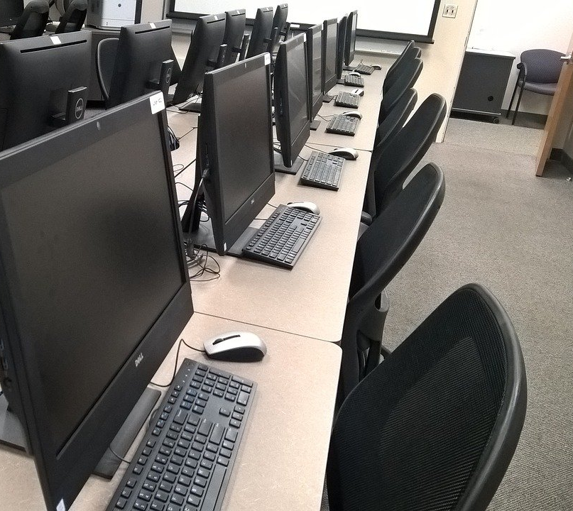
The District Scenario
The District has funds to purchase 100 new computers for student use to be split between College A and College B. College “A” and “B” have the same number of students, but College “A currently has 20 computers and College “B” currently has 60 computers.
What is an equal distribution of the 100 new computers?
What is an equitable distribution of the 100 new computers?

Slide 9
What is Equity-Mindedness?
The term refers to the perspective or mode of thinking exhibited by practitioners who call attention to patterns of inequity in student outcomes.
These practitioners are willing to take personal and institutional responsibility for the success of their students, and critically reassess their own practices.
It also requires that practitioners are race-conscious and aware of the social and historical context of exclusionary practices in American Higher Education
https://cue.usc.edu/about/equity/equity-mindedness/

Slide 10
Recognizing Obstacles to Equity-Mindedness
The English department chair at Anywhere College notices that a large number of African American & Latinx students who are placed in the departments basic skills English/Writing courses do not proceed to credit-level courses. She provides the data at a department meeting for discussion. One faculty member says. “This has nothing to do with race.” Other say, “I teach students. I don’t care whether they are white, black, or purple.” or “Maybe these students are not predisposed to doing well in English because their brains are not wired that way”
Identify the obstacle most relevant to this scenario
Claiming to Not See Race or Skirting Around Race
Not Being Able or Willing to Notice Racialized Consequences
The Pervasiveness of White Privilege & Institutionalized Racism
The Myth of Universalism
Seeing Racial Inequities as a Reflection of Academic Deficiency

Slide 11
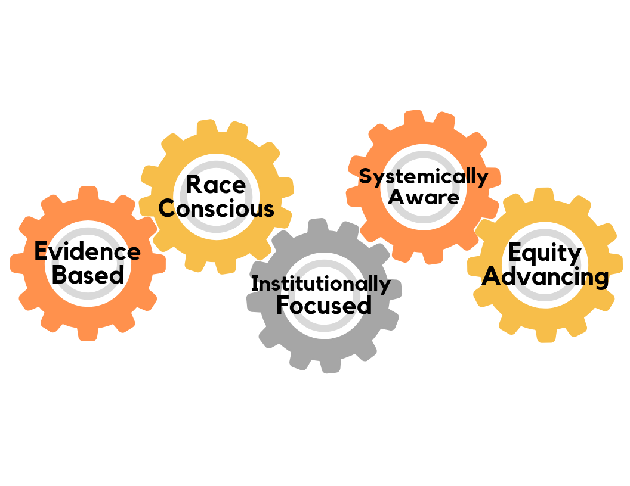
What does it mean to be an “equity-minded practitioner”?
Evaluate their practices for effectiveness
Recognize inequity as something they can control
Question their assumptions
Recognize stereotypes that hinder student success
Fix what is broken
Hold themselves accountable for student success
https://cue.usc.edu/about/equity/equity-mindedness/

Slide 12
How would an equity-minded practitioner approach this opportunity?
The English department chair at Anywhere College notices that a large number of African American & Latinx students who are placed in the departments basic skills English/Writing courses do not proceed to credit-level courses. She provides the data at a department meeting for discussion. One faculty member says. “This has nothing to do with race.” Other say, “I teach students. I don’t care whether they are white, black, or purple.” or “Maybe these students are not predisposed to doing well in English because their brains are not wired that way”

Slide 13
What Makes a Course Equity-Minded?
Equity is embedded in the course design from start to finish. It is reflected in every aspect of the course including but not limited to the title, description, learning outcomes, and theoretical perspective.
Incorporate the identities and lived experiences of students who have been disproportionately-impacted in education.
Prioritizes community and collaboration as opposed to competitiveness.
Students and instructors have opportunities to learn from each other.
A variety of strategies are used to assess student learning.
Adapted from the work of Frank Harris III

Slide 14
What Makes a Course Equity-Minded? (cont.)
A variety of pedagogies are used to address a range of learning strengths and styles.
Content is relevant and facilitates real-world problem-solving.
Relationship building, intentional outreach, validation, humanizing practices, and race consciousness are embedded in the course.
Critical resources are made available at the start of the course.
Course policies relating to grading, attendance, participation, required texts, and the submission of assignments do not disadvantage disproportionately impacted students.
Adapted from the work of Frank Harris III

Slide 15
Areas for Inquiry
Title
Course Description
Learning Outcomes
Assessments
Discipline
Grading
Resources
Theoretical Perspectives
Syllabus

Slide 16
Questions

Slide 17
Resources
https://independentsector.org/resource/why-diversity-equity-and-inclusion-matter/
https://cue.usc.edu/about/equity/equity-mindedness/

