Slide 1
Innovation and Leadership: Theory to Practice for Adult Educators

Slide 2
Innovation and Leadership:
Theory to Practice for
Adult Educators
CNEI 2021
Mitch Rosin, Strategist
P2C Solutions, LLC
Mitch.Rosin2@gmail.com
Emma Diaz, Ed.D.
Noncredit & Basic Skills Committee
San Bernardino Valley College
Ediaz@sbccd.edu
Based on the work of Clayton Christensen and Ed Catmull

Slide 3
How Many of You are Teachers?
How Many of You are Administrators?
How Many of You are Staff?
How Many of You are Something Else?
How Many of You are Unicorns?
Notes:
Goal: Get a sense of the audience, and adjust examples on slides to be relevant to the people in attendance.
- Set a light tone, even though the content of the presentation is theory-driven.

Slide 4
Noticing the unnoticed calls for a peripheral vision where innovators habitually surface new ideas by noticing things at the edge of experience.

Slide 5

High Cotton, Inc.
Doormat Label

Slide 6

Creativity is thinking of something new.
Innovation is the implementation of something new.
?
Turning an idea into a solution that adds value from a customer’s perspective
How is Innovation defined?
A process by which a product or service takes root initially in simple applications at the bottom of a market and then relentlessly moves up market, eventually displacing established competitors.
The introduction of new products and services that add value to the organization.
An innovation is a feasible relevant offering such as a product, service, process or experience with a viable business model that is perceived as new and is adopted by customers.

Slide 7
Education is a Business
Adult Education is an Economic Driver

Slide 8
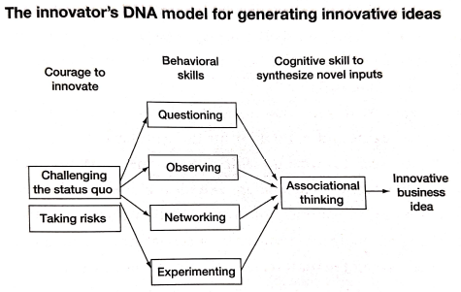

Slide 9
5 Skills of Disruptive Innovation
A.Q.O.N.E.

Slide 10
Skill #1 - Associating
The ability to make surprising connections across areas of knowledge, industries, and geographies.

Slide 11

Skill #1 - Associating
https://www.youtube.com/watch?v=K05lRdL9d4k

Slide 12
Force New Associations
The more random associations you can link to your work and other issues you are working to solve, the more ideas you will generate.
Unsolved Problem | Unrelated Random Item or Idea | Potential Associations
Need more CASAS proctors | Local college is looking for internship options for students | College students could be trained as proctors

Slide 13
Take on the Persona of a Different Agency
Dedicate a few minutes of a meeting to “disruption” and generate ideas of how other agencies do things.
  Healthcare services have Social Workers … Adult Education needs someone to navigate a complex industry and provide resources for students.

Slide 14
Generate Metaphors
Create a list of “What If” statements that link ideas
What If . . . | Possible New Feature or Benefit
My school developed a 100% Distance Learning policy? | We could reach remote sections of our service area.
Adult Education classes were offered on Saturday mornings? | Students who work Monday thru Friday could attend classes

Slide 15
Build Your Own Curiosity Box
Start a collection of odd things that can be used to generate ideas:
Slinky = Spiraling of Curriculum
Lego = Building new pathways or programs
Puzzles = Connect new ideas

Slide 16
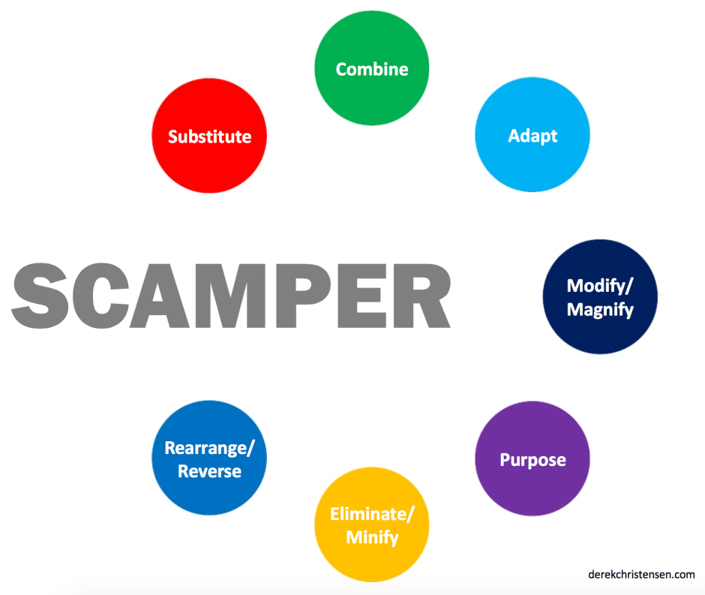
SCAMPER!
Substitute
Combine
Adapt
Magnify/Minimize/Modify
Put to other uses
Eliminate
Reverse/Rearrange

Slide 17
If SCAMPER is too much . . .
Think about SAMR

Slide 18

Models of Implementation

Slide 19
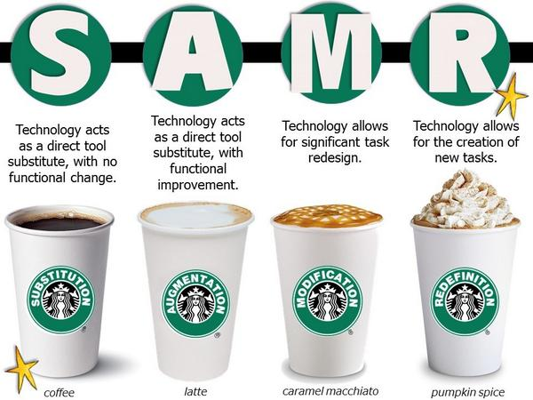
SAMR Model
Models of Implementation

Slide 20
SAMR Model
Models of Implementation
Substitution: Same Task, New Technology
At the Substitution Level, you are substituting a cup of coffee that we could make at home or school with a cup of coffee from Starbucks. It’s still coffee: there’s no real change.
  Reading a book on the iPad would be considered substitution, as you are simply substituting a handheld book for a digital book.
  Taking notes or writing an essay using Google Docs or Evernote instead of using paper and pencil are other examples of substitution.
Although these activities engage students and enhance learning, the level of tech integration is low: teachers are just substituting technology for things you could do without technology.
https://www.edsurge.com/n/2015-02-06-a-guide-for-bringing-the-samr-model-to-ipads

Slide 21
SAMR Model
Models of Implementation
Augmentation: Improve the Task with New Features
At the Augmentation Level, you are taking regular coffee and making it better by adding ice, or a little cinnamon on top. We didn’t change the coffee, but it tastes better because we augmented and enhanced it with additional ingredients.
  With a digital book, students can click on a word and get a definition, synonym, or a link that may take them to more information about that subject area.
  While writing, students can highlight a word, spellcheck, customize and format font.
  Skitch/Evernote or PicCollage are apps that allow you to augment learning by annotating images. Students can find objects in the classroom, take pictures, then label their work, whether it be math, word work, or science.
  Using a Video App students could complete a fluency boot camp, where they would record themselves reading a passage, and play it back checking for fluency and expression.
Although these examples enhance learning, the tasks do not change.
https://www.edsurge.com/n/2015-02-06-a-guide-for-bringing-the-samr-model-to-ipads

Slide 22
SAMR Model
Models of Implementation
Modification: Changing the Task
At the Modification Level, we add some bells and whistles to the augmented coffee. We add a little whipped cream, caramel, and some special flavoring, and we now have a salted caramel mocha with a fancy design.
  At this level, technology allows for significant task redesign, like collaborating in real-time using Google Drive.
  Students are motivated to write for their peers and engage with a global network.
  To use technology to modify learning, we add multimedia through video, sound and audio.
  Students could create a soundtrack in Garageband for a multimedia presentation.
  Students could use iMovie App to create iMovie Book Trailers, or digital stories using the Videolicious App.
Modification involves changing the task, and personalizing the project.
https://www.edsurge.com/n/2015-02-06-a-guide-for-bringing-the-samr-model-to-ipads

Slide 23
SAMR Model
Models of Implementation
Redefinition: A Whole New Task
Finally, at the Redefinition Level, we are ordering a pumpkin spice latte, redefining a regular cup of coffee to something you can only get at Starbucks. We are completing a task that cannot be done without the use of technology. This is the same as higher order thinking levels in Bloom’s Taxonomy like analyzing, creating, and evaluation.
The students are researching, sharing, collaborating, and connecting with not only their classrooms but with classrooms around the world.
They are generating questions, and exploring topics and content using current technologies.
Teachers are using virtual book club discussions through Hangouts, taking Virtual Field Trips to the White House, or talking with experts in the field via Google Connected Classrooms.
Students are developing mapping, critical thinking, and problem solving skills through Mystery Skypes, completing collaborative writing through Google Docs, and connecting to the world through social media like Twitter.
Students are using iBook Author, or Storybook Maker to create their own digital books are more ways students can reach redefinition levels.
https://www.edsurge.com/n/2015-02-06-a-guide-for-bringing-the-samr-model-to-ipads

Slide 24
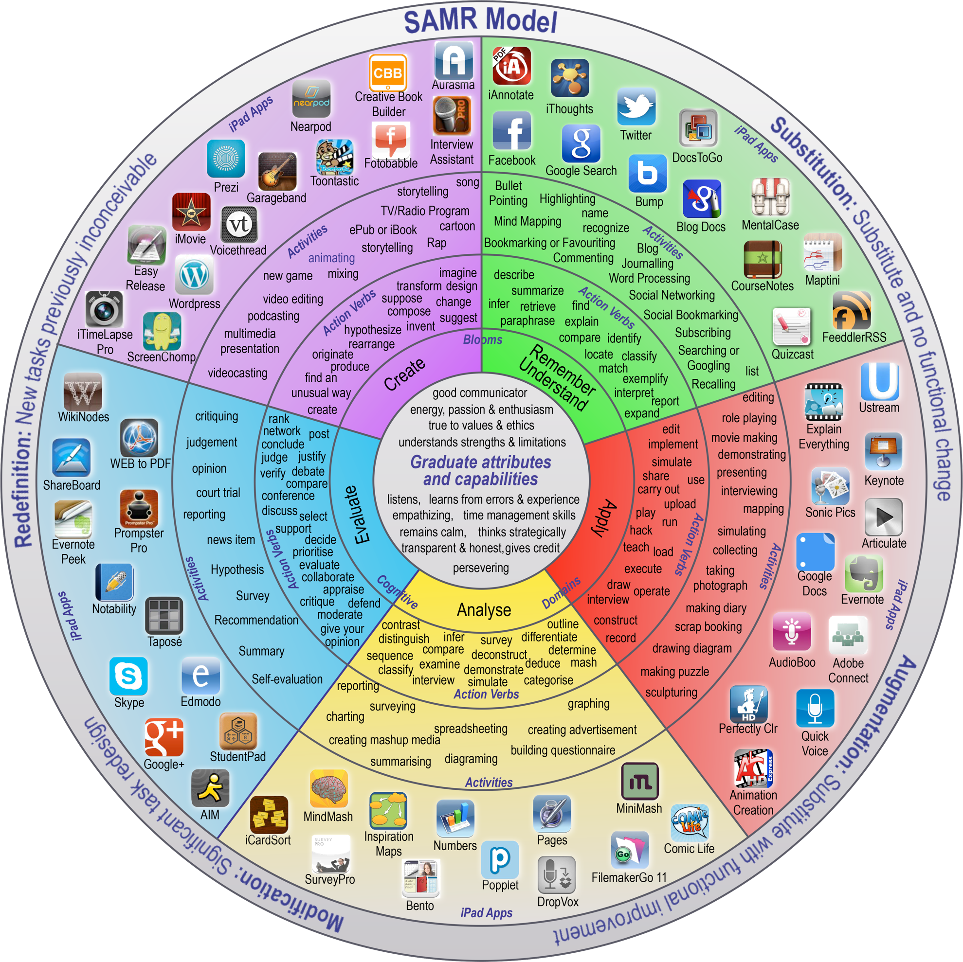
SAMR Model
Models of Implementation
https://www.edsurge.com/n/2015-02-06-a-guide-for-bringing-the-samr-model-to-ipads

Slide 25
Skill #2 - Questioning
Asking a lot of questions is the key to generating powerful solutions to problems.

Slide 26

Skill #2 - Questioning
https://www.youtube.com/watch?v=cOTEzb0GzLs

Slide 27

Ask “What Is” Questions
What is our goal?
What is our expected outcome?
What is accomplished if we . . .
What is most important?
What is the real problem?
What is the cause of . . .
What is . . .

Slide 28
Ask “What Caused” Questions
What caused our lower ABE enrollment?
What caused reduced CASAS outcomes?
What caused CNA students to drop out?
What caused . . .

Slide 29
Ask “Why” and “Why Not” Questions
Question the Norm:
- Why do we open at 2pm?
Why not open earlier?
- Why do we only offer CASAS testing on Tuesdays?
Why not offer testing on multiple days?

Slide 30
Ask “What If” Questions
What if our school had a full-time transition counselor?
What if we offered more blended learning opportunities?
What if we partnered with a local employer to offer on-site classes?
What if we could reach every single person who needed adult ed?
What if we lost all our funding? How would we stay open?

Slide 31

Engage is Question Storming
Dedicate time during a meeting to generate random questions about 1 aspect of your program.
Generate at least 50 questions about the topic.
Everyone should contribute at least one question.
Prioritize the list, and discuss possible solutions.

Slide 32
Cultivate Question Thinking
Generate 3 statements about your agency.
Turn the statements into questions.
Discuss solutions to the questions.
Example:
S: We have the best CNA program in the region.
Q: What would we do if our CNA program lost students?

Slide 33
Track Your Q/A Ratio
You should be asking more questions than finding answers!
Thomas Edison famously said, “I have not failed. I've just found 10,000 ways that won't work.”

Slide 34
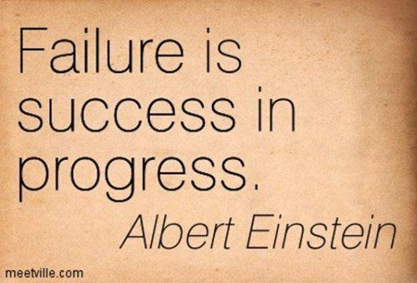

Slide 35
Keep a Question-Centered Notebook
What are your question patterns? What kinds of questions do you ask the most?
What questions yield unexpected insights into the way things are?
How often do your questions challenge the status quo?
Do your questions generate an emotional response?

Slide 36
Skill #3 - Observing
Connect common threads across unconnected data.

Slide 37

Skill #3 - Observing
https://www.youtube.com/watch?v=CKaI6swfrFY

Slide 38

Look for “Vuja De”
The opposite of Deja Vu
A sense of seeing something for the first time, even if you have actually seen it many times!

Slide 39
Observe Your Customers
First, however, identify your customers! Are they students? Teachers? Administrators? Community Stakeholders? Employers? Or all of them!
How do your customers become aware of your services?
What benefit do your customers expect?
What is the most important feature your customer expects?
How do your customers interact with your service?
How can you streamline your service to meet your customers’ needs?
What frustrates your customer?

Slide 40
Observe Your Competitors
Visit other agencies in your community.
Look at:
- How they address customer needs
- How they are different
- How they challenge the norms
- How they succeed in ways your agency doesn’t

Slide 41
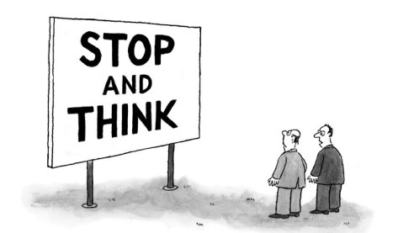
Observe Whatever Makes you Think
Really bad ideas often lead to really good ones!

Slide 42

Observe with All Your Senses
We often observe with our eyes . . . Don’t forget to use your other senses also!

Slide 43
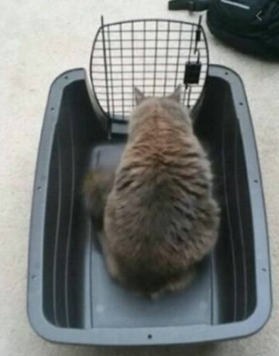
If you focus too much on the problem, you might miss the answer.

Slide 44
Skill #4 - Networking
Link the ideas in your area of knowledge with those of others who play in different boxes . . .
outside your sphere.

Slide 45
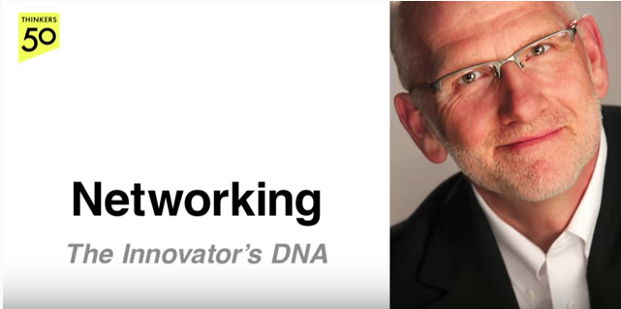
Skill #4 - Networking
https://www.youtube.com/watch?v=S23Y_3UwAB4

Slide 46
Expand the Diversity of Your Network
People connected to groups beyond their own can expect to find themselves delivering valuable ideas.
Build a bridge into a different area of knowledge.
Interact with people who you normally don’t interact with.

Slide 47

Start a “Mealtime Networking” Plan
NAWB holds regular “consultant guild” lunch calls, where consultants from around the country share “the buzz” with each other.

Slide 48
Plan to Attend at Least 2 Conferences Next Year
Find local meetings that are “Venn To You” . . .

Slide 49

Start a Creative Community
Educators call this PLCs (Professional Learning Circles), but you can expand beyond your own profession.

Slide 50
Invite an Outsider
Invite people outside your agency to join staff meetings, and present on their needs, pain points, and stressors of their industry.
Then Question Storm!

Slide 51
Cross-Train with Experts
Don’t be afraid to learn what you don’t know!
Every community has experts who are willing to share their knowledge:
- Workforce Boards
- Library Literacy Programs
- Economic Development Boards
- Chambers of Commerce
- Unions
- You tell us!

Slide 52
Skill #5 - Experimenting
Actively try out new ideas by creating prototypes and launching pilot tests.

Slide 53
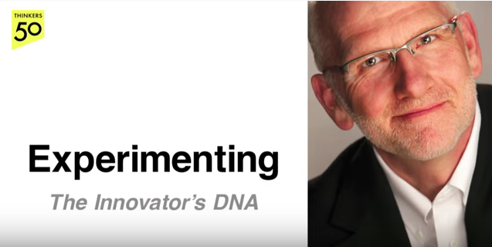
Skill #5 - Experimenting
https://www.youtube.com/watch?v=l41pEGDdzx8

Slide 54
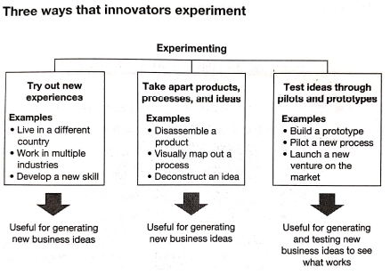

Slide 55
Cross Physical Borders
Diversity of experience leads to divergent thinking.
Visit agencies in areas where you normally don’t go.
Attend conferences in cities that are new to you.
Experience cultures that stretch your mind.

Slide 56
Cross Intellectual Borders
Join list serves that provide new and different ideas in adjoining markets.
Read about your profession in publications from other countries. What do Adult Education teachers focus on in South Africa? Korea?

Slide 57
Develop a New Skill
We spend our days coaching our students to develop new skills that will allow them to be successful in their academic and career pathways. Do we do the same?
Get your Microsoft Office Suite certification!
Get your Google certification!

Slide 58
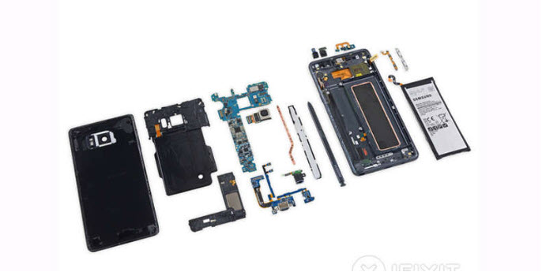
Disassemble (or Deconstruct) a Product
Please hold . . . More on this in the next section!

Slide 59

Build Prototypes
Please hold . . . More on this in the next section!

Slide 60

Regularly Pilot New Ideas
Please hold . . . More on this in the next section!

Slide 61

Go Trend Spotting
Actively seek out information on new ideas in Adult Education
- LINCS
- COABE Journal
- TESOL
- CWA
- NAWB
- AAACE

Slide 62
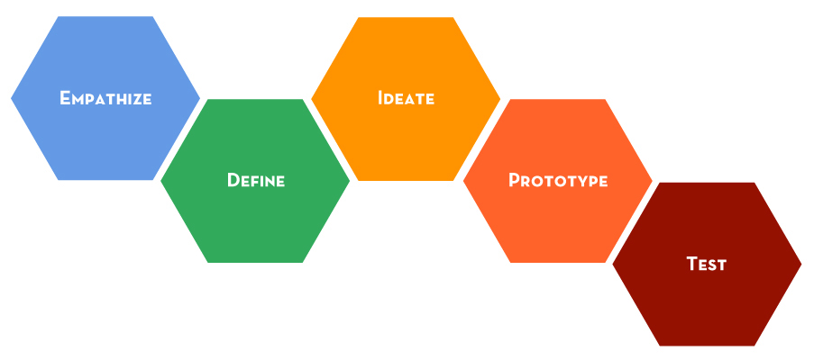
Customer (Human)-Centered Design
WIOA: Customer-Centered Design

Slide 63
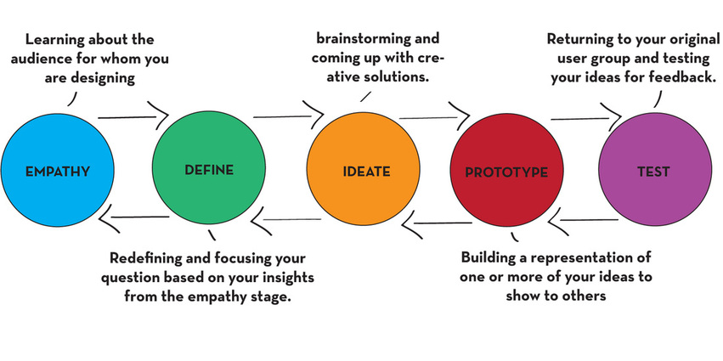
Customer-Centered Design
WIOA: Customer-Centered Design

Slide 64
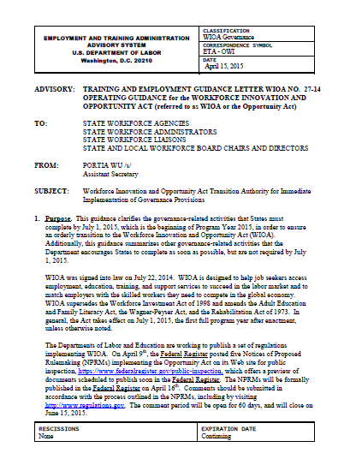
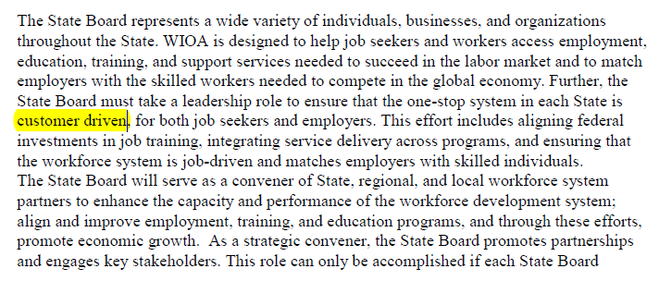
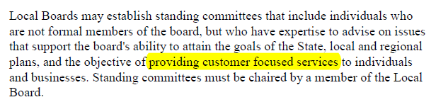
What’s a TEGL?
WIOA: Customer-Centered Design

Slide 65
WIOA: Customer-Centered Design
Customer-Centered Design
Human-centered design is a creative approach to problem solving and the backbone of work at www.IDEO.org.
It's a process that starts with the people you're designing for and ends with new solutions that are tailor made to suit their needs.

Slide 66
WIOA: Customer-Centered Design
Customer-Centered Design
Ask The Right Questions
Most people ask the wrong questions. Questions need to be customer-centered:
“How can we help busy families access our services?”
“How can we reduce frustration during the intake process?”
www.wired.com/2013/12/human-centered-design-matters/

Slide 67
WIOA: Customer-Centered Design
Customer-Centered Design
Get Out From Behind Your Desk
To stay innovative you need to stay inspired. Despite the plethora of information available behind the comfortable confines of your computer screen, you risk mental stagnation when you fall into predictable routines.
Get out into the world and into the contexts that people are using your services– you’ll be surprised how quickly unexpected opportunities are revealed.
www.wired.com/2013/12/human-centered-design-matters/

Slide 68
WIOA: Customer-Centered Design
Customer-Centered Design
Make User Feedback Routine
We are all under pressure. BUT, there’s no substitute for the nuance and depth of insight that can come from an in-person conversation.
It doesn’t have to be a formal or lengthy process.
Ask participants to verbalize their thought process as they use it. Try not to correct the participant or defend your prototype and answer their questions with questions.
www.wired.com/2013/12/human-centered-design-matters/

Slide 69
WIOA: Customer-Centered Design
Customer-Centered Design
Think of Design as a Team Sport
Force yourself to articulate your ideas to someone else in words or sketches, you are inadvertently advancing your thinking.
Collaboration inevitably bring different frames of reference and fresh thinking to the problem, which the work.
It’s important to cultivate a shared ownership of ideas. When a new idea arises, it’s the team’s idea, not an individual’s.
Simple shifts in language go a long way — use inclusive language like “we” and “our” rather then “my” and “mine.”
www.wired.com/2013/12/human-centered-design-matters/

Slide 70
WIOA: Customer-Centered Design
Customer-Centered Design
Build Minimum Viable Prototypes
The concept of the minimum viable product (MVP) has become near doctrine in the startup world.
Before you launch your MVP, think about what prototypes you can create cheaply to address your biggest assumptions.
Then test, iterate, test again and repeat.
www.wired.com/2013/12/human-centered-design-matters/

Slide 71
WIOA: Customer-Centered Design
Customer-Centered Design
Customer-Centered Design Consists of Three Phases
Inspiration Phase: Learn directly from the people you’re designing for as you immerse yourself in their lives and come to deeply understand their needs.
Ideation Phase: Make sense of what you learned, identify opportunities for design, and prototype possible solutions.
Implementation Phase: Bring your solution to life. And you’ll know that your solution will be a success because you’ve kept the very people you’re looking to serve at the heart of the process.
www.designkit.org/human-centered-design

Slide 72
WIOA: Customer-Centered Design
Customer-Centered Design
Customer-centered design is a creative approach to problem solving. It’s a process that starts with the people you’re designing for and ends with new solutions that are tailor made to suit their needs.
Customer-centered design is all about:
  building a deep empathy with the people you’re designing for;
  generating tons of ideas;
  building a bunch of prototypes;
  sharing what you’ve made with the people you’re designing for;
  and eventually putting your innovative new solution out in the world.
“You have to feed forward if you want feedback.” – Matt Kahn
www.designkit.org/human-centered-design

Slide 73
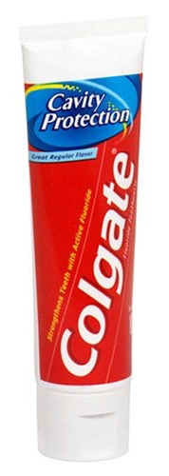


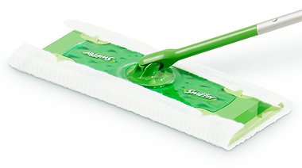


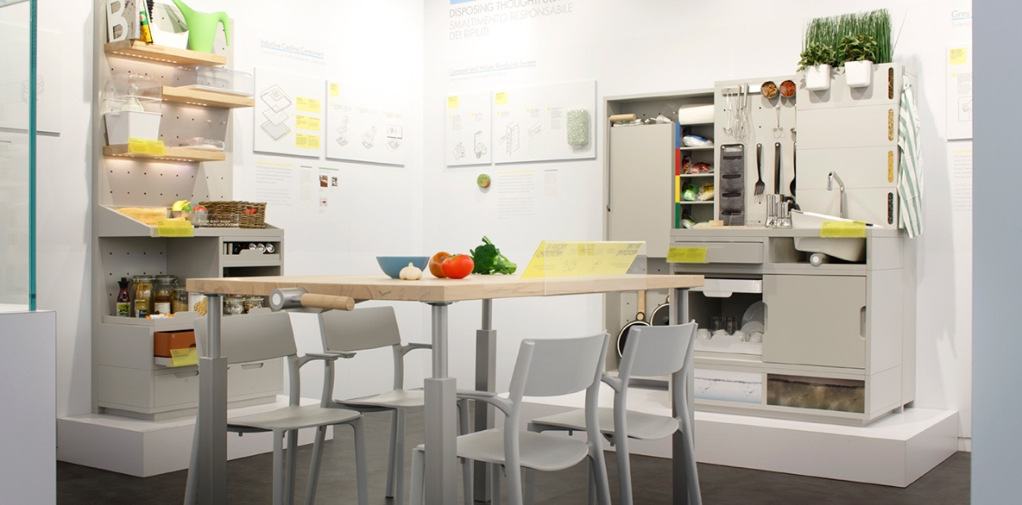
WIOA: Customer-Centered Design
Examples of Customer-Design
Swiffer
Tempur-Pedic
NBC’s Today Show
IKEA’s 2025 Kitchen
Apple’s First Mouse
Stand-Up Toothpaste Tube
Bank of America: Keep the Change

Slide 74
So . . .
What does all of this have to do with INNOVATION??

Slide 75
Follow this logic:

Slide 76
Mistakes aren’t a necessary evil; they are an inevitable consequence of doing something new.

Slide 77
Failure is a manifestation of learning and exploration and should be used as an agent of learning; not as a weapon.

Slide 78
Requirements, however, often make failure impossible, as job pressure focuses on all things being controlled, and for people being in control.

Slide 79
Fear of failure makes people reach for certainty and stability; trust is an antidote to fear . . .
But the unpredictable is the ground upon which creativity occurs.

Slide 80
Unpredictable scenarios are not stored in our brain, which searches for patterns in sights, sounds, interactions and events. . . Unpredictable is a concept that defies categorization by the brain.

Slide 81


Jungle vs Manicure

Slide 82
Example:
If a cat jumps onto a hot stove, the cat will never jump on the stove again . . . Even if it is cold.

Slide 83
The past should be our teacher, not our master. We need to break the schema of our brains that prefers a pattern of success and predictability, rather than one of failure and unpredictability.

Slide 84
So . . .
If we want to be innovative, we need to accept failure and unpredictability as natural steps to success.

Slide 85
Leadership Skills to Practice

Slide 86
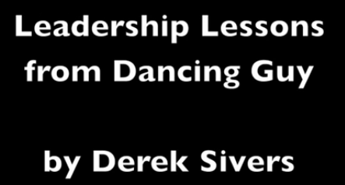
Click Here!

Slide 87
Leadership Styles

Slide 88
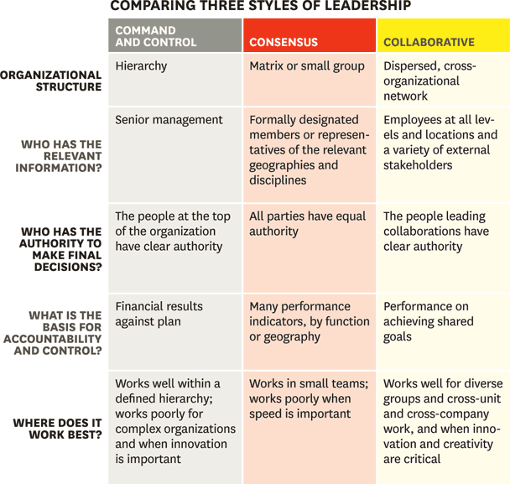

Slide 89
Command and Control
Organizational Structure: Hierarchy
Who Has the Relevant Information: Senior Management
Who Has the Authority to Make Final Decisions: The people at the top
What is the Basis for Accountability: Financial results against the plan
Where Does it Work Best: Works best within a defined hierarchy; Works poorly for complex organizations and when innovation is important

Slide 90
Consensus
Organizational Structure: Matrix or Small Group
Who Has the Relevant Information: Formally designated members or representatives of the relevant geographies and disciplines
Who Has the Authority to Make Final Decisions: All parties have equal authority
What is the Basis for Accountability: Many performance indicators, by function or geography
Where Does it Work Best: Works in small teams; works poorly when speed is important

Slide 91
Collaborative
Organizational Structure: Dispersed, cross-organizational network
Who Has the Relevant Information: Employees at all levels and locations and a variety of external stakeholders
Who Has the Authority to Make Final Decisions: The people leading collaborations have clear authority
What is the Basis for Accountability: Performance on achieving shared goals
Where Does it Work Best: Works well for diverse groups and cross-unit work and when innovation and creativity are critical

Slide 92
What kind of teacher are you?
How does Leadership
relate to Teaching?

Slide 93
TEACHING (Leadership) STYLES

Slide 94
How do YOU teach?

Slide 95
“Sage on the Stage” or “Guide on the Side”?

Slide 96
How do YOU teach?
Formal Authority
Expert
Demonstrator / Personal Model
Facilitator
Delegator

Slide 97
Formal Authority
Focus on content. This style is generally teacher-centered, ”sage on the stage" model, where the teacher feels responsible for providing and controlling the flow of the content and the student is expected to receive the content.
Instructors: "I am the flashlight for my students; I illuminate the content and materials so that my students can see the importance of the material and appreciate the discipline.”
Teachers with this style are not as concerned with building relationships with their students nor is it as important that their students form relationships with other students. This type of teacher doesn't usually require much student participation in class.
Advantage: Focus on clear expectations and acceptable ways of doing things.
Disadvantage: A strong investment in this style can lead to rigid, standardized, and less flexible ways of managing learners and their concerns.
http://old.biz.colostate.edu/mti/tips/pages/WhatisYourTeachingStyle.aspx

Slide 98
Expert
Similar to a demonstrator where experts share knowledge and demonstrate their expertise. But, the instructor also advises students and provides feedback to improve understanding and promote learning.
Instructor strives to maintain status as an expert among students by displaying detailed knowledge and by challenging students to enhance their competence.
Instructors are concerned with transmitting information and insuring that students are well prepared.
Advantage: Knowledge and skills are thoroughly conveyed; commands respect.
Disadvantage: Instructor’s heavy display of knowledge can be intimidating to less experienced students; may not always show the underlying thought processes.
http://old.biz.colostate.edu/mti/tips/pages/WhatisYourTeachingStyle.aspx

Slide 99
Demonstrator / Personal Model
Instructors tend to run teacher-centered classes with an emphasis on demonstration and modeling. Instructor acts as a role model by demonstrating skills and processes and then as a coach/guide in helping students develop and apply these skills and knowledge.
Instructor: "I show my students how to properly do a task or work through a problem and then I'll help them master the task or problem solution. It's important that my students can independently solve similar problems by using and adapting demonstrated methods.”
Instructors encourage student participation and adapt their presentation to include various learning styles. Students are expected to take some responsibility for learning what they need to know and for asking for help when they don't understand something.
Advantages: Emphasizes direct observation; provides an effective example to follow.
Disadvantage: Some instructors may be rigid and discourage a personalized approach; may lead to frustration if learners cannot complete the tasks as effectively as the teacher.
http://old.biz.colostate.edu/mti/tips/pages/WhatisYourTeachingStyle.aspx

Slide 100
Facilitator
Instructors tend to focus on activities. This style emphasizes student-centered learning and much more responsibility is placed on the students to take the initiative for meeting the demands of various learning tasks.
Works best for learners who are comfortable with independent learning and who can actively participate and collaborate with other students.
Instructors design group activities which necessitate active learning, student-to-student collaboration and problem solving. Learning situations and activities are designed that require student processing and application of course content in creative and original ways.
Advantages: Focus on students' specific needs and goals; provides options or alternatives for students; encourages higher-level teaching skills.
Disadvantage: Time consuming (less material can be covered), unpredictable (instructor must be flexible).
http://old.biz.colostate.edu/mti/tips/pages/WhatisYourTeachingStyle.aspx

Slide 101
Delegator
Instructors tend to place much control and responsibility for learning on individuals or groups of students.
Instructors often give students a choice designing and implementing their own complex learning projects and will act in a consultative role.
Learners often asked to work independently or in groups and must be able to maintain motivation and focus for complex projects. Students working in this type of setting learn more than just course specific topics as they also must be able to effectively work in group situations and manage various interpersonal roles.
Advantage: Helps students to perceive themselves as independent learners.
Disadvantage: May misread student's readiness for independent work. Some students may become anxious when given autonomy.
http://old.biz.colostate.edu/mti/tips/pages/WhatisYourTeachingStyle.aspx

Slide 102
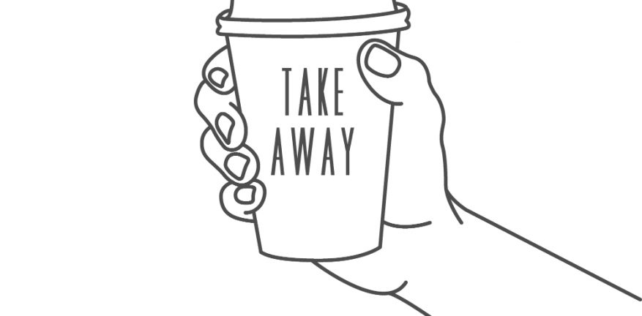
Key Takeaways
What can YOU do Tomorrow?

Slide 103
Questions

