Slide 1
Pre-Institute Session: How to Hire the Best Qualified Industry Experts for Your Classrooms April 30, 2021 9:00-11:00 am 2021 Career Noncredit Education Institute
Notes:
Mayra (2min) Slides 1-2
Lynn describes the taskforce and areas of recommendations
Mayra & Karen Role:
Monitor the Chat in Pathable (maybe in Zoom) Questions and comments in the Pathable Chat
Monitor the “Raise Hand” feature

Slide 2
Our Esteemed Team
CHERYL ASCHENBACH, ASCCC SECRETARY KAREN CHOW, ASCCC NONCREDIT & BASIC SKILLS COMMITTEE CHAIR MAYRA CRUZ, ASCCC CTE LEADERSHIP COMMITTEE CHAIR DR. LYNN SHAW, ASCCC CTE CURRICULUM DIRECTOR ROBERT CABRAL, MOORPARK COLLEGE, INTERIM DEAN BILL ELARTON-SELIG, LOS ANGELES TRADE TECHNICAL COLLEGE, Construction, Maintenance and Utilities Faculty KEVIN CORSE, OXNARD COLLEGE, Auto Technology Faculty
Notes:
Presenters introduce themselves.

Slide 3
25 Strong Workforce Recommendations Adopted by the Board of Governors in Fall 2015
Student Success
Career Pathways
Workforce Data & Outcomes
Curriculum
CTE Faculty
Regional Coordination
Funding
Notes:
Lynn slides 3-6 (3min)
describes the taskforce and areas of recommendations Lynn describes the taskforce and areas of recommendations describes recommendation 13

Slide 4
“Increase the pool of qualified CTE instructors by addressing CTE faculty recruitment and hiring practices.”
Clarify legislative and regulatory barriers to hiring CTE instructors who may not meet existing college hiring standards, but possess significant industry experience.
Disseminate effective practices in the recruitment and hiring of diverse faculty and the application of minimum qualifications and equivalencies.
Develop pipelines to recruit community college faculty with industry expertise through collaborations with higher education, business, and industry professional organizations.
Establish a mentorship model that delineates pathways for industry professionals to intern at colleges to gain teaching skills, knowledge, and experience while pursuing an associate degree or an equivalent.”
Notes:
Lynn gives history of the Workgroup

Slide 5
Chancellor’s Office CTE Minimum Qualifications Work Group
Academic Senate
Chief Instructional Officers
College Presidents
Human Resources
California Community College Chancellor’s Office
Notes:
Lynn

Slide 6
Does your program have challenges hiring CTE faculty?
Comments in a Chancellor’s Office Survey (43 Colleges)
Recognize the abilities people have who are eminent or nationally recognized experts in their field, without an Associate Degree.
“The need to revise the equivalency evaluation process for industry experts that do not have an AA/AS degree is extreme.”
Very small pool of applicants, often far less than 10, as opposed to general education areas that get 100’s of applicants.
Not understanding their CTE colleagues issues and programs.
Many comment on the irony of college preparing people for work, yet we didn’t accept industry credentials (the very place we are sending students to work) as equivalent to an Associate Degree.
Mismatch between what colleges require and what the industry actually needs and wants. Colleges are preparing people for jobs in industries that sponsor the industry credentials yet the college does not accept the industry experts as instructors with the industry credentials.
“Boils down to this- Experience should be the most important factor in any CTE discipline.”
The CTE faculty find it nearly impossible to hire industry experts
Notes:
Lynn

Slide 7
Need for an Equivalency Resource
Colleges and districts are struggling with consistent
application of equivalency.
Most difficulties surround equivalence to the
associate’s degree, particularly to the general education component.
Notes:
Cheryl

Slide 8
CTE Minimum Qualifications Tool Kit
Equivalency
Faculty Internship
Apprenticeship Minimum Qualifications
Notes:
Cheryl (2min)

Slide 9
CTE Faculty Minimum Qualifications Tool Kit Sample Contents
Pre-planning checklist for Equivalency by Department
Equivalency Checklist for Human Resources Departments
Model Equivalency Committees Composition and Policies
Information and Checklist for Potential Equivalency Applicants
Credit for Prior Learning
Notes:
Cheryl

Slide 10
Diversity Equity and Inclusion (DEI) Statewide Work
BOG established accountability body to implement
68 DEI recommendations (January 2020)
Released legislative report (February 2020)
First meeting of the DEI Implementation Workgroup (March 2020)
Launched review of the CCC Registry (June 2020)
Call to Action connecting DEI and anti-racism to curriculum & campus climate (June 2020)
Legal Opinion to include students in hiring processes (August 2020)
Launch DEI glossary and professional development calendar (September 2020)
Notes:
Mayra Slides 10-12 (3min)
System focusand the movement
Reducing barriers to diverse faculty
Collaboration and partnership
Title 5 51201
•(a) With the goal of ensuring the equal educational opportunity of all students, the California Community Colleges embrace diversity among students, faculty, staff and the communities we serve as an integral part of our history, a recognition of the complexity of our present state, and a call to action for a better future.
•(b) Embracing diversity means that we must intentionally practice acceptance, anti-racism, and respect towards one another and understand that racism, discrimination, and prejudices create and sustain privileges for some while creating and sustaining disadvantages for others.
•(c) In order to embrace diversity, we also acknowledge that institutional racism, discrimination, and biases exist and that our goal is to eradicate these from our system. Our commitment to diversity requires that we strive to eliminate those barriers to equity and that we act deliberately to create a safe, inclusive, and anti-racist environment where individual and group differences are valued and leveraged for our growth and understanding as an educational community.
•(d) To advance our goals of diversity, equity, inclusion, and social justice for the success of students and employees, we must honor that each individual is unique and that our individual differences contribute to the ability of the colleges to prepare students on their educational journeys. This requires that we develop and implement policies and procedures, encourage individual and systemic change, continually reflect on our efforts, and hold ourselves accountable for the results of our efforts in accomplishing our goals. In service of these goals, the California Community Colleges are committed to fostering an anti-racist environment that offers equal opportunity for all.
•(e) As a collective community of individual colleges, we are invested in cultivating and maintaining a climate where equity, anti-racism, and mutual respect are both intrinsic and explicit by valuing individuals and groups from all backgrounds, demographics, and experiences. Individual and group differences can include, but are not limited to the following dimensions: race, ethnicity, national origin or ancestry, citizenship, immigration status, sex, gender, sexual orientation, physical or mental disability, medical condition, genetic information, marital status, registered domestic partner status, age, political beliefs, religion, creed, military or veteran status, socioeconomic status, and any other basis protected by federal, state or local law or ordinance or regulation.

Slide 11
Diversity Equity and Inclusion (DEI) Statewide Work
Update Title 5 regulations to adopt a system DEI Statement (September 2020) Adopt DEI Awareness Month to celebrate and protect DEI champions (September 2020)
Guidance memo on equivalency processes (December 2020)
Guidance memo on Minimum Qualifications and Hiring Process for faculty (March 2021)
Completed DEI Integration Plan Recommendations (March 2021)
ACHRO: Diversifying hiring and screening committees with members of diverse educational background, gender, and ethnicity.
CCCT: Adopt a diversity statement as part of each college/district’s mission statement.
Integrating DEI into organization’s awards letter
New EEO plan regulations, template and allocation formula (First reading May 2021)
EEO Best Practices Handbook (June 2021)
Notes:
Mayra

Slide 12
ASCCC Commitment to Faculty Diversification
Revised the ASCCC Inclusivity Statement
Created the CTE Faculty Minimum Qualifications Toolkit
Created the Model Hiring Principles and Procedures Canvas site
Papers, numerous articles and resolutions
Notes:
Mayra
Prepare a reference handout. Hyper link the resources

Slide 13
Common CTE Minimum Qualifications
Three categories of Minimum Qualifications (MQ Handbook):
Disciplines Requiring a Master’s Degree
Disciplines Requiring a Specific Bachelor’s or Associate Degree and Professional Experience
Specific AA + 6 years professional experience
Specific BA + 2 years professional experience
Disciplines Requiring Any Degree and Professional Experience
AA + 6 years professional experience
BA + 2 years professional experience
MQs for Noncredit and Credit
Notes:
Cheryl (5-6min) Slides 13-15

Slide 14
Minimum Qualifications & Equivalency Defined
Education Code §87359 and §87360
“Individuals who do not possess the minimum qualifications for service may be hired as faculty members if they possess “qualifications that are at least equivalent to the minimum qualifications.”
The Disciplines List
Board of Governors’ adopted list of minimum qualifications for hiring faculty, uses the term “equivalency” to describe processes to support this regulation.
A district may hire a person who possesses qualifications different from, but equivalent to, those listed on the disciplines list, according to criteria and procedures agreed upon by the governing board and the academic senate (Title 5 §53430).
Equivalency philosophies and processes vary significantly between colleges and districts.
Notes:
Cheryl
Education Code §87355
“…every person authorized to serve as a community college instructor, librarian, counselor...shall be deemed to possess the minimum qualifications specified for every discipline...”

Slide 15
ASCCC Basic Principles for Granting Equivalency
Equivalent to the minimum qualifications means equal to the minimum qualifications, not nearly equal.
The applicant must provide evidence he or she has attained the breadth of coursework or experience equal to the general education component of an earned associate’s or bachelor’s degree.
The applicant must provide evidence he or she has attained the skills and knowledge provided by specialized coursework required for the degree listed in the Disciplines List.
For non-master’s disciplines, evidence that the requisite professional experience is equivalent to the required full-time experience required for the discipline.
Eminence should not be used as the sole criteria for granting equivalence (ASCCC Resolution 10.01 SP09).
Notes:
Cheryl (5-6min)

Slide 16
EQUIVALENCY PROCESSES & CAREER TECHNICAL EDUCATION MINIMUM QUALIFICATIONS TOOL KIT
CAREER TECHNICAL EDUCATION FACULTY
Notes:
Kevin and Robert Slides 16 -24 (10min)

Slide 17
Notes:
Kevin and Robert Slides 16 -24 (10min)

Slide 23
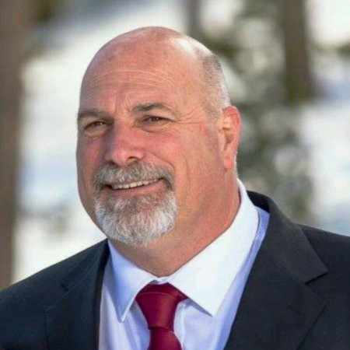
Notes:
Kevin slides 23-24

Slide 24
College stakeholders to collaborate on training your equivalency committee
Professor Corse CHAMPION this effort
Partners to include HR, change in mindset
Include faculty, Academic Senate leadership, Key influencers/industry representation and partners
Multi college/district effort to build the equivalency committee
Notes:
Kevin

Slide 25
Changes in Apprenticeship and Title 5
The new regulations allow for credits earned within an apprenticeship program to count toward meeting the new minimum qualifications. In practice, this means anyone who completes a credit-based registered apprenticeship program (and nearly all community college apprenticeship programs are credit based) and has six years of work experience can qualify to teach.
Notes:
Lynn Slides 25-26 (2min)
Change to Apprenticeship Minimum Qualifications
In May 2018, the Board of Governors approved a Title 5 change revising the minimum qualifications for apprenticeship instructors (Section 53413 of article 2 of subchapter 4 of chapter 4 of division 6 of title 5 of the California Code of Regulations). The goal and the result of this change was to expand the pool of industry experts to teach in apprenticeship classrooms. In the past, the minimum qualifications required a community college apprenticeship instructor to have 18 units of general education courses. The new regulations allow for credits earned within an apprenticeship program to count toward meeting the new minimum qualifications. In practice, this means anyone who completes a credit-based registered apprenticeship program (and nearly all community college apprenticeship programs are credit based) and has six years of work experience can qualify to teach

Slide 26
Changes in Apprenticeship and Title 5
•In addition to apprenticeship credits” is eliminated from regulation, allowing credits earned in an apprenticeship program to count toward meeting the faculty minimum qualifications.
•A section on an urgency condition is added.
•18 semester units is changed to 12 semester units.
•“Community college faculty” member is changed to apprenticeship Instructor
Notes:
Lynn
Change to Apprenticeship Minimum Qualifications
In May 2018, the Board of Governors approved a Title 5 change revising the minimum qualifications for apprenticeship instructors (Section 53413 of article 2 of subchapter 4 of chapter 4 of division 6 of title 5 of the California Code of Regulations). The goal and the result of this change was to expand the pool of industry experts to teach in apprenticeship classrooms. In the past, the minimum qualifications required a community college apprenticeship instructor to have 18 units of general education courses. The new regulations allow for credits earned within an apprenticeship program to count toward meeting the new minimum qualifications. In practice, this means anyone who completes a credit-based registered apprenticeship program (and nearly all community college apprenticeship programs are credit based) and has six years of work experience can qualify to teach

Slide 27
CAREER TECHNICAL EDUCATION
MINIMUM QUALIFICATIONS TOOL KIT
APPRENTICESHIP HIRING
Notes:
Bill (2-3min)

Slide 28
CAREER TECHNICAL EDUCATION MINIMUM QUALIFICATIONS TOOL KIT
Evaluating Experience for
Equivalency to the AA
Notes:
Cheryl Slides 28-34 (15min)
participant engagement via chat

Slide 29
Associate Degree Requirements
California Community Colleges associate degrees are awarded to students based on the philosophy and requirements for the degrees in Title 5 § 55061-55063.
Minimum of 60 degree applicable units, including
Major or area of emphasis (18 units minimum) *Depth of knowledge
General education (18 units minimum) *Breadth of knowledge
Electives
Demonstrated competence in reading, in written expression, and in mathematics
When evaluating a candidate for equivalency to the AA degree, it is important to keep the AA requirements in mind
Notes:
Cheryl
Why General Education?
Purpose of GE is to produce a citizen who can interact effectively with the world around them based on critical thinking and reasoning, sound oral and written communication, an applied understanding of other peoples and cultures, and applied experiences with science and its impact on people.

Slide 30
What General Education is required for an Associate of Arts or Associate of Sciences?
GE for an AA degree includes demonstrated competencies in math and English along with 18 units in 5 areas:
A. Natural Sciences
B. Social and Behavioral Sciences
C. Humanities
D.1. Language and Rationality: English Composition
D.2. Language and Rationality: Communication and Analytical Thinking
Notes:
Cheryl talks about all the specific areas of the general education areas focusing on the cte examples

Slide 31
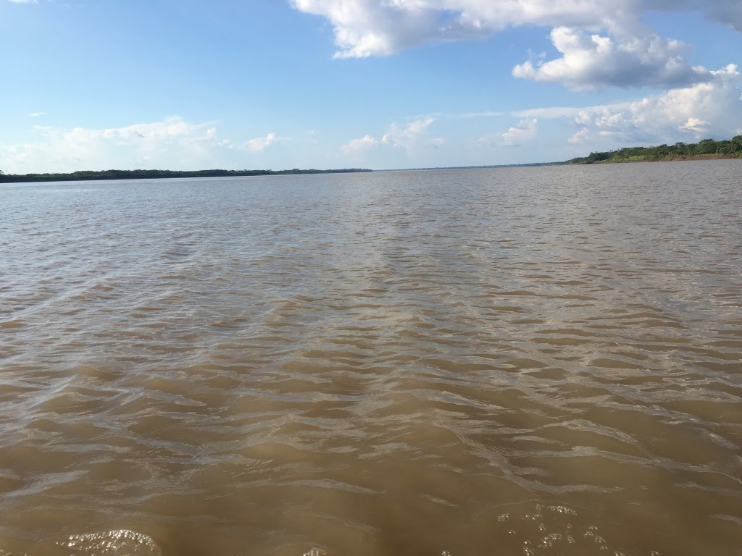
General Education Area A Natural Sciences
Example: Aviation (Certified Flight Instructor)
A certified recreational, private, or commercial must understand and apply Newton’s Basic Laws of Motion and Bernoulli’s Principle Ref: FAR 61.185(2)
Purpose for Including One Course in Natural Sciences for General Education
For students to develop the ability to examine the physical universe, its life forms, and its natural phenomena
For students to develop an appreciation of, understanding of, and ability to apply the scientific method
For students to develop the ability to understand the relationship between science and other human activities
Notes:
Cheryl talks about all the specific areas of the general education areas focusing on the cte examples

Slide 32
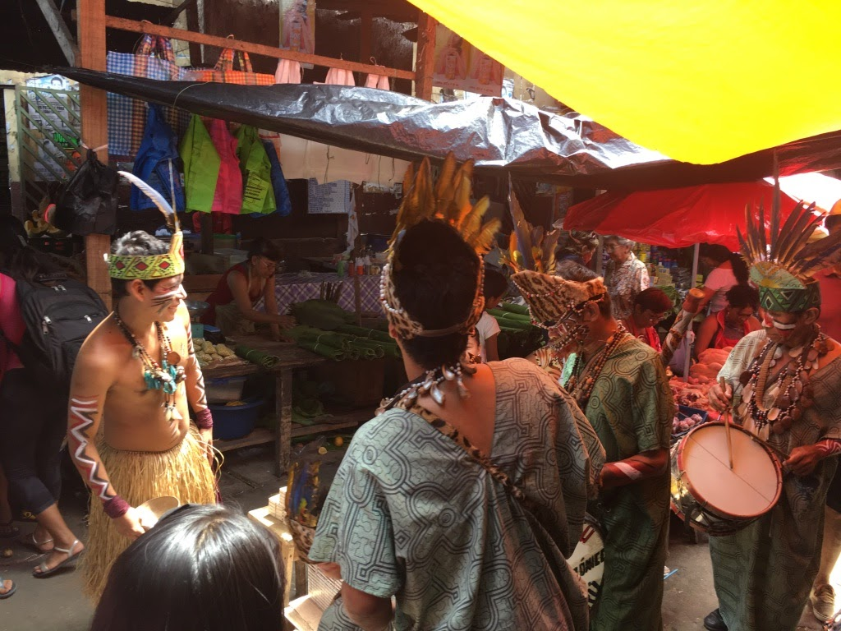
General Education Area B Social and Behavioral Sciences
Example: Culinary Arts/Food Production
A chef or culinary artist works within varied ethnic foods and understands and applies an understanding of foods and culture as well as historical food trends Purpose for Including One Course in Social and Behavioral Sciences for GE
For students to develop an awareness of the methods of inquiry used by the social and behavioral sciences.
To stimulate students’ critical thinking about ways people act or have acted in response to their societies
To promote students’ appreciation of how societies and social subgroups operate
To develop or promote a students’ understanding and appreciation of ethnic groups (Title 5 §55063 (b)(2) requires a course in Ethnic Studies. It is most likely met through the course/experience/ability counted in Area B or Area C)
Notes:
Cheryl talks about all the specific areas of the general education areas focusing on the cte examples

Slide 33
General Education Area C Humanities
Certified Funeral Service Practitioners complete
Celebrant training to develop an awareness of traditions of different cultures and religions
Purpose for Including One Course in Humanities for GE
For students to develop an awareness of the way in which people throughout the ages and in different cultures have responded to themselves and the world around them in artistic and cultural creations.
For students to develop or demonstrate aesthetic understanding and an ability to make value judgements.
To promote a students’ understanding and appreciation of ethnic groups (Title 5 §55063 (b)(2) requires a course in Ethnic Studies. It is most likely met through the course/experience/ability counted in Area B or Area C)
Notes:
Cheryl talks about all the specific areas of the general education areas focusing on the cte examples

Slide 34
General Education Area D.1. Language and Rationality: English Composition
Example: Any Discipline
Publishing a peer-reviewed article
Writing of a market, technical or sales report or manual, or writing of a similar document within the work environment
Purpose for Including English Competency and One Course in Language and Rationality: English Composition for General Education
For students to develop the principles and applications of language toward logical thought, clear and precise written expression and critical evaluation of written communication in whatever symbol system the student uses.
For students to develop expository and argumentative writing skills (English Composition)
Notes:
Cheryl talks about all the specific areas of the general education areas focusing on the cte examples

Slide 35
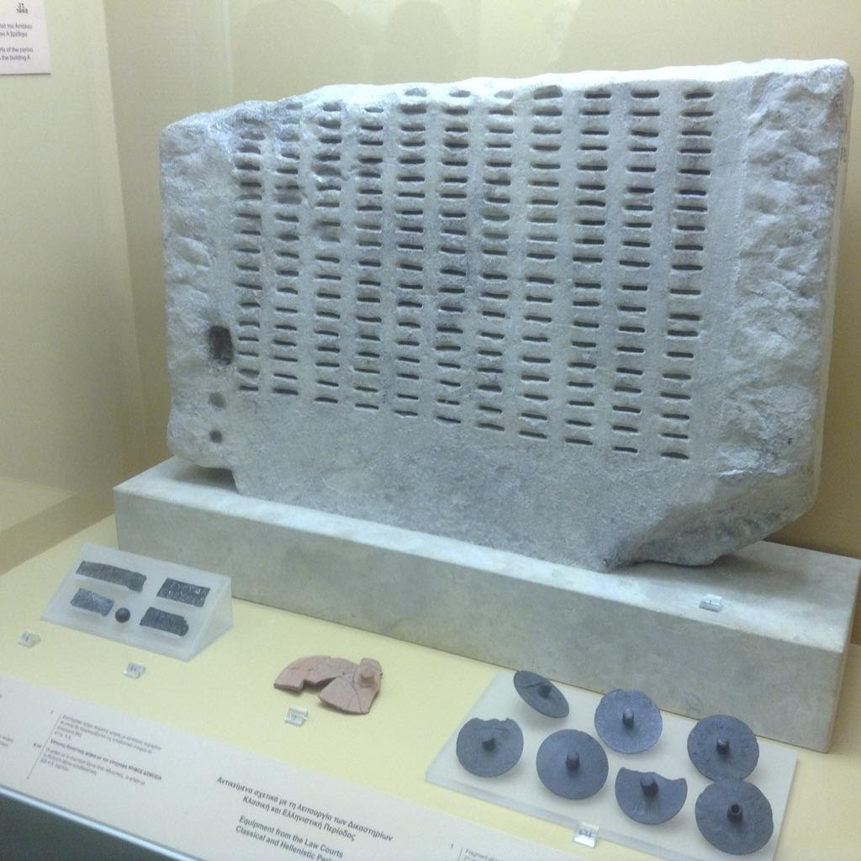
General Education Area D.2. Language & Rationality: Communication & Analytical Thinking
Example: Automotive Technology
A licensed automotive technician must use mathematical skills to manage and calculate ratios, measurements, comparisons, and specifications related to investigation of problems; may also use mathematical skills and reasoning to machine parts and tools to exact specification.
Purpose for Including One Course in Language and Rationality for General Education
For students to demonstrate competence in mathematics at a level equivalent to intermediate algebra
For students to develop oral communication and analytical thinking skills
For students to develop skills interpreting and assessing data and statistics to draw conclusions.
Notes:
Cheryl talks about all the specific areas of the general education areas focusing on the cte examples

Slide 36
Scenarios Breakout Activity:
Notes:
Mayra & Cheryl to facilitate (45min) 3 Scenarios
Facilitator Instructions in Breakout Rooms: (Kevin, Robert, Lynn, Bill)
Assign participants randomly.
15 min for each scenario- 10 in breakout and 5 back in the main room
At the breakout:
Facilitator ask participants to introduce themselves in the chat- Name, college & role
Facilitator reads the scenario
Facilitator ask one or more of these prompt questions or your own questions
Using the current equivalency process, would this candidate be included in the hiring pool?
Knowing what you now know about the Tool Kit, could this person be added to the hiring pool?
What “objections” would different representatives on your equivalency committee have and how could you counter them? (HR, Deans, General Education Faculty)
Back to Main room 5 min discussion
What did your small group decide about the candidate?

Slide 37
Tanisha, Diesel Mechanics
Tanisha is actively managing one of the largest diesel repair facilities in the region. She has 15 years of experiences in diesel repair and maintains power plant certifications from Cummins, Detroit, Mack, Freightliner and Volvo. Tanisha is considered one of the region’s most highly respected diesel repair experts. Tanisha has extensive experience in training new mechanics and has established the first online, industry supported, professional development program in California for diesel professionals. Tanisha sits on the local college’s Green Diesel advisory board. She also provides education at Statewide training events, speaks at a statewide manufacturer’s conference and hires about 35% of the local program graduates. Tanisha ensures that her employer strongly supports CTE pathway efforts at several inner city high schools. Tanisha has been recognized by the High School Board of Trustees for her work with non-traditional students. Tanisha has a high school and certification from a private trade school.

Slide 38
What meets Area A Natural Sciences?
What meets Area B Social and Behavioral Sciences
What meets Area C Humanities
What meets Area D1 English Composition?
What meets Area D2 Communication & Analytical Thinking (including Math competency?
-----------------------------------------------------------------------------------------------
With your equivalency committee, you decide: Would you recommend Tanisha for equivalency?
Notes:
Questions to relate to the Toolkit and the work of the Equivalency Committee

Slide 39
Marco, Power Line Mechanic
The Power Line program was started 12 years ago and we had one applicant after a national search. This program has excellent wages (over $100,000 a year) and the skills are much need in the industry. The program had a waiting list. Marco was an adult school teacher and had over 10 years teaching in the adult school system. He received teachers training and received a certification through his union. He also was a leader at the adult school and ran the advisory committee, wrote curriculum, and developed the lab activities. He did not have an Associate Degree.

Slide 40
What meets Area A Natural Sciences?
What meets Area B Social and Behavioral Sciences
What meets Area C Humanities
What meets Area D1 English Composition?
What meets Area D2 Communication & Analytical Thinking (including Math competency?
-----------------------------------------------------------------------------------------------
With your equivalency committee, you decide: Would you recommend Marco for equivalency?

Slide 41
Debbie, Health Information Technology (Medical record technology)
Debbie currently manages an office of 5 staff at a regional Health Information Technology (HIT) company and has 15 years experience implementing HIT recommendations from California’s Department of Health Services. Debbie is has completed several industry recognized credentials. She is responsible for the staff development of her employees and has developed a training handbook as a resource. Debbie’s organization provides internships for the local community college’s HIT graduates. As an armed forces reserve soldier, Debbie recently returned from a 3-month deployment to Peru, where she actively trained HIT professionals from several state-run medical systems. Debbie speaks fluent Spanish. Debbie has a certificate of achievement in HIT from her local community college. She has no additional college credit.

Slide 42
What meets Area A Natural Sciences?
What meets Area B Social and Behavioral Sciences
What meets Area C Humanities
What meets Area D1 English Composition?
What meets Area D2 Communication & Analytical Thinking (including Math competency?
-----------------------------------------------------------------------------------------------
With your equivalency committee, you decide: Would you recommend Debbie for equivalency?

Slide 43
Notes:
Lynn (15min)
facilitates questions and comments

Slide 44
Resources
Technical visits, including training your Equivalency Committee, as requested (https://www.asccc.org/contact/request-services)
Career Technical Education Faculty Minimum Qualifications Toolkit https://asccc.org/sites/default/files/ADAversion_CTEMinQualsToolkit.pdf
Notes:
Karen

Slide 45
For more information and support contact: info@asccc.org
Thank you!!!
Karen Chow chowkaren@fhda.edu
Mayra Cruz cruzmayra@deanza.edu
Lynn Shaw shawlynn@gmail.com
Robert Cabral RCabral@vcccd.edu
Bill Elarton ElartoWD@lattc.edu
Kevin Corse kevin_corse1@vcccd.edu
Cheryl Aschenbach caschenbach@lassencollege.edu
Notes:
Karen- Promote info@asccc.org Thanks the presenters, Office Staff and attendees.

Slide 46
Have a great Institute!
Notes:
Karen
Announce: The Institute starts at 11:30 with a general session and a panel of amazing CTE and Noncredit students.

