Slide 1
Rethinking Marketing Strategies for Recruitment to a Broader Diverse Spectrum of Students Juan Arzola, ASCCC CTE LC Chair and At-Large Representative Sharon Sampson, ASCCC CTE LC Member and Professor (Administrative Justice)

Slide 2
Breakout Description
It is clear that a four-year degree is key to social mobility and career attainment Join this session as we discuss the positive impact that community college baccalaureate (CCB) programs have for students, particularly those from historically marginalized social groups, which highlights the need to revisit current marketing strategies with the intentional goal of increasing the diversity of students pursuing a CCB.

Slide 3
The Desire for Baccalaureate Programs in California Is Not New…
Eight Legislative Items
AB 1932 (Maze, 2004)
AB 1280 (Maze, 2005)
AB 1455 (Hill, 2009)
AB 2400 (Block, 2010)
AB 661 (Block, 2011)
SB 850 (Block, 2014)*
SB 769 (Hill, 2017)
SB 1460 (Hill, 2018)*
*Passed

Slide 4
Nor Are We Alone…All of These States Currently Have CC Baccalaureate Programs
Arizona (AZ)
California (CA)
Colorado (CO)
Delaware (DE)
Florida (FL)
Georgia (GA)
Hawaii (HI)
Idaho (ID)
Indiana (IN)
Michigan (MI)
Missouri (MO)
Nevada (NV)
New Mexico (NM)
North Dakota (ND)
Ohio (OH)
Oklahoma (OK)
Oregon (OR)
South Carolina (SC)
Texas (TX)
Utah (UT)
Vermont (VT)
Washington (WA)
West Virginia (WV)
Wyoming (WY)

Slide 5
Some Quick Background Information – SB 850 (Block, 2014)
Allowed 15 districts to propose and implement one bachelor’s degree per district.
State Chancellor/BoG determined pilot districts based on resources, and local and regional needs
Coordination with UC and CSU (spoiler alert – neither system of public higher ed was pleased)
Duplication of public university programs was to be avoided
Legislature set student fees, state compensation
Local boards determined governance, administration, standards, and formats
Evaluation and report to Legislature, State Chancellor, and Board of Governors

Slide 6
15 Colleges Approved for the Pilot
College
Antelope Valley College
Bakersfield College
Cypress College
Feather River College
Foothill College
MiraCosta College
Modesto Junior College
Rio Hondo College
San Diego Mesa College
Santa Ana College
Santa Monica College
Shasta College
Skyline College
Solano College
West Los Angeles College
Program
Airframe Manufacturing Technology
Industrial Automation
Mortuary Science
Equine and Ranch Management
Dental Hygiene
Biomanufacturing
Respiratory Care
Automotive Technology
Health Information Management
Occupational Studies
Interaction Design
Health Information Management
Respiratory Care
Biomanufacturing
Dental Hygiene

Slide 7
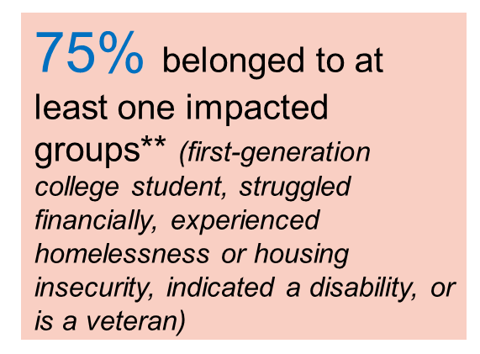
Student Demographics for Pilot Cohorts…
ETHNICITY | Cohort 2016 | Cohort 2017 | Cohort 2018 | Cohort 2019 | Cohort 2020 | Total
American Indian/Alaskan Native | 2% | 1% | 0% | 0% | 1% | 2%
Asian | 14% | 16% | 11% | 18% | 13% | 14%
Black/African-American | 5% | 4% | 7% | 4% | 6% | 5%
FilipinX | 8% | 6% | 9% | 5% | 7% | 8%
LatinX | 26% | 31% | 28% | 32% | 32% | 26%
Pacific Islander/Hawaiian Native | 1% | 1% | 0% | 1% | 0% | 1%
White | 37% | 32% | 37% | 30% | 31% | 37%
Multi-Ethnicity | 5% | 5% | 5% | 7% | 5% | 5%
Unknown | 3% | 4% | 3% | 3% | 5% | 3%
Total | 100% | 100% | 100% | 100% | 100% | 100%
Gender* | Percent
Female | 66%
Male | 33%
Unknown | 1%
Source: * MIS and Legislative Analyst Office;
** Statewide Employment Survey

Slide 8
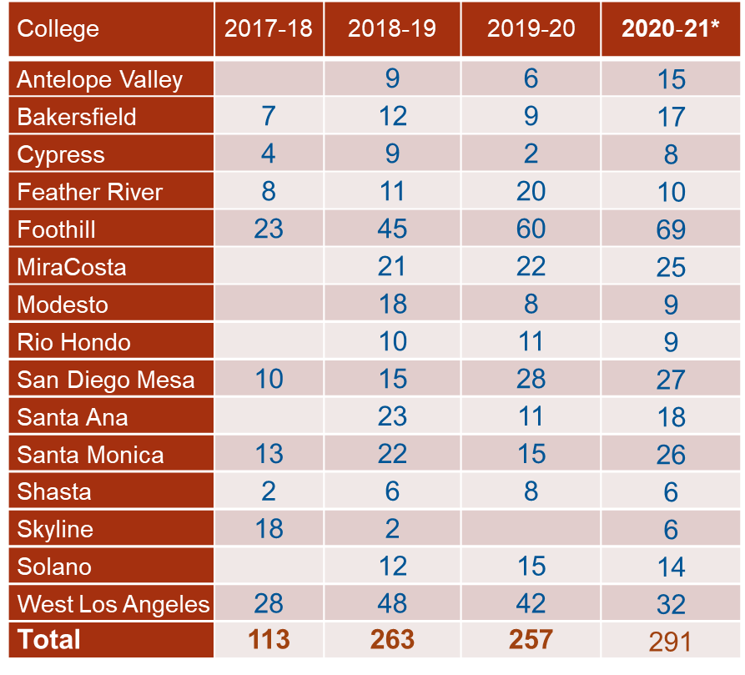
Pilot Program Graduation Rates

Slide 9
Student Perceptions of the Bachelor’s Program
51% said they would not have pursued a Bachelor’s degree otherwise
87% agreed that the value of the program worth the tuition cost, and the tuition cost was affordable
92% agreed that community college should continue offering Bachelor’s degrees
Source: Statewide Employment Survey

Slide 10
Cost Calculations
 | Cost Per Semester Unit (resident fee)
First Two Years (traditional AA/AS/ADT degree) | $46/unit for two years (approximately 60 units)
Second Two Years | $46/unit + $84/unit (baccalaureate tuition) = $130/unit
Total Cost | $10, 560

Slide 11
Loan and Employment Outcomes
72% did not take out loan to complete the Bachelor’s program
83% employed in a job. Among them,
80% found job within 3 months
95% employed in the same field of study
94% employed in the state of California
$25,000 average income increase
Source: Statewide Employment Survey

Slide 12
New Legislation – AB 927 (Medina, 2021)
This legislation:
Makes the 15 pilot programs permanent by removing the sunset provision
Expands this opportunity to all California community colleges through an approval process in the CCC Chancellor’s Office
Proposal approvals are limited to 30 per year, with submission dates of January 15 and August 15
Stronger consultation between the California Community Colleges Chancellors Office and the universities

Slide 13
First Submissions due by 15 January 2022: Approved Programs to be Announced No Later than 31 May 2022
Programs That Were Submitted:
4 in Respiratory Care
Automotive Technology Management
Biomanufacturing
Cyber Defense and Analysis
Ecosystem Restoration and Applied Fire
Hisotechnology
Research Laboratory Technology

Slide 14
Benefits for Offering CCBs
Addresses workforce and economic needs, as mentioned frequently by Governor Newsom and others
Provides accessible bachelor’s degree programs for students who are “place bound” or are unable to attend one of the public higher education institutions
Provides high-quality education by colleges that often offer associate degree programs in the same workforce fields.
Is affordable - $10,560 for all 4 years in tuition costs (does not reflect total cost of attendance)

Slide 15
Student Perspective for Pursuing a CCB
Students have a variety of reasons for enrolling in a CCB program but their reasons are grounded in a desire for economic security and social mobility for themselves and their families.
Some students pursue a CCB to advance in their current career path.
Others look at CCB programs as a chance to change careers.
Yet, most student report that CCB programs that allow them to continue working and caring for family, stay local, and afford to enroll.
* Community college baccalaureate programs as an equity strategy: Student access and outcomes data. March, 2022.

Slide 16
CCBs through an Equity Lens
More than half of all African American, Latina/o, and Native American undergraduates attended a community college in fall 2014 (American Association of Colleges and Universities, 2016).
Community college serves as the primary pathway to advancing baccalaureate attainment for historically marginalized and minoritized students.
Yet, structural inequities in higher education contribute to the gaps in achievement experienced by historically marginalized and minoritized students, particularly if they begin at a community college (Long & Kurlaender, 2009).
Interesting though…

Slide 17
Dominant Marketing Framework
Scholarship reveals that the dominant marketing framework used by community colleges is to focus on “workforce goals to advancing socioeconomic mobility as a way these programs promoted equity” (Cuellar and Gandara, 2021).
Consequently, institutional outreach and marketing practitioners implement “colorblind” strategies that emphasize closing the equity gaps for low-income students (Cuellar and Gandara, 2021).
By and large, outreach and marketing of baccalaureate programs were conducted through traditional approaches, which include website information, local newspaper and television advertisements, brochures, and partnerships with local chambers of commerce and professional associations (Cuellar and Gandara, 2021).

Slide 18
CCBs Intentional Marketing Strategies that Center Race/Ethnicity, Gender, and Gender Identity?
To what extent does your institutional utilize student demographic data to determine marketing strategies to address local workforce needs?
Thinking about your student demographics, what are some possible intentional marketing strategies your institution might be able to adopt to address opportunities gaps experienced by historically marginalized students?

Slide 24
Thank You!
Additional information on CCBs, visit or send inquiries to:
info@asccc.org
cccbac.org

