Slide 1
San Diego College of Continuing Education Distance Education & Mentoring Programs

Slide 2
San Diego College of Continuing Education Online Faculty Certification Program
Date​ | March 1, 2020​ | Jan. 7, 2021
Faculty Completions​ | 60 completions​ | 244 completions
Completion rate | 50% | 87%

Slide 3
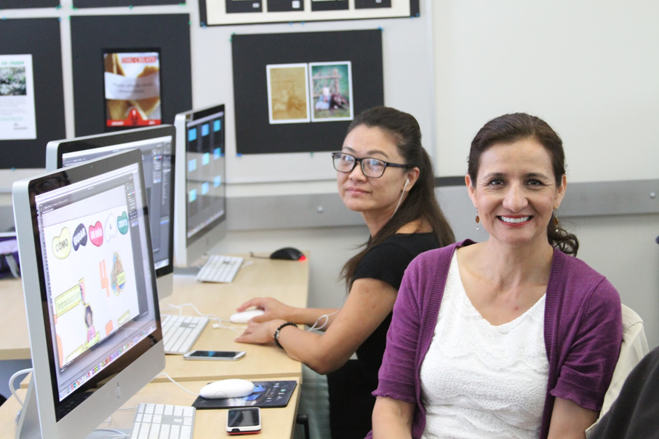
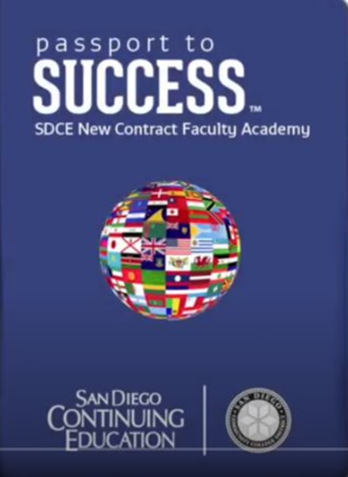
San Diego College of Continuing Education Best Practices for Online Faculty Mentoring
CE Students
CE Passport to Success

Slide 4
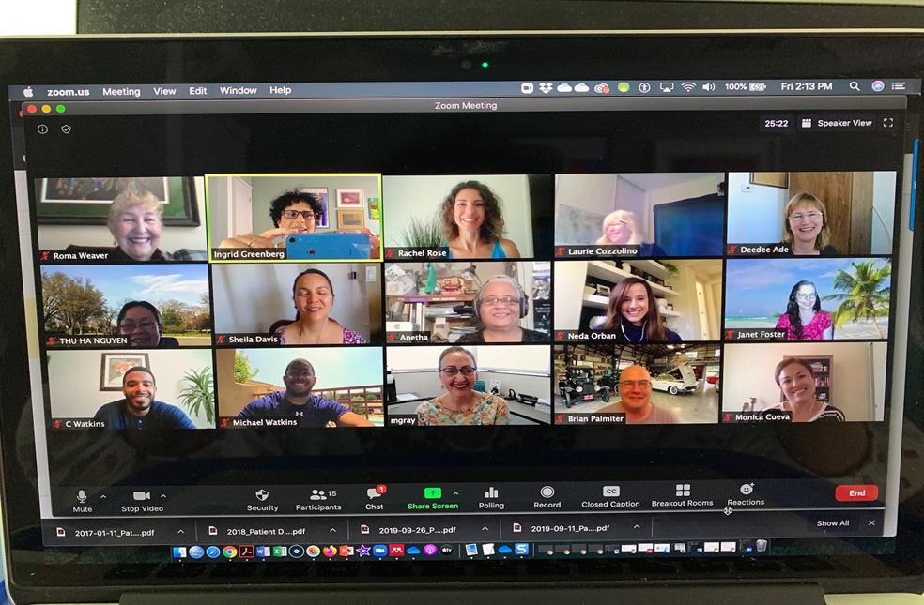
San Diego College of Continuing Education Online Faculty Mentoring

Slide 5
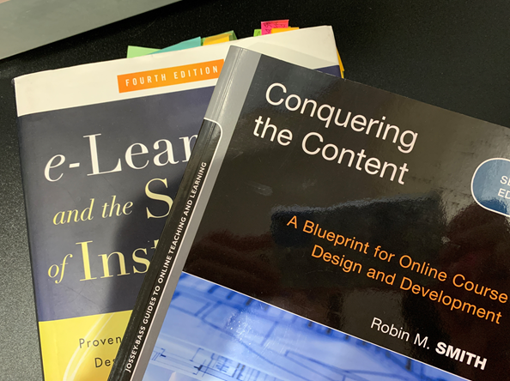
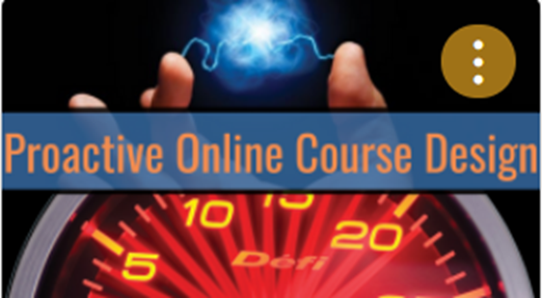
San Diego College of Continuing Education Online Course Design Classes for Noncredit

Slide 6
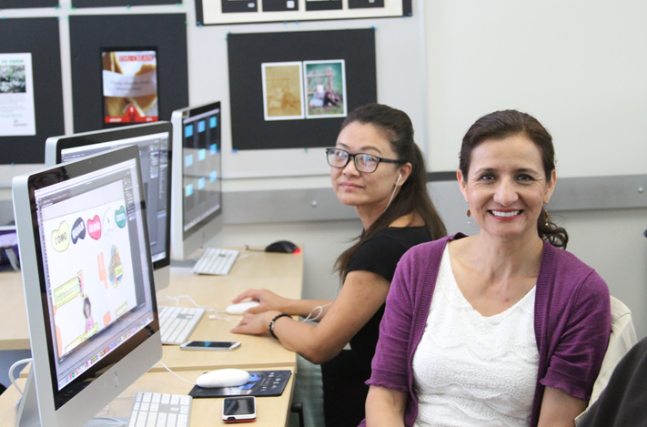
San Diego College of Continuing Education Post-pandemic: Mentoring for online and hybrid, and maybe HyFlex teaching
Photo by Chris Montgomery on Unsplash

Slide 7
San Diego College of Continuing Education Online Faculty Certification Program
For more information, please contact:
Ingrid Greenberg
SDCCE Online Faculty Mentor/Coordinator
igreenbe@sdccd.edu
Diana Vera-Alba
SDCCE Online Faculty Mentor
ESL Professor
dveraalb@sdccd.edu
Brian Palmiter
SDCCE Online Faculty Mentor
CTE Automotive Professor
bpalmiter@sdccd.edu

