Slide 1
Cooperative Work Experience/Internships
Dolores Davison, ASCCC Vice President
Jackie Escajeda, Dean, Chancellor’s Office
Kim Schenk, Senior Dean, Diablo Valley College
Michael Wyly, Solano Community College
Notes:
Dolores

Slide 2
Outcomes For This Session
Review various forms of Cooperative Work Experience Education (CWEE)
Review Title 5 and CWEE
Review Strong Workforce Priorities and the CTE Guided Pathways Tool Kit
Review how CWEE fits within CTE Guided Pathways
Possible ways to form internship opportunities
Notes:
Dolores

Slide 3
Various Types of Work-Based Learning
Contextualized Learning
General Cooperative Education Experience (CB10)
Occupational Cooperative Education Experience (CB10)
Internships
Service Learning
Clinical Experience
Field Experience
Mentoring
Job shadowing: an initial experience where the individual follows a regular employee through a day to gather information on the job and the work setting; Typically unpaid;
Work Study
APPRENTICESHIPS – Labor Code, division 3 and the California Apprenticeship Council
Note: Data Element XB09 – Section Work-Based Learning Activities
Notes:
Kim
I would like Craig to double check that accuracy of my statement here: Of these different types of Cooperative Work Experience Education, which are specifically mention in Title 5, Chapter 6, Curriculum and Instruction?
General Cooperative Education Experience
Occupational Cooperative Education Experience
Internships are not called out specifically in T5, Chapter 6.
Clinical Experience isT5 , for nursing..
Apprenticeships are Labor Code, Division 3
The others: Service Learning, Field Experience, Mentoring/Job shadowing and “work study” are not referenced in Title 5 Chapter 6.
While the link to the booklet, Work-Based Learning Handbook may be dated, I find it to be the most straightforward.
There are several other resources which will be listed at the end of this presentation.

Slide 4
Title 5 and Work Experience (WE) §55250 - 55257
Responsibilities of the District, College, Student, and Employer
Responsibilities of the District:
Approved Plan Required; Requirements of the Plan; types of Cooperative Work Experience; Laws/Rules Pertaining to Minors in WE; Funds for WE for Students with Developmental Disabilities; WE Involving Apprenticeships; WE Outside the District; Wages & Workers’ Compensation; College Credit and Repetition; District Services; Records
Responsibilities of the College:
College-defined Student Qualifications; Work Experience Credit; Retention of a WE Coordinator; Retention of WE Instructors; Retention of Adequate Clerical Assistance; Retention of Adequate Instructional Services
Responsibilities of the Student:
Student Qualifications; Student Responsibilities;
Responsibilities of the Employer and Job Learning Stations:
Learning Station Criteria; Employers’ Records;
Notes:
Jackie
Updates to regs

Slide 5
Cooperative Work experience
APPROVED PLAN REQUIRED - § 55250
REQUIREMENTS OF THE PLAN - § 55251
WORK EXPERIENCE CREDIT - § 55265.5
Approved at the March Board of Governor’s meeting and the revisions to regulations for CWE plans and courses will:
Support the streamlining of curriculum by transferring authority from the Chancellor’s Office to local districts to approve CWE plans and courses.
Allow colleges to incremental units.
Notes:
This allows the colleges an opportunity to develop CWE courses that respond to emerging community needs in a timely manner including those workforce needs as stated in the Taskforce on Workforce, Job Creation and a Strong Economy

Slide 6
CWE - REQUIREMENTS OF THE PLAN - § 55250
Any program of Cooperative Work Experience Education conducted by the governing board of a community college district pursuant to this article and claimed for apportionment pursuant to sections 58051 and 58009.5 shall conform to a plan adopted by the district. The plan adopted by the district shall set forth a systematic design of Cooperative Work Experience Education whereby students, while enrolled in college, will gain realistic learning experiences through work. This plan shall be submitted to and approved by the Chancellorlocal governing board.

Slide 7
CWE - § 55251. REQUIREMENTS OF THE PLAN
(a) The district plan shall contain the following provisions:
(1) A statement that the district has officially adopted the plan, subject to approval by the State Chancellorlocal governing board.
(2) A specific description of the respective responsibilities of college, student, employer, and other cooperating agencies in the operation of the program.
(3) A specific description for each type of Cooperative Work Experience Education program.
(4) A description of how the district will:
(A) Provide guidance services for students during enrollment in Cooperative Work Experience Education.
(B) Assign a sufficient number of qualified, academic personnel as stipulated in the district plan to direct the program and to assure district services required in section 55255.
(C) Assure that students' on-the-job learning experiences are documented with written measurable learning objectives.
(D) With the assistance of employers, evaluate students’ on-the-job learning experiences.
(E) Describe basis for awarding grade and credit.
(F) Provide adequate clerical and instructional services.
(b) Prior to implementation, any changes or revisions to the district plan shall be submitted for approval to the Chancellorlocal governing board.

Slide 8
CWE - § 55256.5. Work Experience Credit
(a) One student contact hour is counted for each unit of work experience credit in which a student is enrolled during any census period. In no case shall duplicate student contact hours be counted for any classroom instruction and Cooperative Work Experience Education. The maximum contact hours counted for a student shall not exceed the maximum number of Cooperative Work Experience Education units for which the student may be granted credit as described in section 55253.
(b) The learning experience and the identified on-the-job learning objectives shall be sufficient to support the units to be awarded.
(c) The following formula will be used to determine the number of units to be awarded:
(1) Each 75 hours of paid work equals one semester credit or 50 hours equals one quarter credit.
(2) Each 60 hours of non-paid work equals one semester credit or 40 hours equals one quarter credit.
(3) Units may be awarded in 0.5 unit increments.

Slide 9
New process slide
CWE
Develop plan
Curriculum committee review
Develop CWE course
Implement CWE Plan
Local governing board approval
COCI
Notes:
Dolores will do this slide. Kim and Jackie to help with slide content

Slide 10
Strong Workforce Program
The goals of Doing What Matters for Jobs and the Economy:
to supply in-demand skills for employers -
create relevant career pathways and stackable credentials
promote student success and
get Californians into open jobs
HOW?
Give Priority for Jobs and the Economy
Make Room for Jobs and the Economy
Promote Student Success
Innovate for Jobs and the Economy
Notes:
Dolores

Slide 11
Milestones incorporating CC CWEE!
Notes:
dolores

Slide 12
Strong Workforce CTE Guided Pathways Tool Kit:
Element One: Build Cross-Agency Partnerships
Element Two: Identify Industry Sector and Engage Employers
Element Three: Design Education and Training Programs
Element Four: Identify Funding Needs and Sources
Element Five: Align Policies and Programs
Element Six: Measure System Change and Performance
Notes:
dolores

Slide 13
Establishing Internships
Which part of establishing Internships have you found to be the most confusing or time-consuming on your campus?
Responsibilities of the District
Responsibilities of the College
Responsibilities of the Student
Responsibilities of the Instructor
Notes:
Mychael

Slide 14
Grow-Our-Own Through Work Experience: Teaching Apprentices at Solano College
Background and Program Development
Began as an informal internship program between Solano alumni and an English faculty member
Interns enrolled at nearby graduate institutions
Complemented by a Supplemental Instructor program, incl. compensation
To support efforts in developmental instruction in English and mathematics, formal Teaching Apprentice program proposed as part of Basic Skills Transformation Grant
First-round of hires in English began in 2016
Key to student support for changes to developmental sequences including acceleration and curricular changes, including co-requisite models (which aligns with AB 705)
All developmental and co-requisite sections in English are now supported by TAs
Full implementation in Fall 2018 for both English and mathematics
Faculty Coordinator for the Program (reassigned time)

Slide 15
Grow-Our-Own Through Work Experience: Teaching Apprentice Job Description
Description
(English) Under the direction of the School Dean and guidance from the mentor/instructor of record, work with students in the classroom and one-on-one outside of class; provide instruction and remedial assistance in writing and reading skills to students enrolled in various levels of a variety of college courses.
(Math) Under the direction of the Division Dean and guidance from the mentor/instructor of record, work with students in the classroom and lab; provide instruction and remedial assistance in math skills to students enrolled in various levels of a variety of college courses.
Minimum Qualifications
(English) B.A. or B.S. in any field requiring substantial writing desired OR two years of work experience in writing, editing, proofreading, teaching, or tutoring--including ESL or persons with diverse socio-economic, cultural, and ethnic backgrounds, including persons with disabilities --or any combination of training, experience, and/or education that provides the required knowledge, skills, and abilities.
(Math) STEM related majors in any field at the University with tutoring experience OR two years of work experience in teaching mathematics or statistics--or any combination of training, experience, and/or education that provides the required knowledge, skills, and abilities.
Compensation
$21.00/hour (not to exceed part-time)

Slide 16
Grow-Our-Own Through Work Experience: Benefits and Next Steps
Benefits to the TA
Hands-on Experience
Engaged Mentoring
Structured program
Benefits to the Student
Increased access to assistance and guidance: TAs serve as mentors/examples of success.
Reduced teacher-to-student ratio
Benefits to the College
Support for student success and curriculum changes to increase access and reduce equity gaps
Increase of diversity of hiring pool as TAs are eligible for PT hiring pool (and eventually applicants for FT positions)

Slide 17
Grow-Our-Own Through Work Experience: EEO Plan
Connection to EEO Plan: Grow-Your-Own Programs
Solano now working to expand the program into other disciplines, including CTE
Desired correlation between increase of diversity of hiring pools and successful TAs
Required longitudinal studies to inform where to expand the program as part of EEO Plan
Highlights of Solano’s EEO submission (2018):
Solano Community College currently benefits from a Teaching Apprentice program wherein we cultivate and train through mentorship future community college faculty, many of whom began as our students.
The TA program at Solano hires local students in possession of a bachelor degree; ideally, successful candidates are enrolled in a graduate program. Outreach for this program places emphasis on recruiting college alumni.
Moreover, successful TAs are eligible to teach as part-time faculty at the college, once they attain minimum qualifications: the TA program helps the college to build and maintain robust and diverse adjunct teaching pools, while providing immediate access to diverse models of success for our current students.
The College intends to analyze longitudinal data for applicant pools, hiring, and faculty retention to identify equity gaps in hiring at Solano.
The outcomes of the expansion of the TA program should include measurable changes to the diversity of applicants, hiring pools, and teaching faculty to the benefit of our students.

Slide 18
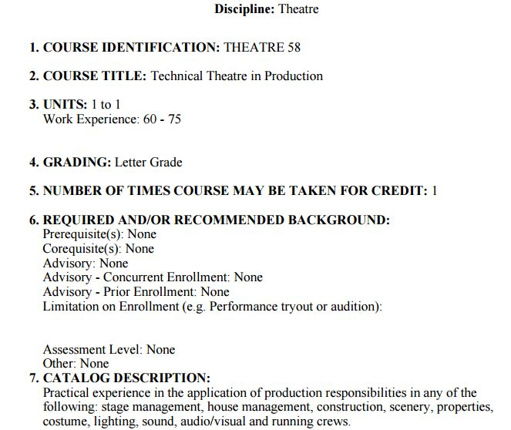
Critiquing a CWEE Course Outline of Record from Sunshine College
Notes:
Dolores

Slide 19
8. CONTENT (Scope and Description of Content):
A. Assignment to production and performance responsibilities
1. Grip or stage hand
2. Flyman or stage hand
3. Automated scenery operator
4. Prop master
5. Electrician
6. Deck electrician
7. Light board operator
8. Moving light operator
9. Follow spot operator
10. Audio Technician
11. Audio Board Operator
12. Mic Technician
13. Costume Technician
14. Dresser
15. Wardrobe
16. Costume Laundry
B. Preparation for production including necessary theatrical techniques.
1. Scenery
2. Costumes
3. Lighting
4. Audio
5. Properties
6. Make Up
7. Hair
8. Wigs
9. Special effects
10. Projections
11. Promotional
C. Appropriate tools to fulfill production requirements for performance.
D. Basic technical theatre terminology.
E. Collaborative responsibilities with the director, designers, and crew supervisors.
F. Basic skills in running a production.
G. Creation, maintenance or construction of basic production elements.
H. Proper use and basic understanding of appropriate tools to fulfill production requirements for performance which may include the following areas:
1. Carpenter and/or painter - Construction and implementation of scenery and properties required for the production.
2. Stitcher, cutter, draper - Construction and implementation of costumes required for the production
3. Makeup technician -Construction and implementation of make-up required for the production.
Notes:
Dolores

Slide 20
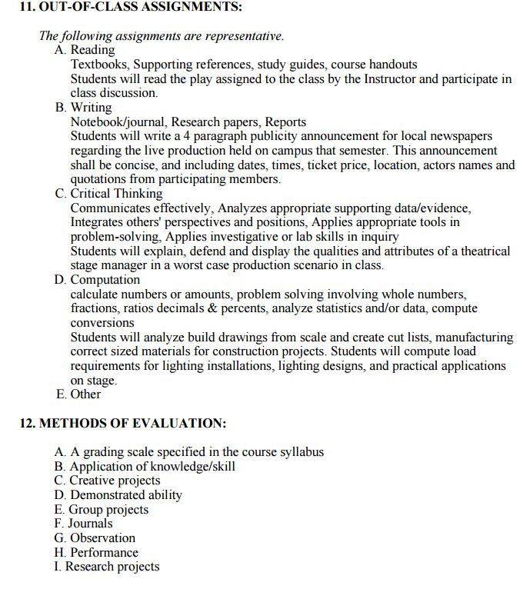
Notes:
Dolores

Slide 21
Notes:
Dolores

Slide 22
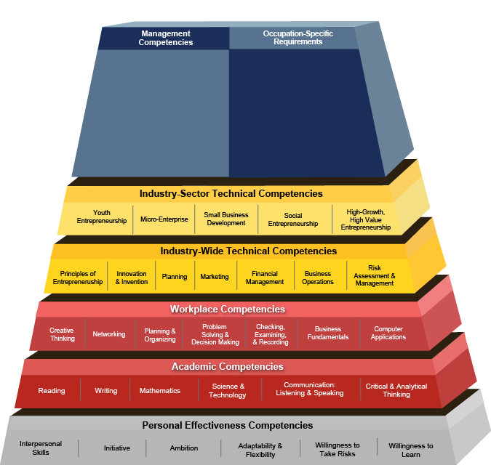
Building an Internship from: Competency Model Clearinghouse
Pre-requisite Courses
Work Site Requirements:
Content on the COR
Pre-requisite Courses
EXAMPLE: Entrepreneurship from
https://www.careeronestop.org/CompetencyModel/competency-models/entrepreneurship.aspx
Notes:
Kim

Slide 23
Coming Soon!
RESOLUTION 13.05S18 ASCCC White Paper on Career and Technical Education, Cooperative Work Experience, Internship, and Apprenticeship Programs
Whereas, apprenticeship programs are regulated by federal labor laws and are primarily funded by labor unions and/or industry;
Whereas, Career and Technical Education (CTE), Cooperative Work Experience (CWE), and internship programs are regulated by California Education Code and primarily funded by public funds; and 41 Section 504, the Americans with Disabilities Act, and California Government Code section 1135 et. seq. 42 California Title 5 Code of Regulations, §§56000-56076 (DSPS) 43 California Education Code, §§67310-13 and 8485028
Whereas, CTE, CWE, internship programs, and apprenticeship programs are often conflated, and no current clear guidelines exist for the use of best practices for setting up these various programs;
Resolved, That the Academic Senate for California Community Colleges develop a paper that clearly explains and differentiates Career and Technical Education, Cooperative Work Experience, internship, and apprenticeship programs, including their regulations, funding models, and overall guiding principles, and bring the paper to the Spring 2019 Plenary Session for approval.
Notes:
Dolores

Slide 24
Resources
Chancellor’s Office. Cooperative Work Experience Education. http://extranet.cccco.edu/Divisions/WorkforceandEconDev/CareerEducationPractices/CoopWorkExperienceEduc.aspx
California Statewide System Advisory Committee on Work-Based Learning and Student Employment. http://cacareerbriefs.com/wp-content/uploads/new-handbook-1.pdf
U. S. Department of Labor. Competency Model Clearinghouse. Careeronestop. https://www.careeronestop.org/CompetencyModel/careerpathway/cpwreviewsamplepaths.aspx
Darche, S., Nayar, N., Reeves, K., Work-Based Learning in California. West ED, 2009 http://www.connectedcalifornia.org/downloads/WBLReport.pdf
Notes:
Dolores

Slide 25
FOLLOW-UP!
As promised, here are some follow-ups:
1. Q: Where are “faculty responsibilities” listed in the Internship outline document I distributed?
A: In the attempt to make this outline fit on one page, I abbreviated the outline GREATLY! Consequently, some material was minimized. The “faculty responsibilities” were listed under 2.5 and 2.6 of the fuller document. I will send this fuller outline to be attached with the PP of the presentation.
2. Q: Can Internships be offered on a noncredit basis?
A: At the Fall 2017 plenary, 7.04 F17 was passed (https://asccc.org/sites/default/files/Resolutions%20Packet%20F17%20Saturday%2011-4-2017%20Final.pdf) which calls for consultation with the Chancellor’s Office: Resolved, That the Academic Senate for California Community Colleges work with the California Community Colleges Chancellor’s Office and other system partners to identify and eliminate state-level barriers to providing internship opportunities for students enrolled in noncredit courses and programs.
Needless to say, this has not happened yet with the Chancellor’s Office.
3. Some of you asked abut that colorful chart I passed out towards the end of the session. It was to be an exercise in building an Internship by filling in the blanks on your sheet, using the model on slide 19 as a guide. Have fun with this back at your college.
It was very nice to share the afternoon event with you all discussing Internships.
Marie Boyd
Chaffey College

