Slide 1
Credit for Prior learning, dual enrollment, and other topics
Dolores Davison, ASCCC Secretary
Julie Land, ASCCC Transfer, Articulation, and Student Services Committee
TASCC Regionals March 2018
Notes:
Introductions, Temperature of the Room (Michael), Pass our Stickie Notes for Questions (Donna)

Slide 2
What is Credit for Prior Learning?
Course credit given for previous experience
Through credit by exam
Through matching course experiences or expectations to learned experiences
Through examinations
CLEP
AP
Others?

Slide 3
Convergence of CPL in California
Various CCC projects looking for ways to uncover CPL opportunities for students
Veterans and military students (AB 2462)
Bachelor’s Degree Pilot
Nursing and military students (SB 466)
Workforce and Career/Technical (Doing What Matters for Jobs and the Economy)
Online process to connect students with CPL opportunities (Online Education Initiative)

Slide 4
ASCCC Work on CPL
Leverage prior work (2014)
ASCCC participation on Workforce and OEI steering committees
Need active consultation and collaboration of faculty leadership
ASCCC expertise and leadership helps ensure success and participation

Slide 5
Actions at the CCCCO
CPL Workgroup
Formed during Spring 2016
CCCCO, ASCCC, Colleges, Faculty Advisory Committees, CACCRAO, Financial Aid, Statewide Initiatives
Report of Survey Findings
Chancellor’s Office Advisory on Awarding Credit for Prior Learning: AB 2462 (Military Experience)

Slide 6
Going Forward
Examination of other methods to award CPL
Increased interest in models from other states
Work with ACE and other groups
Role in baccalaureate degrees?

Slide 7
And Now For Something Entirely Different…

Slide 8
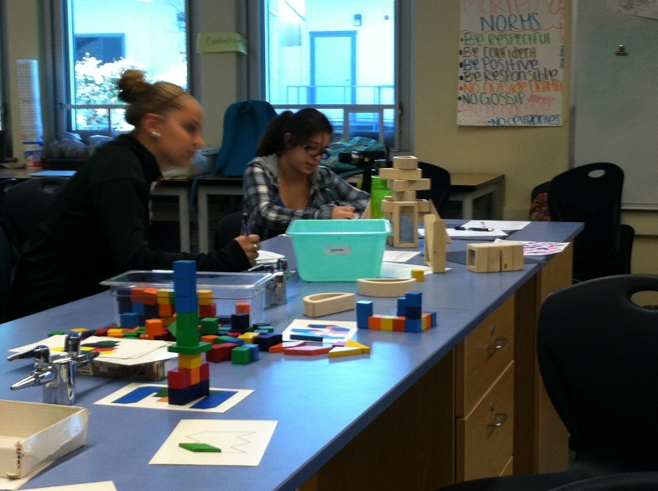
Just Kidding…It’s Time for Dual Enrollment!
What is Dual Enrollment? High school students taking colleges courses while enrolled in high school
Notes:
Donna

Slide 9
Benefits to Students
Complete high school and college credits at same time
Introduction to/preparation for college life for a smoother transition to college
More time for career and/or college major exploration
Address skills gaps and improve study skills/academic knowledge
Increased confidence and motivation to persist
Students experience the benefits of a college education
Notes:
Donna

Slide 10
Some Topics of Interest about Dual Enrollment
Classes can be offered
On college campus or satellite, including Distance Ed
Individual students
Cohorts
On high school campus before or after school
On high school campus during school day
Open vs closed
Notes:
Donna

Slide 11
Money…
Credits earned may be applied in both systems
Apportionment
Average Daily Attendance (ADA)
FTES
Both
Notes:
Donna

Slide 12
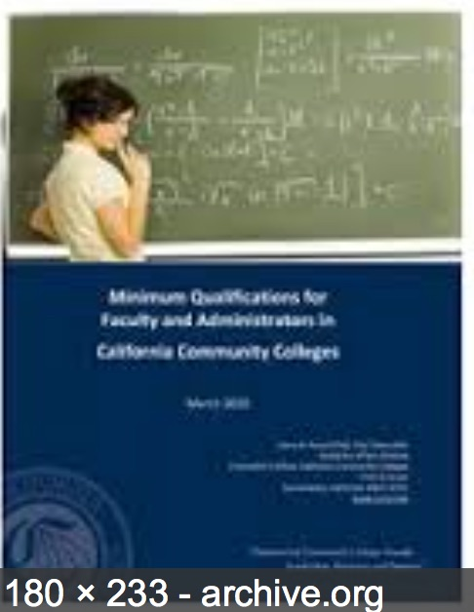
Faculty
Instructor must meet MQs
Who teaches class?
High school teacher
College teacher
What’s the difference?
Notes:
Donna

Slide 13
So Why Isn’t Everyone Doing This?
Programs vary in purpose
intentional college/career pathway programs
vs.
“chasing FTES”
Notes:
Donna

Slide 14
So Why Isn’t Everyone Doing This?
Programs vary in purpose– intentional college/career pathway programs vs. “chasing FTES”
Programs vary in degree of “formality”
memorandum of understanding
vs.
verbal agreement
Notes:
Donna

Slide 15
So Why Isn’t Everyone Doing This?
Programs vary in purpose– intentional college/career pathway programs vs. “chasing FTES”
Programs vary in degree of “formality”
memorandum of understanding
vs.
verbal agreement
If a college is doing a Partnership under AB288 – verbal is not okay. (more on this later)
Notes:
Donna

Slide 16
So Why Isn’t Everyone Doing This?
Programs vary in purpose– intentional college/career pathway programs vs. “chasing FTES”
Programs vary in degree of “formality” – memorandum of understanding vs. verbal agreement
Programs vary in degree of faculty engagement
faculty are partners
vs.
“the administration does its own thing”
Notes:
Donna

Slide 17
So Why Isn’t Everyone Doing This?
Programs vary in purpose– intentional college/career pathway programs vs. “chasing FTES”
Programs vary in degree of “formality” – memorandum of understanding vs. verbal agreement
Programs vary in degree of faculty engagement
faculty are partners
vs.
“the administration does its own thing”
What do you think about this??
Notes:
Donna

Slide 18
So Why Isn’t Everyone Doing This?
Programs vary in purpose– intentional college/career pathway programs vs. “chasing FTES”
Programs vary in degree of “formality” – memorandum of understanding vs. verbal agreement
Programs vary in degree of faculty engagement –faculty are partners vs. “the administration does its own thing”
Problems with the CCCCO survey and misreporting – colleges are worried about getting in trouble
Notes:
Donna

Slide 19
AB 288 (Holden, 2015) Has Been a Game Changer
College and Career Access Partnerships (CCAP)
District level agreement to offer Dual Enrollment
Intended to reach broader range of students, not just highly gifted or advanced scholastic or vocational work
Emphasis on college and career readiness and CTE and transfer pathways
Reduce the number of students needing remedial math and English instruction at the community college level
Notes:
Kim

Slide 20
College and Career Access Partnerships (CCAP)
Adds a new option for Dual Enrollment
Does not replace existing models
Colleges can continue with existing dual enrollment programs
Colleges can continue with existing and have CCAPs
Notes:
Kim

Slide 21
What does CCAP allow that is different?
Provides added flexibility in three areas
Limit enrollment in college courses taught on high school campus to high school students
Raise maximum units per term for special high school admits to 15 college credits (but no more than 4 courses)
Provide CCAP students same enrollment priority as Middle College High School students
Notes:
Kim

Slide 22
What does a CCAP agreement require?
In exchange for added flexibility, districts must…
Review and approve CCAP agreements in two open board meetings of both districts
Comply with all existing state and federal reporting requirements and local collective bargaining agreements
Ensure faculty are not displaced and that “traditional” community college students have access to the courses they need – so what about oversubscribed courses?
Report on student outcomes in CCAP courses
Notes:
Kim

Slide 23
Provisions of Note
A community college district participating in a CCAP partnership shall not provide physical education course opportunities to high school pupils
Notes:
Kim

Slide 24
Provisions of Note
A community college district participating in a CCAP partnership shall not provide physical education course opportunities to high school pupils
A community college district shall not enter into a CCAP partnership with a school district within the service area of another community college district, except where an agreement exists, or is established
Notes:
Kim

Slide 25
Provisions of Note
A community college district participating in a CCAP partnership shall not provide physical education course opportunities to high school pupils
A community college district shall not enter into a CCAP partnership with a school district within the service area of another community college district, except where an agreement exists, or is established
A community college district participating in a CCAP partnership is not required to provide the same services at the high school campus that are on the college campus (but may choose to do so).
Notes:
Kim

Slide 26
A Major Change in “Remedial” Course Offerings
The CCAP partnership agreement shall certify that any remedial course taught by community college faculty at a partnering high school campus shall be offered only to high school students who do not meet their grade level standard in math, English, or both on an interim assessment in grade 10 or 11, as determined by the partnering school district, and shall involve a collaborative effort between high school and community college faculty to deliver an innovative remediation course as an intervention in the student’s junior or senior year to ensure the student is prepared for college-level work upon graduation
Notes:
Kim

Slide 27
Questions to Be Asking
Administrative intent to offer dual enrollment
High school partnerships
Increase to FTES
Concerns of local senate
Curriculum, incl. articulation and impact on programs
Min. quals. and hiring
Student preparation, assessment and success
Faculty Union concerns
Which contract?
Impact on adjunct faculty, incl. load, seniority and rehire rights
How best to engage the whole college, and why is it in the best interests of the College?
Notes:
Michael

Slide 28
Best Practice: Senate Engagement
It is appropriate to initiate these conversations with the local senate and its leadership, and to involve the union, management and support staff from the out-set
One college’s method was to appoint representative to a joint taskforce, to include senate representation; association representative; management
Charge: to consult the campus community as well as other CA CCs to develop recommendations for how to implement Dual Enrollment at the College
Cited Key Concerns of the Taskforce
Minimum Qualifications & Faculty Hiring Procedures
Faculty roles, including Outcome Assessment
Notes:
Michael

Slide 29
Why Does This Matter?
Research has demonstrated that dual enrollment participants, even those who are from traditionally underrepresented groups, do as well or better than their non-dual enrolled peers in a range of areas, including:
High school graduation rates;
High school grade point average;
High school on-time graduation rates;
Assessment into college courses;
College GPA and credit accrual; and
Community College enrollment, retention, and persistence rates.
Summary of these results can be found at: http://67.205.94.182/publications/what-we-know-about-dual-enrollment.html as well as the Dual Enrollment Toolkit http://www.careerladdersproject.org/ccccode/
Links to New High School Graduation Standards
Pathways Development/Planning
Notes:
Michael

Slide 30
Academic and Professional Considerations
Curriculum
Graduation requirements
Minimum qualifications and equivalency
Professional development
Student preparation and success
Notes:
Michael

Slide 31
ASCCC Positions on Dual Enrollment
Resolution 4.01 F07 – encourage expansion of concurrent enrollment opportunities
Resolution 4.02 F07 – local senates encouraged to engage in discussions about concurrent enrollment opportunities, faculty voice essential
Resolution 4.01 S08 - legislation regarding concurrent enrollment needs to be consistent with the recommendations in the ASCCC paper "Minors on Campus” (fall 2006)
Resolution 15.02 S09 – clear and appropriate limits on concurrent enrollment opportunities at colleges (concern about skewing curriculum too much towards basic skills courses)
Notes:
Michael—if needed

Slide 32
Recent ASCCC Positions
Resolution 6.03 (S15):
Resolved, That the Academic Senate for California Community Colleges support the legislative intent of AB 288 (Holden, as of March 23, 2015) to increase or improve dual enrollment opportunities for all high school students, especially for struggling and at-risk high school students.
Resolved, That the Academic Senate for California Community Colleges work with the Chancellor’s Office and other system partners to draft guidelines for the field on the implementation of dual enrollment that promote collegial consultation with local senates in the development of dual enrollment agreements, assert community college faculty primacy in all curricular matters involving dual enrollment course offerings, provide a clear system-wide interpretation of the requirements and conditions for the college and school districts to receive apportionment that includes a clear definition of the meaning “instructional activities” in the proposed new Education Code §76004(l), and promote the fulfillment of accountability requirements and incentives for both college and school districts.
Notes:
Michael—if needed

Slide 33
Resources
Dual Enrollment Toolkit Resources: http://www.careerladdersproject.org/ccccode/
CCRC: What We Know About Dual Enrollment: http://67.205.94.182/publications/what-we-know-about-dual-enrollment.html
Guide to Launching and Expanding Dual Enrollment Programs for Historically Underserved Students in CA (R. Purnell; RP Group 2014)
http://www.rpgroup.org/projects/dual-enrollment-guide-2014
http://www.rpgroup.org/system/files/High-School-Transition-Brief_0.pdf
Concurrent Courses Initiative (Community College Research Center, Career Ladders Project, James Irvine Foundation)
http://irvine.org/evaluation/program-evaluations/concurrent-courses-initiative
Career Ladders Project: HS to College Transition Web Resources
http://www.careerladdersproject.org/high-school-to-college-transition-tools/early-college-experiences-and-transition-support/
Santa Barbara City College: Dual Enrollment Program Resources
http://www.sbcc.edu/dualenrollment/programresources.php
Dual/Concurrent Enrollment Conference (Sacramento, January 30th)
http://extranet.cccco.edu/Divisions/AcademicAffairs/CurriculumandInstructionUnit/MiddleCollegeHighSchool/DualEnrollmentSummit.aspx
Notes:
Michael—if needed

Slide 34
Questions? Thank You!
Notes:
All

