Slide 1
Credit for Prior Learning – Where Do We Go After Military Credit?
Dolores Davison, Vice President, ASCCC
Michael Wyly, Solano Community College
ASCCC Fall 2018 Plenary Session

Slide 2
CPL Convergence in California
Various CCC projects looking for ways to uncover CPL opportunities for students
Veterans and military students (AB 2462)
Bachelor’s Degree Pilot
Nursing and military students (SB 466)
Workforce and Career/Technical (Doing What Matters for Jobs and the Economy)
Online process to connect students with CPL opportunities (Online Education Initiative)

Slide 3
CPL Workgroups, Reports, & Advisories
CPL Workgroup
Formed during Spring 2016
CCCCO, ASCCC, Colleges, Faculty Advisory Committees, CACCRAO, Financial Aid, Statewide Initiatives
Report of Survey Findings
Chancellor’s Office Advisory on Awarding Credit for Prior Learning: AB 2462 (Military Experience)

Slide 4
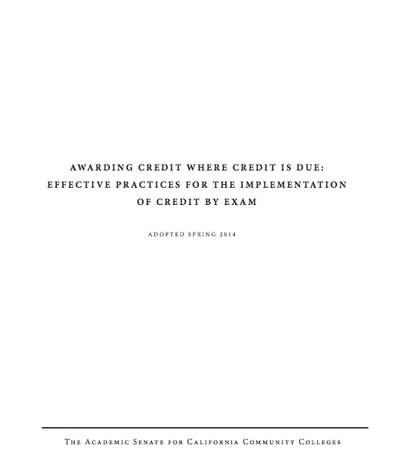
Leadership from ASCCC
Leverage prior work (2014)
ASCCC participation on Workforce and OEI steering committees
Need active consultation and collaboration of faculty leadership
ASCCC expertise and leadership helps ensure success and participation

Slide 5
ASCCC: 7.01 S16 Costs Associated with Prior Military Experience Credit
Resolved, That the [ASCCC], in conjunction with the Chancellor’s Office and other system partners, research the costs of implementation of credit for prior military experience; and
Resolved, That the [ASCCC], in conjunction with the Chancellor’s Office and other system partners, work to secure sufficient and ongoing funding to cover the costs for colleges to ensure the timely implementation and
ongoing awarding of credit for prior military experience.

Slide 6
ASCCC: 7.02 S16 Awarding Credit for Prior Learning Experience
Resolved, That the [ASCCC] work with the
Chancellor’s Office and other interested stakeholders to develop effective practices for the awarding of credit for prior military learning and experience; and
Resolved, That the [ASCCC] work with the Chancellor’s Office and other interested stakeholders to explore the option of awarding credit for forms of prior learning and experience outside of those involving military
experience.

Slide 7
Methods to Assess Prior Learning
Credit by Exam
Military
Credit
Training
Credit
Portfolio
Credit

Slide 8
CCCCO Survey – March 2016

Slide 9
CCCCO College Survey
113 colleges surveyed
3 surveys conducted Nov 2014 to Mar 2016
96 colleges participated
102 unduplicated courses reported
Units of Credit Awarded: 0.5 to 10

Slide 10
Course Identifiers and C-ID Descriptors
Colleges requested to specify the Course Identification Descriptor, if applicable
Top 3 Reported
Physical Education
Administration of Justice
Information Technology

Slide 11
Courses Frequently Reported Among C-ID, SOC, and TOP Codes
Administration of Justice
Business and Management
Information Technology

Slide 12
Other Areas of Interest
Which other fields are currently being examined for students who are not veterans or current military personnel?
Who would those students be?
Would they be in programs that offered a degree/certificate?

Slide 13
Thank you!
For more information, please email:
info@asccc.org

