Slide 1
Credit for Prior Learning – Moving the Needle
Dolores Davison, Vice President, ASCCC
Michael Wyly, Solano Community College
ASCCC Spring 2019 Plenary Session

Slide 2
CPL Convergence in California
Various CCC projects looking for ways to uncover CPL opportunities for students:
Veterans and military students (AB 2462)
Bachelor’s Degree Pilot
Nursing and military students (SB 466)
Workforce and Career/Technical (Doing What Matters for Jobs and the Economy)
Online process to connect students with CPL opportunities (Online Education Initiative)

Slide 3
CPL Workgroups, Reports, & Advisories
CPL Workgroup
Formed during Spring 2016
CCCCO, ASCCC, Colleges, Faculty Advisory Committees, CACCRAO, Financial Aid, Statewide Initiatives
Report of Survey Findings
Chancellor’s Office Advisory on Awarding Credit for Prior Learning: AB 2462 (Military Experience)

Slide 4
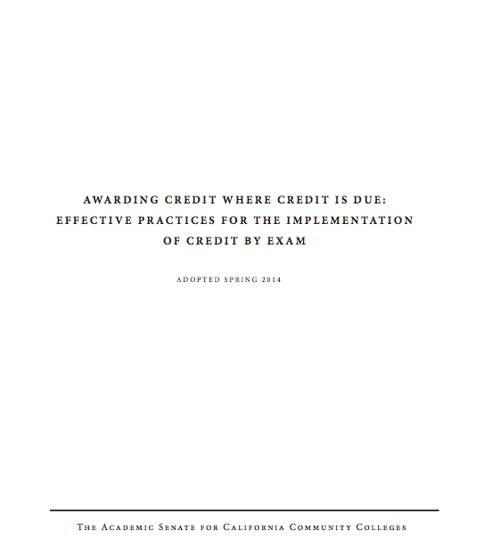
Leadership from ASCCC
Leverage prior work (2014)
ASCCC participation on Workforce and OEI steering committees
Need active consultation and collaboration of faculty leadership
ASCCC expertise and leadership helps ensure success and participation

Slide 5
ASCCC: 7.01 S16 Costs Associated with Prior Military Experience Credit
Resolved, That the [ASCCC], in conjunction with the Chancellor’s Office and other system partners, research the costs of implementation of credit for prior military experience; and
Resolved, That the [ASCCC], in conjunction with the Chancellor’s Office and other system partners, work to secure sufficient and ongoing funding to cover the costs for colleges to ensure the timely implementation and ongoing awarding of credit for prior military experience.

Slide 6
ASCCC: 7.02 S16 Awarding Credit for Prior Learning Experience
Resolved, That the [ASCCC] work with the
Chancellor’s Office and other interested stakeholders to develop effective practices for the awarding of credit for prior military learning and experience; and
Resolved, That the [ASCCC] work with the Chancellor’s Office and other interested stakeholders to explore the option of awarding credit for forms of prior learning and experience outside of those involving military experience.

Slide 7
Methods to Assess Prior Learning
Credit by Exam
Military
Credit
Training
Credit
Portfolio
Credit

Slide 8
CCCCO Survey – March 2016

Slide 9
CCCCO College Survey
113 colleges surveyed
3 surveys conducted Nov 2014 to Mar 2016
96 colleges participated
102 unduplicated courses reported
Units of Credit Awarded: 0.5 to 10
Top 3 Reported
Physical Education
Administration of Justice
Information Technology

Slide 10
Courses Frequently Reported Among C-ID, SOC, and TOP Codes
Administration of Justice
Business and Management
Information Technology

Slide 11
Saddleback College’s Project – Veterans Credit Articulation Track (V-CAT)
Types of Military Learning identified by their pilot:
Regionally Accredited Courses
Non-Collegiate Setting Courses
Non-Collegiate Setting
Occupations/Experiences

Slide 12
Goals of the Project
Minimize CTE and Transfer Pathways for Veterans to Maximize Use of VA Benefits in the Public CA Systems
Increase Intersegmental Dialog and Collaboration
Enhance Understanding of DoD Training and Experiences by IHLs and Workforce
Enhance Understanding of ACE
Build Trust Across Sectors

Slide 13
Initial Findings – Crypto Linguistics
5,000 Crypto-Linguists in Next 5 Years
12 Units and Area C2 Earned
5,000 Semesters = $2.7M in GI Bill Funds and $44M in Basic Allowance for Housing Retained
60,000 Redundant Units Saved
$10.8M in Apportionment Funds
Increase in Completion Time and Transfers/Completers
Total Savings = $57.8 million

Slide 14
Norco College – Veterans Center
Value the learning and working experiences of all veterans.
Offers “Tuition Support” (California Assembly Bill 13)
Offers intentional advisement and resource assistance for challenges such as College Fees, Books, Housing Needs, Educational Counseling and Student Support Services.
Allocates a dedicated “Space” for this specialized student population.

Slide 15
Using the Joint Services Transcript
The Joint Services Transcript (JST) provides a description of military schooling and work history in civilian language. It serves as a counseling tool for academic and career counselors in advising service members and veterans. It serves as an aid in preparing resumes and explaining Army, Coast Guard, Marine Corps, National Guard and Navy work experience to civilian employers. It also saves time and money by awarding academic credits, which means less tuition to pay and less time spent in the classroom.
The JST is accepted by more than 2,300 colleges and universities, but it is only released to the student and has to be sent to the college by the student veteran.

Slide 16
CCCCO CPL Advisory Group
Convening of stakeholders under a grant from Lumina.
Three in-person meetings to create suggested revisions to Title 5 language around credit by exam and credit for prior learning, to discuss recommendations for colleges in terms of procedures and policies, and to create a potential pilot involving colleges and disciplines.
Recruitment letters will be going out to the disciplines next week seeking faculty to be involved in the pilot.

Slide 17
Disciplines Within the Pilot
The pilot will result in cross-walks in a total of seven (7) disciplines that can be shared with statewide faculty and used for multiple students with the same training credentials, and a model process that can be applied by faculty across disciplines. The disciplines are:
Administration of justice
Automotive technology
Business administration and management
Cybersecurity
Fire science
Health
Information Technology

Slide 18
Thank you!
For more information, please email:
info@asccc.org

