Slide 1
Implementing Credit for Prior Learning
February 11, 2020 3:00-4:00pm
Peggy Campo, Norco College Anatomy and Physiology
Mayra Cruz, Academic Senate for California Community Colleges Treasurer
Chantee Guiney, California Chancellor’s Office Education Services and Supports
Jackie Martin, Palomar College, Business & Administration Department
Sharon Sampson, Grossmont College Administration of Justice Department
Notes:
Description:
Credit for Prior Learning (CPL) is an evidence-based, transformative and equity driven strategy that awards college credit to students for validated college-level skills and knowledge gained outside of a college classroom. Join us for a conversation on how to operationalize and successfully implement credit for prior learning at your college. The session will also provide an overview of resources available for faculty who will assess prior learning.

Slide 2
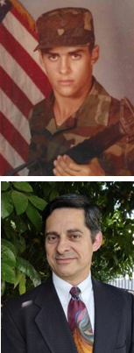
Student Story
Darrell Palmer is a Norco College student and a U.S. Army veteran who served as a Tactical Satellite/Microwave Systems Operator (MOS26Q).
In the Spring of 2020, Mr. Palmer was awarded 26 units applicable credit towards his Digital Electronics AS degree getting back 6 months of his life and saving thousands of dollars on student fees, textbook costs, and living expenses.
https://knowledgebase.militaryarticulationplatform.org/veterans-story-darrell-palmer/

Slide 3
After attending this session, attendees will be able to:
Summarize what Credit for Prior Learning is and describe its benefits to students
Access state regulations and general resources related to CPL
Identify barriers to delivering access to CPL and strategies to overcome them
Share CPL resources

Slide 4
Notes:
•The Board of Governors unanimously approved an amendment to title 5 § 55050, Credit for Prior Learning, to support and achieve the requirements enacted in statute and the goals identified by the Credit for Prior Learning (CPL) Advisory Committee (effective March 20, 2020)
•The CPL policy is designed to help community colleges meet goals and commitments outlined in the Vision for Success, including to increase degree and certificate completion, close equity gaps, and meet California’s projected workforce demands
•Policy reforms encourage districts and colleges to provide students consistent and equitable access to CPL, to promote quality, integrity and equity in the award of credit; makes programs more accessible to millions of students without certificates or degrees

Slide 5
TIMELINE
ASCCC Faculty Discipline Crosswalk Workshop Convening
Districts’ CPL policy certifications due to CCCCO
8/20
2021
Spring 2020
12/20
CO system-wide policy memorandum
CO and Academic Senate (ASCCC) collaborations on CCC CPL events

Slide 6
What Is Credit for Prior Learning (CPL)
Industry Training
Portfolio Based Assessment
Military Training
Gov’t Training
Notes:
Workforce and community-based training resulting in certifications, licenses, or certificates of completion.
Military training and occupational experiences.
National examinations, including the College Level Examination Program (CLEP), Advanced Placement (AP), or challenge exams offered by colleges resulting in college credit.
Individual assessments in which students document and demonstrate college-level learning gained through work experiences, civic activities, community volunteerism, and other informal learning experiences

Slide 7
Notes:
The national emphasis on increasing the number of individuals holding high-quality, workforce-valued postsecondary credentials and degrees is causing the broader higher education community to examine strategies for accelerating learning and supporting students to credential or degree completion, while at the same time not compromising on issues of academic quality or rigor. CPL is emerging as one way to address this issue.

Slide 8
Visioning: Equity, Opportunity & Economic Prosperity
What stage is your college at in implementation?
”Today, more than ever, education equals opportunity. In fact, college-level learning is now seen as key – to individual prosperity, to economic security, and to the enduring strength of our democracy.” Lumina Foundation
Notes:
It’s a critical strategy for ensuring abundant economic opportunities for our citizens, enhanced economic competitiveness for our businesses, and robust economic growth for our state. Our workforce development mandate is clear: To enhance personal prosperity, economic security and our democratic society, we must close existing knowledge and skill gaps. To be competitive in a talent-hungry, talent-driven global economy, the CCCs must increase the number and percentage of its citizens with high-quality college degrees or postsecondary credentials of value in the marketplace
Padlet link- https://padlet.com/cruzmayra/y6x2xghuxf8jch32 Share on the Chat
Post the question.
1.What stage is your college at in implementation?

Slide 9
Artificial Barriers
Implicit biases
Understanding students’ lived experiences
Equitable assessment
Concern about learning standards “lowering standards”
Enrollment concerns; loss of FTES and funding
Concerns about CSU/UC’s assessment may not align
Image istocksphoto
Notes:
Many students come to CCC with learning acquired outside the traditional classroom.
They may have learning that was acquired from a corporate training program or through extensive volunteer activity.
It may be from the military or workplace experience
Flush out each bullet point and how to overcome them
Implicit bias
Spend time interrogating your individual bias
Assess the work and not the person
Streamlined and consistent process
The unwillingness of colleges to accept prior learning stems from a long-standing faculty skepticism of, and bias against, learning that happened somewhere else, believing what was learned elsewhere to be of lower or inferior quality. The bias against prior learning is very similar to the bias against accepting transfer of credit from other institutions.
Additional barriers that many schools have put up against prior learning are rules that only allow credits earned through prior learning to be applied as elective credits or placing caps on the number of credits that can be earned through prior learning assessment.

Slide 10
Implicit Bias
Notes:
Spend time interrogating your individual bias
Assess the work and not the person
Streamlined and consistent process
The unwillingness of colleges to accept prior learning stems from a long-standing faculty skepticism of, and bias against, learning that happened somewhere else, believing what was learned elsewhere to be of lower or inferior quality. The bias against prior learning is very similar to the bias against accepting transfer of credit from other institutions.
Additional barriers that many schools have put up against prior learning are rules that only allow credits earned through prior learning to be applied as elective credits or placing caps on the number of credits that can be earned through prior learning assessment.

Slide 11
Understanding students’ lived experiences
Notes:
The CCC value the diversity of our students. This diversity includes the unique experiences, interests, and intellectual pursuits that lead to the acquisition of knowledge that may be at the college level. College-level learning is the same, whether acquired in the traditional college classroom or through non-collegiate sources. This equivalency is validated by academically sound and rigorous prior learning assessment methods

Slide 12
Re-imagining Different Pathways
Equity
Time spent in career path
Funding
Success
Validating
Jobs and a successful career
Image by Study.com

Slide 13
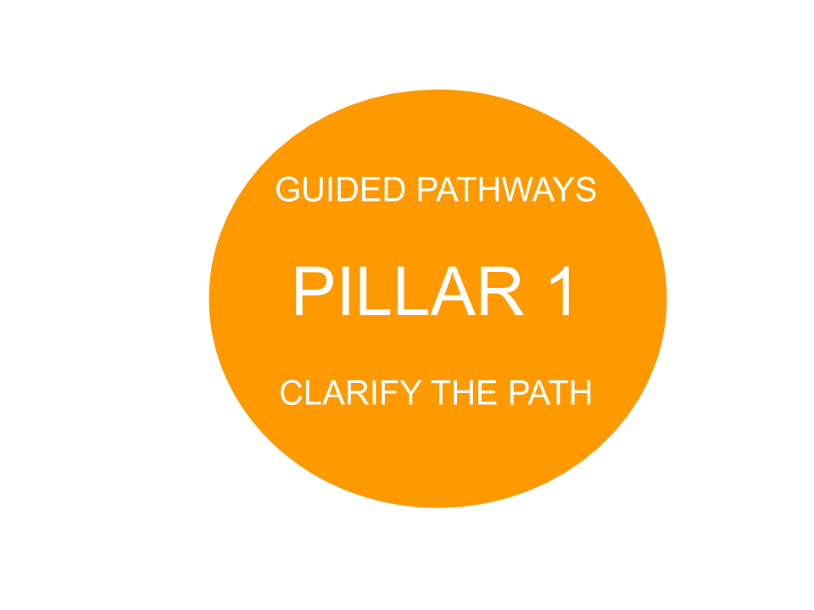
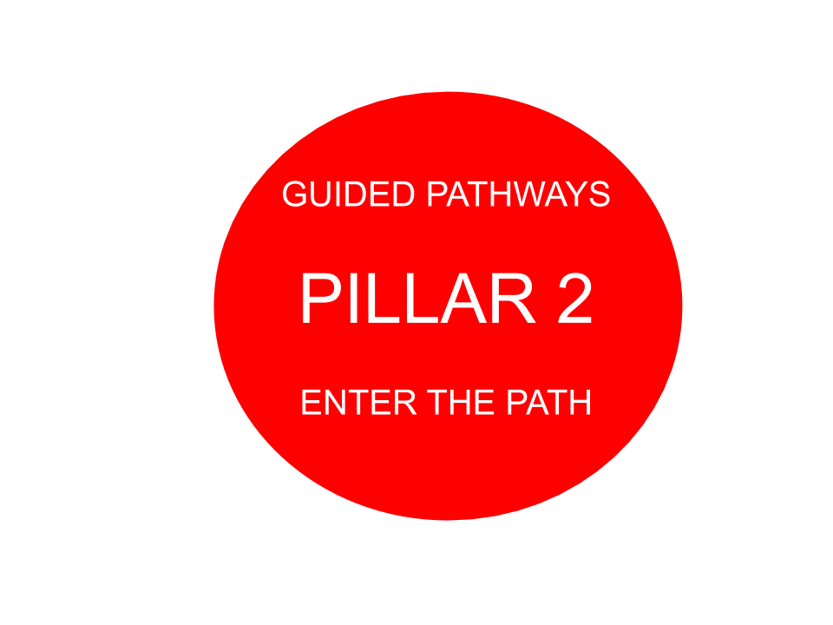
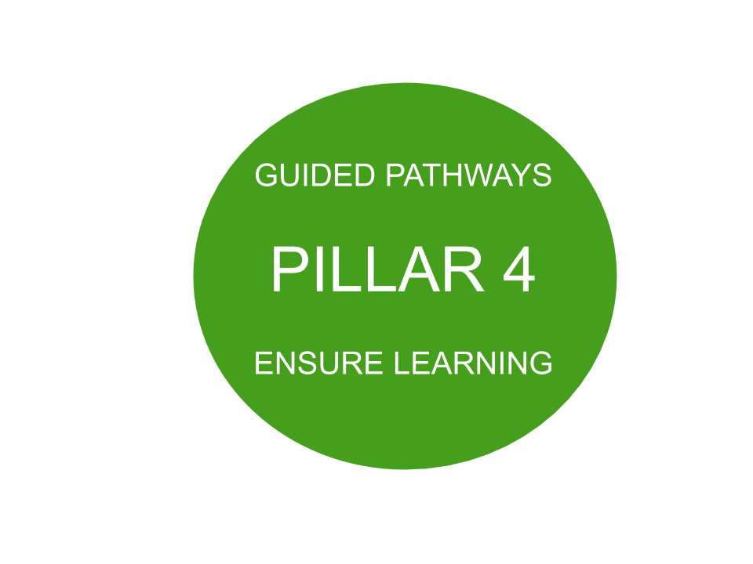
CPL & Guided Pathways
CCC Vision Goals Guided Pathways Strong Workforce
“The pandemic-induced recession presents a uniquely important opportunity to support unemployed and underemployed Californians, particularly those of color, in reskilling and upskilling to secure better-paying jobs in the future.”
“When colleges require students to take courses with content they have already mastered on the job, in the military,... potential graduates often must spend extra time and money duplicating their education—or deferring it.”
“By contrast, more uniform and widely implemented CPL policies throughout California’s public higher education segments could elevate the economic trajectories for hundreds of thousands of uncredentialed adults — while helping the state increase degree attainment and meet workforce demands.” California Competes: Higher Education for Stronger Economy

Slide 14
Benefits to the College
Access to diverse students
Increased enrollment
Streamlined processes to
completion of awards
Increased number of awards
(certificates/degrees)
Meeting demand
Notes:
CCs can attract, retain and graduate new student populations, strengthen employer relationships, and remain more competitive in the higher education landscape

Slide 15
Benefits to Students
Accelerated completion
Motivation to persist
Flexibility
Cost saving
Eliminate redundancies for students
Increase transfer opportunities
Notes:
Adult students who received CPL credit were 2.5 times more likely to persist in their education and complete their degrees than students who received no credit for prior learning.
The acceptance of CPL can open up a world of opportunity to students, breaking down traditional barriers to information.

Slide 16
Benefits to Employers
Employability
Meeting unfulfilled workforce demands
Providing a skilled workforce
Notes:
Currently, the nation faces the challenge of having a skills and training gap that contributes to lower employment rates. Applying CPL allows colleges and universities to produce more employable graduates with skills that are in demand by today’s workforce.
Our current education and workforce training system will fail to produce those skilled workers, falling short by 3 million associate or bachelor’s degrees, and almost 5 million post-secondary credentials. All of this means that important jobs will go unfilled because employers can’t find workers with the right skills to fill them. CPL has the potential to produce more graduates.12

Slide 17
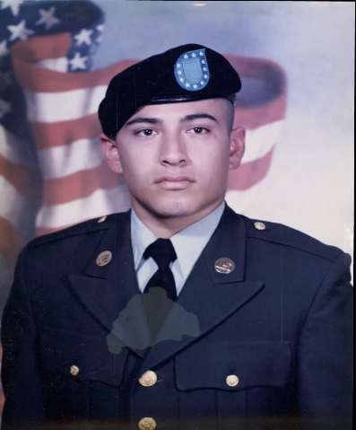
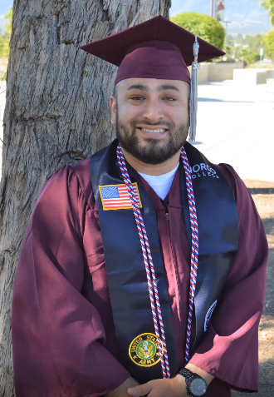
Student Story
Edwin Duarte served for 13 years in the U.S Army as a Forward Observer (13Fox).
Upon returning to civilian life, Edwin enrolled at Norco College where his joint service transcript (JST) was evaluated and 15 units of credit for prior learning went towards his associate’s degree in History and Political Science.
https://knowledgebase.militaryarticulationplatform.org/veterans-story/

Slide 18
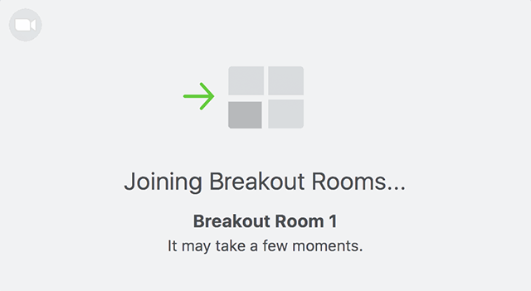
Strategies for Implementation and Marketing
Notes:
Breakout (5) with structure discussion. Each presenter is assigned to a breakout; assign participants randomly to breakout rooms.
Google doc link:
https://docs.google.com/document/d/17nSDY17cNixEptk6-u2PTs7sw7ts-Ot_YKj1qxUWkQQ/edit?usp=sharing
Questions:
How would you demystify CPL at your campus? Think broadly.
How do you increase participation and buy-in?
What strategies would you need implement to notify students regarding CPL?
What questions to you have?
What would faculty need to be successful at implementing CPL?
Return to Main Room- highlight a few ideas
----------------------------------------------------------------------------------------
Palomar College has almost completely operationalized its CPL program. I could share a slideshow here from Palomar?
Know your learner populations.
Identify sources of learning.
Start with achievable goals.
Create comprehensive, accessible policies.
Build CPL awareness and expertise.
Connect and integrate programs and services
Marketing
Accessibility
Policy Requirements: Pursuant to Education Code statute 66025.71, each community college campus shall post on its Internet Web site the most recently adopted CPL policy.

Slide 19
CPL Fully Implemented
Palomar College has operationalized and institutionalized Credit for Prior Learning.
The web site is an interactive site where students go from Step 1 through the entire process of mapping their certificate/degree, locate courses in that program, complete a survey, meet with the faculty and/or chair, complete the assessment for college credit, and have their course transcripted.
https://www2.palomar.edu/pages/cpl/credit-for-prior-learning-course-list/
https://docs.google.com/presentation/d/1rqNSGjJUd4Ip-zHBTKrLqPp90l_oaI_H6Q9ALorWI1E/edit#slide=id.gb92a14cd6b_0_6

Slide 20
CPL Resources
CPL Memorandum: Guidance and System-wide Policy Advisory for the Approved California Code of Regulations, title 5 section 55050, Credit for Prior Learning (CPL), Effective March 20, 2020
California Education Code, Statutes 66025.7, 66025.71
CCR title 5, § 55050. Credit for Prior Learning
CCC Vision Resource Center (VRC)
CPL Policy Guidance Memorandum
CPL Implementation Toolkit
CPL Community Forum
https://www.acenet.edu/Events/Pages/Demystifying-Student-Success-Building-Credit-for-Prior-Learning-Opportunities.aspx
https://www.cccco.edu/-/media/CCCCO-Website/Reports/success-center-cpl-initiative-report-for-cccco-final.pdf?la=en&hash=2B50F17C0A47775A58EAF6631613B6A4D537CB8F
Notes:
The summit is Friday, February 26 from 9:00 a.m. – 12:00 p.m. Click here for more information.
https://www.acenet.edu/Events/Pages/Demystifying-Student-Success-Building-Credit-for-Prior-Learning-Opportunities.aspx

Slide 21
For more information and support
info@asccc.org
Peggy Campo Peggy.Campo@norcocollege.edu
Mayra Cruz cruzmayra@deanza.edu
Chantee Guiney cguiney@cccco.edu
Jackie Martin ljmartin@palomar.edu
Sharon Sampson sharon.sampson@gcccd.edu

