Slide 1
Credit for Prior Learning
Dolores Davison, Secretary, ASCCC
Chantée Guiney, Specialist, CCCCO
Barbara Illowsky, Chief Academic Affairs Officer, OEI
July 14, 2017
Curriculum Institute

Slide 2
CPL Convergence in California
Various CCC projects looking for ways to uncover CPL opportunities for students
Veterans and military students (AB 2462)
Bachelor’s Degree Pilot
Nursing and military students (SB 466)
Workforce and Career/Technical (Doing What Matters for Jobs and the Economy)
Online process to connect students with CPL opportunities (Online Education Initiative)

Slide 3
CPL Workgroups, Reports, & Advisories
CPL Workgroup
Formed during Spring 2016
CCCCO, ASCCC, Colleges, Faculty Advisory Committees, CACCRAO, Financial Aid, Statewide Initiatives
Report of Survey Findings
Chancellor’s Office Advisory on Awarding Credit for Prior Learning: AB 2462 (Military Experience)

Slide 4
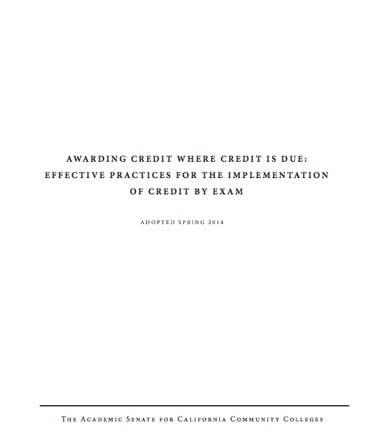
Leadership from ASCCC
Leverage their prior work (2014)
ASCCC participation on Workforce and OEI steering committees
Need active consultation and collaboration of faculty leadership
ASCCC expertise and leadership helps ensure success and participation

Slide 5
ASCCC: 7.01 S16 Costs Associated with Prior Military Experience Credit
Resolved, That the [ASCCC], in conjunction with the Chancellor’s Office and other system partners, research the costs of implementation of credit for prior military experience; and
Resolved, That the [ASCCC], in conjunction with the Chancellor’s Office and other system partners, work to secure sufficient and ongoing funding to cover the costs for colleges to ensure the timely implementation and
ongoing awarding of credit for prior military experience.

Slide 6
ASCCC: 7.02 S16 Awarding Credit for Prior Learning Experience
Resolved, That the [ASCCC] work with the
Chancellor’s Office and other interested stakeholders to develop effective practices for the awarding of credit for prior military learning and experience; and
Resolved, That the [ASCCC] work with the Chancellor’s Office and other interested stakeholders to explore the option of awarding credit for forms of prior learning and experience outside of those involving military
experience.

Slide 7
CPL Collaboration Across CCCs

Slide 8
Workforce Goals
Doing What Matters / Strong Workforce Task Force – “Lessons Learned”
“…recognize prior learning and work experience for adults and develop mechanisms to award credit toward CTE pathways.”
Lessons Learned, Workforce Data & Outcomes http://doingwhatmatters.cccco.edu/StrongWorkforce/LessonsLearned.aspx
Notes:
Sample of language defining how credit for prior learning is included as a component of a statewide initiative.

Slide 9
CCC Online Education Initiative
Focus on increased access and helping student complete their educational goals, including across colleges
“Identify and address the needs of students who have prior learning and wish to acquire course credit through an online process (including but not limited to Credit by Exam)…”
CCC Online Education Initiative Work Plan, Objective 2E
Notes:
Sample of language defining how credit for prior learning is included as a component of a statewide initiative.

Slide 10
Catalyst for the Conversation
AB 2462 (Block 2012)
Provisions established under § 66025.7 of the California Education Code:
“…the Chancellor of the California Community Colleges, using common course descriptors and pertinent recommendations of the American Council on Education, shall determine for which courses credit should be awarded for prior military experience.”

Slide 11
Awarding Community College Credit for Prior Military Experience (AB 2462)

Slide 12
CCCCO College Surveys
113 colleges surveyed
3 surveys conducted Nov 2014 to Mar 2016
96 colleges participated
102 unduplicated courses reported
Units of Credit Awarded: 0.5 to 10

Slide 13
Course Identifiers C-ID Descriptor
Colleges requested to specify the Course Identification Descriptor, if applicable
Top 3 Reported
Physical Education
Administration of Justice
Information Technology

Slide 14
Course Identifiers – SOC Code
Colleges requested to specify respective service members Opportunity College (SOC) Code, if applicable
Top 3 Reported
Accounting
Administration of Justice
Automotive

Slide 15
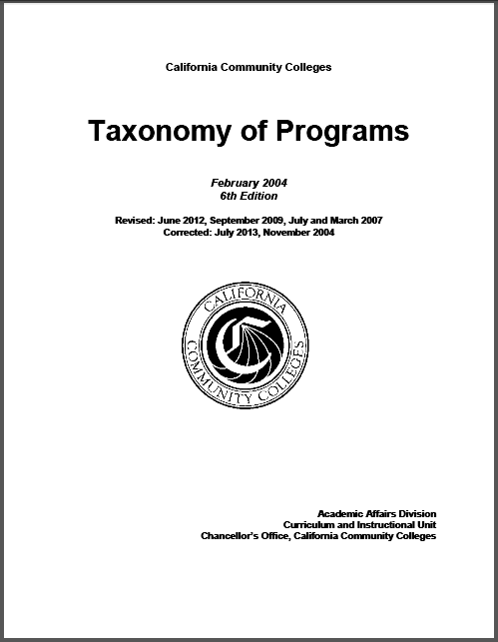
Course Identifiers – TOP Code
Courses classified according to their respective Taxonomy of Programs (TOP) Code
Top 3 Reported
Physical Education
Office Technology
Automotive

Slide 16
Courses Frequently Reported Among C-ID, SOC, and TOP Codes
Administration of Justice
Business and Management
Information Technology

Slide 17
Research by CAEL via DataMart
Identify top CCC institutions per district by veterans and military students (VMS) enrollment
Determine most common TOPs for VMS by the top schools and system-wide program awards

Slide 18
Top 10 Colleges Based on Average VMS Enrollment in 2015-16
Institution | VMS Enrollment
Solano | 7171
Palomar | 4880
San Diego Mesa | 3339
American River | 2985
San Francisco | 2588
Mira Costa | 2425
Southwestern | 2287
Mt San Jacinto | 2120
San Diego Miramar | 2107
Saddleback | 2091
Total: | 31,993
Notes:
Average based on Fall 2015 and Spring 2016 Enrollments
Total 31993 out of 106643 or 30%

Slide 19
Top 10 Instructional Program TOP Codes at Target Schools, 2015-16
TOP Codes | Program Awards
Transfer Studies – 490110 | 290
Biological and Physical Sciences (including Mathematics) - 490200 | 276
Administration of Justice – 210500 | 202
Paramedic – 125100 | 126
Social Sciences, General – 220100 | 122
Liberal Arts and Sciences, General – 490100 | 121
Liberal Studies – 490200 | 106
Business Administration – 050500 | 99
Fire Technology – 213300 | 88
Psychology, General - 200100 | 52
Total: | 1,482
Notes:
The information provided by the CCCS for analysis was the program awards (i.e. completions) for VMS in the 2015-16 academic year
The benefit of using the program awards data is that they reflect the true intentions of the VMS population. This is not always the case for these students prior to completion because many are required to state a “major” for VA reporting purposes before they have made a final decision.

Slide 20
Top 10 Instructional Discipline TOP Categories for VMS System-wide, 2015-16
Instructional Disciplines | Program Awards
Interdisciplinary Studies- 49 | 2261
Business and Management – 05 | 1160
Public and Protective Services – 21 | 1138
Engineering and Industrial Technologies – 09 | 1068
Health – 12 | 615
Social Sciences – 22 | 590
Information Technology – 07 | 192
Family & Consumer Sciences -13 | 168
Psychology – 20 | 162
Fine and Applied Arts – 10 | 158
Total: | 7,512
Notes:
Given the relatively low number of codes based on awards for the above colleges, CAEL also analyzed all instructional discipline TOP codes for program awards throughout the community college system to detect any patterns or clusters. In Table 3, we grouped the instructional discipline TOPs by their general program classifications as listed in the sixth edition of the California Community Colleges Taxonomy of Programs (2013).
As indicated, the first four programs have significantly higher numbers of program awards. Program classifications with over 1,000 awards are:
Interdisciplinary
Business and Management
Public and Protective Services
Engineering and Industrial Technologies

Slide 21
Top 10 Instructional Program TOP codes for VMS System-wide, 2015-16
Instructional Program Codes | Program Awards
Transfer Studies – 490110 | 781
Administration of Justice – 210500 | 605
Biological and Physical Sciences (and Mathematics) 490200 | 541
Business Administration – 050500 | 518
Liberal Arts and Sciences, General – 490100 | 506
Social Sciences, General – 220100 | 331
Business Management – 050600 | 238
Fire Technology – 213300 | 189
Automotive Technology – 094800 | 183
Liberal Studies – 490120 | 162
Total: | 4,054
Notes:
The above instructional program TOPs are similar in content to the target colleges with high military and veteran populations with some variance in rankings. Specifically, the top instructional program codes for the target schools and the system are the same in:
Transfer Studies – 490110
Biological and Physical Sciences (and Mathematics) – 490200
Liberal Arts and Sciences, General – 490100
Fire Technology – 213300
Social Sciences, General – 220100
Liberal Studies – 490120
Administration of Justice - 210500
The system-wide common TOP instructional program codes for VMS include Business Management and Automotive Technology, which are not in the top ten TOPs for the target colleges. Paramedic and Psychology are included in the top ten VMS TOP instructional program codes for the target colleges but are not included in the system-wide top list.
Top ten TOP instructional program codes in Table 4 account for almost half of all VMS program awards (4,054 out of 8,310 total awards).
Even taking a conservative approach of analyzing the number of awards in traditional transfer programs (Transfer Studies, Liberal Arts and Sciences, General and Liberal Studies), the number of awards reflects 36% of the total top ten majors/concentrations. If Biological and Physical Sciences (and Mathematics), Business Administration, Social Sciences, General, and Business Management are also included, VMS reflects 76% of the total top ten instructional program TOPs.

Slide 22
Observations
There is strong consistency between program awards of top colleges and system.
Most VMS program awards are geared towards transfers into four-year programs.
Transferability is a key issue.
Analysis allows CA to prioritize its efforts for PLA and potential gap programming

Slide 23
Methods to Assess Prior Learning
Credit by Exam
Military
Credit
Training
Credit
Portfolio
Credit

Slide 24
Trends & Effective Practices
Crosswalks
Bridge/Gap Courses
and Programs

Slide 25
Example: IVY TECH CC
CPL offerings include:
AP and IB
CLEP
DSST/DANTES
Credit for industry certifications (through a crosswalk)
Non-military training (using ACE recommendations)
UExcel Exams
Portfolios
Military Credit (though a crosswalk using ACE recommendations)
Notes:
Point of this slide is to note that crosswalks are never done in isolation. They are always part of a larger PLA program and plan. Development of some parts (whether academic or administrative) can influence others. For example, Ivy Tech has crosswalks for non-military certifications, and they use a similar process to develop these and to make students aware of them.

Slide 26
IVY TECH COMMUNITY COLLEGE
Crosswalk Procedure
Reviews of ACE recommendations conducted by curriculum committees
Ivy Tech focuses specifically on trainings represented on JSTs
Overseen by Vice Chancellor for Academic Affairs
Students must submit JSTs for credit
Students may receive credit for major requirements or degree program electives
Notes:
Groups of faculty members within a specific discipline make the decisions as to which courses, if any, military training my match.
Ivy Tech focuses on individual military trainings (and their ACE recommendations) listed on the joint service transcripts (JSTs) rather than examining the military occupational specialty (MOS) evaluations (which also have ACE recommendations).

Slide 27
Crosswalking SLOs – a preliminary sample
DEMO PURPOSES ONLY!
AJ - 140 - Criminal Investigation - Summarized Learning Outcomes (3 credits) | ACE - Military Police Investigations - 830-ASIV5
Concepts of documentation in investigation process | Report writing; impression documentation
Understanding of implication of evidence | Criminalistics, collecting evidence, chain of custody, tactics and techniques Collecting evidence from a variety of sources, proper procedure, analysis, and judicial considerations
Crucial ethical issues | Judicial considerations Addressed by several topics including chain of custody, crime scene processing, evidence room procedures, search and seizure, suspect interrogation, and victim interviews Military Police Code of Ethics integrated into course and pre-requisites
Stages of investigation process | Plan complex criminal investigations; plan covert narcotics operations
First responder procedures | Crime scene processing and analysis; additional areas covered in military police training
Crime scene management | Crime scene collection, processing, and investigative skill
Forensics examination basics | Computer and physical forensics in various forms covered
Interrogation and interviews | Interrogation
Information sources and data systems | Criminalistics; various information sources covered (including computer forensics, sketches, photography, physical evidence, fibers, fingerprints, etc.)
Judicial role | Court room testimony
http://www2.acenet.edu/militaryguide/ShowAceCourses.cfm?ACEID=1328134
Notes:
Example of a potential crosswalk between a California community college course and an ACE military course evaluation. This was put together by CAEL staff who are not subject matter experts in criminal justice – this is just a sample. Any actual crosswalk would rely on processes endorsed by the Academic Senate and would require CCC subject matter experts.

Slide 28
OEI Guiding Principle
Focus on how technology can connect students with CPL opportunities in our system.
(In other words, we don’t want to re-write the book on how credit is awarded!)
Notes:
The OEI is committed to helping connect students with credit for prior learning opportunities, as outlined in the OEI grant. We rely on colleges and faculty to develop processes and identify any opportunities for students to earn credit by exam, through crosswalks, or other prior learning assessment methods.

Slide 29
Vision: Create an Online Tool
Accelerate time to completion by leveraging military training and experience
Connect students with CPL crosswalks or other credit opportunities have been identified using online tool
Enhanced messaging, starting with veterans & military students to connect with additional support resources

Slide 30
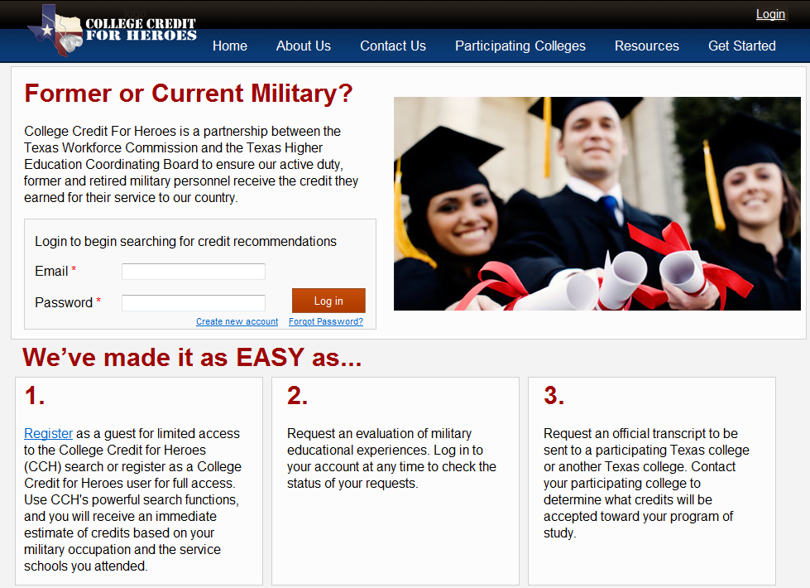
Example: Texas
www.collegecreditforheroes.org
Notes:
Example, including a screenshot of the Texas College Credit for Heroes portal that helps match students to CPL opportunities across over 30 state institutions.

Slide 31
Example:MNSCU Crosswalk
Notes:
Example of the Minnesota State Colleges and Universities’ portal for students to match military training to CPL opportunities.

Slide 32
Achieving the Vision
Requires:
Partnerships (CCCCO, workgroups, initiatives, ASCCC, colleges, and discipline faculty)
Creativity: “How can we do this in a way that meets the needs of students and supports faculty?”
Trust and transparency between all parties
Identify Resources – what’s needed? (financial, expertise, technical, other?)

Slide 33
Additional Resources
Chancellor’s Office Advisory: Credit for Prior Learning (pending)
Chancellor's Office Report on AB 2462 (2015)
System Advisory on Prior Learning Assessment (2015)
Academic Senate Report on Credit By Examination (2014)
Chancellor’s Office Veterans Summit Presentations

Slide 34
Questions? Comments?

Slide 35
Thank you!
Dolores Davison davisondolores@fhda.edu Chantée Guiney cguiney@cccco.edu
Barbara Illowsky billowsky@cccOnlineEd.org

