Slide 1
Credit for Prior Learning
Dolores Davison, Secretary, ASCCC
Jory Hadsell, Executive Director, OEI
Barbara Illowsky, Chief Academic Affairs Officer, OEI
March 18, 2017
Instructional Design & Innovation Institute

Slide 2
CPL Convergence in California
Various CCC projects looking for ways to uncover CPL opportunities for students
Veterans and military students (AB 2462)
Bachelor’s Degree Pilot
Nursing and military students (SB 466)
Workforce and Career/Technical (Doing What Matters for Jobs and the Economy)
Online process to connect students with CPL opportunities (Online Education Initiative)

Slide 3
CPL Workgroups, Reports, & Advisories
CPL Workgroup
Formed during Spring 2016
CCCCO, ASCCC, Colleges, Faculty Advisory Committees, CACCRAO, Financial Aid, Statewide Initiatives
Report of Survey Findings
Chancellor’s Office Advisory on Awarding Credit for Prior Learning: AB 2462 (Military Experience)

Slide 4
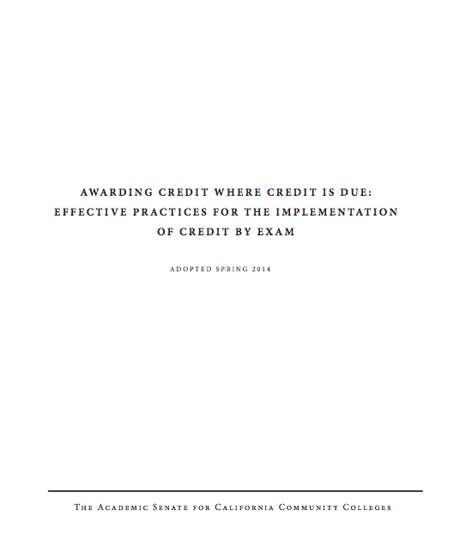
Leadership from ASCCC
Leverage their prior work (2014)
ASCCC participation on Workforce and OEI steering committees
Need active consultation and collaboration of faculty leadership
ASCCC expertise and leadership helps ensure success and participation

Slide 5
ASCCC: 7.01 S16 Costs Associated with Prior Military Experience Credit
Resolved, That the [ASCCC], in conjunction with the Chancellor’s Office and other system partners, research the costs of implementation of credit for prior military experience; and
Resolved, That the [ASCCC], in conjunction with the Chancellor’s Office and other system partners, work to secure sufficient and ongoing funding to cover the costs for colleges to ensure the timely implementation and
ongoing awarding of credit for prior military experience.

Slide 6
ASCCC: 7.02 S16 Awarding Credit for Prior Learning Experience
Resolved, That the [ASCCC] work with the
Chancellor’s Office and other interested stakeholders to develop effective practices for the awarding of credit for prior military learning and experience; and
Resolved, That the [ASCCC] work with the Chancellor’s Office and other interested stakeholders to explore the option of awarding credit for forms of prior learning and experience outside of those involving military
experience.

Slide 7
CPL Collaboration Across CCCs

Slide 8
Workforce Goals
Doing What Matters / Strong Workforce Task Force – “Lessons Learned”
“…recognize prior learning and work experience for adults and develop mechanisms to award credit toward CTE pathways.”
Lessons Learned, Workforce Data & Outcomes http://doingwhatmatters.cccco.edu/StrongWorkforce/LessonsLearned.aspx
Notes:
Sample of language defining how credit for prior learning is included as a component of a statewide initiative.

Slide 9
CCC Online Education Initiative
Focus on increased access and helping student complete their educational goals, including across colleges
“Identify and address the needs of students who have prior learning and wish to acquire course credit through an online process (including but not limited to Credit by Exam)…”
CCC Online Education Initiative Work Plan, Objective 2E
Notes:
Sample of language defining how credit for prior learning is included as a component of a statewide initiative.

Slide 10
Catalyst for the Conversation
AB 2462 (Block 2012)
Provisions established under § 66025.7 of the California Education Code:
“…the Chancellor of the California Community Colleges, using common course descriptors and pertinent recommendations of the American Council on Education, shall determine for which courses credit should be awarded for prior military experience.”

Slide 11
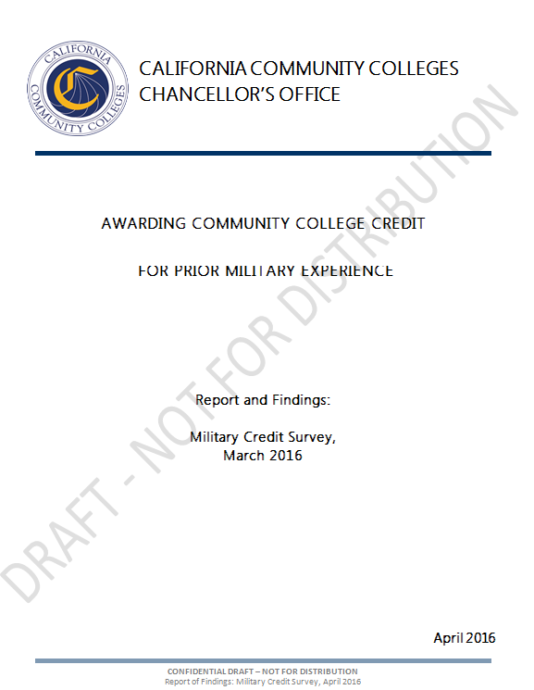
Awarding Community College Credit for Prior Military Experience (AB 2462)

Slide 12
CCCCO College Surveys
113 colleges surveyed
3 surveys conducted Nov 2014 to Mar 2016
96 colleges participated
102 unduplicated courses reported
Units of Credit Awarded: 0.5 to 10

Slide 13
Course Identifiers C-ID Descriptor
Colleges requested to specify the Course Identification Descriptor, if applicable
Top 3 Reported
Physical Education
Administration of Justice
Information Technology

Slide 14
Course Identifiers – SOC Code
Colleges requested to specify respective service members Opportunity College (SOC) Code, if applicable
Top 3 Reported
Accounting
Administration of Justice
Automotive

Slide 15
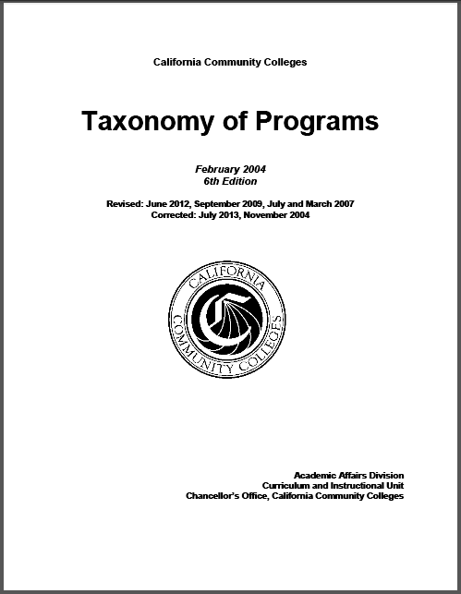
Course Identifiers – TOP Code
Courses classified according to their respective Taxonomy of Programs (TOP) Code
Top 3 Reported
Physical Education
Office Technology
Automotive

Slide 16
Courses Frequently Reported Among C-ID, SOC, and TOP Codes
Administration of Justice
Business and Management
Information Technology

Slide 17
Methods to Assess Prior Learning
Credit by Exam
Military
Credit
Training
Credit
Portfolio
Credit

Slide 18
Trends & Effective Practices
Crosswalks
Bridge/Gap Courses
and Programs

Slide 19
Example: IVY TECH CC
CPL offerings include:
AP and IB
CLEP
DSST/DANTES
Credit for industry certifications (through a crosswalk)
Non-military training (using ACE recommendations)
UExcel Exams
Portfolios
Military Credit (though a crosswalk using ACE recommendations)
Notes:
Point of this slide is to note that crosswalks are never done in isolation. They are always part of a larger PLA program and plan. Development of some parts (whether academic or administrative) can influence others. For example, Ivy Tech has crosswalks for non-military certifications, and they use a similar process to develop these and to make students aware of them.

Slide 20
IVY TECH COMMUNITY COLLEGE
Crosswalk Procedure
Reviews of ACE recommendations conducted by curriculum committees
Ivy Tech focuses specifically on trainings represented on JSTs
Overseen by Vice Chancellor for Academic Affairs
Students must submit JSTs for credit
Students may receive credit for major requirements or degree program electives
Notes:
Groups of faculty members within a specific discipline make the decisions as to which courses, if any, military training my match.
Ivy Tech focuses on individual military trainings (and their ACE recommendations) listed on the joint service transcripts (JSTs) rather than examining the military occupational specialty (MOS) evaluations (which also have ACE recommendations).

Slide 21
Crosswalking SLOs – a preliminary sample
DEMO PURPOSES ONLY!
AJ - 140 - Criminal Investigation - Summarized Learning Outcomes (3 credits) | ACE - Military Police Investigations - 830-ASIV5
Concepts of documentation in investigation process | Report writing; impression documentation
Understanding of implication of evidence | Criminalistics, collecting evidence, chain of custody, tactics and techniques Collecting evidence from a variety of sources, proper procedure, analysis, and judicial considerations
Crucial ethical issues | Judicial considerations Addressed by several topics including chain of custody, crime scene processing, evidence room procedures, search and seizure, suspect interrogation, and victim interviews Military Police Code of Ethics integrated into course and pre-requisites
Stages of investigation process | Plan complex criminal investigations; plan covert narcotics operations
First responder procedures | Crime scene processing and analysis; additional areas covered in military police training
Crime scene management | Crime scene collection, processing, and investigative skill
Forensics examination basics | Computer and physical forensics in various forms covered
Interrogation and interviews | Interrogation
Information sources and data systems | Criminalistics; various information sources covered (including computer forensics, sketches, photography, physical evidence, fibers, fingerprints, etc.)
Judicial role | Court room testimony
http://www2.acenet.edu/militaryguide/ShowAceCourses.cfm?ACEID=1328134
Notes:
Example of a potential crosswalk between a California community college course and an ACE military course evaluation. This was put together by CAEL staff who are not subject matter experts in criminal justice – this is just a sample. Any actual crosswalk would rely on processes endorsed by the Academic Senate and would require CCC subject matter experts.

Slide 22
OEI Guiding Principle
Focus on how technology can connect students with CPL opportunities in our system.
(In other words, we don’t want to re-write the book on how credit is awarded!)
Notes:
The OEI is committed to helping connect students with credit for prior learning opportunities, as outlined in the OEI grant. We rely on colleges and faculty to develop processes and identify any opportunities for students to earn credit by exam, through crosswalks, or other prior learning assessment methods.

Slide 23
Vision: Create an Online Tool
Accelerate time to completion by leveraging military training and experience
Connect students with CPL crosswalks or other credit opportunities have been identified using online tool
Enhanced messaging, starting with veterans & military students to connect with additional support resources

Slide 24
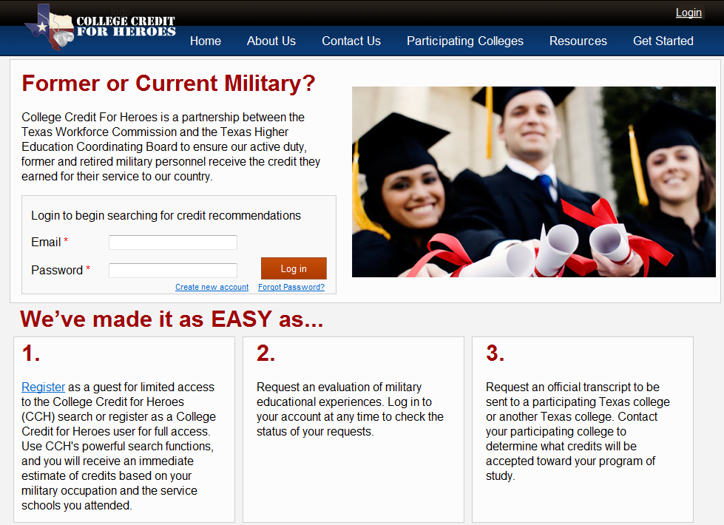
Example: Texas
www.collegecreditforheroes.org
Notes:
Example, including a screenshot of the Texas College Credit for Heroes portal that helps match students to CPL opportunities across over 30 state institutions.

Slide 25
Example:MNSCU Crosswalk
Notes:
Example of the Minnesota State Colleges and Universities’ portal for students to match military training to CPL opportunities.

Slide 26
Achieving the Vision
Requires:
Partnerships (CCCCO, workgroups, initiatives, ASCCC, colleges, and discipline faculty)
Creativity: “How can we do this in a way that meets the needs of students and supports faculty?”
Trust and transparency between all parties
Identify Resources – what’s needed? (financial, expertise, technical, other?)

Slide 27
Additional Resources
Chancellor’s Office Advisory: Credit for Prior Learning (pending)
Chancellor's Office Report on AB 2462 (2015)
System Advisory on Prior Learning Assessment (2015)
Academic Senate Report on Credit By Examination (2014)
Chancellor’s Office Veterans Summit Presentations

Slide 28
Questions? Comments?

Slide 29
Thank you!
Dolores Davison davisondolores@fhda.edu
Jory Hadsell jhadsell@cccOnlineEd.org
Barbara Illowsky billowsky@cccOnlineEd.org

