Slide 1
CTE Curriculum Basics
Dianna Chiabotti, Napa Valley College
Lorraine Slattery-Farrell, ASCCC Executive Committee

Slide 2
Breakout Description
Curriculum is curriculum, regardless of discipline, but career technical education (CTE) courses and programs can have additional steps within the curricular process. Learn the important elements to consider when moving new CTE curriculum from concept to completion.

Slide 3
General Process: All Curriculum . . .
Development of the COR (Course Outline of Record)
Determining all data elements
Creation of Certificates
Creation of Degrees
Local Approval
Curriculum Committee process
Local BOT
Chancellor’s Office submittal

Slide 4
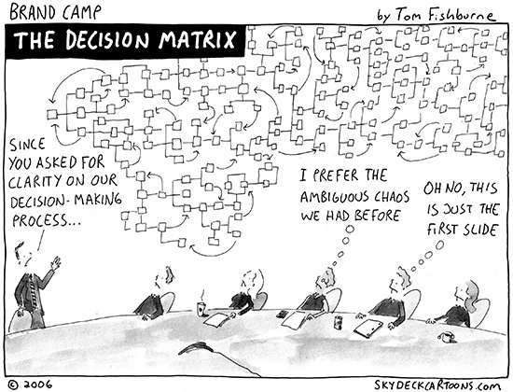
CTE Curriculum is all that
. . . and so much more!

Slide 5
Advisory Committee Recommendation
Must endorse the creation of the program
Need:
Committee membership
Minutes
Summary of recommendations

Slide 6
Advisory Committee
Title 5 §55601
BOT must appoint
Develop recommendations on the program
Provide liaison between district and potential employers

Slide 7
Title 5 §55601
The governing board of each community college district participating in a vocational education program shall appoint a vocational education advisory committee to develop recommendations on the program and to provide liaison between the district and potential employers.
The committee shall consist of one or more representatives of the general public knowledgeable about the educational needs of disadvantaged populations, students, teachers, business, industry, the college administration, and the field office of the Employment Development Department.

Slide 8
Labor Market Information
Title 5 §55130(b)(8)(C)
Must support need for the program

Slide 9
Regional Consortium Approval
Title 5 §55130(b)(8)(E)
Verification of approval
Minutes showing approval

Slide 10
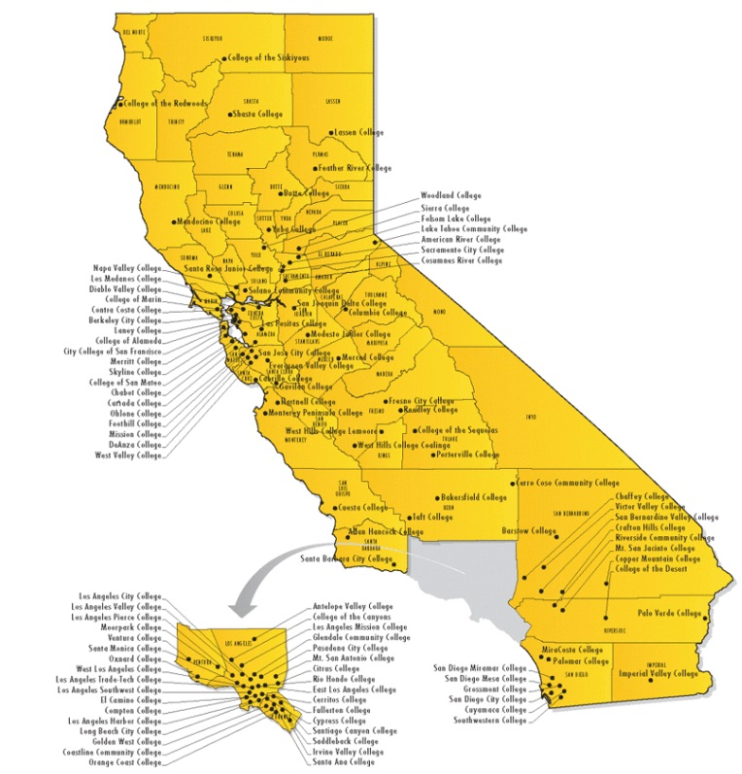
Regional Consortia Consider
Labor Market Data
Undue Impact on other colleges

Slide 11
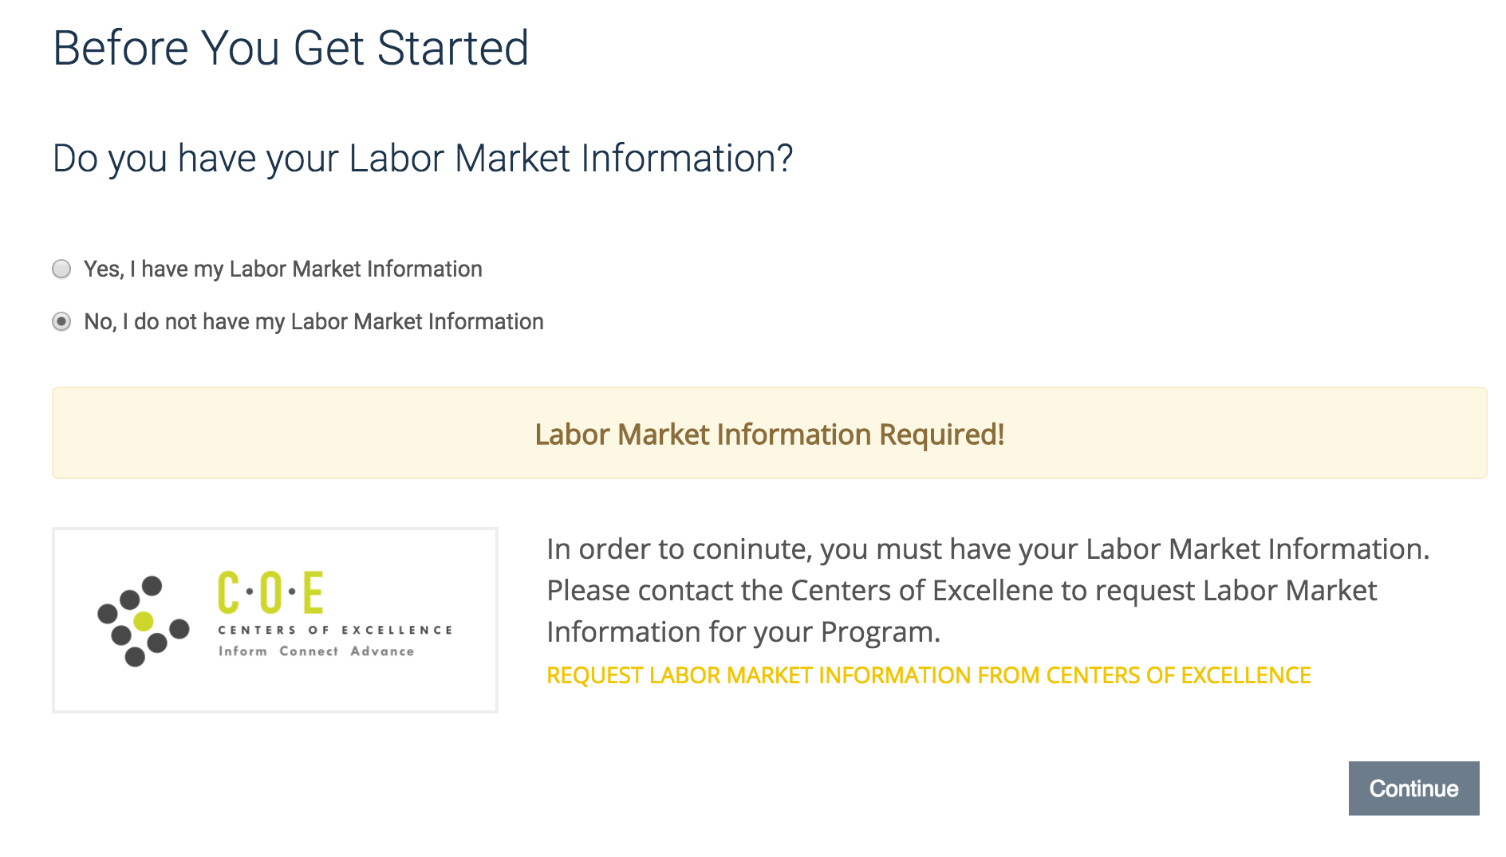
Notes:
Submit Form Pt 1.

Slide 12
Regional Consortia
Bay Area
Central – Motherlode
Inland Empire/Desert
Los Angeles/Orange County
North Far North
San Diego/Imperial
South Central Coast

Slide 13
If, CTE Program Intent is Transfer
Verification of alignment of degree for transfer
Notes:
must include at least one of the following documents to substantiate the alignment of the degree with transfer preparation standards. When programs are designed to provide transfer preparation for more than one baccalaureate institution, documentation should demonstrate alignment with the requirements for lower division major preparation at no more than one institution.
Appropriate documentation may include, but is not limited to, any of the following that sufficiently demonstrate this requirement:
• Programmatic articulation agreements.
• ASSIST documentation verifying that a majority (51% or greater) of required courses in the
program are articulated for the major (AAM) at the baccalaureate institutions to which the
program’s students are likely to transfer.
• Table of major requirements from the most recent catalogs, with catalog dates and page
numbers cited, for targeted transfer institutions showing crosswalk with CCC program
requirements.
• Summary of lower division major preparation published or endorsed by relevant
professional bodies or programmatic accreditors, with citations included.
• Formal letters from the intended receiving institution that verify alignment of proposed
program with their program curriculum.

Slide 14
Close Look Needed on . . .

Slide 15
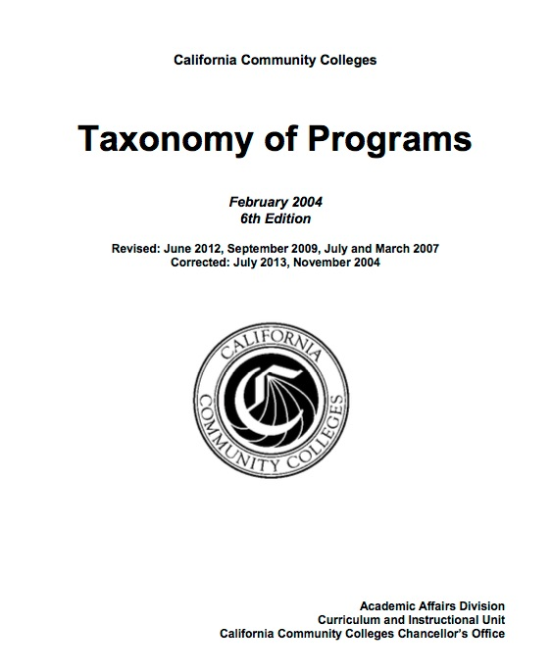
TOP Code Assignment
Taxonomy of Programs
Must be a CTE TOP Code
Indicates subject area of each
Course
Certificate
Degree

Slide 16
SAM Codes
Standard Accountability Measure
A - Apprenticeship
B - Advanced Occupational
C - Clearly Occupational (not advanced)
D - Possibly Occupational
E - Non-Occupational

Slide 17
Why are SAM Codes important?

Slide 18
Why are SAM Codes important?

Slide 19
Speed of Process

Slide 20
Questions?

Slide 21
Thank you!
Dianna Chiabotti
Lorraine Slattery-Farrell: lfarrell@msjc.edu

