Slide 1
Career Technical Education (CTE) Hot Topics
Dianna Chiabotti, Napa Valley College Lorraine Slattery-Farrell, ASCCC South Representative

Slide 2
Description
Many hot topics are appearing around the 17% Committee, including college level data-driven planning for program development with respect to the Strong Workforce Program and the need to involve faculty and CIOs. This breakout will consider how to involve the necessary stakeholders in CTE discussions and other issues and rumors regarding CTE curriculum.

Slide 3
Strong Workforce Program

Slide 4
Something . . .

Slide 5
SWF – the Good News
Funding for CTE Programs
Can’t be used to supplant

Slide 6
SWF – the Not-So-Good News
Incentivized Funding
First of its kind!
17% of the SWF funding based on metrics

Slide 7
17% Committee
Multiple stakeholders
Used research from other states
Developed incentivized, point-based, funding model

Slide 8
17% Committee
Points based on CTE student
Progress toward completion
Earning a certificate or degree
Transfer to 4-year college
Secures employment
Increase in wage

Slide 9
Curriculum Innovation
Collaboration with neighboring colleges
Providing options for emerging industry
Pathways
Meaningful, stackable certificates
Low Unit Certificates
Alignment with 3rd party credentials

Slide 10
Speed of Curriculum Process
Considerations
On-demand curriculum
Streamlining local processes
Simultaneous local & regional process

Slide 11
Advisory Committees
Effectiveness
Membership
Local vs. Regional
Role of DSNs & SNs

Slide 12
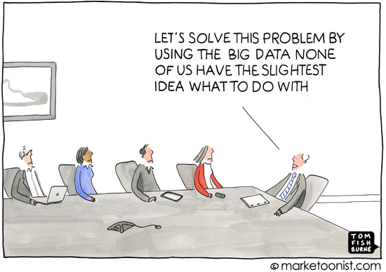
Data – Data - Data

Slide 13
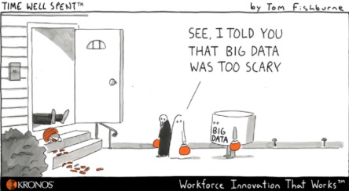
Data – Data - Data

Slide 14
Data – The Good News

Slide 15
Data – The Good News

Slide 16
Data – The Good News

Slide 17
Data – The Not-So-Good News

Slide 18
And . . .

