Slide 1
CAREER AND TECHNICAL EDUCATION Better Together: Student Services Faculty and Instructional Faculty Working Together to Promote Student Success
Presented by:
Lorraine Slattery-Farrell, ASCCC Executive Committee
Escarlet Wirth & Karie White, CTE Counselors
Mt San Jacinto College

Slide 2
Goals For Today
Discuss the disconnect between counseling and instructional faculty
The role of CTE designated counselors
A case study of success
Strategies to explore on your campuses

Slide 3
DISCUSSION
Root of the Problem and How to Solve it
Other Challenges
Other Solutions

Slide 4
COMMON GOALS
Student Success
Increase the number of students completing one or more courses in a CTE Pathway
Increase the number of students graduating with an educational plan and knowing their career goals…and how to get there
Educate students and help them link classroom knowledge with what they will be doing at a job or in their career

Slide 5
THE DISCONNECT…
Counselors responsible for knowing everything about everything…career…transfer….academic challenges….personal issues such as finance, housing, food, childcare…etc.
Faculty have lots of students, lots of responsibilities to the students, administrators, and requirements outside of the classroom
TIME. Time to talk. Time to educate. Time to collaborate.

Slide 6
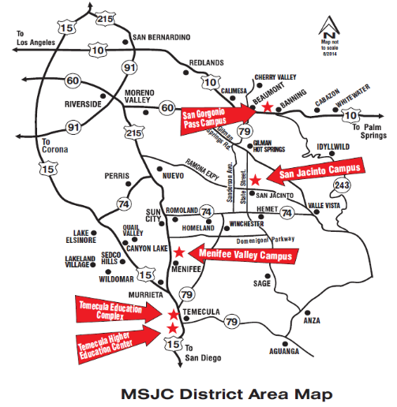
WHERE IS MSJC?

Slide 7
WHO IS MSJC CTE?
Administration of Justice
Allied Health (CNA; EMT)
Audio & Video Technology (SJC)
Automotive/Transportation Technology (SJC)
Business Administration (2+2)
Child Development & Education
Computer Information Systems
Diagnostic Medical Sonography (MVC)
Engineering: Drafting Technology
Engineering Technologist Support
Fire Technology
Geographic Information Science
Golf Course/Turf Management
Legal Assistant
Management/Supervision
Digital Media (MVC)
Nursing-RN (MVC)
Office Administration
Photography
Real Estate
Viticulture, Enology, Winery Technology
Water Technology

Slide 8
One Program Model
CDE students in entry level course required to do Ed plan with counselor
Students confused, misinformation given, anxiety all around
Our CDE program has multiple degree and certificate options
Recognized the complexity for non-majors
Sought out opportunities to build relationships with counseling faculty
Developed pathways
Designated counselor for each major to visit

Slide 9
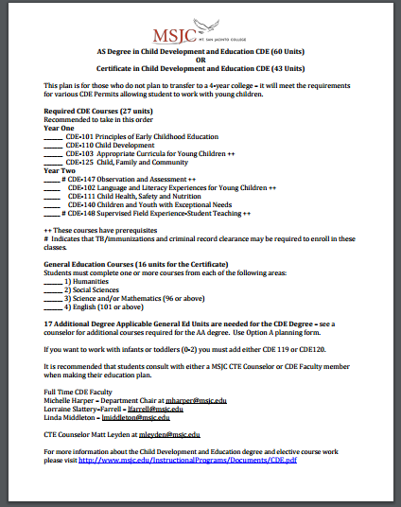
Course Pathway Plans
CDE Initiated
DIG and others following
Required courses and sequence of classes suggested
Projected Schedule of Courses

Slide 10
Keys to Success: TALK!
Visit counselor meetings to present program information, career information related to your discipline, employment examples, student success stories (CDE, Art, DIG)
Have counselors come to your class and discuss educational plans, careers in your discipline, potential internships, employment options known about (10/15 min or longer; start of end of class)
Invite counselor(s) to department meetings

Slide 11
Keys to Success: EDUCATE!
What is CTE? Who are your students?
Language, stereotypes, old school vs. new school thoughts

Slide 12
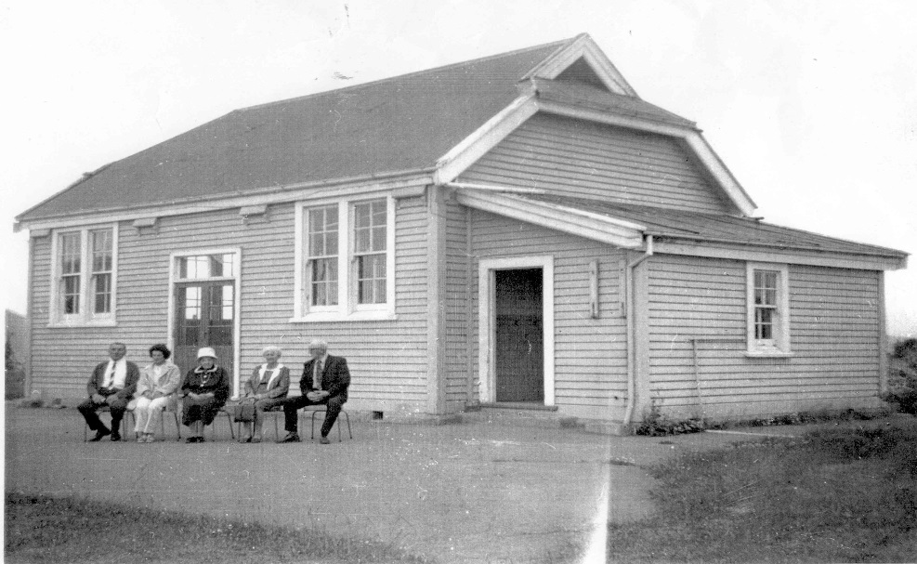
VS.
OLD SCHOOL
Referred to as vocational
Provided skills training in limited fields for students and stressed no college
Separated academic courses from skills training courses
Dumping ground for problem students or low achieving students

Slide 13
NEW SCHOOL
Referred to as Career Technical Education (CTE)
Prepares for Career & College in a wide variety of career fields
Integrates academics into career preparation
Honors students sitting next to students with special needs
Automotive is STEM on steroids
Project Lead the Way (PLTW) uses Calculus, 3D printers

Slide 14
WHAT KIND OF STUDENT PURSUES CTE?
Students are Ready
Students are with like minded students
They form a community within their community
Students who know what they want and don’t want to wait to start towards their future
Learning by Doing
They create stuff They blow stuff up They dress stuff up
They theorize about stuff They fix stuff They invent stuff
Crazy Smart
Alternative to the way it’s always been done
Many ways to success
Marketing Firm MeringCarson

Slide 15
WHY CHOOSE A CTE PROGRAM OR DEGREE?
More than half of skilled jobs don’t require a college degree
Research has shown that people who earn short-term certificates in fields like computer and information services or mechanical engineering can earn even more than people with bachelor’s degrees
Information from Aug 18, 2016 article in www.marketplace.org

Slide 16
WHY CHOOSE A CTE PROGRAM OR DEGREE?
A person with a CTE related degree or credential will earn on average between $4,000 and $19,000 more a year than a person with a humanities degree
67% of jobs in the future will require a certificate and/or associate degree (2 year degree), not a bachelor’s degree
Students over the age of 25 are now one of the fastest growing populations in community colleges. They often enroll to acquire additional skills to be competitive in the workplace. Many students have already completed some college or even a 4 year degree but have found the preparation inadequate or inappropriate for career opportunities available.
Information from Association for Career and Technical Education | www.acteonline.org

Slide 17
CTE Prepares Students for Career AND College
CAREER & COLLEGE:
explore majors and thus possible careers and try out classes at a low cost
College-Prep and CTE are complementary NOT competing goals
CAREERS:
certificates and class projects that help build skills employers are looking for
internships that relate to career and skill interests
COLLEGE:
rigorous classes, self initiated scheduling, studying, and completing
Meet 4 year college admission reps
1:1, college fair, campus tours
Acceptance rates for transfer students are higher than high school graduates

Slide 18
COLLABORATE
“Our research shows that the number-one predictive element of an individual’s success is the number, the quality, and the depth of social capital—the personal relationships among those that they do business with.”
- Keith Ferrazzi, CEO of Ferrazzi Greenlight, an enterprise consulting, research and training firm. www.Nasdaq.com

Slide 19
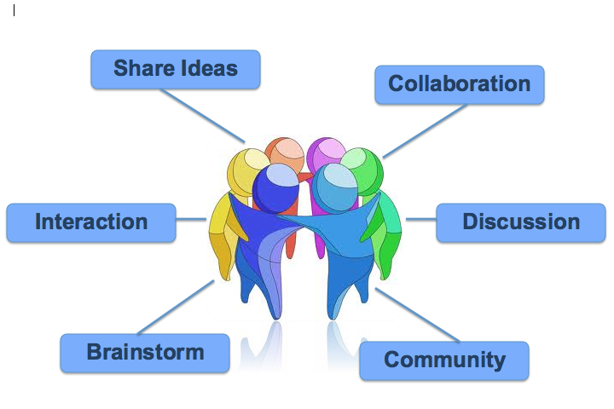
COLLABORATE
Build Relationships and Partnerships
High School Partners
Counselors
Other Faculty
Internship Coordinator(s)
Administrators
Employers
Student Clubs
Regional Counterparts

Slide 20
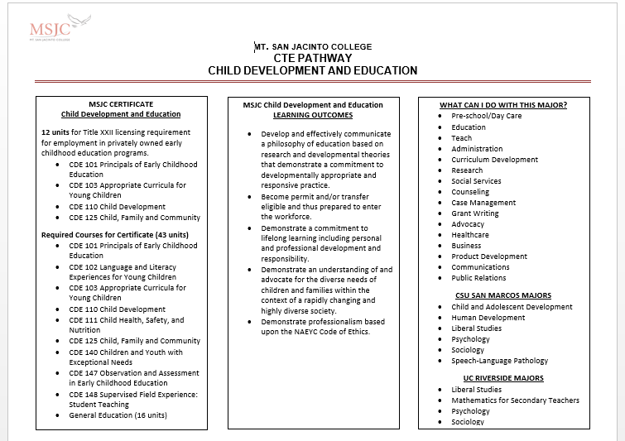

Slide 22
FUTURE
Counselor Notes Accessed by Faculty
Online Counseling, Advising, Educational Plans
Pathways Handout Online

Slide 23
COLLABORATE
Counselor Liaison to Your Department
Regional Counterparts
Faculty Retreats & Planning Meetings
Advisory Panels/Industry Panels
Faculty Advisor for Internship Program
CWEE Coordinator is CTE Counselor
Pathways Handout
Designed by CTE Counselor
Vetted by Department Chair and Faculty

Slide 24
Questions Thank You Lorraine Slattery-Farrell, lfarrell@msjc.edu Escarlet Wirth, ewirth@msjc.edu Karie White, kwhite@msjc.edu

