Slide 1

Maximizing Sector Navigators
and Deputy Sector Navigators
Linda L. Zorn and Jim Caldwell
SECTOR LOGO
(insert here)

Slide 2

Who We Are
Sector | Sector Navigator
Advanced Manufacturing | Jose Anaya
Advanced Transportation and Renewables | Peter Davis
Agriculture, Water, & Environmental Technologies | Nancy Gutierrez
Energy, Construction, & Utilities | Jim Caldwell
Global Trade & Logistics | Jeff Williamson
Health | Linda Zorn
ICT/Digital Media | Steve Wright
Life Sciences/Biotech | Sandy Slivka
Retail/Hospitality/Tourism | Phil Sutton
Small Business | Charles Eason
http://doingwhatmatters.cccco.edu/Contact.aspx
doingwhatmatters.cccco.edu

Slide 3
What We Do
Alignment
Connectivity
Labor Supply/Demand
State/Federal Mandates
Industry Standards
Funding
Industry
Economic Development
Strategy
Sector-based
Statewide Focus
Regional Implementation
Facilitation
Coordination
Industry Advisories
Priority Initiatives
Multi-College Collaboration
Investment
Curriculum Alignment
Professional Development
doingwhatmatters.cccco.edu

Slide 4

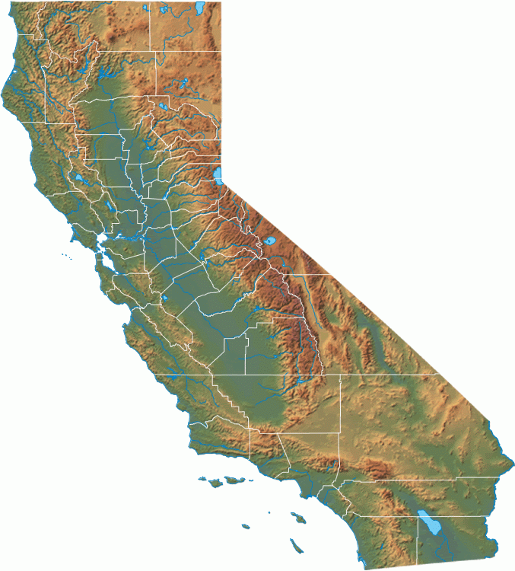



Common to All Sectors
Resource Networks
Statewide
Industry
Advisory
Relationships
Industry
Expertise

Slide 5

What help do you want?
For Students ….
Enrollment
Persistence
Work Experience
Employment
doingwhatmatters.cccco.edu

Slide 6
Typical Services
Strategy …
    For marketing & outreach
    To attract likely completers
Student engagement …
Competitions
Industry events
Leadership opportunities
Boot camps
Career exploration
Work experience
Internships
Job shadowing.
Employment
Industry network
Student portfolios
Employer events

Slide 7





Examples
Talent Pipeline Development

Slide 8
Difference Makers
A lot of jobs
Clear pathway
Good money
Engage with employers
It’s work I want to do
Debt-free college
https://www.youtube.com/watch?v=oBIucwqLsrM

Slide 9
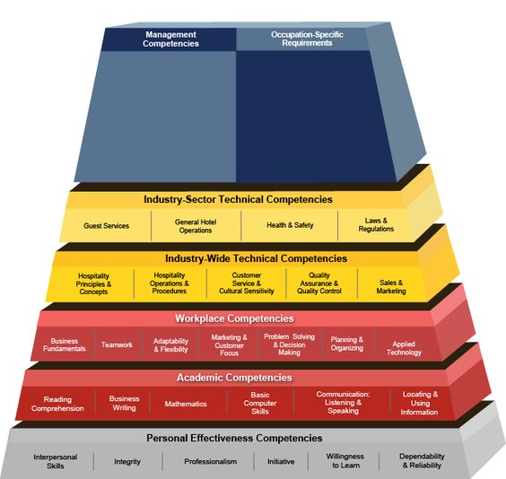
What help do you want?
With Student Learning Outcomes …
Industry relevance
Labor market insights
Priority KSAs
Pathway development
Transfer model

Slide 10


Typical Services
Industry relevance
Technology updates
Regional advisory
Industry credentials
Labor market insights
Regional job market
Opportunity analysis
Priority KSAs
Employer skills panels
Leverage industry research
Industry DACUM support
Pathway development
Career clusters
Mapped to entry-level jobs
Transfer Model
  Mapped to 4-year

Slide 11





Examples
Competency |  |  |  |  |  | HVACRedu
Core/ Electrical
Air Conditioning
Gas Heat
Oil Heat
Heat Pumps
Light Comml Air Cond
Light Comml Refrig
Benchmark
HVAC Excellence
Employment Ready
Credential
Compliance with Benchmark:
90% +
75%
50%
25%
0%

Slide 12

Difference Makers
Resources to address industry priorities
Added value for student portfolios
Critical mass via regional collaboration
Relationships with industry

Slide 13

What help do you want?
With Connections …
Industry expertise
Professional development
Best practices
Shared curriculum
Funding

Slide 14





Typical Services
Industry Expertise
Seminars
Licensed curriculum
Guest lecturers
Professional Development
    Linkage to industry associations
    National, state, & regional
    Expert networks
Best Practices
Regional collaboration
Shared resources
Shared Curriculum
Regional pathways
Curriculum database
Curriculum collaboratives
Funding
Business case development
Identifying sources

Slide 15
Health Workforce Initiative
https://ca-hwi.org/
Curriculum – Hi-Touch Health Care: The Critical Six Soft Skills
  Background – Faculty development team
  We can bring an implementation workshop to your college
  Contact Linda Zorn – ZornLi@butte.edu
Other Model Curriculum
Conferences – Calendar of Events
  Innovations in Health Occupations Education – January 10, 2018
  Men in Nursing –November 11, 2017
Educators Tab
Health Occupations Directory
Resources – DACUM Job Profiles
Labor Market Information/Reports – Next up – HIT/HIM
Statewide Industry Advisory Committee

Slide 16
Agriculture, Water and Environmental Technologies
Professional Development for Faculty (Faculty Expert Network)
  December Institute
  June Conference
Career Pathway/Curriculum Alignment
  CA Ag Teachers Association
  Curriculum Committee
  Landscape Hort Collaborative
  Career awareness/resource material (http://www.calagcc.org/ )
  Curriculum Website – agnrcurriculum.com
Networks
  CATA – faculty in secondary, community college and university
  Collegiate Ag Leaders – Student Organization

Slide 17


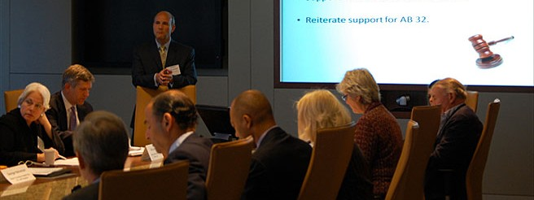




Examples
Regional Collaborative
Regional
^

Slide 18
Difference Makers
New resources
New support
New ideas
New funding

Slide 19

What help do you want?
With economic development …
Global trade
Entrepreneurship
Workforce upskilling

Slide 20
Typical Services
Global Trade (www.citd.org)
Curriculum repository
Sponsorship for conferences
Industry-recognized credentials
Export training for employers
Entrepreneurship
Contextualized curriculum
Entrepreneurship mini-grants
Business pitch competition
Workforce Upskilling
Emerging technologies
New regulations
best practices

Slide 21
Small Business Sector
Small Business Sector Highlights and Resources for Faculty
Provided professional development opportunities for faculty such as the annual Digital Media/Business Educators and Small Business Educators Conference
Hosted annual Contextualized Entrepreneur Curriculum Collaborative for faculty to work together on model curriculum and programs to infuse/embed small business/entrepreneurship in to various CTE disciplines
Funded Faculty Entrepreneurship Champion Mini-grants across the state to infuse/embed small business/entrepreneurship in to various CTE disciplines
Provided experiential learning opportunities to integrate into the classroom such as the statewide “Get a Taste of Success” Business Pitch Competition
doingwhatmatters.cccco.edu
For more information or assistance contact:
Charles Eason, Small Business Sector Navigator
(707) 863-7846 charles.eason@solano.edu www.SmallBusinessSector.net

Slide 22
New Curriculum
Transfer Model Curriculum: Hospitality Management
C-ID: Hospitality Management
C-ID: Culinary Arts
Professional Development: Industry Trends & Professional Certifications for Instructors
Curriculum Database
Industry Certifications for Students
American Hotel & Lodging Association: Guest Service Gold for Customer Service
Western Association of Food Chains: Retail Management Certificate
Retail, Hospitality, Tourism, Learn & Earn

Slide 23

Our Role is to research, assist and communicate workforce needs in the following sub-sectors:
Information Technology – Networking
CyberSecurity – IoT
IT Technician Pathway
ICT Winter Conference
Computer Science
Coding and Software Development Pathways
Business Applications Software
Business Information Worker
Digital Media
Digital Media Educators Conference
Entertainment
Production Assistant Bootcamp
Entertainment course guide
Visit us at: http://ict-dm.net
Contact us at: Steve@WrightCA.com
ICT-Digital Media Sector

Slide 24




Examples

Slide 25


ATRE Faculty
Assistance
Prepare the workforce to Meet California Vehicle Mandates
Prepare the workforce to Meet Zero Net Energy
Mandates by the CEC, ARB and CPUC
Curriculum and Technical assistance
Regional Data
College Participation in advanced transportation
and renewable energy training
Connections with industry, trade groups, agency
stakeholders
Place in context the Labor Market Information in
advanced transportation or renewable energy
Prepare for Emerging Technologies in advanced
transportation and renewable energy
Contact: Peter Davis
ATRE Statewide Sector Navigator
Phone: 619 473-0090
Email: outrchpd@me.com
Visit our websites at: www.atreeducation.org
and 4nrg.org
ATRE & 4nrg websites include valuable resources such as:
Curricula
Data
Best Practices
Documents
Videos
Training

Slide 26



Difference Makers
These young people have a great future
Opened
a new market
Found new trade partners

Slide 27
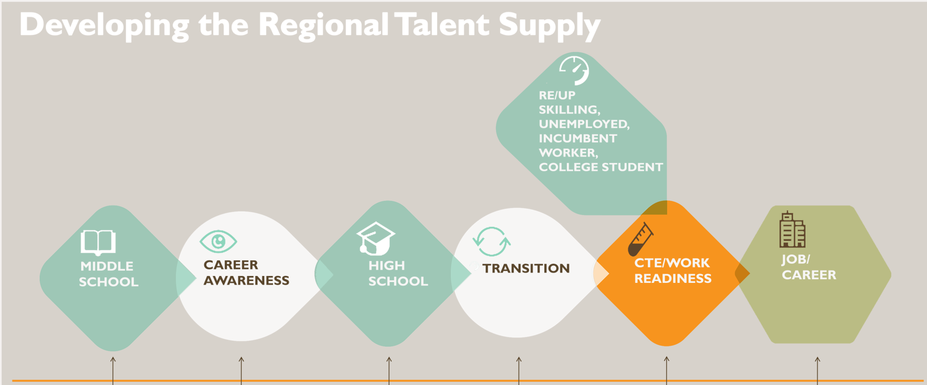
Summing Up
Lifesciences/Biotech Sector Strategy http://www.calbiotechcareers.org

Slide 28
To contact SN’s or DSN’s:
http://doingwhatmatters.cccco.edu/Contact.aspx

Slide 29
Questions
Thank You!
doingwhatmatters.cccco.edu

