Slide 1


Regional Consortia Planning

Slide 2
Session Overview
Of the $200 million in Strong Workforce funding, 40% is allocated to regions to invest in coordinated efforts to increase CTE enrollments and improve the quality of their CTE programs. This session will provide an overview of regional planning efforts, regional structures, and the important role faculty play.

Slide 3
Learning Outcome
As a result of your participation in this session, you will …
be inspired to learn more about your own region’s Strong Workforce Program plan and you will be motivated to engage in the process.

Slide 4
Agenda
Planning
Consortia
  Partners, Governance
Fiscal
  Timelines
Local
SWP Resources
Faculty Involvement
What’s Next

Slide 5
70
Notes:
Regional structure

Slide 6
How many times the word plan or planning is used in the Trailer Bill language.
Notes:
What does the legislation say about planning?

Slide 7
A regional plan, developed with input from regional stakeholders, updated yearly, renewed every 4 years.
Notes:
What does the legislation say about planning?

Slide 8
The regional plan should inform:
Regional (40%) Allocations
Local Campus (60%) Allocations
Notes:
What does the legislation say about planning?

Slide 9
53

Slide 10
How many times consortia are referenced in the Trailer Bill language.

Slide 11
7

Slide 12








Slide 13
The Consortia Role in SWP
Collaboration
Coordination
Governance
Fiscal

Slide 14
Partners

Slide 15
(2) The consortium shall collaborate with other public institutions, including, but not limited to, local educational agencies, adult education consortia, local workforce development boards, and interested California State University and University of California institutions ... civic representatives, representatives from the labor community, and economic development and industry sector leaders within the region.

Slide 16
How do regions plan and allocate resources?
Ongoing (timelines)
Gather data
Develop proposals (template)
Decisions (governance)
Implementation

Slide 17
Decision Making

Slide 18
(2) The governance model for the consortium. Decisions governing, or relating to, the distribution of fiscal resources shall be determined exclusively by the community college districts participating in the consortium.

Slide 19
Governance structures in place in all 7 regions

Slide 20
Fiscal 101

Slide 21

Notes:
Making lots of money after graduation

Slide 22
(f) A consortium shall allocate funds only to community college districts.

Slide 23
Notes:
Regional structure

Slide 24
The Local Planning Process
Notes:
Regional structure

Slide 25

Notes:
(Susanne) Getting started on a career path in high school. Students may think life after high school will be all rainbows and butterflies. Articulation. Get focused, stay focused.
is not all rainbows and butterflies

Slide 26
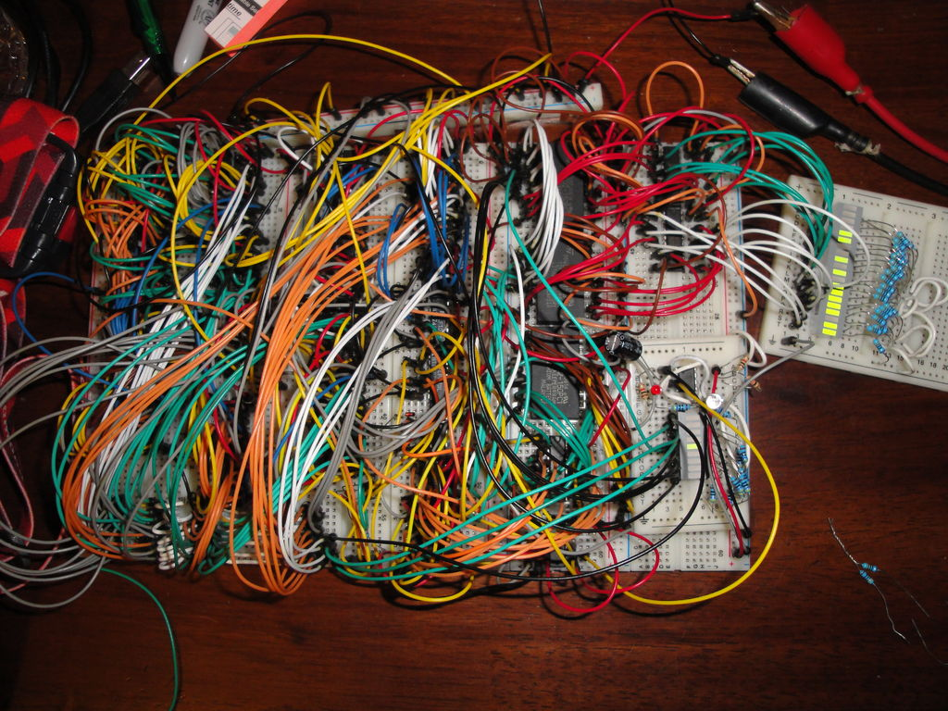
Notes:
It’s more like this … it’s not easy work

Slide 27
All Things Strong Workforce
http://doingwhatmatters.cccco.edu/StrongWorkforce.aspx
Notes:
Look at the regional plan links and analytics

Slide 28
184
Notes:
Regional structure

Slide 29
Plans by Region
Bay - 70
Central / Mother Lode - 16
Inland Empire / Desert – 9
Los Angeles / Orange – 37
North / Far North - 22
San Diego – 5
South / Central Coast - 25

Slide 30
563
Notes:
Regional structure

Slide 31
Faculty Engagement
Notes:
Regional structure

Slide 32
Local Plans by Region*
Bay - 166
Central / Mother Lode - 74
Inland Empire / Desert – 93
Los Angeles / Orange – 110
North / Far North - 69
San Diego – 12
South / Central Coast - 39
*Only includes “certified” plans ($91M

Slide 33

Choice
Notes:
It’s more like this …

Slide 34
Faculty Engagement
Bring your ideas and expertise to the planning table.
Can’t attend a meeting? Who is already at the regional planning table?
  Discuss your ideas with your CTE Dean
  Reach out to your CTE Liaisons
  Engage with your DSN and other regional faculty
Share with the region the gaps your employers/advisors are talking to you about?

Slide 36
When does the next round of planning begin?
Bay Area – Fall webinars; ongoing marketplaces
LA / Orange – Started next round of planning
San Diego / Imperial – Ongoing
North/Far North – August
Central / Mother Lode – June
Inland Empire / Desert – Now through September
South Central Coast -

Slide 37


