Slide 1
CTE C-ID is Alive and well!
Cheryl Aschenbach, ASCCC North Representative
Njeri Griffin, C-ID Project Monitor, CCCCO
Michelle Pilati, Rio Hondo College
ASCCC Spring Plenary – April 2019

Slide 2
Overview
C-ID: Basics
C-ID: Intersegmental vs Intrasegmental
C-ID Vocabulary
C-ID & Career Education – Process, Descriptors, and Model Curriculum
C-ID & Guided Pathways
C-ID & Career Education – Challenges, Solutions, and Moving Forward

Slide 3
C-ID Basics
Began in 2007 as a pilot project to replace CAN (California Articulation Number) and provide a response to the call for a “common course numbering system”
Faculty-based system of common course identifiers and descriptors
Provides a mechanism for identifying required courses in Associate Degrees for Transfer (ADTs)
Descriptors: sets expectations for course content, rigor, and student learning outcomes or objectives.
Receipt of a C-ID designation confirms a course meets the published standards of course content, rigor, and student learning outcomes or objectives.
Notes:
LDTP – lower division transfer pattern. C-ID and LDTP initially existed in parallel.

Slide 4
C-ID: Intersegmental vs Intrasegmental
Initial Goal of C-ID: Facilitate transfer process for California students by increasing articulation between postsecondary education segments and institutions
Intrasegmental Articulation
Between CCCs
Intersegmental Articulation
CSU – TMCs > ADTs
UC Transfer Pathways
System transfer agreements with HBCUs, CA Independent Colleges & Universities
Articulation & transfer agreements with local colleges & universities – any entity can articulate with all CCCs by agreeing to articulate a C-ID descriptor

Slide 5
C-ID and Model Curriculum Vocabulary
C-ID = Course Identification Numbering System. Establishes a common numbering system. Courses with a C-ID-aligned number are considered to have content in common and are to be recognized and received as comparable for transferring students.
Descriptor = Framework of course content, objectives, and description which provides information for students, staff, faculty, and system partners (including universities and industry) to understand common expectations. Also provides information for ongoing curriculum development and revision of lower division courses
TMC = Transfer Model Curriculum. TMCs are developed collaboratively between CCC and university faculty (primarily CSU). They describe the major component of associate degrees for transfer (ADTs).

Slide 6
C-ID and Model Curriculum Vocabulary
MC = Model Curriculum. MC may be developed for CTE or non-transferable programs or transfer programs that are not aligned with TMC criteria. CTE MCs are developed collaboratively between CCC faculty, Doing What Matters key talent, and industry.
DIG = Discipline Input Group. A meeting of faculty formed to initiate the discussion of C-ID course descriptors and MCs or TMCs. All faculty are welcome to attend and provide feedback at the DIG for their discipline.
Notes:
MC definition edited – we have MC for engineering

Slide 7
C-ID and Model Curriculum Vocabulary
FDRG = Faculty Discipline Review Group. FDRGs work with input from DIGs to prepare descriptors and MCs or TMCs for vetting. The FDRG reviews the feedback from the vetting process and makes final determinations. The composition of the FDRG may be either intersegmental or CCC only.
Notes:
MC definition edited – we have MC for engineering

Slide 8
C-ID and Career Education: Process
Prior to a Discipline Input Group (DIG) meeting:
C-ID works with Sector Navigators (SNs) and Deputy Sector Navigators (DSNs) to identify disciplines to bring together for DIG meetings
Sector Navigators contact industry partners and seek input on existing community college programs
SNs and DSNs are invited to attend the DIG
Faculty register to attend the DIG meeting, bringing with them materials from their local college to review with colleagues during the meeting

Slide 9
C-ID and Career Education: Process
At DIG meetings
Faculty develop descriptors and model curriculum
Industry input is provided through the industry survey and via the SNs/DSNs in attendance
After DIG meetings
Faculty discipline review group (FDRG) is convened for the discipline. The group reviews and finalizes drafts of model curriculum and descriptors for statewide vetting.
Industry partners, faculty, articulation officers, and other interested parties are asked to provide input on the draft documents
FDRG reviews vetted materials and finalizes documents
Result: Statewide model curriculum and descriptors

Slide 10
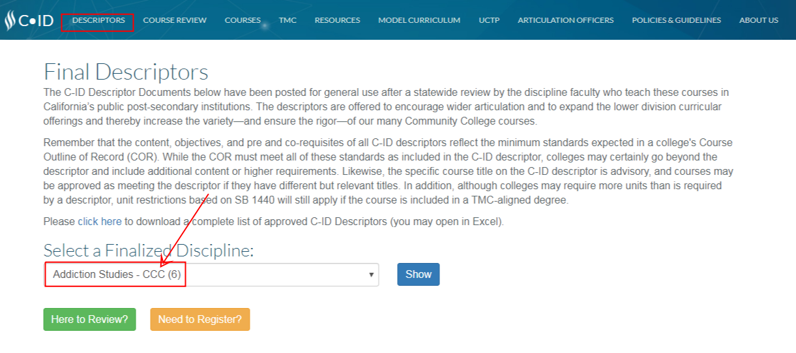
C-ID and Career Ed: Descriptors & Model Curriculum
Accessing C-ID descriptors and model curricula

Slide 11
C-ID and Career Ed: Descriptors & Model Curriculum

Slide 12
C-ID and Career Ed: Descriptors & Model Curriculum

Slide 13
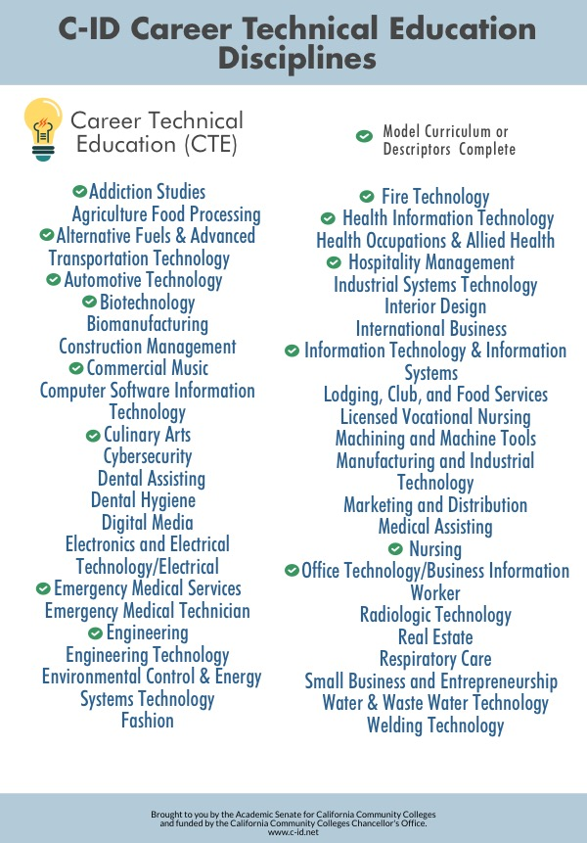
C-ID and Career Ed: Descriptors & Model Curriculum
Working with 31 CTE disciplines
114 finalized descriptors
75 descriptors in progress
27 draft descriptors
12 finalized Model Curricula (MC)
3 Intersegmental, 9 CCC
22 MC in progress, 9 draft MC

Slide 14
C-ID and Career Ed: Descriptors & Model Curriculum
Office Technology / Business Information Worker
Finalized 22 descriptors and 3 MC in Fall 2018
These align with the Business Information Worker Pathway to Success, part of the CCC Doing What Matters Initiative
Four disciplines are working to align MC to the CCC baccalaureate programs
Target: completed and available by fall 2019.
Disciplines are: Respiratory Care, Biomanufacturing, Automotive Technology, and Dental Hygiene.

Slide 15
C-ID and Career Ed: Descriptors & Model Curriculum
Water/Waste Water Technology & Real Estate
Difficulty getting enough faculty feedback
Few programs in state, so less feedback expected, but how much is needed?
Should we consider approval with a lack of negative feedback, no matter how little positive feedback is received?

Slide 16
C-ID and Career Education: Challenges
Challenges
Regional differences in faculty and industry perceptions around curriculum
Benefit to students is less apparent than with ADTs based on C-ID descriptors
Creating and maintaining meaningful connections with industry, including employers, SNs, and DSNs
Internal committee structure for CTE Curriculum
Some articulation officers involved with C-ID submission for transfer only or don’t have enough time to assist CTE faculty with the alignment process

Slide 17
C-ID and Career Education: Responding to Challenges
Streamlined descriptor and model curricula approval process (distinct from transfer model curriculum)
Revised MCW membership
CCCAOE input (CTE faculty & deans)
More CTE faculty
10+1 Reasons to use model curriculum
Training for ASCCC CTE Liaisons
Encourage faculty peers to participate in DIGs, descriptor and MC feedback, and FDRGs
Potential for regionally-developed MC
Potential for curriculum streamlining for C-ID-aligned CTE programs

Slide 18
10+1 Reasons to Use Model Curriculum
Providing students with the skills to fill employer needs for specified training.
Establishing appropriate program consistency in awards across the colleges.
Facilitating student goal completion and simplifying student movement between colleges by establishing intra-segmental (within the CCCs) articulation.
Increasing student access to statewide offerings of C-ID aligned online CTE courses applicable to programs at their local college.
Increasing faculty access to C-ID model curricula and descriptors to assist in developing or updating courses and programs.
Providing a benchmark for quality and currency, C-ID descriptors and model curricula are regularly reviewed and developed with input from faculty and industry, benefiting faculty, students, and industry.
Enabling CTE disciplines to participate in Open Educational Resources Initiative (OERI), Guided Pathways, and other critical statewide initiatives.
Increasing opportunities for students through the development of C-ID model curricula articulated to Bachelor’s Degrees in the CCCs or other colleges or universities.
Allowing for “one-to-many” articulation or acceptance by industry partners by establishing that a C-ID descriptor or model curricula fills a transfer or employer need.
Leveraging C-ID alignment to support increased funding for programs to ensure currency of instructional equipment.
+1. Providing an opportunity for a community of faculty to engage in dialogue
impacting programs.

Slide 19
C-ID, CTE, and GP: Moving Forward
Your turn:
How can CTE C-ID be helpful for you?
How can C-ID be part of your GP efforts?
What do you need from C-ID to help with your C-ID efforts?
How can we further incentivize faculty to align courses with C-ID descriptors and submit for C-ID approval?

Slide 20
IDEAS? QUESTIONS?
Contact us! info@asccc.org
Cheryl Aschenbach caschenbach@lassencollege.edu
Njeri Griffin ngriffin@cccco.edu
Michelle Pilati mpilati@riohondo.edu

