Slide 1
Contextualized Teaching and Learning - Overview
December 3, 2016
Naomi Castro
Director

Slide 2
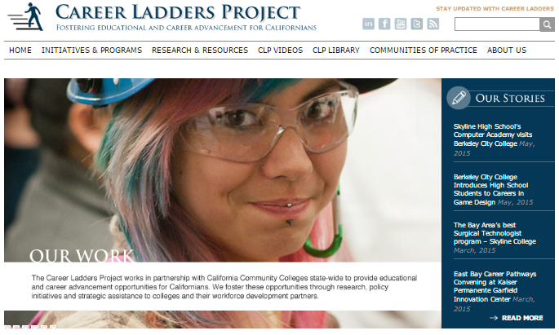
Career Ladders Project
Career Ladders Project fosters educational and career advancement through research, policy initiatives and direct assistance to community colleges and their partners.
Notes:
Katherine

Slide 3
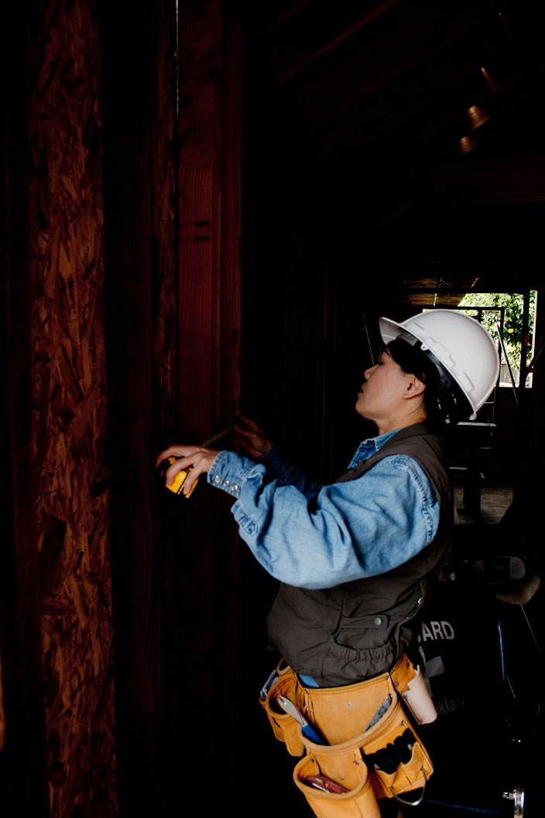
Who is Here?
What do you Need?
Notes:
multiple examples – esp CAA re multiple skills, AB86, CBOs, CA Endowment for Men and Boys of Color, Sparkpoint Centers (United Way & Skyline), CCCCO Inmate Pilot Education Program … print out Linda’s examples

Slide 4
Contextualized Teaching
and Learning (CTL)
From Basic Skills Transformation grant RFA:
Contextualize remedial instruction in foundational skills for the industry cluster, pathways, or both, in which students seeks to advance.
CTL is a group of instructional strategies designed to link the learning of basic skills with academic or occupational content by focusing teaching and learning directly on concrete applications in a specific career context that is of interest to students.
Notes:
our focus here is on basic skills – but CTL can be used as a strategy to provide coherence and relevance for broad pathways across the entire curriculum, cite Laney college level English, and the move to contextualize GE courses in light of broad meta majors as is being discussed by CCRC in guided pathways.

Slide 5
Prediction:
What would be evidence
of the effectiveness of CTL?
Notes:
our focus here is on basic skills – but CTL can be used as a strategy to provide coherence and relevance for broad pathways across the entire curriculum, cite Laney college level English, and the move to contextualize GE courses in light of broad meta majors as is being discussed by CCRC in guided pathways.

Slide 6
Evidence
STUDENT SUCCESS
Chuck Wiseley, who compared non-CTL developmental math to CTL developmental math in California Community Colleges. His research involved over 17,000 student records from 10 colleges. He found that students in the CTL course were:
3 times more likely to pass
4 times more likely to pass degree applicable coursework in same semester
4 times more likely to pass transfer level work in same semester
1.7 times more likely to pass degree applicable coursework in subsequent semester
From: Bernhard, G. et. al. (2013). Contextualizing Adult Education Instruction to Career Pathways. Jobs for the Future, Literacywork International and Career Ladders Project.

Slide 7
Evidence
PERSISTENCE
Students given integrated contextualized instruction were more likely to persist in college level training, earn credits toward a certificate or degree, and show gains in overall basic skills.
Wachen, J., D. Jenkins, & M. Van Noy. 2011. “Integrating Basic Skills and Career-Technical Instruction: Findings From a Field Study of Washington State’s I-BEST Model.” Community College Review. Vol. 39, No. 2, 136-159. .

Slide 8
Evidence
PROGRESSION
A study in California Community Colleges found that offered tailored developmental education courses targeted to specific occupational interests (business, construction), students in contextual developmental math courses progressed at much higher rates (86 percent vs. 59 percent) than students in traditional developmental education.
Wiseley, W.C. 2009. Effectiveness of contextual approaches to developmental math in California community colleges (Doctoral dissertation, University of the Pacific).
From: Bernhard, G. et. al. (2013). Contextualizing Adult Education Instruction to Career Pathways. Jobs for the Future, Literacywork International and Career Ladders Project.

Slide 9
Evidence
MOTIVATION
Strawn & Martinson (2000) found that contextualized instruction enhances student motivation and can reduce attrition rates in job training programs.
Martinson, K. 2000. The National Evaluation of Welfare-to Work Strategies. New York, NY:
MDC, Inc.

Slide 10
Evidence
ENGAGEMENT
Research has shown that “teaching academic applications in a career context is an effective way to engage hard-to-reach students and motivates them in the areas of math, written and oral communication, critical thinking skills, and problem solving.”
Carrigan, V.L. 2008. “Contextualizing Basic Skills and Career Technical Education (CTE) Curricula,” referencing The Research and Planning Group for California Community Colleges. 2007. Basic Skills as a Foundation for Student Success in California Community Colleges (2nd ed.). Sacramento, CA: Author. Paris, K. & L. Huske. 1998. Critical Issue: Developing an Applied and Integrated Curriculum.
From: Bernhard, G. et. al. (2013). Contextualizing Adult Education Instruction to Career Pathways. Jobs for the Future, Literacywork International and Career Ladders Project.

Slide 11
Prediction:
What models/structures do you
know of for CTL delivery?
Notes:
our focus here is on basic skills – but CTL can be used as a strategy to provide coherence and relevance for broad pathways across the entire curriculum, cite Laney college level English, and the move to contextualize GE courses in light of broad meta majors as is being discussed by CCRC in guided pathways.

Slide 12
Models
Academic courses with embedded CTE material
Career technical courses with embedded basic skills instruction
Linked courses or learning communities
Team teaching of integrated academic and occupational courses
Courses contextualized for metamajors

Slide 13
Pros and Cons of Models
Academic courses with embedded CTE material
Career technical courses with embedded basic skills instruction
Linked courses or learning communities
Team teaching of integrated academic and occupational courses
Courses contextualized for metamajors

Slide 14
How would you start?
Think of some ways to contextualize
English (or math) with auto?
Notes:
our focus here is on basic skills – but CTL can be used as a strategy to provide coherence and relevance for broad pathways across the entire curriculum, cite Laney college level English, and the move to contextualize GE courses in light of broad meta majors as is being discussed by CCRC in guided pathways.

Slide 15
Levels of CLT
EXAMPLE
Auto and English class
Low level CLT – auto vocabulary
Mid level – students write a blog explaining auto tech procedures or reviewing parts
High level – instructor arranges for local auto employers to read and comment on blogs
Notes:
Also CTL can be used w college level – Laney has an Eng 1A class contextualized for general trades. A cluster of health and biotech classes and CTL English and math – think about CTL general ed courses. This strategy cuts across the curriculum. Its been used the most in CTE – similar to themed/linked learning communities. Faculty are pioneerings.

Slide 16
Examples of CTL
Iron Hearts
"Everyone sees the Unseen in proportion to the clarity of his heart, and that depends upon how much he has polished it. Whoever has polished it more sees more--more Unseen forms become manifest to him."
-Rumi

Slide 17
Examples of CTL - Iron Hearts
The Laughing Heart
your life is your life
don’t let it be clubbed into dank submission.
be on the watch.
there are ways out.
there is light somewhere.
it may not be much light but
it beats the darkness.
be on the watch.
the gods will offer you chances.
know them.
take them.
you can’t beat death but
you can beat death in life, sometimes.
and the more often you learn to do it,
the more light there will be.
your life is your life.
know it while you have it.
you are marvelous
the gods wait to delight
in you.
-- Charles Bukowski

Slide 18
Examples of CTL
Iron Hearts
IRON HEARTS
Students read poetry about “polishing” their hearts in English class
Write vignettes about their own transformation in welding
Create metal hearts in welding

Slide 19
Brian’s Heart
“I could shape it anyway I wanted, nothing was impossible. It was great to work through the entire process of fabricating metal, the fire, the forming, the fusing … the freedom.”

Slide 20
Monica’s Heart
“My journey started with a feeling of intimidation and ended with a feeling of accomplishment …I can do this and I made it mine!”

Slide 21
Pasadena City College
Design Tech Pathway
Notes:
A way for them to reach mastery w/in context of CTE skill, not tracking them but utilizing a trade to master and move beyond basic skills. CTL can be tailored narrowly such as a w a specific class, but also more broadly as with a meta major. How do we find ways to credit their competencies so they don’t get caught again in dev ed sequence

Slide 22
Notes:
A way for them to reach mastery w/in context of CTE skill, not tracking them but utilizing a trade to master and move beyond basic skills. CTL can be tailored narrowly such as a w a specific class, but also more broadly as with a meta major. How do we find ways to credit their competencies so they don’t get caught again in dev ed sequence

Slide 23
Notes:
A way for them to reach mastery w/in context of CTE skill, not tracking them but utilizing a trade to master and move beyond basic skills. CTL can be tailored narrowly such as a w a specific class, but also more broadly as with a meta major. How do we find ways to credit their competencies so they don’t get caught again in dev ed sequence

Slide 24
Notes:
A way for them to reach mastery w/in context of CTE skill, not tracking them but utilizing a trade to master and move beyond basic skills. CTL can be tailored narrowly such as a w a specific class, but also more broadly as with a meta major. How do we find ways to credit their competencies so they don’t get caught again in dev ed sequence

Slide 25
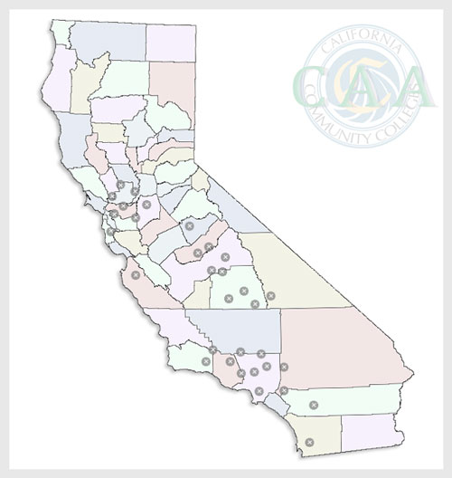
Integrated Approach
Career Advancement Academy
FRAMEWORK
Industry Responsive Training
Contextualized Basic Skills
Cohorts
Transitions Supports
Intensive Student Supports
IMPACT
10,000 students
30 colleges
During Phase II over 51% received system recognized degree or certificate or low unit certificate
During phase II over 23% received a system recognized degree or certificate – 3% higher than the comparison group
Equal Measures CAA Evaluation: Sustaining the Career Advancement Academies
Notes:
A way for them to reach mastery w/in context of CTE skill, not tracking them but utilizing a trade to master and move beyond basic skills. CTL can be tailored narrowly such as a w a specific class, but also more broadly as with a meta major. How do we find ways to credit their competencies so they don’t get caught again in dev ed sequence

Slide 26
Questions?
Discussion

Slide 27
Resources
Career Advancement Academies
http://www.careerladdersproject.org/initiatives-programs/career-advancement-academies/
Contextualizing Adult Education Instruction to Career Pathways
http://www-tcall.tamu.edu/docs/pdf/ContextualizatingAdultEdInstructionCareerPathways.pdf
CTL Community of Practice
https://clpcop.wordpress.com
CAA Videos
http://www.careerladdersproject.org/videos/contextualized-teaching-learning/
Equal Measures CAA Evaluation: Sustaining the Career Advancement Academies
http://www.equalmeasure.org/wp-content/uploads/2015/05/CAA-Report-Final-050115.pdf

Slide 28
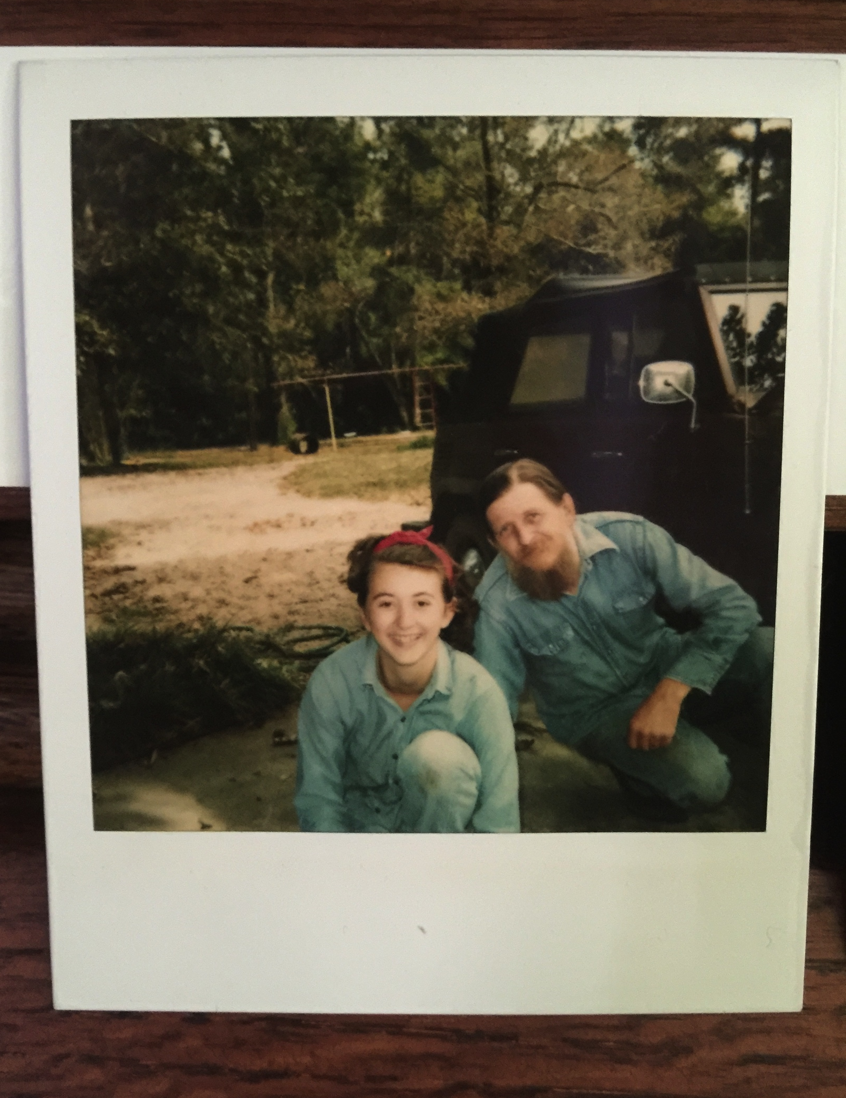
FOR MORE INFORMATION:
Naomi Castro
Ncastro@CareerLaddersProject.org
@NaomiCastroProf

