Slide 1
CVC-OEI: WHAT'S BEEN ACCOMPLISHED, WHAT'S NEW, AND WHERE IT'S HEADED
Lawrence Su, Executive Vice President, SCCCC Jory Hadsell, Executive Director, CVC-OEI Geoffrey Dyer, Area A Representative, ASCCC
ASCCC Academic Academy, September 13, 2019

Slide 2
Session Description
The California Virtual Campus-Online Education Initiative (CVC-OEI) increases access and success in high-quality online courses. Even if your college is not a member of the CVC-OEI consortium, your students can use Finish Faster Online to enroll in online courses across the California Community Colleges. While CVC-OEI provides Canvas free to all CCCs, consortium colleges have access to a variety of tools selected to improve the student experience. Colleges that have adopted the CVC-OEI Course Design Rubric and engaged in a peer online course review (POCR) process have developed accessible, highly interactive courses which are easy for students to navigate. This session presents the latest from CVC-OEI, including online certificates of achievement and transfer degrees, and allows participants to brainstorm how to best leverage CVC-OEI’s resources to support students.

Slide 3
Topics
What is CVC-OEI?
What do Students Need, and How Can CVC-OEI serve them?
Completion: Students Need All Courses . . .
Student Need for Courses
Student Concern: Quality
CVC-OEI Course Design Rubric
Badging: Quality and Resources
Online Certificates and Degrees
What’s Next for CVC-OEI
How can you use this at your campus?

Slide 4
What is the CVC-OEI?
Collaborative effort among California Community Colleges to ensure that significantly more students are able to complete their educational goals by increasing both access to and success in high-quality online courses.
Multi-year grant disbursed by the California Community College Chancellor’s Office.
Composed of high-quality online courses, resources for students, and technology
Leverages effective practices and technology to significantly increase the opportunity for higher education degree attainment in California.
Notes:
Jory (Note: mention we pay for Canvas)

Slide 5
CVC-OEI Consortium
Currently 57 colleges in the Consortium. These colleges:
Align courses with the Course Design Rubric’s high-quality standards.
Participate in the CVC Exchange.
Receive online student support tools (tutoring, counseling proctoring, etc.) known as the CVC-OEI Ecosystem.
Most resources available to non-Consortium colleges at little to no-cost, including professional development!
Goal is for all CCCs to become Consortium colleges.
Notes:
Jory

Slide 6
What is the CVC Exchange?
Notes:
Jory

Slide 7
Consortium vs. Non-consortium
Consortium Colleges
Non-consortium Colleges
Canvas at no cost
CVC Exchange (online course finder, cross enrollment, online pathways)
Readiness Modules
CVC-OEI Ecosystem
CVC-OEI Course Design Rubric
Professional development
Canvas at no cost
Online course finder
Readiness Modules
Notes:
Jory

Slide 8
What Does CVC-OEI Do for Students?
Through an online course finder, provides access to courses they need through cvc.edu.
Identifies high-quality and fully-resourced course sections via badging.
Provides online support services that are comparable to on-campus services
Showcases online ADTs and COAs offered at Consortium Colleges
Helps students complete their program of study faster.
Notes:
Jory

Slide 9
What Do Students Need Online?
Options
Specific courses for their programs of study
Quality
Ease of enrollment
Take courses from CSUs, UCs, and CCCs
Notes:
Lawrence

Slide 10
Students Need Options!
Students are able to select which college to take their classes at
Students are able to choose the professor they want
Students are able to add a class from a wide selection
Notes:
Lawrence

Slide 11
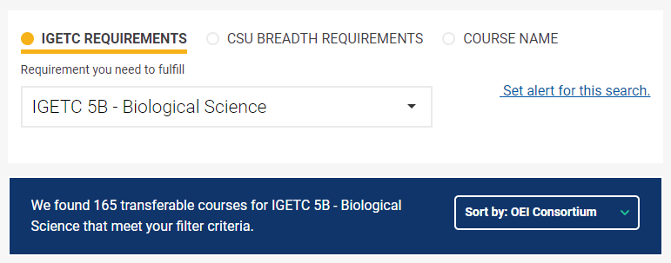
The more colleges participate,
the more choices students have.
Notes:
Lawrence

Slide 12
Students Need Specific Courses
Students need to fulfill CSU GE and IGETC to transfer
Current demand for lab sciences, oral communication courses, English, and economics online
Allow students to get the vital class they need to transfer on time
Notes:
Lawrence

Slide 13
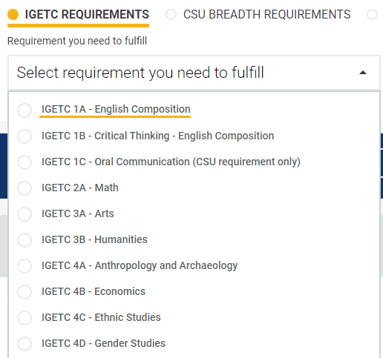
Notes:
Lawrence

Slide 14
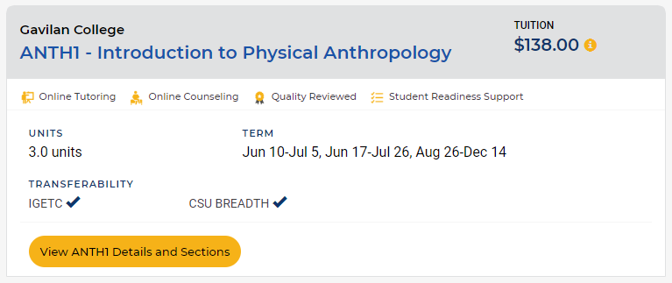
Students Need Quality
Students need to be reassured the class is of high quality and reviewed
Notes:
Lawrence

Slide 15
Students Need Quality
Students need support for their online classes, even hundreds of miles away
Notes:
Lawrence

Slide 16
Students Need Ease of Enrollment
Students need to a user-friendly platform to find information easily
Students need to be able to enroll in classes smoothly, no matter what college
Notes:
Lawrence

Slide 17
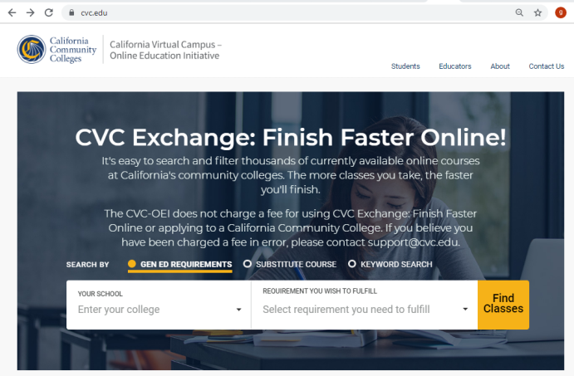
How Can CVC-OEI Help Meet These Needs?
Finish Faster Online! Helps students identify options and search for specific courses by requirement.
Notes:
Demo here—We will show how to search, the badging and services, etc. (Geoffrey)

Slide 18
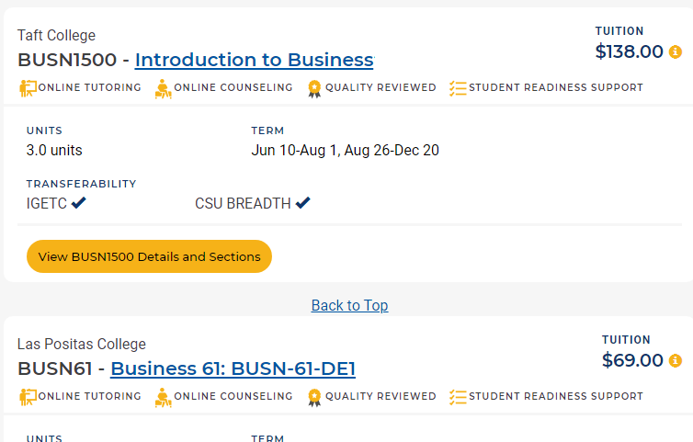
How Does CVC-OEI Support Course Quality?
Course Design Rubric supported by ASCCC resolution.
Provides professional development for faculty through @one.
Course Design Academy for faculty at consortium colleges.
Badged, peer-reviewed courses aligned with CVC-OEI rubric filter to top of search results in Course Finder.
Notes:
Geoffrey

Slide 19
Notes:
Geoffrey

Slide 20
Course Design Rubric Addresses:
Course Content
Interaction
Assessment
Accessibility
Notes:
Geoffrey

Slide 21
CVC-OEI Course Design Rubric
Developed in 2014, updated in 2016 and 2018
ASCCC, faculty, and CVC-OEI Advisory Committee participation in development, review, and revision.
Can be locally adopted for peer online course review
Alignment with rubric required for courses in Course Exchange (Consortium College Commitment)
ASCCC encourages CCCs to adopt for local use
Notes:
Geoffrey

Slide 22
ASCCC Resolution 9.03 F18
Notes:
geoffrey

Slide 23
Rubric: Accessibility
Adopting rubric locally and training faculty in creating accessible course content can help make accessibility business as usual.
Notes:
Geoffrey

Slide 24
Course Exchange/Seamless Cross-Enrollment
Will allow students at consortium colleges to enroll directly in courses at other consortium colleges through course finder without leaving site or going through separate registration process.
Currently live at De Anza and Foothill.
More colleges will be live soon!
Vision is that all colleges will participate.
Notes:
Jory

Slide 25
Online Certificates & Degrees
Fully online at a single consortium college
54 Different Certificates of Achievement
18 Different Associates’ Degrees for Transfer:
Administration of Justice
Anthropology
Art History
Business Administration
Child and Adolescent Development
Early Childhood Education
Economics
Elementary Teacher Education
English
Geography
History
Hospitality Management
Mathematics
Philosophy
Political Science
Psychology
Sociology
Spanish
Notes:
Jory

Slide 26
What’s Next for CVC-OEI?
Focus on expanding Course Exchange/seamless enrollment
Support colleges local peer online course review processes
Development of online quality rubric
Expansion of Consortium
Notes:
Jory

Slide 27
How can you use this at your campus?
Course Finder/Finish Faster
Consortium Colleges: Continue to direct and orient students to resources in ecosystem
Discuss applying to join consortium at next opportunity
Adopt CVC-OEI Course Design Rubric locally
Your ideas?
Notes:
Geoffrey/All

Slide 28
Questions?
Lawrence Su—evp@studentsenateccc.org
Jory Hadsell—jhadsell@cvc.edu
Geoffrey Dyer—gdyer@taftcollege.edu

