Slide 1
CVC/OEI/C-ID: The Intersection of Initiatives
Anna Bruzzese, ASCCC South Representative
Kate Jordahl, Director of Academic Affairs and Consortia, CVC-OEI
Julie Oliver, Cosumnes River College
Michelle Pilati, Special Projects Director, C-ID

Slide 2
Overview
Why CVC/OEI/C-ID?
History
CVC-OEI Today
C-ID Today
Intersections
Discussion

Slide 3
Why CVC/OEI/C-ID?
Why would we be discussing these three efforts at the same time?

Slide 4
History – All dates are approximate
ASSIST - 1985
CAN (1982 - 2005)
CVC (1999 - ~ 2005)
LDTP(2005 - 2009)
C-ID – 2007
OEI – 2013
CVC-OEI – 2018
Notes:
The ASSIST acronym stands for Articulation System Stimulating Interinstitutional Student Transfer. California Articulation Number System.

Slide 5
ASSIST > CAN > LDTP > C-ID
ASSIST –
Articulation System Stimulating Interinstitutional Student Transfer
Continuing to evolve
CAN – California Articulation Number System
Voluntary
Lacked quality control
LDTP – Lower Division Transfer Pattern
CSU-centric
C-ID – Course Identification Numbering System
Initially operated alongside LDTP
Eventually absorbed LDTP work
Status elevated by ADTs

Slide 6
Original CVC
Notes:
https://www.ohlone.edu/sites/default/files/documents/imported/cetc-cvc.pdf

Slide 7
California Virtual Campus History

Slide 8
Original CVC
California Virtual Campus Catalog
CVC Professional Development PDC Website
Listserv and Newsletters
CVC prize
Merlot Collaboration
CVC Conferences
Hosting of Online Courses
Spring 2018 new California Virtual Campus-Online Education Initiative Grant is awarded with a new scope and re-focusing of OEI goals.

Slide 9
Current CVC-OEI
Statewide funding for Canvas Learning Management System ($12M)
Integrate the OEI, Course Exchange, and CVC into a single project, with a single online portal to help students find, enroll and succeed in high-demand online courses and programs - focus on ADTs ($8M)

Slide 10
Current CVC-OEI
Professional development and instructional design support for faculty, with norming to statewide quality course design rubric and digital badging
Support online instructional and student support services/platforms which contribute to success (e.g., online readiness, tutoring, counseling, proctoring)
Expand the number of teaching colleges and availability of online degree and certificate pathways in the course exchange (re-branded CVC Exchange)
Targeted equity outreach to monitored groups – reduce online achievement gap

Slide 11
Updates to CVC Website
New CVC launched on Friday, September 28.
In addition to Finish Faster Online search, site includes student-facing icons:
Featured Online ADTs
Student Success Resources
Course Finder (Finish Faster Online)

Slide 12
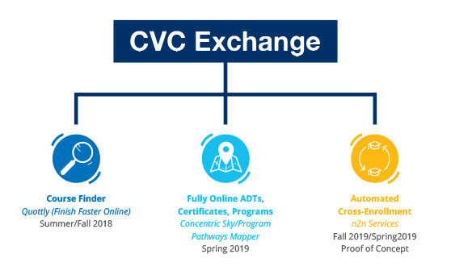
CVC Exchange Update

Slide 13
What is C-ID?
Course Identification Numbering System
Products
Course descriptors
Processes
Convening of intersegmental faculty for descriptor development
Statewide vetting of draft descriptors
Submission of course outlines for review
Course outline review process

Slide 14
What does C-ID do?
Provides a numerical “tag”, a C-ID designation, for courses that match an intersegmentally (or intrasegmentally) developed descriptor
Provides a means of identifying comparable courses and of ensuring course portability within the CCCs
Addresses the need for “common course numbers”
When a college submits a course outline to obtain a C-ID designation, they are agreeing to accept other courses with that C-ID designation in lieu of their native course

Slide 15
What does C-ID do?
Provides a mechanism for one to many articulation
Any university can opt to articulate C-ID descriptors, effectively granting articulation to all colleges that have a course matching a given descriptor
“descriptor-based” articulation
Offers a quality control and model for required courses in the TMCs (transfer model curricula) that are the basis of the statewide response to SB 1440 (associate degrees for transfer; AA-T/AS-T degrees)

Slide 16
How does C-ID relate to SB 1440?
C-ID’s products (descriptors) describe the courses that are required in a Transfer Model Curriculum (TMC).
C-ID descriptors simplify the degree approval process at the CCCCO.
C-ID facilitates the portability of courses taken as part of AA-T/AS-T degrees.
C-ID’s processes are used to develop and vet TMCs.

Slide 17
What could else is – or can - C-ID do?
Descriptors developed for courses in CTE disciplines, transfer and non-transfer, where there is statewide consistency in curriculum
Where CTE programs are transfer programs, clear high school – community college – university pathways can be identified by
Descriptors developed for basic skills courses
Facilitate AB 705 implementation

Slide 18
What could C-ID do?
Serve as a vehicle to facilitate growth of emerging fields
Enable 114 colleges to collaborate effectively to provide online opportunities across the state

Slide 19
C-ID’s Current Challenges
Technology
Lack of CSU Reviews
CCC adoption/use of intrasegmental descriptors

Slide 20
Intersections
How can these efforts work together to benefit our students and our colleges?
Are there C-ID/online opportunities that we should be capitalizing on?

Slide 21
In Closing
Questions…
Thoughts…
Discussions….

Slide 22
Resources and Contacts
www.SB1440.org
www.ASCCC.org
info@asccc.org (email)
www.C-ID.net
www.ADegreeWithAGuarantee.com
www.cvc.edu
https://onlinenetworkofeducators.org/

Slide 23
Thank you!
Anna Bruzzese, bruzzeaa@piercecollege.edu
Kate Jordahl, kjordahl@cvc.edu
Julie Oliver, OliverJ@CRC.losrios.edu
Michelle Pilati, mpilati@riohondo.edu

