Slide 1
Story from the Foothills: How the “Chunking” Process Effectively Reviewed and Improved Our Catalog

Slide 2
Chunking at Columbia: Why might you listen?
Policy & Procedure Review
Policies become better for students
Easier to find and use
Ensure currency w/ regs & standards
Accreditation Expectations
Healthier College

Slide 3
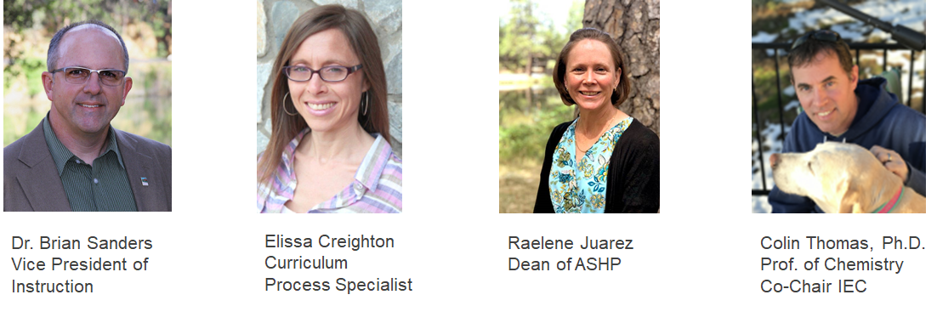
Sharing the Story Today from Columbia College

Slide 4
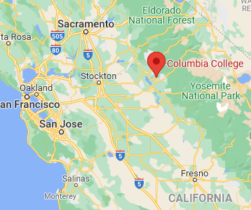

Slide 5
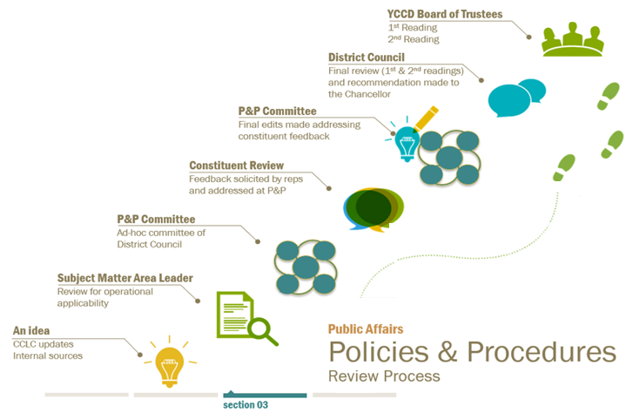
Ah Ha Moment!
Cyclical review of policies is an expectation of the ACCJC Standards
Term “Policy” or "Policies" appears 58 times!
YCCD has a robust and established cycle for reviewing all Board P&P
CHECK!
We've got this!
Notes:
Scene 1: 4:00 am. Writing in a darkened den with the glow of a monitor illuminating Brian’s face...

Slide 6
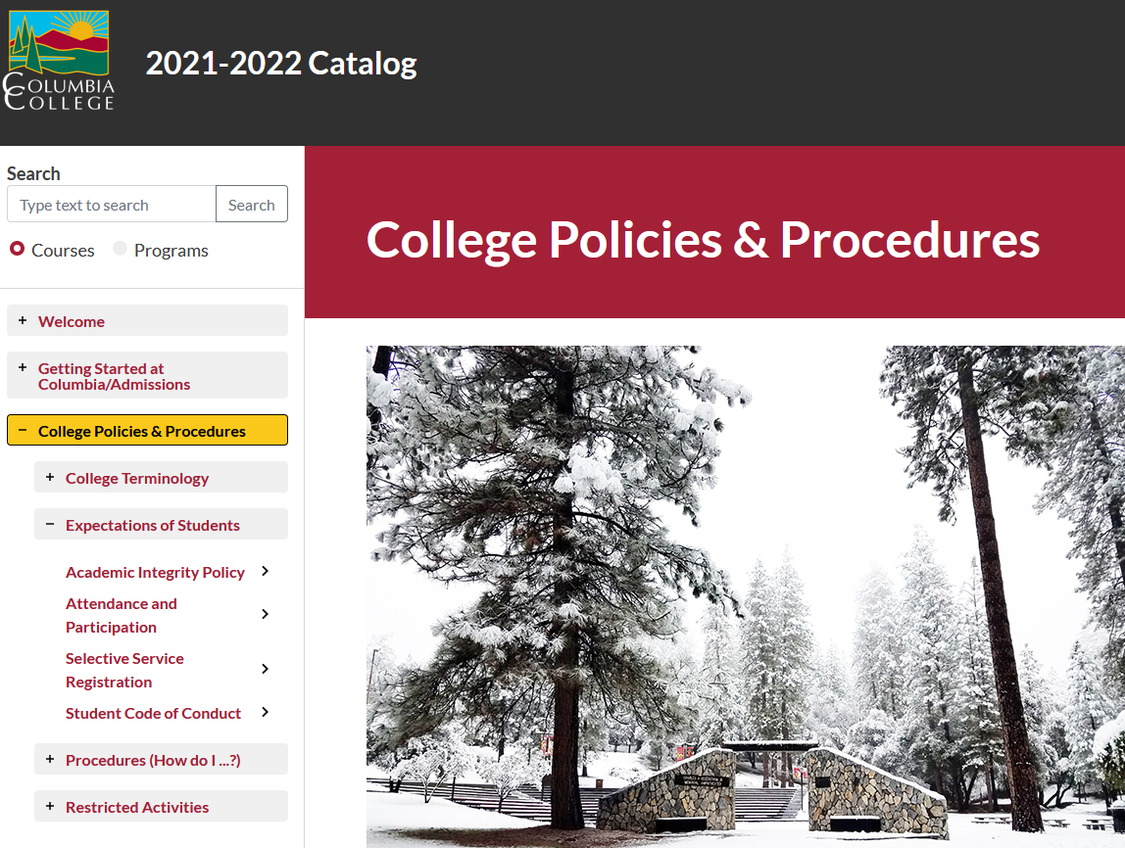
Uh Oh Moment!
Do we have a good review cycle for policies stated in the college catalog???
Action Plan Time!

Slide 7
Framing the Problem
ACCJC Accreditation Standards (June 2014) require catalogs to contain
“major policies and procedures affecting students” and “locations or publications where other policies may be found.”
Many catalog policies are specific and directed toward students
Aligned with Board Policies
Paraphrased for students
Affect students
Therefore… Need a review cycle for catalog policies
Assuming "someone else" is doing is unsafe
Unexamined Policies and Procedures (P&P) may result in institutional racism; DEI opportunity
Updated catalog P&P must reflect updated Board P&P, Title 5, Ed Code, & ACCJC standards

Slide 8
The Journey Begins!
Issue brought forward to the Institutional Effectiveness Council.
IEC found:
“Regular evaluation of policies and practices” is haphazard (I.B.7)
Student-facing polices differ in their “integrity and effectiveness.” (IV.A.7)
Result – Workgroup formed to review policies in the catalog:
The Catalog Chunking Committee!

Slide 9
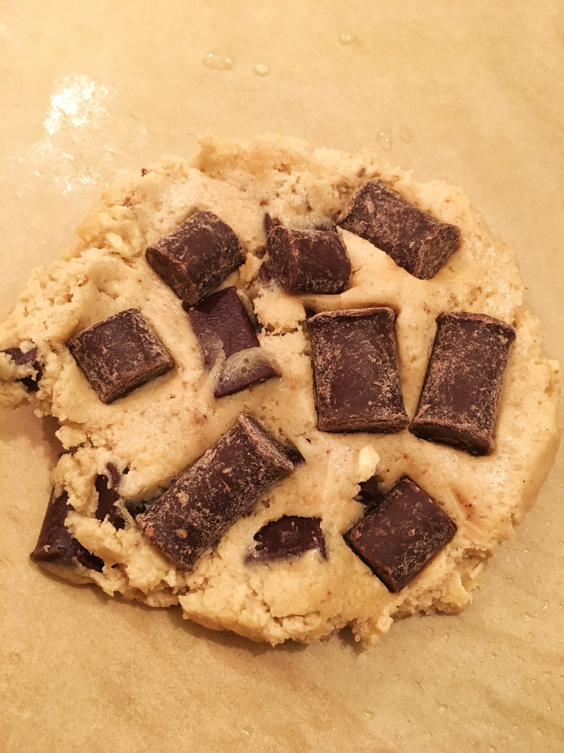
Why Catalog “Chunking” Committee?
Word “Chunking” evolved for a lack of a better term
Existing Catalog Committee annually works on catalog and makes updates
Chunking Committee decided to review the catalog in “Chunks” (sections)
This Photo by Unknown Author is licensed under CC BY-NC-ND

Slide 10
The Main Characters (Chunkers)
Elissa Creighton, Curriculum Specialist
Raelene Juarez,
Dean of Arts, Sciences, and Human Performance
Jill Olson (retired), Counselor and Instructor
Torri Keever, Admissions & Records Specialist
Notes:
Not quite clear what was involved in the task at hand
There were no directions or guidelines on how to proceed
But knew they all could contribute effectively (unknowingly)

Slide 11
Mapping the Path - Sections or Chunks Identified
Academic Policies & Procedures
College Policies & Procedures
Applying for Admission
This Photo by Unknown Author is licensed under CC BY-NC-ND

Slide 12
Mapping the Path - Content Experts Identified
Compliance
Accreditation
Board Policy
Ed Code – laws
Title 5 – regulations

Slide 13
Mapping the Path - Questions to Ask on the Journey
Is policy accurate and being followed?
Does it pose barriers to students?
Is it clear to the average reader?
Is it compliant?
The “Chunkers” are positive, yet embark on the journey!
This Photo by Unknown Author is licensed under CC BY-NC

Slide 14
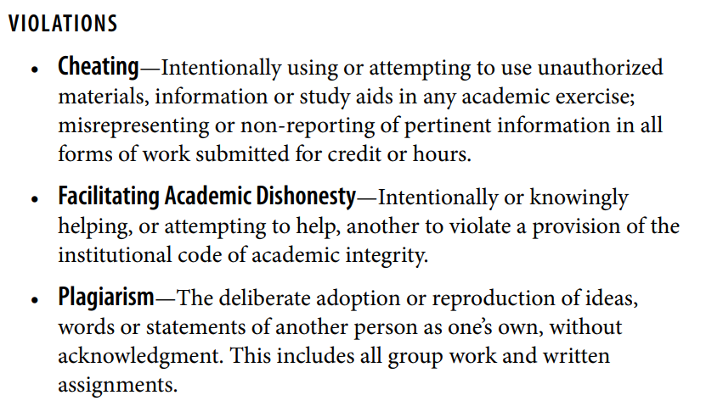
One Success Story - Academic Integrity Policy
BEFORE
AFTER
Violations
Examples of violations are listed below. Professors may define additional specific guidelines within their courses; refer to the course syllabus.
CHEATING
copying from someone else’s assignment, homework, or exam or allowing others to copy you;
altering or interfering with grading;
using resources during an exam that are not allowed;
consulting with someone other than the professor or proctor during an exam; or
making or taking a copy of an exam with the intention of sharing with other students.

Slide 15
Interactive Moment
Can you find your Academic Integrity Policy in your Catalog?
Poll #1 (In Pathables environment) – When was your college policy last reviewed?
1-2 years ago
3-5 years ago
5-10 year ago
Over 10 years ago
Impossible to tell – no date is listed

Slide 16
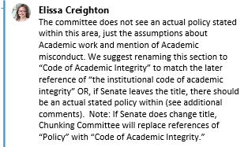
Nugget Found - Use Consistent Wording

Slide 17
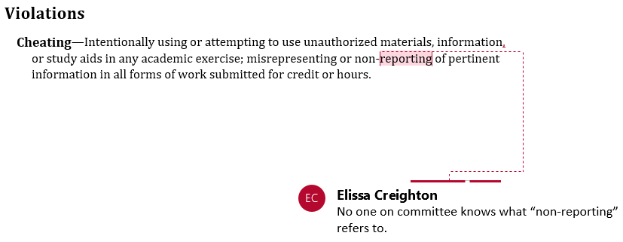
Nugget Found – Use Understandable Language

Slide 18
Nugget Found - Define Policy (or link to it)

Slide 19
Nugget Found - Use an Equity and Inclusivity Lens

Slide 20
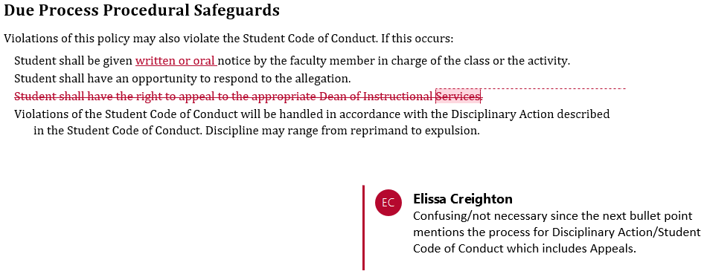
Nugget Found - Remove Unnecessary Wording

Slide 21
Wandering Off the Path - Academic Integrity on Website
Student shall be given notice by the faculty member in charge of the class or the activity on the Academic Integrity Violation Form, available on the college website.
Copies of this form will be given to the professor, the student, the appropriate division dean for the class where the violation occurred, Dean of Arts, Sciences & HHP, Dean of Career Technical Education, or the Dean of Student Services.
The Dean of Student Services will be given a copy to have a record in the student’s conduct file. If needed, the violation will be evaluated against the Student Code of Conduct policy and further action taken.
If the student disagrees with the faculty’s accusation, the appropriate Dean will investigate and render a decision within 15 college business days. Student will be informed in writing of the results of the investigation.
Student may challenge the findings within 5 college business days by contacting the Vice President of Student Services.
The Vice President’s decision is final.
From https://www.gocolumbia.edu/student_services/integrity.php (no longer available)

Slide 22
Interactive Moment
Can you find your Academic Integrity Policy on the college website?
Poll #2 (In Pathables environment) – How well does your catalog policy align with your website?
Verbatim – word for word exact!
Almost identical
Clearly written from the same source document
Distant cousins
Written on different planets

Slide 23
Further Off the Path - Academic Integrity in Student Code of Conduct
Student Code of Conduct violations are reported through Online Reporting System (Maxient)

Slide 24
Interactive Moment
What does your Student Code of Conduct say about Academic Integrity?
Poll #3 (In Pathables environment) – How well does your Student Code of Conduct align with your Academic Integrity Policy?
They are well-aligned – not exactly the same words, but pointed in the same direction.
It’s a little fuzzy. They align well in some ways but not others.
Diametrically opposed – as though the two documents have never been reviewed side-by-side.

Slide 25
Finding Our Way - Content Experts to the Rescue
Student Services
Academic Senate
Meets with:
Shared process for Student Code of Conduct (Online Reporting)
Instructional Deans
Work-group reviewed:
Catalog Policy
Website with reference to Original Form
Student Code of Conduct
Shared perspective

Slide 26
Result - Clearer Pathway!
Catalog Chunking Committee Report & Action Plan 10/5/18 (revised 10/10/18 with input from the IEC)
The committee reviewed the catalog to identify internal and external policies and the person/area responsible for each policy. The committee now proposes to review each of the catalog sections in order to launch a more in-depth editing process:
Academic Schedule/Calendar
About Columbia College
Applying for Admission
Services for Students
Activities & Student Life
College Policies & Procedures
Academic Policies & Procedures
College Fees & Expenses
Educational Planning Resources
Course Descriptions (pg 148)
any other IEC identified priorities (i.e. Field Trips and Credit by Examination)
= completed after 3 yrs

Slide 27
The Journey Continued!
Content Experts
review
IEC
approve
draft
Chunkers
This Photo by Unknown Author is licensed under CC BY

Slide 28
Other Nuggets Found
Provide sequential steps in a process
Check the flow from section to section
Rearrange content to appropriate sections
Eliminate redundancy
Eliminate redundancy
After three years,
the “Chunking” Committee still looking positive!

Slide 29
Another Fork in the Road
Website and Catalog continue not to match
Another consideration, catalog moving from “paper” to online
Question – What to keep in the catalog and online?
Thus, the Catalog Website Sorting Committee was formed

Slide 30
Getting Others On the Path
The “Chunkers” struggled with authority and accountability
Folks were ‘rubber stamping’ and not deep reviewing
Institutional Effectiveness Council became the muscle
However, the bigger question was who would continue to lead the journey and how to implement...???

Slide 31
The “Chunking” Journey Ends
IEC - Establishes Process
Regular Review – Annual review and update of pages for accuracy
Deep Review – Every three years at minimum, each area will conduct a thorough review by checking beyond accuracy

Slide 32
Questions and Answers?

Slide 33
Remaining slides for use during Q&A if necessary

Slide 34
Deep Review Process
Organized and understandable to the average reader
Reflects current YCCD and external agency policy/procedure
Policy numbers (internal/external) are included and correct
Links work and go to appropriate webpage
In line with content on college webpages, avoiding duplication when possible
See ACCJC Catalog Requirements before removing info from catalog
Check that policies are equitable and inclusive – Contact DEI
Note: Curriculum Specialist will brings edits to the Catalog Committee

Slide 35
The Journey Eliminated Barriers
Example – Pass/No Pass Policy
Title V: 55022 (b) states, All units of credit earned on a “pass-no pass” or “credit-no credit” basis in accredited California institutions of higher education or equivalent out-of-state institutions shall be counted in satisfaction of community college curriculum requirements.
Previous Catalog Policy Read
Students may only choose P/NP grading in one class per semester.
Students may enroll in as many courses designated as “P/NP only” as they choose

Slide 36
The Journey Brought Clarity
Example – Policy on Earning Multiple Degrees

Slide 37
Finding Our Way - Content Experts to the Rescue
Academic Senate
Formed a Workgroup
Reviewed Info
Catalog Policy
Website with reference to Original Form
Student Code of Conduct
Met with Student Services & Instructional Deans
Student Services
Shared process for Student Code of Conduct (Online Reporting)
Instructional Deans
Shared perspective

Slide 38
The Journey Continued!

