Slide 1
Civic Engagement As a Component of Discipline Instruction (De Anza College)
Karen Chow, Marc Coronado, Alicia De Toro, and Jim Nguyen

Slide 2
Civic Engagement in English Composition
EWRT 211 (1 level below 1A):
Dia de los Muertos Altars on the Main Quad
Global Issues Conference

Slide 3
Civic Engagement in English Composition
EWRT 1A & 2
Ham 4 Ham
Global Issues Workshop
Women and Children Incarcerated in Prison Industrial Complex as well as in Immigration Detention Centers
Proposals For Change
Artist visits/discussions: John Jung and artist Flo Oy Wong: social history of Chinese restaurants in the U.S. as documented in "Sweet and Sour: Life in Chinese Family Restaurants."

Slide 4
Civic Engagement in English Composition
EWRT 1A & 2 (continued)
Cross-Disciplinary Faculty and Student Teach-Ins
Unnatural Disasters
Civil Liberties
Artist visits/discussions:
John Jung and artist Flo Oy Wong: social history of Chinese restaurants in the U.S. as documented in "Sweet and Sour: Life in Chinese Family Restaurants."
Austin Willacy, “Song, Telling Our Own Stories, and Telling Someone Else’s Story (Coffee and Tea)”

Slide 5
Civic Engagement in Women’s Studies
It’s a natural fit.
Praxis:
Study and issue and propose a project
Take part in solving a problem
Reflect on that process

Slide 6
Pad Me!
The Issue: Homeless women and victims of domestic
violence lack funds to purchase needed products
The research: Read about situation in prisons, shelters, etc.
The project: Collect products and educate community,
donate to local shelter, learn about the shelter and resources.
The reflection: Few people know much about their own
bodies, about the tax on these products or the resources
available

Slide 7
Rebel Stitches
The issue - lack of opportunities to build community
The research - How have women traditionally
created community and solidarity?
The project - Teach Queer Scouts to make hats and
neckwarmers, organize Rebel Stitches
The reflection - To come

Slide 8
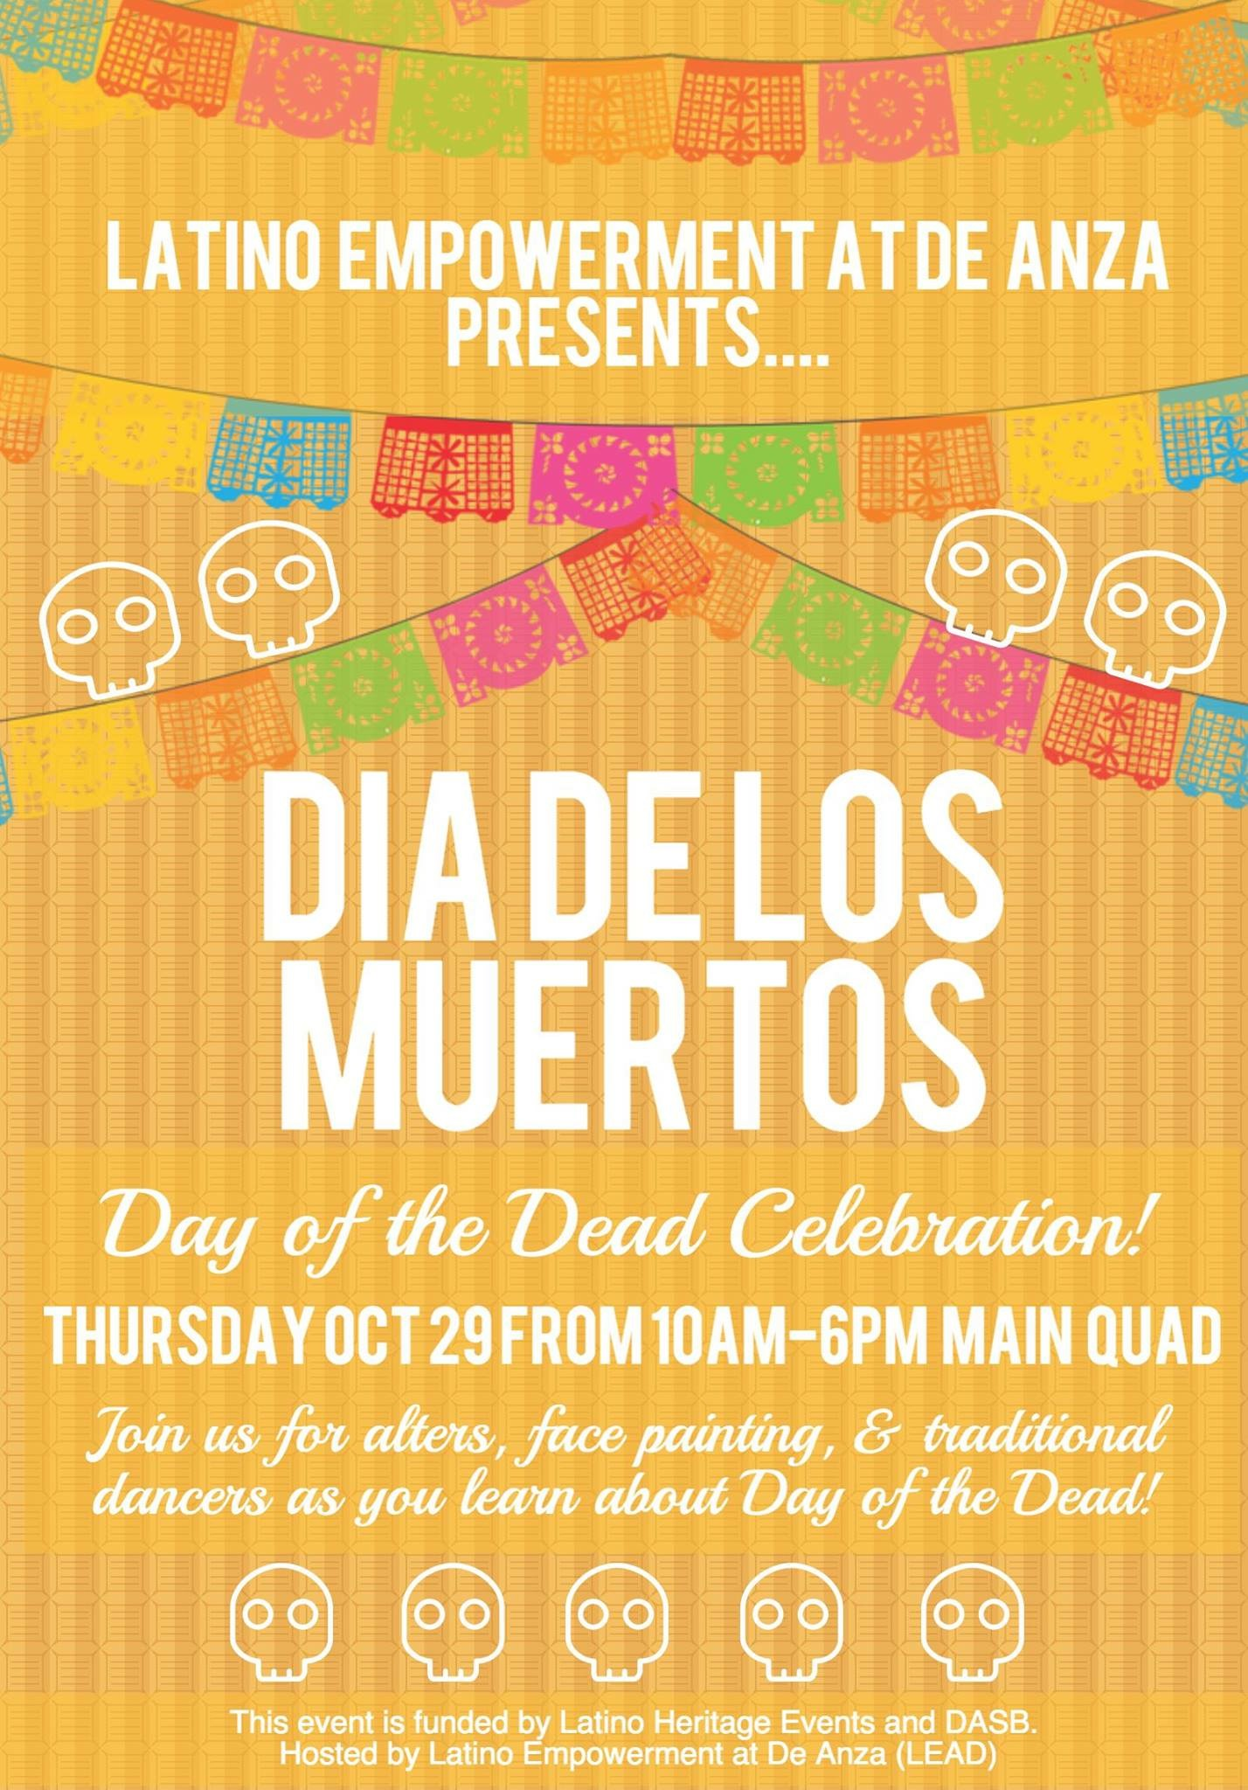
Civic Engagement in Environmental Science
Dia de los Muertos Altars on the Main Quad
In class group assignment
Integration of cultural understanding and ESCI
Students researched Dia de los Muertos history and altars
Selected an extinct species and began to create altar

Slide 9
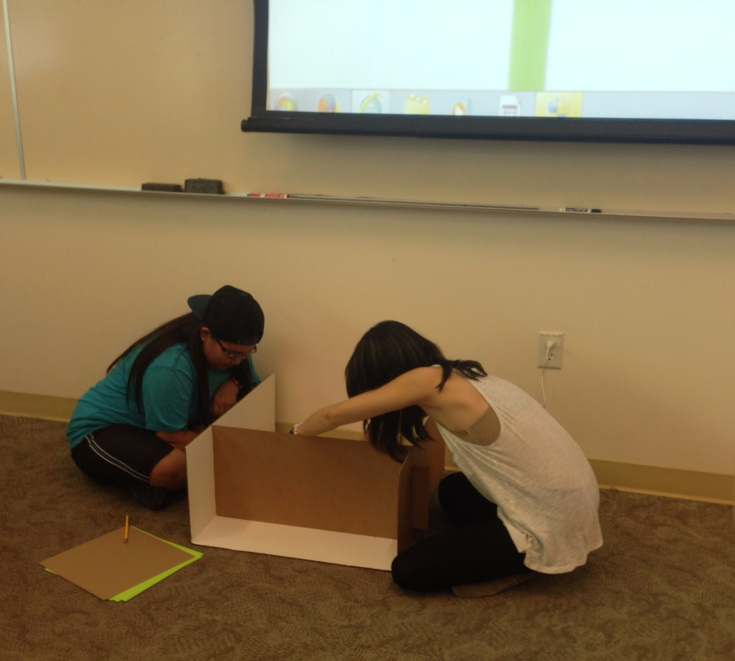
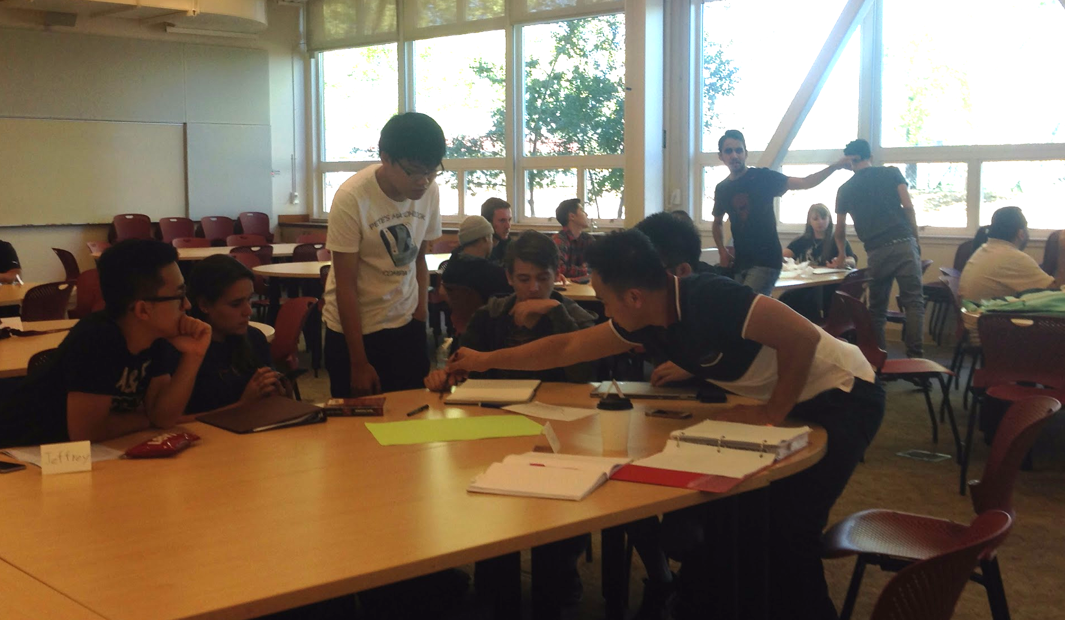
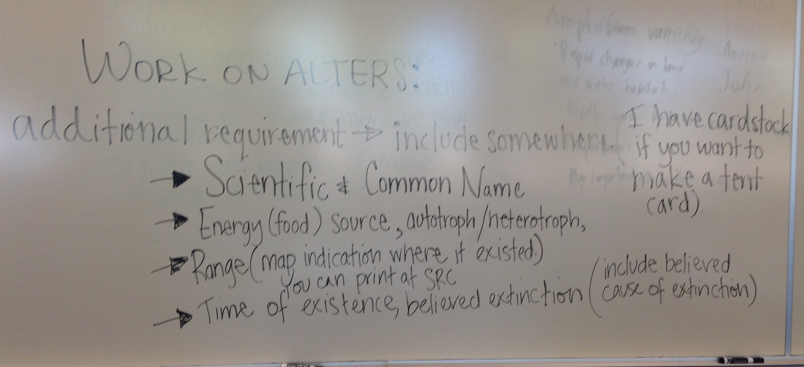
Civic Engagement in Environmental Science

Slide 10
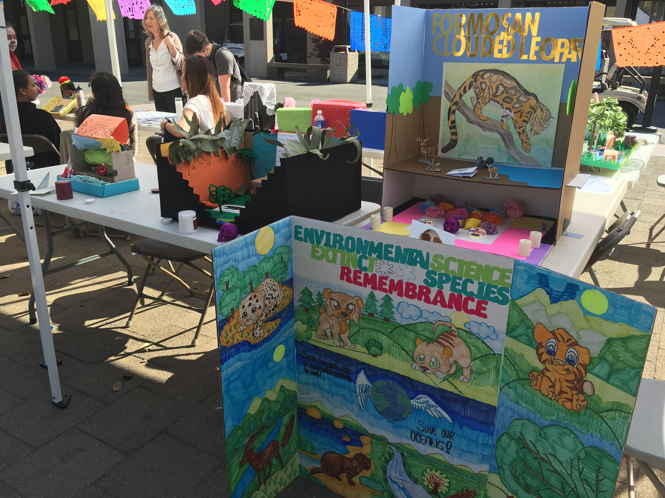
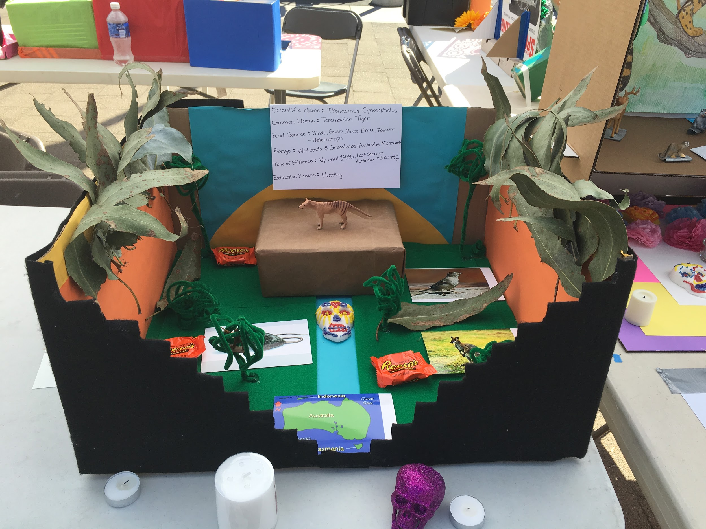
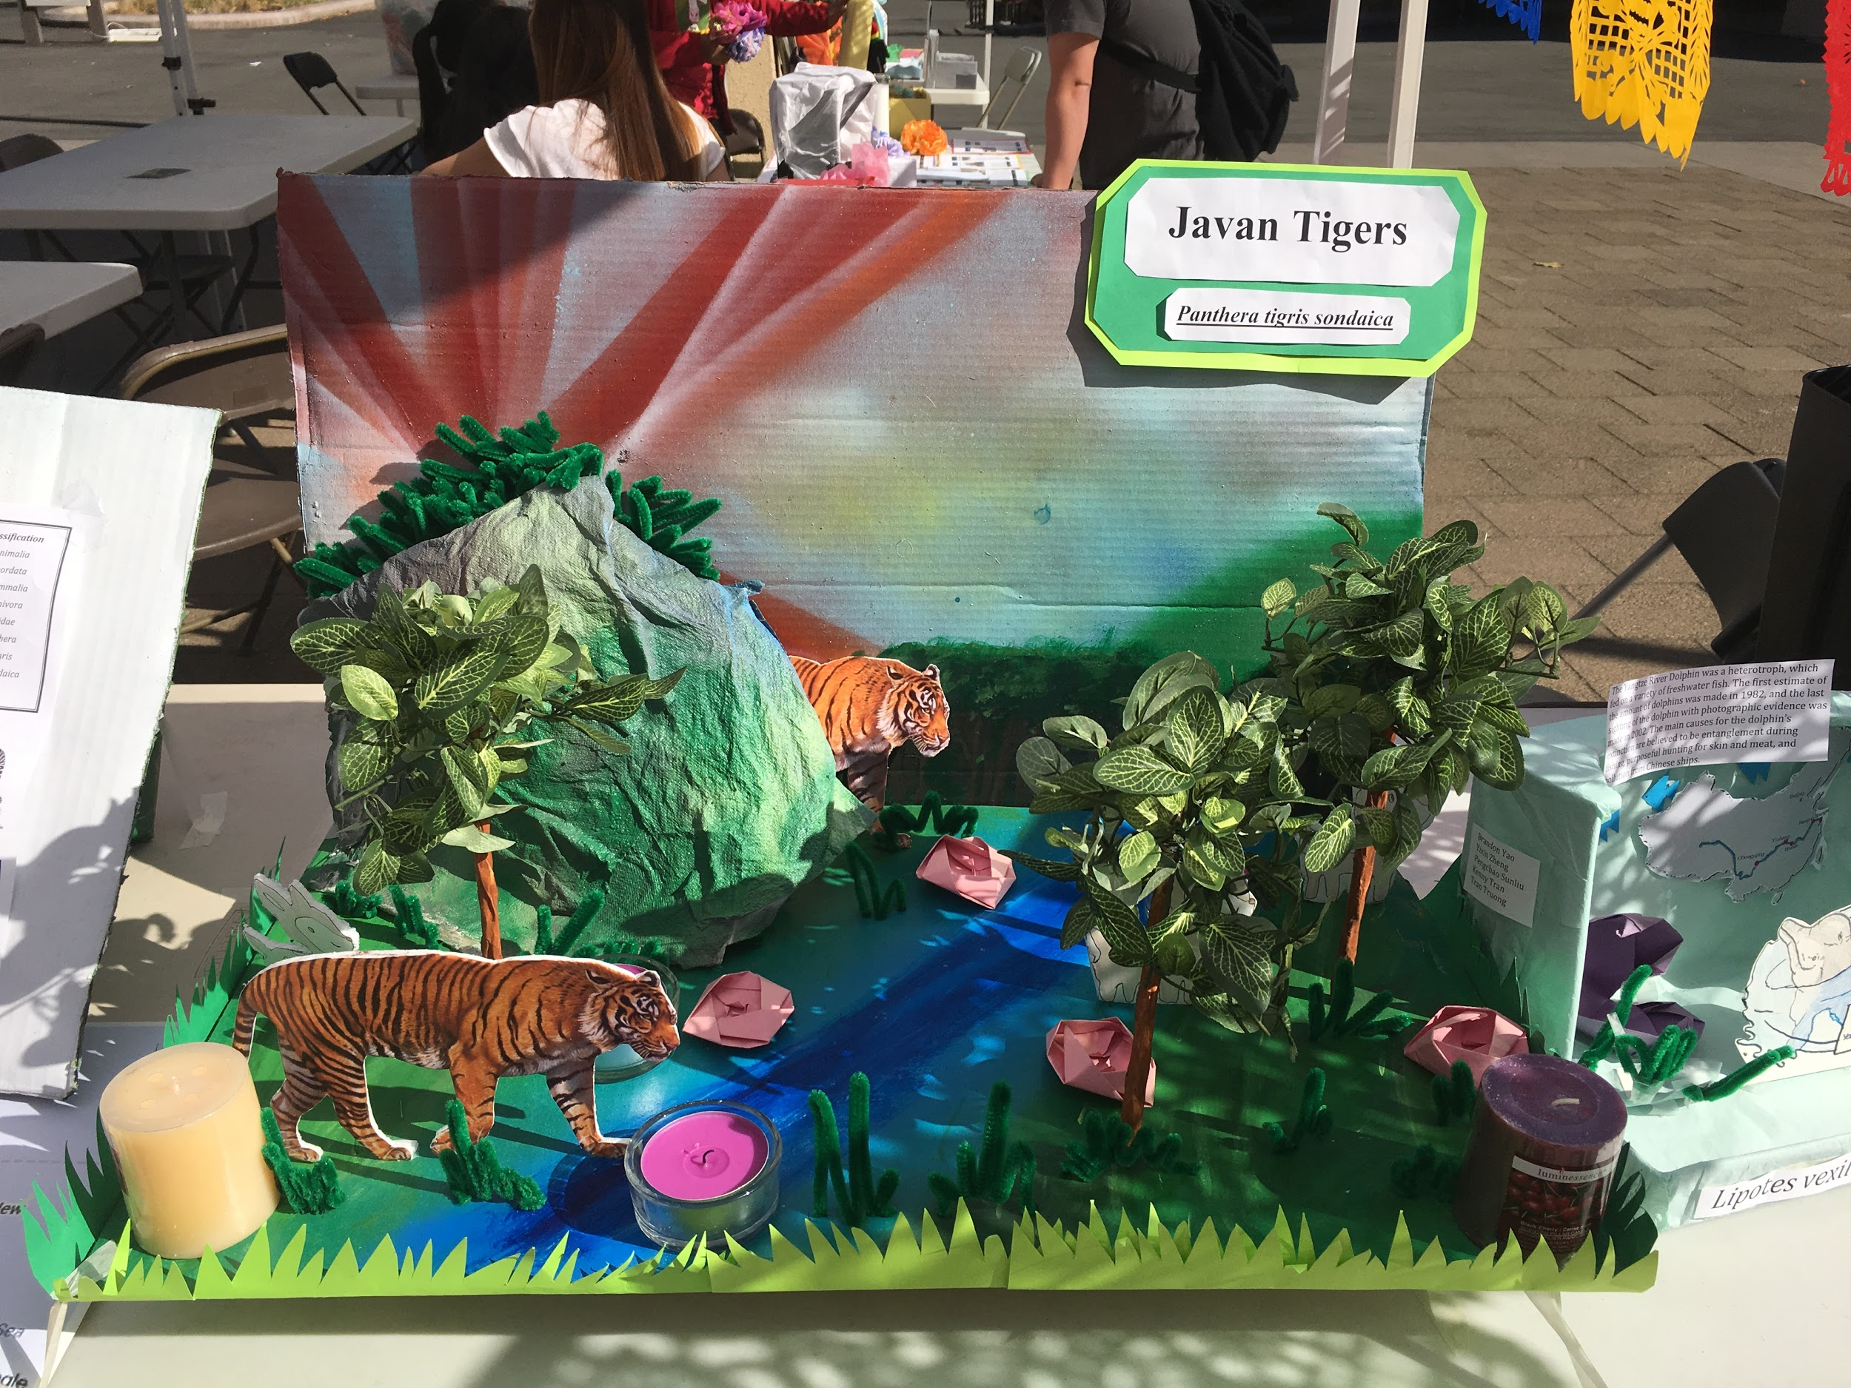
Civic Engagement in Environmental Science

Slide 11
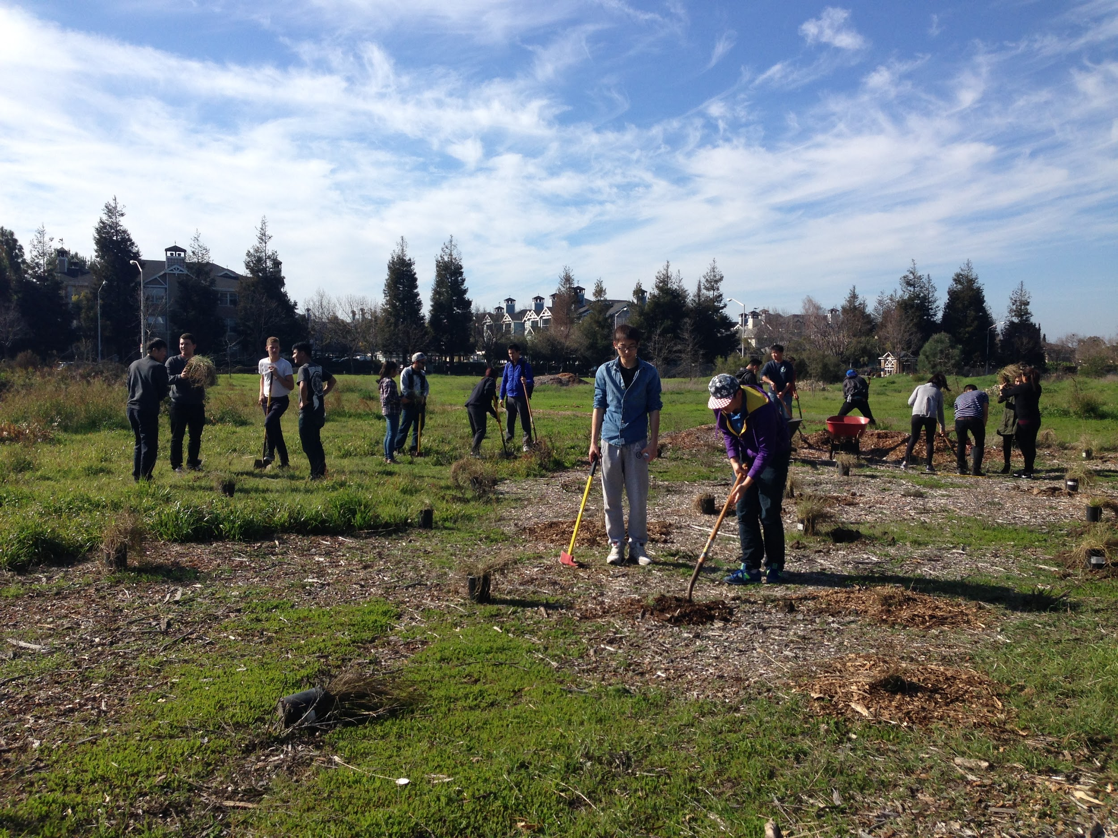
Civic Engagement in Environmental Science
Restoration ecology is process of assisting the recovery of an ecosystem that has been degraded, damaged or destroyed.
http://www.ulistac.org/

Slide 12
Civic Engagement in Political Science
Political Science 1: VIDA and Service Learning (12 hour requirement)
  2016 election, campaign work, post-election
    Voter Registration Drives
    Campaign Issues and Candidates
    Post-election issues: immigration protections, labor rights, hate crimes
Public Policy School - training students for visits to DC and Sacramento
Political Science Internships for Course Credit - with local legislative reps
Overall impact: increased civic capacity and agency, success and retention

Slide 13
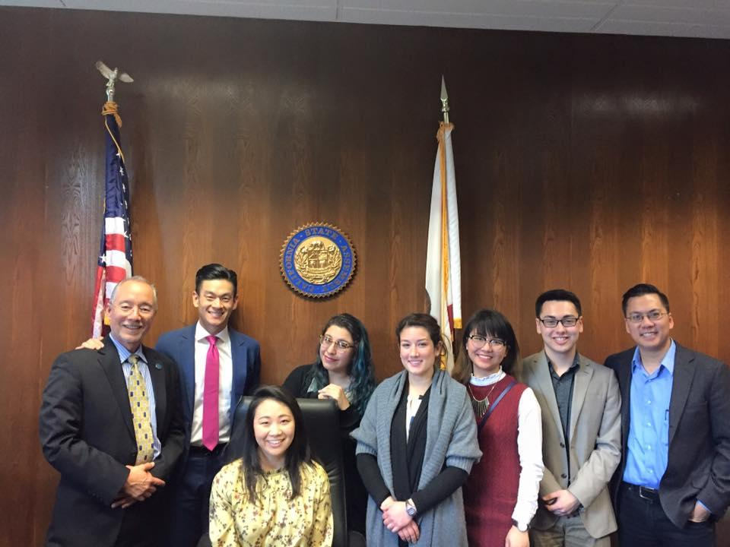
FACCC/Public Policy School Legislative Visits March 2017
Public Policy Students
With Asm. Evan Low

Slide 14
Group Discussion/Activity
Attendees will join panelists in a discussion/small group breakouts to discuss how they can incorporate civic learning into their disciplines.

Slide 15
Thank you!!
For more information about the civic engagement initiatives covered today:
Karen Chow: chowkaren@deanza.edu
Marc Coronado: coronadomarc@deanza.edu
Alicia De Toro: detoroalicia@deanza.edu
Jim Nguyen: nguyenjames@deanza.edu

