Slide 1
Curriculum Innovation: Civic Engagement Across the Curriculum
Manuel Baca, Political Science, Rio Hondo College
Julie Bruno, Communication Studies, Sierra College
Stacey Searl-Chapin, Political Science, Mt. San Jacinto College

Slide 2
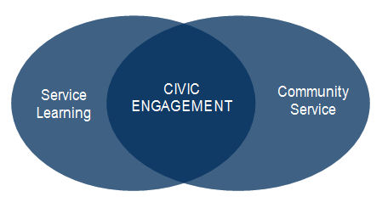
Preview
Defining “Civic Engagement”
Contextualizing “Civic Engagement”
The United States Constitution: Awareness and Understanding
Group Activity: Civic engagement at Our Colleges
Strategies
Next Steps

Slide 3
Civic Engagement Defined
Individual and collective actions designed to identify and address issues of public concern.
~American Psychological Association
Political advocacy
Organizational Involvement
Community Problem Solving
Active participation in public life

Slide 4
Civic Engagement
Civic engagement means working to make a difference in the civic life of our communities and developing the combination of knowledge, skills, values and motivation to make that difference. It means promoting the quality of life in a community, through both political and non-political processes.
~Civic Responsibility and Higher Education
Edited by Thomas Ehrlich

Slide 5
Contextualizing “civic engagement”

Slide 6
Voter Turnout

Slide 7
Voter Turnout

Slide 8
Voter Turnout

Slide 9
Civic Engagement

Slide 10
The Constitution: Awareness and Understanding

Slide 11
National Survey of Americans’ Awareness and Understanding of the Constitution and Constitutional Concepts
Sponsored by the Claude Moore Charitable Foundation & conducted by the Center for the Constitution at James Madison’s Montpelier (2010)

Slide 12
How much of the Constitution do you understand?

Slide 13
How much of the Constitution have you read?

Slide 14
How recently have you read the Constitution?

Slide 15
Does the Constitution still work, or is it time for a new Constitution?

Slide 16
On a day-to-day basis, how much would you say the Constitution affects you?

Slide 17
The American Constitutional system is one in which the powers of government are limited.

Slide 18
The American Constitutional system is one in which government is empowered to act for the common good.

Slide 19
The American Constitutional system is one in which your rights are yours because . . .

Slide 20
Selected Laws and Regulations: The Constitution and Education
Consolidated Appropriations Act, 2005: Section 111 of Division J of Pub. L. 108-447
Federal funding and Constitution Day Activities
Education Code section 44335 and Title 5 section 80415 provide that the US Constitution requirement may be met by coursework or a college-level examination completed at a regionally-accredited community college or four-year college or university.
Teachers and Knowledge of the U.S. Constitution

Slide 21
Institutional or GE Outcomes
The student will display personal and civic responsibility.

Slide 22
Institutional or GE Outcomes
Evaluate social justice issues and identify social responsibilities to elicit social change. Recognize the ethical implications of political, social, and economic institutions.
Community and global awareness includes an understanding of community and global issues and cross-cultural awareness. This includes but is not limited to:
Civic Awareness: Appreciate the importance of public service Understand the grounds of civic duty

Slide 23
Institutional or GE Outcomes
Civic Engagement and Global Citizenship – includes an understanding of current events, of ethics and the implications of personal and societal choices as they affect our interconnected world economy, governments, environment, and social climate; as well as acceptance of responsibility for civic and societal engagement.

Slide 24
Group Discussion
What is your college doing to promote civic engagement and awareness of the U.S. Constitution?
How do you make it productive and sustainable?
What curriculum explicitly engages students? Course? Internships?
What faculty, staff, or administrators are involved? Do you have “champions”?
What extra curricular activities are offered?

Slide 25
Group Discussion
Does your curriculum committee ensure that the organizational value and institutional outcome of civic engagement is embedded in the curriculum?
Can our colleges do better? How?
How do you engage all faculty, staff and administrators in the effort?

Slide 26
Report out from group discussion

Slide 27
Next Steps
What do you need to increase and improve the efforts of civic engagement?
What does your college need to be more effective?
What can the ASCCC do to assist?

Slide 28
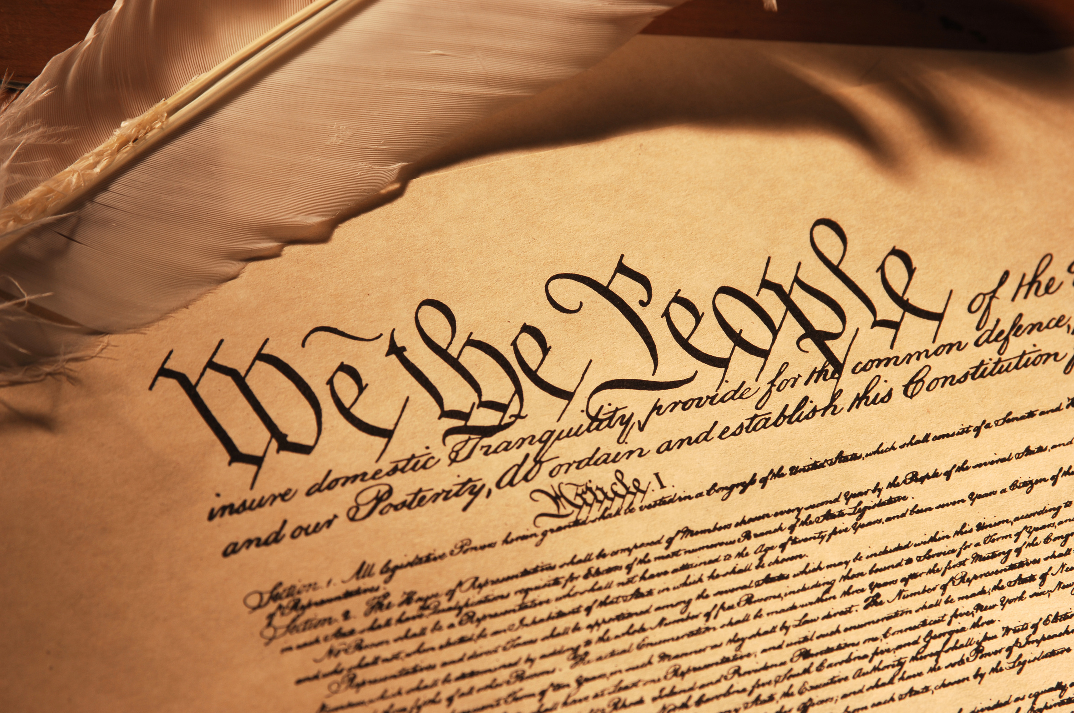
Selected Resources: The Constitution
Annenberg Public Policy Center, University of Pennsylvania
Civics Renewal Network
The State of the Constitution: What Americans Know (Executive Summary)

Slide 29
Selected Resources
Civic Renewal Network (partners)
United States Constitution and Citizenship Day (provisions for institutions receiving federal funding)
California Teacher Credentialing: U.S. Constitution Requirement
Pew Research Center

Slide 30
Additional Resources
Academic Senate for California Community Colleges Rostrum Articles
The Democracy Commitment
Annenberg Institute for Civics
AACU: Civic Learning and Democracy Engagement
Additional Presentation Information and Materials

Slide 31
Final Thoughts
Share your good work.
Submit Civic Engagement Proposals to the ASCCC Instructional Design and Innovation Institute, January 21-23, 2016
Stay tuned…

Slide 32
Contacts
Manuel Baca, Political Science, Rio Hondo College, MBaca@riohondo.edu
Julie Bruno, Communication Studies, Sierra College, jbruno@sierracollege.edu
Stacey Searl-Chapin, Political Science, Mt. San Jacinto College, schapin@msjc.edu

Slide 33
Thank You!

