Slide 1
Civic Engagement Across the Curriculum
ACTIVISM
Protecting the Learning Environment

Slide 2
“No one should make the claim of being educated until he or she has learned to live in harmony with people who are different.”
Wilson, A. H. (1982, Summer). Cross-cultural experiential learning for teachers. Theory Into Practice, 21(3), 184-192.

Slide 3
ACTIVISM
The Starting Point
Considerations
What is the faculty role here?
Are we obligated to do something?
Is there a disconnect between our awareness of current issues and how we handle them?
How do we play fair and nice without insult or grievances?
Should we?
Why should we care?
Balance between applying critical analysis to issues of public importance vs. political correctness?
Inclusion within our curriculum?

Slide 4
Who voted?
Registered voters who identified as Democrats and independents were more likely than Republicans to stay home.
Non-white and Hispanic Americans were more likely to stay home than white voters.
Younger voters were more likely to stay home than older voters.
Registered Voters Who Stayed Home Probably Cost Clinton The Election, Jan. 5, 2017, available at:
https://fivethirtyeight.com/features/registered-voters-who-stayed-home-probably-cost-clinton-the-election/

Slide 5
ACTIVISM
According to the Southern Poverty Law Center, between the election and Nov. 14 (seven days), there were 437 incidents of intimidation, targeting blacks and other people of color, Muslims, immigrants, the L.G.B.T. community, and women.
Alexis Okeweo, The New Yorker, Nov. 17, 2016.

Slide 6
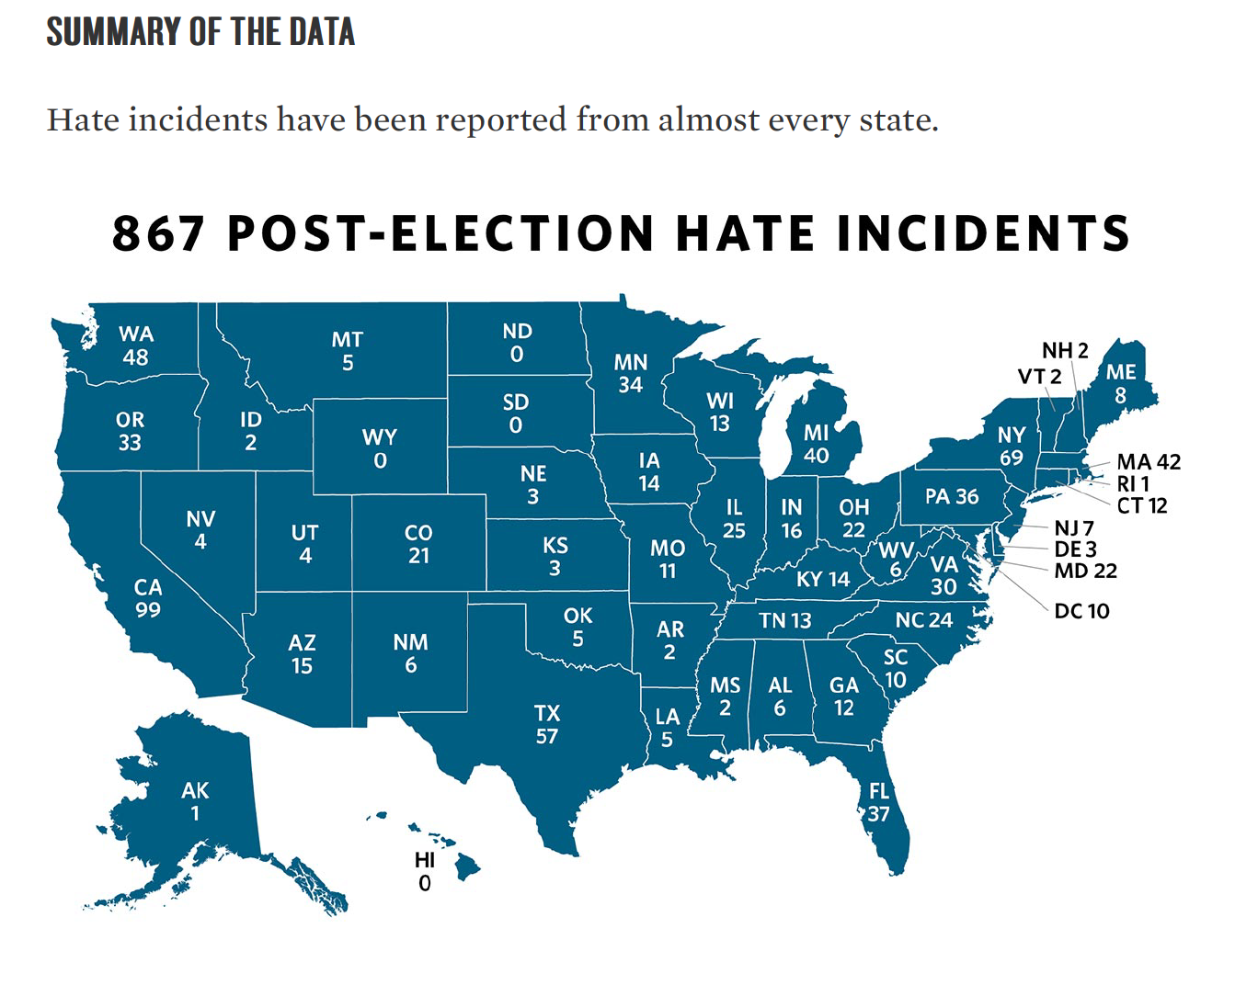
Ten Days After: Harassment and Intimidation in the Aftermath of the Election, Southern Poverty Law Center, Nov. 29, 2016.

Slide 7
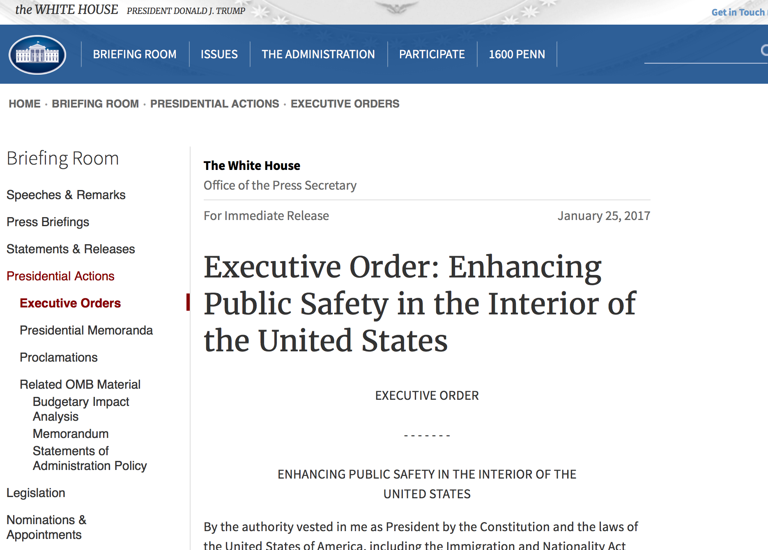

Slide 8
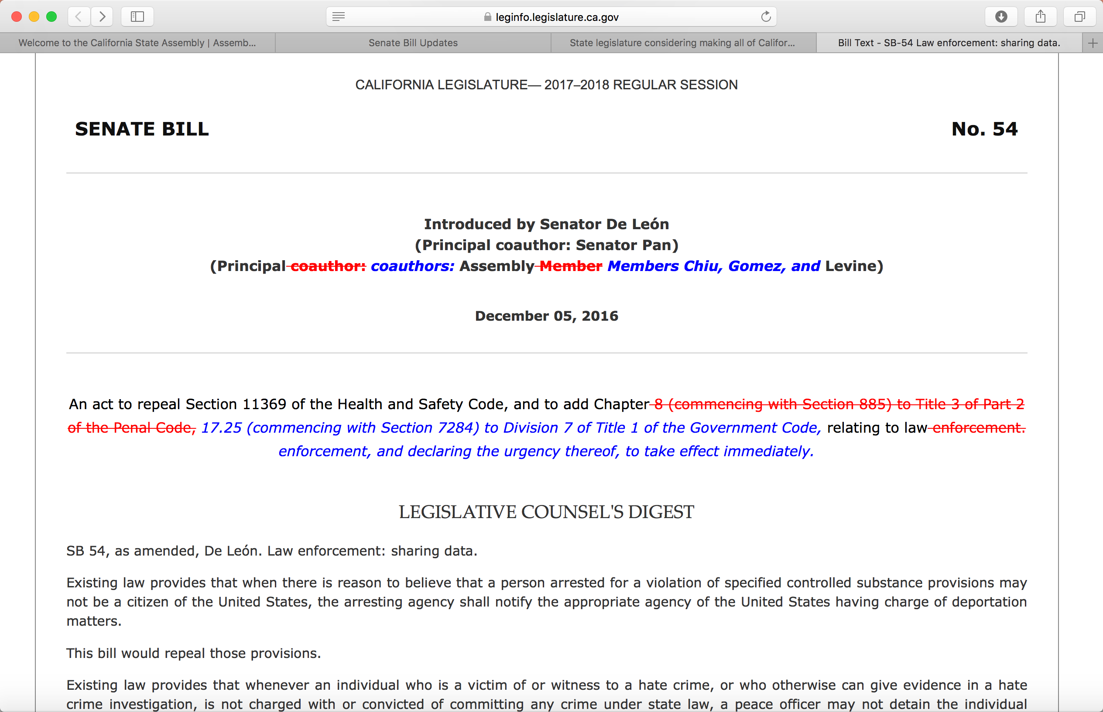

Slide 9
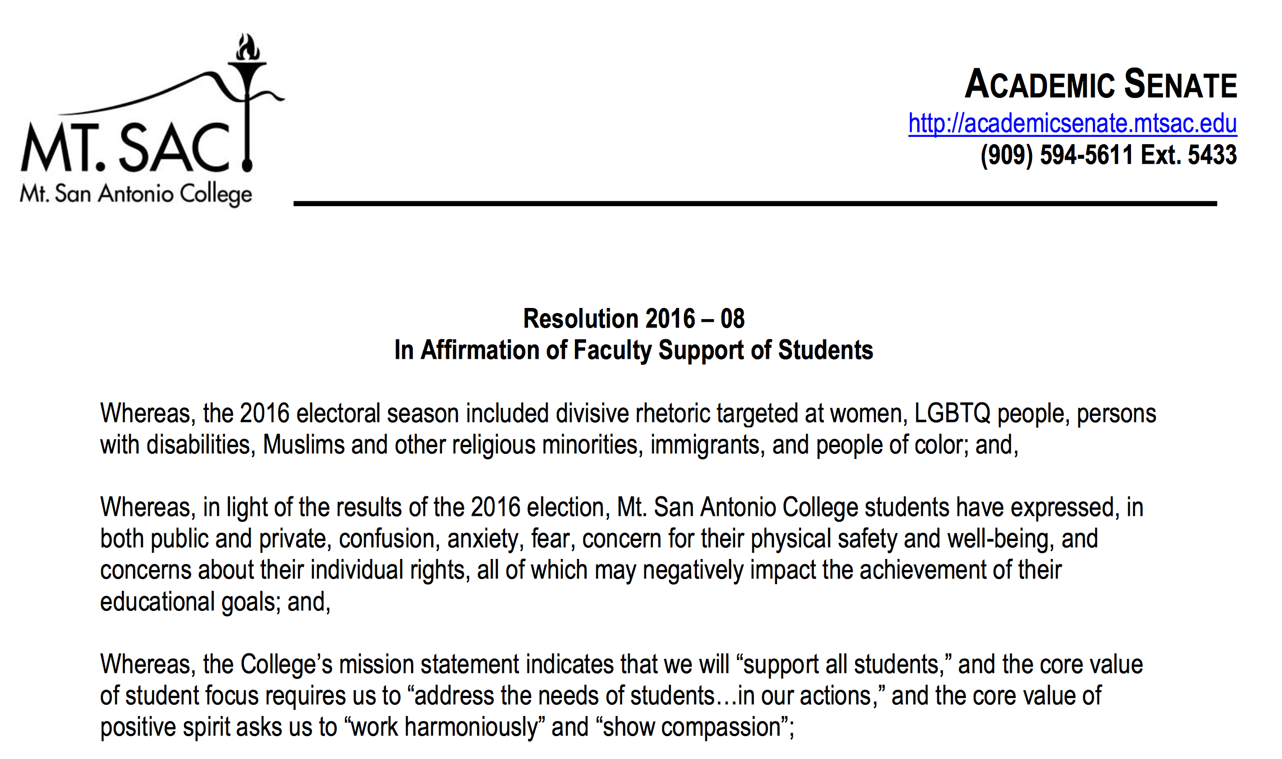
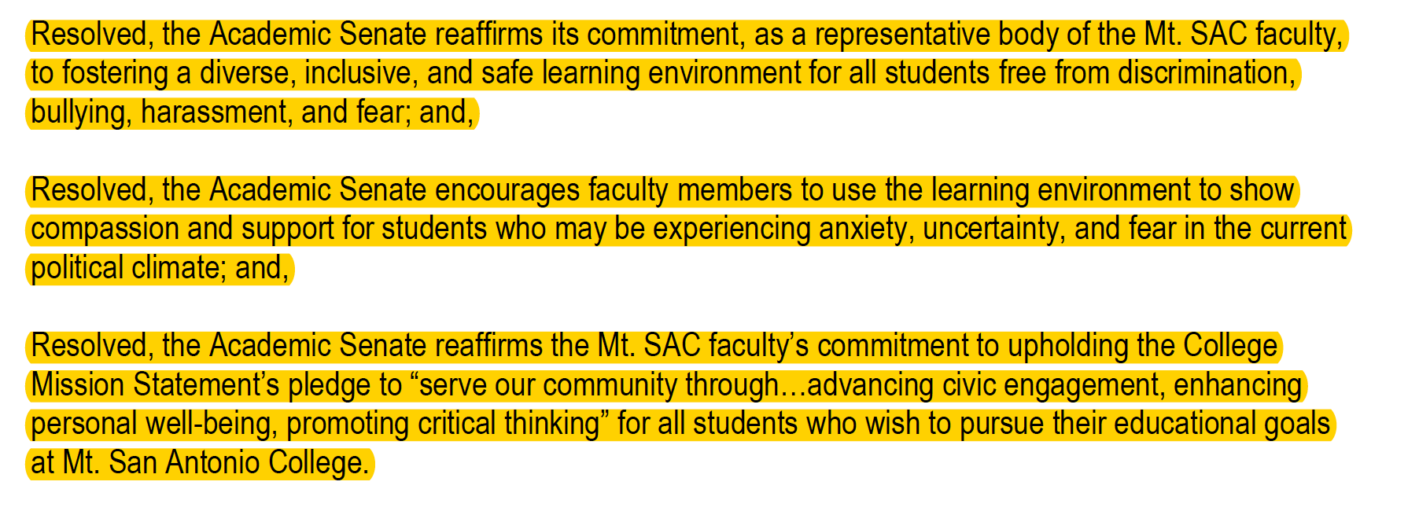

Slide 10
Strategies to Consider
Invigorate difficult classroom discussions with critical analysis
Managing dissenting views, managing conflict, facilitating compromise and working together toward possible solutions
Encourage students to vote
Incorporate service-based learning into the curriculum
Infuse curriculum with topics on personal and social responsibility
Adopt a civility statement and/or include your district's anti-discrimination policy for your syllabi

Slide 11
Strategies to Consider
Stronger faculty mentor-student club involvement
Educate all students about your district’s unlawful discrimination and harassment policies
Provide faculty support to students impacted
Strengthen communication and collaboration between Academic Affairs and Student Services, make referrals as needed
Provide professional development such as diversity training
Train peer mentors, student ambassadors and student leaders about diversity awareness and the importance of inclusiveness

Slide 12
Questions to Explore with Your Legal Counsel
Can a district decline to disclose student information, e.g., social security numbers and related residency information to ICE or other federal agencies that request it?
Can a district protect student privacy by narrowing the passive forms of sharing information, for example by not identifying key student information for certain types of applications, records, or requests for information? (Federal Integrated Postsecondary Education Data System (IPEDS), campus police reports, student discipline records, financial aid documents, admissions applications, etc.)

Slide 13
Questions to Explore with Your Legal Counsel
Can a district opt out of CCC Apply if SSNs are required for noncredit student enrollment?
What legal guidelines can a district offer its students in protecting their privacy?
Can a district stop requiring the FAFSA as a universal application for community college financial aid and instead make the BOG Fee Waiver Application widely available?
Can a district declare it will not voluntarily report student worker information?
Can a district continue to employ students who hold DACA work permits after those permits expire?
What options are available for DACA students now after the inauguration?

