Slide 1
The World Around Us:
Cultivating Global Perspectives in Advanced ESL Classes
Clara Lam, De Anza College
Instructional Design & Innovation Institute March 17, 2017

Slide 2
Why the need to internationalize?
Paradigm Shift
Treasure troves to be utilized
Global citizenship

Slide 3
ESL 5 (English 1A) Class size: 29

Slide 4
Cultivating international content from different angles
Changing an existing assignment
Using texts about the world

Slide 5
Food Story Assignment
Original assignment: Peer review in pairs of two.
New design:
Students posted third drafts on Lacuna and shared stories in groups of five.
Identified use of concrete details and use of sensory language in classmates’ papers.
Wrote “end comments” on what they had learned from classmates’ food traditions.

Slide 6
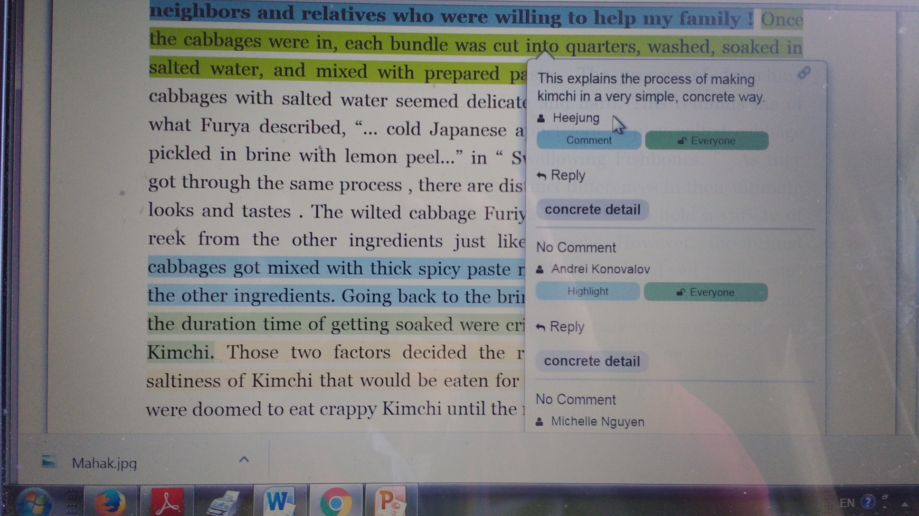
A Screen Shot from

Slide 7
Students’ end comments on Lacuna
“I really enjoyed your story. It not only appealed to my senses but also brought vivid memories of my experiences of making Kimchi. Reading your story, I could picture the scene where people gathered together helping each other as a community. As a Korean myself, I am proud of this tradition and think it’s a culture that we should maintain.”
“When I watch Korean dramas, I have seen Koreans usually eat Kimchi whenever they eat. Now I can see how Koreans make this dish through your story. I love kimchi and will make it in the Korean way as you described.”

Slide 8
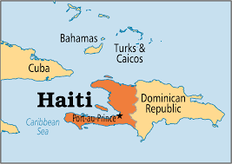
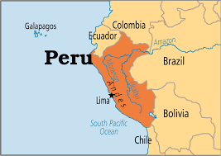
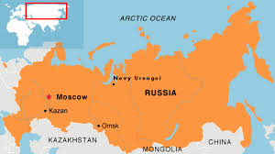
Research Paper
Challenges: 3 ½ weeks; research skills; writing skills.
Reassurance: an update on PIH (Partners in Health) work in Haiti, Peru, or Russia; a similar effort or organization in student’s own country.

Slide 9
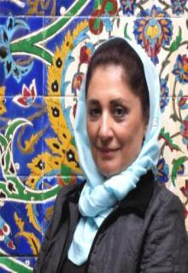
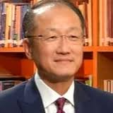
Sample Topics for Research Paper
A True Super Hero: Dr. Paul Farmer’s Work in Haiti
Women at Risk in the HIV Epidemic in Haiti
The Mahak Charity in Iran
Jim Kim’s Journey from PIH to World Bank
Student comments about the book:
“Now I know where Haiti is”
“so much inequality in this world”
“I thought my country, Vietnam, is poor, but there are poorer places….”

Slide 10
Intervention with Lacuna
Problems: getting sources; integrating and documenting information; writing a six-page paper; laziness, tardiness, and fear.
Intervention
Posted four sample drafts of research paper on Lacuna.
Students selected one draft to read;
identified thesis ; then, main points and supporting details in two body paragraphs;
wrote an end comment on what they had learned.

Slide 11
Student Comments on Using Lacuna
“It gave me an opportunity to practice my writing and reading skills, such as easily find the main points and supporting details in my classmate’s paper.”
“Annotation itself makes me think critically.”
“When I don’t understand the sentence or where it’s unclear to me, other classmates summarizes the point and it really helped me understand better.”
“Reading a classmate’s Research Paper helped me improve and work on my own because I was lost all this time, even after I had asked for help.”
“I didn’t know that citing sources inside the essay was so simple, so that was useful to know.”

Slide 12
Special Thanks to
My ESL 5-02 Students in Fall 2016
The Lacuna Program for Innovative Pedagogy

