Slide 1
Collaboration between Curriculum and Articulation to Support Student Transfer Friday, July 8, 2022 ǀ 2:15pm -3:30pm

Slide 2
Session Presenters
Adrienne Brown, Los Angeles Harbor College
LaTonya Parker, ASCCC Secretary
Christopher Howerton, ASCCC North Representative

Slide 3
Breakout Session Description
Articulation and transfer are often considered one and the same, but there are differences. Learn more about the complex role of articulation officers, how they support faculty in curriculum, and the relationship between articulation and transfer. Additional topics include criteria for transfer general education approval (IGETC and CSU GE-Breadth), C-ID, and development of Associate Degrees for Transfer (ADTs), including transfer model curricula (TMC), articulation agreement by major (AAM), GECC, and BCT.

Slide 4
Welcome and Session topics
The role of an articulation officer
Articulation officers’ support for faculty curriculum and CORs
ADTs and TMCs
C-ID
Criteria for GE approval and sample timeline
Legislation/regulations and other emerging “hot topics”
Suggestions for getting involved
Notes:
POLL QUESTIONS (both on Pathable and in the room):
POLL 1: Who’s in the room? (What roles are represented in this session’s audience?)
POLL 2: Years of Experience? (less than one year, 1-3, 4+)?
POLL 3: Are you in a single or multi-college district?

Slide 5
Role of Articulation Officers
Serve as an advocate for the transfer student and, through the articulation process, seek to ease the student’s transition.
Be a well-informed resource person for students, campus faculty, administration, counseling/advising staff, and transfer center personnel on transfer curriculum, articulation, and related matters.
Disseminate current, accurate, articulation data to students, staff, appropriate departments, and campuses.
Serve on appropriate campus committees such as General Education, Curriculum, Academic Policies, and Catalog to provide input and to receive information about proposed changes in campus policy and curriculum.
Serve as a consultant to faculty, academic, and student services units, providing needed materials and information about course articulation proposals and acceptances.
Facilitate campus participation in intersegmental programs such as C-ID, regional transfer fairs, and ICC activities.
Monitor each stage of the articulation process and follow up with department and faculty for timely responses and decisions
Notes:
Just a small list provided from the California Intersegmental Articulation Council (CIAC)- California Articulation Policy and Procedures Handbook. (link provided on next page)

Slide 6
Role of Articulation Officers (cont.)
Manage and update campus articulation data and provide an annual summary of transfer-related curricular changes for both internal and external recipients
Be a gatekeeper of course outlines, IGETC, CSU GEB, baccalaureate lists, TCA Lists, , ASSIST, and other articulation-related data
Serve as a proactive agent for enhancing and improving existing articulation.
Initiate faculty-approved articulation agreements between institutions of higher education
Serve as an advocate for the faculty and campus academic programs.
Serve as an advocate for the other articulating institution, responsible for accurately communicating and conveying information and concerns about that institution’s curriculum to the faculty.
Serve as a moderator and mediator of problems or disagreements between the faculties of the home campus and the articulating institutions.
Serve as the campus liaison to the segmental systemwide office.
Attend and participate in conferences and workshops on articulation issues.
https://www.csusb.edu/ciac/ciac-resources/articulation-handbook

Slide 7
Articulation Officers’ Support for Faculty Curriculum and CORs
Curriculum Committee Service
Technical Review Process
When does articulation impact analysis happen in your process?
Course Outline of Record
COR vs Syllabus (ICAS Memo May 2019)
Discipline specific considerations for CORs for Articulation
Textbook/ OER requirements
Prerequisites
Course Content & Objectives: Descriptors (C-ID) & Core Competencies (GE)
Academic freedom and specificity
Articulation considerations for multi-college districts

Slide 8
Articulation & Transfer is everyone’s business!
Discipline Faculty
Counselors
Community/Industry
Students
Administration/District (Enrollment Management/Swirl)
Notes:
CTE Advisory Logistics Example

Slide 9
ADTs and TMCs
Acronym Definitions
ADT – Associate Degree for Transfer
TMC – Transfer Model Curriculum
AAM – Articulation Agreement by Major
BCT – CSU Baccalaureate level Course List by Department
GECC – CSU GE Certification Course List by Area
FDRG – Faculty Discipline Review Groups (roles and responsibilities)
Notes:
FDRG – Roles and Responsibilities
Considerations for structuring your ADT
CSU designation of “similar”

Slide 10
Instructions included on the template
Attach the appropriate ASSIST documentation as follows:
Articulation Agreement by Major (AAM) demonstrating lower division preparation in the major at a CSU;
CSU Baccalaureate Level Course List by Department (BCT) for the transfer courses; and/or,
CSU GE Certification Course List by Area (GECC).
The acronyms AAM, BCT, and GECC will appear in C-ID Descriptor column directly next to the course to indicate which report will need to be attached to the proposal to support the course’s inclusion in the transfer degree. To access ASSIST, please go to http://www.assist.org.

Slide 11
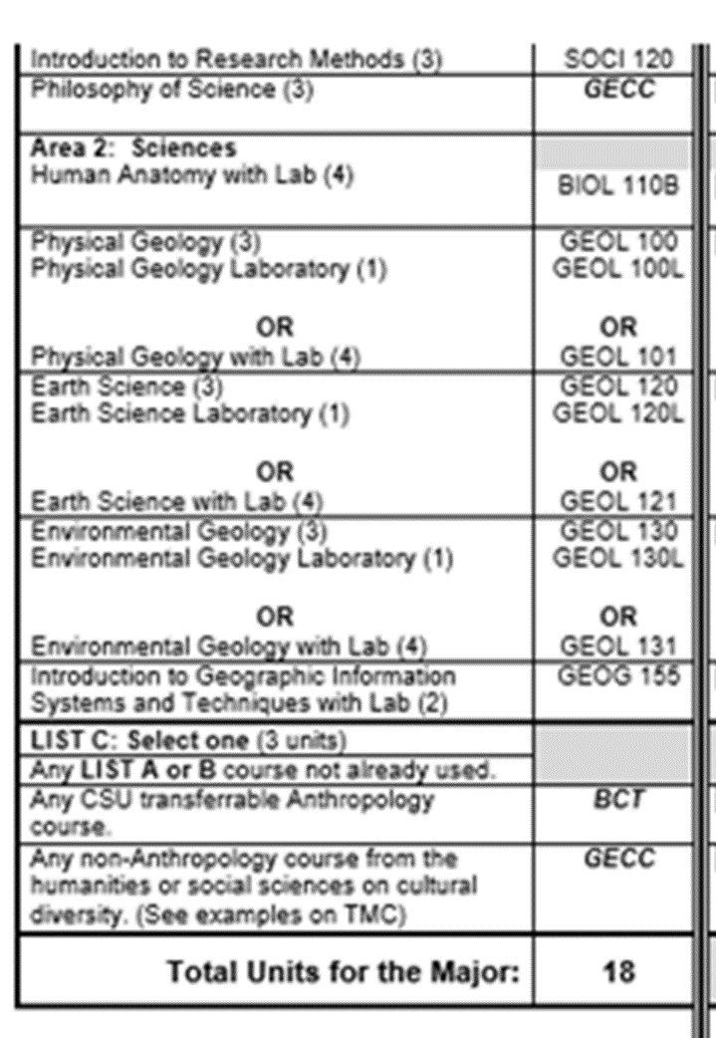
Notes:
Just a sample of a submitted TMC using C-ID Descriptor, AAM, GECC, and BCT

Slide 12
C-ID
BIOL 110B
Final Descriptors
The C-ID Descriptor Documents have been posted for general use after a statewide review by the discipline faculty who teach these courses in California’s public post-secondary institutions. The descriptors are offered to encourage wider articulation and to expand the lower division curricular offerings and thereby increase the variety—and ensure the rigor—of our many Community College courses.
Remember that the content, objectives, and pre and co-requisites of all C-ID descriptors reflect the minimum standards expected in a college's Course Outline of Record (COR). While the COR must meet all of these standards as included in the C-ID descriptor, colleges may certainly go beyond the descriptor and include additional content or higher requirements. Likewise, the specific course title on the C-ID descriptor is advisory, and courses may be approved as meeting the descriptor if they have different but relevant titles. In addition, although colleges may require more units than is required by a descriptor, unit restrictions based on SB 1440 will still apply if the course is included in a TMC-aligned degree.
Draft Descriptors
Notes:
Course Identification Numbering System (c-id.net)

Slide 13
Criteria for GE approval
Present
IGETC Standards
Review Process
CSU Guiding Notes & CSU formerly EO 1100
Review process
Area F challenges
Independent Colleges, other Educational Institutions, and Employers
MOU
WICHE Interstate Passport
Title 5
K-12 A-G
Upcoming
AB928
Title 5 Ethnic Studies

Slide 14
Sample Course Approval Timeline
Notes:
COCI information

Slide 15
Sample Articulation Timeline

Slide 16
Sample of recent Legislation & Regulations & other “hot topics”
•AB927 (Medina, 2021): (chaptered 10/6/2021)This bill extends the operation of the statewide baccalaureate degree pilot program indefinitely, remove the requirements that the program consist of a maximum 15 community college districts, and require a district seeking approval to offer a baccalaureate degree program provide evidence of unmet workforce needs
•AB 928 (Berman, 2021): (chaptered 10/06/21) This bill requires the CSU/UC to establish a singular lower division general education pathway that meets the academic requirements necessary for transfer admission into both segments.
•AB 1111 (Berman 2021: (chaptered 10/6/2021)This bill requires the CCCs to adopt a common course numbering system, starting with courses included in the Course Identification Numbering System (C-ID) and expanding to general education requirements and transfer pathway courses
Resource: https://leginfo.legislature.ca.gov/faces/home.xhtml
Establish a local Legislative Liaison
Notes:
In files, add the ICAS recommendation Singular GE Pathway (AB 928)

Slide 17
Getting Involved at the System-Level
ASCCC Committee Service (Volunteer Application)
local, and other state opportunities,
C-ID, TMC development, FDRG
legislation advocacy
Feedback on drafts (e.g. AB 928)
Others ways?

Slide 18
Question & Discussion

Slide 19
Resources
ASCCC – info@asccc.org
Curriculum Resources for California Community Colleges
California Articulation Policies and Procedures Handbook (Revised Spring 2013)
ICAS Memo: https://icas-ca.org/wp-content/uploads/2020/06/2019-UPDATE_ICAS_Memo_to_Articulation.pdf
CSU-GEB Guiding Notes: https://www2.calstate.edu/csu-system/administration/academic-and-student-affairs/academic-programs-innovations-and-faculty-development/geac/documents/GE-Reviewers-Guiding-Notes.pdf
IGETC Standards: https://icas-ca.org/wp-content/uploads/2020/06/IGETC-STANDARDS-FINAL-Approved-June-3-2020.pdf
C-ID Policies and Guidelines: https://c-id.net/page/1
PCAH (7th edition)

