Slide 1
College Promise in California
Alexander Kolesnik, Ventura College
Carlos López, Folsom Lake College
Ginni May, ASCCC North Representative, Sacramento City College
Fall Plenary Session
November 3-5, 2016
Westin South Coast Plaza

Slide 2
Overview
College Promise in California
Ventura Promise
Rancho Cordova Promise
Discussion/Questions

Slide 3
College Promise
In January of 2015, President Obama Unveiled America’s College Promise Proposal: Tuition-Free Community College for Responsible Students – America’s College Promise Act of 2015. [H.R. 2962—114th Congress (2015-2016) Referred to the Subcommittee on Higher Education and Workforce Training 11/16/2015]
State sponsored Promise Programs in Minnesota, Oregon, and Tennessee
Legislation passed in California and Kentucky appropriating funds
37 states with over 150 Promise Programs
Kalamazoo Promise in MI—1st Promise Program in nation – 2005

Slide 4
College Promise Campaign
Dr. Martha Kantor – Executive Director
Dr. Jill Biden – Honorary Chair
Jim Geringer – Honorary Vice Chair
(former Governor R Wyoming)
Mission
We are a national non-partisan, local and state-led higher education initiative -- beginning in America’s community colleges. We seek to build broad public support for state and localities to provide all responsible students with access to a free community college education…Our campaign encourages local communities and states to cover tuition and fees for every hard working student seeking a community college education, whether that’s an associate’s degree, an occupational certifcate, or credits that transfer to a four-year university.

Slide 5
College Promise
In September of 2016, California Governor Brown approved the California College Promise Innovative Grant Program (AB 1741) $15M, which provides the California community colleges an opportunity to move forward with Promise programs.
The Board of Governors Fee Waiver Program (BOG Fee Waiver) is a Promise Program
23 Promise Programs in California – more on the way…

Slide 6
College Promise Options
Student Funding:
First Dollar – Award given regardless of other Financial Aid
Middle Dollar – Some Financial Aid is factored in to determine need
Last Dollar – Other Financial Aid is factored in to determine need
Student Requirements:
Complete Application
Financial Need
GPA
Enrollment Timing
FT Student

Slide 7
College Promise Options
Covered Expenses:
Full Tuition
Other Fees
Transportation
Books
Non-restricted
Residency Requirements:
None
Community College Service Area
Community College District
City
County
Graduate of partner district
Graduate of specified HS

Slide 8
College Promise Options
Student Support:
College Prep Programs
Summer Boot Camps
Support Services for Promise Students
Internships
Preferential Transfer Agreements
More…

Slide 9
College Promise Funding
Community College Foundations
Community Colleges
Other non-profits
Federal Grants
Individual Donors
City operating budgets
K-12 district budgets
Private Foundations
Native American Tribe
Other…

Slide 10
College Promise Goals
Increase…
Enrollment
Persistence
Completion
Employment
Transfer
Strength in local economy

Slide 11
Ventura College Promise
Alex Kolesnik
Academic Senate President

Slide 12
The Ventura College Promise Overview
Began in 2006
Served over 12,000 students
Over $3M in enrollment fee support
High persistence, completion, and success rates
Doubled private funding

Slide 13
Ventura College Promise
Program Summary
Qualified Ventura County high school graduates and GED completers have their enrollment fees covered during their first year of attendance at Ventura College
Student Qualifications
Students must attend a Ventura County high school.
Students must commit to attending Ventura College for two consecutive semesters immediately after their graduation or GED completion.
Students must work with a Ventura College counselor to develop an education plan and goal and/ or enroll in a counseling workshop.
Students must complete the FAFSA.
Students must complete the VC Math/English Assessment.

Slide 14
Details
First Dollar/Last Dollar
Last dollar. Program factors in all financial assistance received by students before determining need.
Cost Coverage
Type of Cost Does scholarship cover cost?
Course tuition Yes
Other enrollment fees Yes
Books No
Transportation No

Slide 15
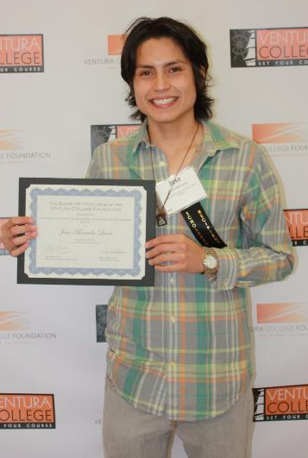
Jose
“Before I heard the Promise VC, I was scared. I thought that I needed to find a job first before I get into the college. With the Promise, I felt confident and applied and coming here. That’s why I think it’s really important.”
I’m the first to come to college here in the United States.

Slide 16
Ventura College Study Parameters
Research Question:
Over a 4-year period, how do Promise students perform compared to Non-Promise students in the areas of educational achievement and academic performance?
Population:
First-Time Student in Fall 2012
17-19 years of age
Enrolled in one or more units in Fall 2012
Had attended a local high school

Slide 17
Findings
Fall 2012 VC Promise Students enjoyed greater success rates in Degree/Certificate completion
Category | VC Promise | Non-Promise
Total Students | 742 | 1029
Total Degrees & Certificates Awarded | 415 | 340
% Success | 56% | 33%

Slide 18
Findings
Fall 2012 VC Promise students were 70% more likely to receive a degree or certificate within 4 years

Slide 19
Findings
Greater degree/certificate achievement by Promise students per demographic:
Promise Latino students -- Almost twice the rate than non-Promise Latino students
African American Promise students – 3.5x the rate than non-Promise African American students
Male Promise students – Over twice the rate than non-Promise male students

Slide 20
Looking Ahead - Data Gaps to Fill
Complete Impact Study on recent cohort
Success at University
Job Placement – Industry relevance to area of study
Integration with other state initiatives and college programs (ex: Sail to Success)
More Socioeconomic gradations

Slide 21
Moving the Ventura College Promise Forward
Better data leads to greater funding which leads to increased services to students
Promise to cover 100% of incoming First-Year students
Promise to cover second year at VC
Increasing annual funds by 10% each year
Expand an endowment fund

Slide 22
Folsom Lake College/Rancho Cordova
Promise Program
Carlos López
Academic Senate President

Slide 23
Folsom Lake College
Los Rios Community College District
Three sites:
Folsom
El Dorado Center
Rancho Cordova Center
Notes:
why FLC decided to do the Promise program, our deliberations around the decision, how FLC decided to structure it, how the Measure H funding mechanism works, etc.

Slide 24
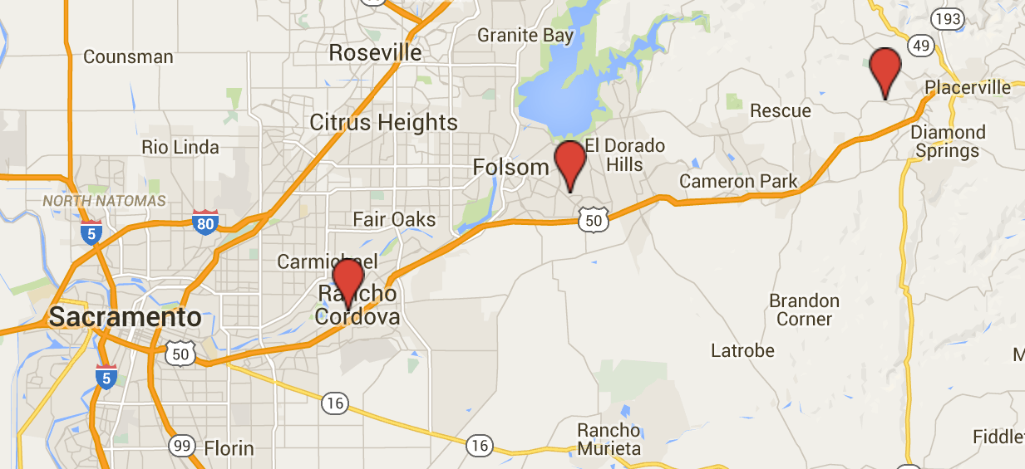
Folsom Lake College
Mule Creek State Prison
Folsom Cordova Unified STARS program

Slide 25
Rancho Cordova Measure H - Community Enhancement Fund
Passed in November 2014
½ cent local sales tax
Locally controlled funds for local priorities
Generates $7.2M annually

Slide 26
Rancho Cordova Measure H - Community Enhancement Fund
15-16: failed request
$21M in requests, $7.7M awarded
16-17: successful request!
$11M in requests, $7.2M awarded
“Buckets”
Arts, Culture, History, Entertainment
Education, After School Programs
Sports
Public Safety, Public Works
Community Development

Slide 27
Why a Promise Program?
Common goals
Creates a well-educated workforce that advances the local economy.
Economic development tool
Net positive economic benefit
Cultivates a sense of common responsibility to educate students
Students more likely to remain in the community after graduation

Slide 28
Decision to Apply
Management team
Advancement Office
Consultation
Folsom Cordova USD
City of Rancho Cordova
College constituents
Corporate partners

Slide 29
FLC/Rancho Cordova Promise Program
Funded $100,000 in 16-17
Largest award in education “bucket”
Program begins fall 2017

Slide 30
FLC/Rancho Cordova Promise Program
Structure
Modeled after Long Beach Promise and Ventura College Promise
“First In”
Place based
Universal eligibility
First year
Size
110 students per year

Slide 31
FLC/Rancho Cordova Promise Program Eligibility and Allowable Expenses
$579 per student, per semester for one year
Current resident of Rancho Cordova
Graduate from high school during the 2016-17 academic year
Enroll in Folsom Lake College for the Fall 2017 semester full-time (at least 12 units)
Funding for tuition and books
Must successfully complete 6 units in fall to be eligible for spring

Slide 32
FLC/Rancho Cordova Promise Program Short-Term Goals
Program Team
Finalize eligibility criteria, application process, and tracking
Design Marketing/Outreach protocols
Determine program evaluation metrics
Fund Development
Confirm corporate partnerships
Establish sustainable funding sources

Slide 33
FLC/Rancho Cordova Promise Program Long-Term Goals
FLC/Rancho Cordova Program
Reduce financial barriers
Create college going culture
Increase enrollment at FLC from 19% to 25%
Increase certificate and degree completion
Support well educated workforce
Promote economic development

Slide 34
Capital Area Promise Program
Commitment from
Chancellor
Los Rios Foundation

Slide 35
References
Potential funding
$15M in 16-17 state budget
Recent Conferences
Statewide Conference, August 30, Oakland
PromiseNet Conference, October 24-26, DC
Research
Promise Nation, Miller-Adams
What are Community College Promise Programs, Jameson-Meledy

Slide 36
Discussion and Questions

Slide 37
Thank you!!

Slide 38
References
College Promise Campaign: https://collegepromise.org
White House Press Release on College Promise Proposal: https://www.whitehouse.gov/the-press-office/2015/01/09/fact-sheet-white-house-unveils-america-s-college-promise-proposal-tuitio
America’s College Promise—A Progress Report on Free Community College: https://www.whitehouse.gov/sites/default/files/docs/progressreportoncommunitycollege.pdf
America’s College Promise Act of 2015: https://www.congress.gov/bill/114th-congress/house-bill/2962/text
2015-2016 Annual Report College Promise Campaign: http://collegepromise.org/wp-content/uploads/2016/10/66787_CN_Rev_proof.pdf
The College Promise in California: https://relwest.wested.org/system/resources/221/REL_CollegePromise_Booklet_508.pdf?1474570694

