Slide 1
Designing a Completion Initiative
Our response to the question, “What do you mean our students aren’t completing?!”

Slide 2
About Norco College
Inland Empire – One of the lowest college going rates in the nation
Corona-Norco Unified School District – 8th Largest school district in California, 54,000 students
Norco College – Accredited in 2010; 112th college in the system
Serve over 13,000 students annually
Serve over 1,900 new students annually
~ 6300 Fulltime Equivalent

Slide 3
Norco College Demographics

Slide 4
Beginning Conversations
Our Concerns …
Only 9.8% of first time students complete a degree or certificate in four years.
14-15 Certificate Completion at Norco was 5.4%
African Americans, African American males, Hispanics, part-time students, older students are lowest performing across all metrics.
Our Dialogues …
Equity Summit
High Impact Practices Institute
Shared Governance Committees
Academic Senate
July 22 & 23 Completion Initiative event

Slide 5
Two-Day Summer Event
Aspen Prize Winning Schools
Recognizes exceptional outcomes in:
student learning
certificate and degree completion
employment and earnings
high levels of access and success for minority and low-income students
2015 Winner Santa Fe College (Gainesville, FL)

Slide 6
Two-Day Summer Event
Complete College America
Game Changers:
Performance Funding
Corequisite Remediation
Full-Time is Fifteen
Structured Schedules
Guided Pathways to Success
Completecollegeamerica.org

Slide 7
We Brainstormed

Slide 8
We Reconsidered

Slide 9
We Imagined

Slide 10
We Collaborated

Slide 11
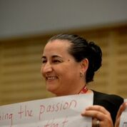
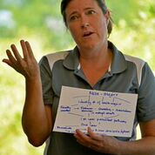
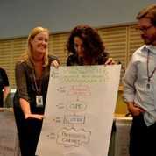
We Planned

Slide 12
Two Days … Five Take A-Ways
Clear & Directed Pathways
Meta Majors
Faculty Advisement Models
Linking College to Careers
Student Ambassador/Care

Slide 13
Survey Results from Two-Day Event
90% said they considered ideas that were new to them.
93% were enthusiastic about implementing a Completion Initiative at Norco College.
95% said they want to participate in the implementation of a Completion Initiative.

Slide 14
What Happened Next?
Brown Bag Series
Meta Majors
Faculty Advisement Models
Clear & Directed Pathways
Linking College to Career
Student Mentor/Care Programs

Slide 15
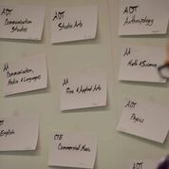
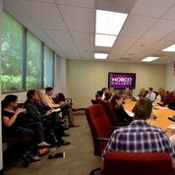
Meta Majors Brown Bag

Slide 16
What Are Meta Majors?
Collections of academic majors and certificates that have related courses.
Clustered/groups of majors that fit within a career area and have related courses.
Meta-Major help students choose a major and degree based on their interests, knowledge, skills and abilities.
Selecting a Meta-Major helps students select classes that relate to a specific degree.

Slide 17
Our Questions
What would it take to implement meta majors?
Who would be involved?
What would the challenges be?
What would the benefits be?

Slide 18
Meta Majors Discussion
Has your college implemented a similar model?
If not, have you had any conversations about doing so?
What challenges might you face in doing so?

Slide 19
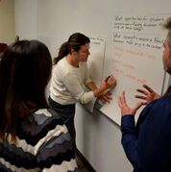
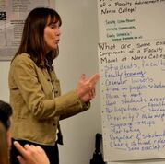
Faculty Advisement Model

Slide 20
Faculty Advisement Model Definition
Enhance Student Goals Setting
Discover Appropriate Course Selections
Process of Communication
Program Guidance and Resource Referrals
Resource: ASCCC White Paper – The role of Counseling Faculty and Delivery of Counseling Services in the CCC

Slide 21
Implementation
Roles
Clear delineation between counseling and instructional faculty
Responsibility for planning, implementation, maintenance, and evaluation
Rules
Teambuilding and training among faculty
Resources
Physical resource needs
Develop student motivation for model use
Allocation of faculty time and equitable use of faculty resources
Implementation timeline
Student and institutional awareness

Slide 22
The Collaborators
Faculty
Students
Managers
Paraprofessionals

Slide 23
The Challenges
Balancing All Other Institutional Needs
Time
Compensation
Physical Resources
Institutional Buy-in
Student
Buy-in
Student: Faculty Ratio

Slide 24
Potential Benefits
Increased Success for All Students
Increased Faculty Awareness of Student Needs
Elimination of Wasted Time
Build Stronger Relationships Between Faculty
Encourage and Motivate Students – Accountability and Support

Slide 25
Clear & Directed Pathways

Slide 26
Clear & Directed Pathways
Students committing to pathways
Structured schedules
Prescribed courses
Imposing enrollment restrictions
Mandating English/Math the 1st year
Holding students accountable and engaged

Slide 27
Linking College to Career
College is a means, not an end
Connecting students with industry experiences
Internship opportunities
Major-specific work experiences
Major-/career-focused faculty seminars & panels
Career exploration

Slide 28
Student Mentoring/Care Programs
From Our Students…
…we want to talk with other students.
…we want a student success coach.
…we want peer-to-peer mentoring.
…we want a sense of belonging and to know that someone cares.

Slide 29
Mentoring/Care Definition
Elite peer-to-peer mentoring group
In-reach & outreach to local middle/HS
Student Mentoring/Care Programs
Student Ambassadors

Slide 30
Implementation
Roles
Defining difference between mentors and student ambassadors
Rules
Allocation of fiscal resources
Student ambassador and mentor training and workshops
Resources
Budget ($31,000 start up grant)
Administrative Oversight (Dean of Student Life)
Developing strategic partnerships (e.g. CTE, CalWORKs)
Defining role of ambassadors in Student Life versus Outreach Services

Slide 31
The Collaborators
Student Ambassador Advocate
Associated Students & Organization Leaders
Office of Student Life & Outreach Services
Middle and High School Partners

Slide 32
The Challenges
Balancing All Other Institutional Needs
Student Recruitment
Gaining Student Trust
Selling the Program
Program Marketing
Continued Funding
Institutional
Buy-in

Slide 33
Potential Benefits
Student Retention and Increased Enrollment
Increase Student Earnings and Involvement on Campus
Better Understanding of College Experience
Create Role Models for Education Planning
Support Behavioral Intervention Team Efforts
More College Visibility with our School Partners

Slide 34
How Do We Make Organizational Change?
Multiple/ongoing opportunities to enrich shared understanding
Sense of urgency – emphasizing speed and early tangible deliverables
Limited and focused agenda for change – identifying 2- 4 major priorities, and driving them hard and fast
Rapid, strategic decision-making and resource deployment
Engaging early adopters rapidly, and bringing along the ‘fence-sitters’
Identifying sources of resistance and addressing concerns
Strong and consistent leadership –evidence of true commitment to change and the relentless pursuit of the new direction
FAST FORWARD: A NEW FRAMEWORK FOR RAPID ORGANIZATIONAL CHANGE by: Elspeth Murray, Peter Richardson, Peter Richardson, Peter R. Richardson is professor of strategic management, School of Business, Queen's University and a co-author of Fast Forward: Organizational Change in 100 Days

Slide 35
Our Plan Moving Forward
Academic Senate approval
Institutional Strategic Planning Council approval
Committee of the Whole approval
Workgroup established (late spring & summer)
Fall 2016 launch

Slide 36
Facing the Giants
Has your college ever attempted a similarly large-scale initiative? If so, what challenges have you encountered?

Slide 37
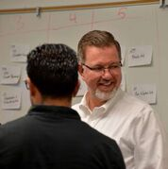
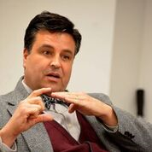
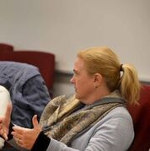
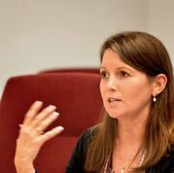
Questions for the team?

