Slide 1

Conducting a Cultural Curriculum Audit
Long Beach City College
2020 ASCCC Curriculum Institute
Dr. Kathleen Scott, Vice President, Academic Affairs
Dr. Wendy Koenig, Chair of Committee on Curriculum and Instruction
Dr. Jerome Hunt, Assistant Professor, Political Science

Slide 2
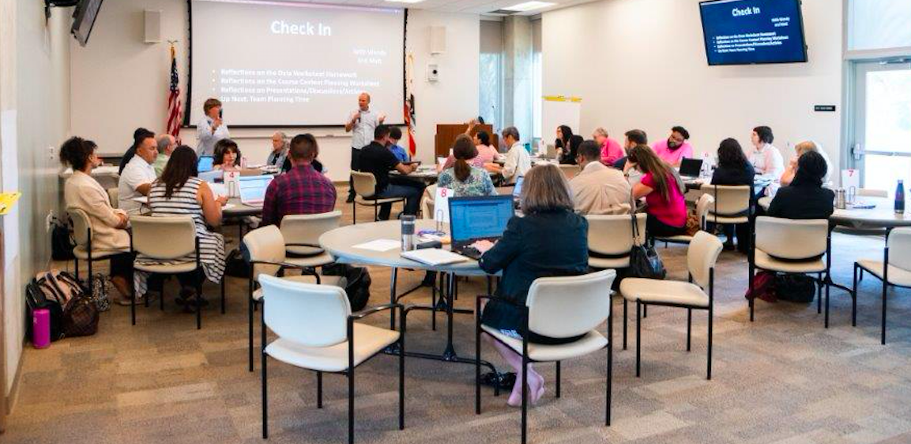
What is a “Cultural Curriculum Audit” and how do we get started?
Why do we need one?

Slide 3
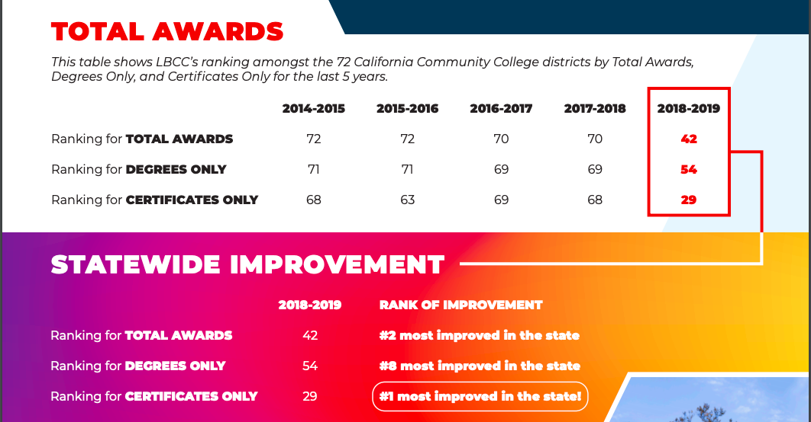

Slide 4
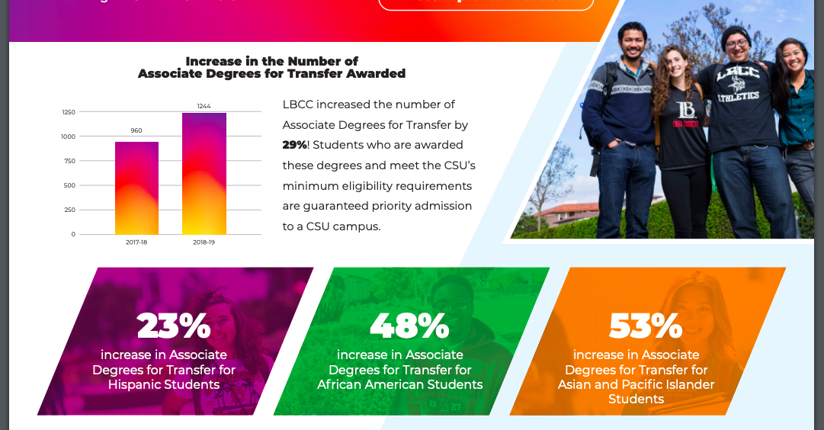

Slide 5

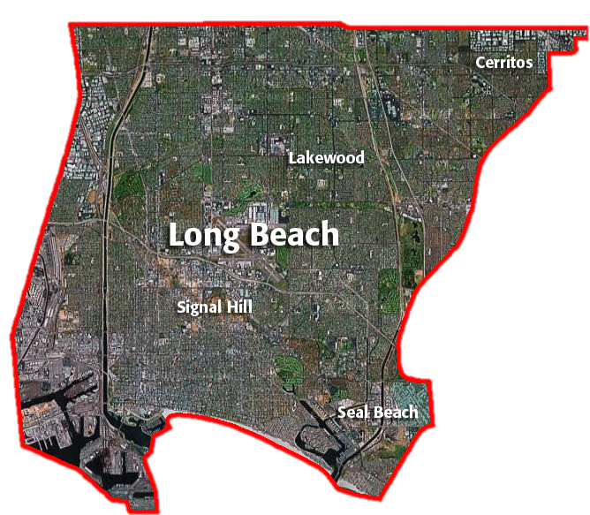
In the spring of 2018, Long Beach City College was ranked #113 out of 114 California Community Colleges for course-level student success. This was disturbing news. The statewide average for course success is 72% while LBCC’s average is 65%.
While our average for course success is about 65%.
72%
65%

Slide 7
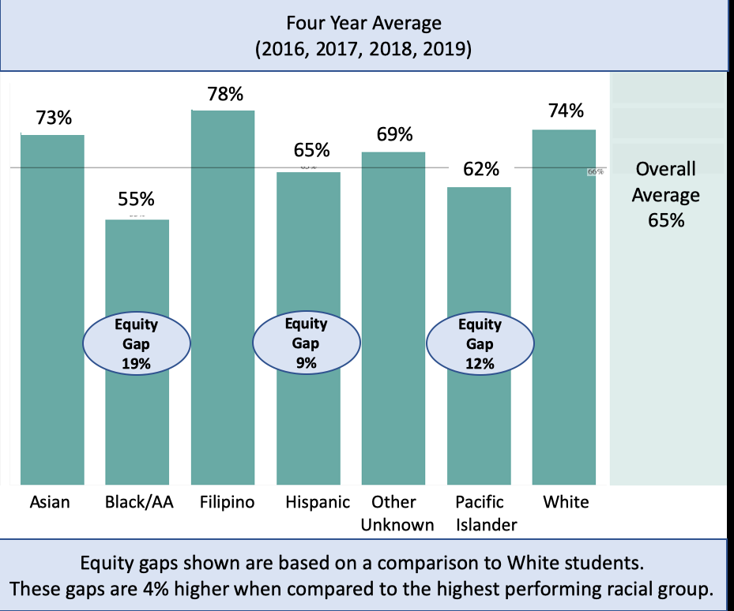

Slide 8
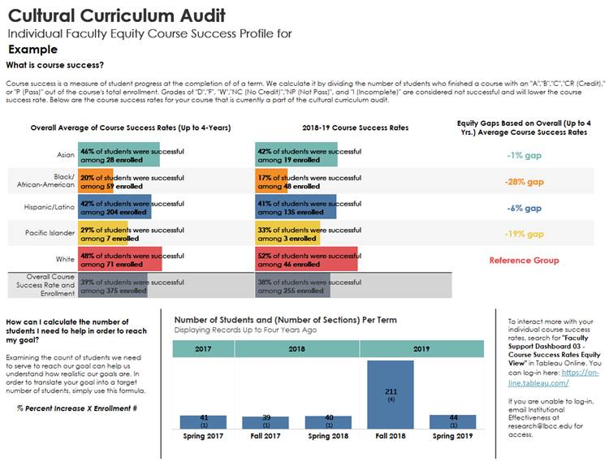
Clearly, LBCC has a course success rate issue and an equity gap problem. We needed to have tough conversations and come up with creative solutions.
The first step was to ask faculty to engage with their individual course success data and to look carefully at equity gaps.
Our Office of Institutional Effectiveness provided a ”Course Success Profile” to each of our participants. This information was kept confidential and was distributed at the beginning of the Audit in sealed envelopes.
At no time were faculty required to reveal personal information but they were encouraged to use the data to inform their efforts during the event.

Slide 9

At Long Beach City College, we held our inaugural Cultural Curriculum Audit in August 2019. The event was a group effort and the development team included:
Dr. Matt Lawrence, Faculty Student Equity Coordinator
Dr. Wendy Koenig, Curriculum Chair
Dr. Kathleen Scott, VP, Academic Affairs
Kenna Hillman, Associate Dean, Academic Affairs and Guided Pathways Taskforce Coordinator
Dr. Heather Van Volkinburg, Dean of Institutional Effectiveness
Various Academic Senators and interested faculty
SLO Coordinators
Four of the members had completed training on equity mindedness with the Center for Urban Education (USC)

Slide 10
Announcement
The Cultural Curriculum Audit will engage a small cohort of faculty in a collaborative evaluation and redesign of their courses. Each faculty participant will choose one course that they wish to enhance or re-design. Sessions will provide training in reviewing and possibly revising the COR (Course Outline of Record), syllabi, assignments, grading and teaching practices and outcomes. The focus will be on developing culturally responsive, engaging and relevant materials, high impact teaching practices, and developing equity-mindedness in the spirit of Guided Pathways.

Slide 11
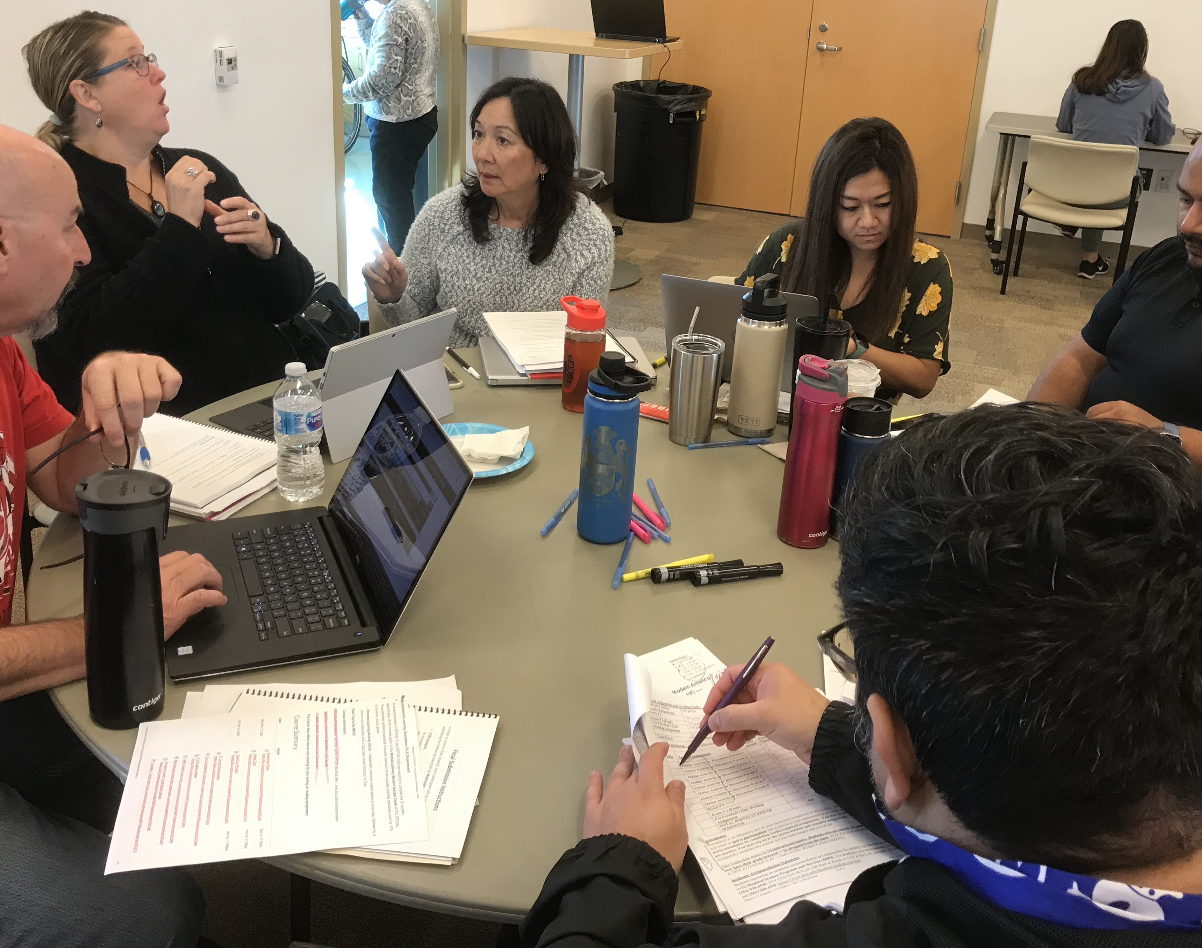
Format
The event was held over three days during Summer 2019 and again during Winter 2020 intersession.
Faculty were required to participate in all three sessions and they were provided a 100+ page workbook. The readings and homework assignments helped them to prepare for breakout discussions and to experiment with possible revisions to their course and teaching strategies.
Various faculty members were asked to offer demonstrations of equity-minded practices.

Slide 12
Viewing your course with an equity lens
Our Faculty Student Equity Coordinator, Matt Lawrence, shared his “Eight Equity Precepts” with the group and we used materials in the workbook and various activities and demonstrations to illustrate these concepts.
Activities included:
Collaborative Norm Setting
Understanding Implicit Bias (option to take one or more of the “Implicit Association Tests”
https://implicit.harvard.edu/implicit/
Cultural representation (syllabus and images review)
Preferred Pronouns
Combating a Deficit Mindset

Slide 13

Focus: Four Domains of Teaching
Course Content (Course Outline of Record)
Classroom Experience
Assignments/Assessments (including equitized syllabus)
Grading and Feedback

Slide 14
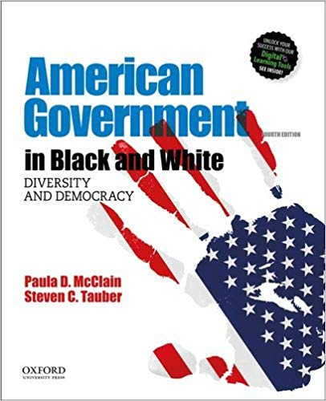
Course Content (Course Outline of Record)
Culturally-responsive teaching
Strategies to diversify content
How to keep “covering the content” from destroying student engagement
When to revise a course outline (and when to take advantage of flexible assignment descriptions)
Reasons to switch your texts to Open Educational Resources
How to ensure that content is inclusive and accessible

Slide 15

Classroom Experience
Active Learning Strategies
What is your teaching style?
How to make your teaching/classroom more inclusive
Improving Group Project cohesiveness
Reaching beyond the classroom walls

Slide 16

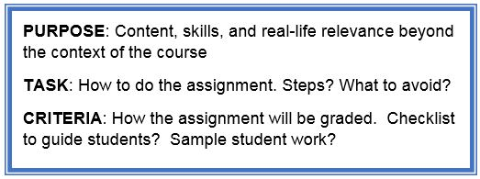
Assignments and Assessments
Equitized Welcoming Syllabus
Transparency in teaching
Using the Transparent Assignment Template
Rethinking expectations about assignments
Plan a sequence of assignments
Expanding submission requirements/options

Slide 17
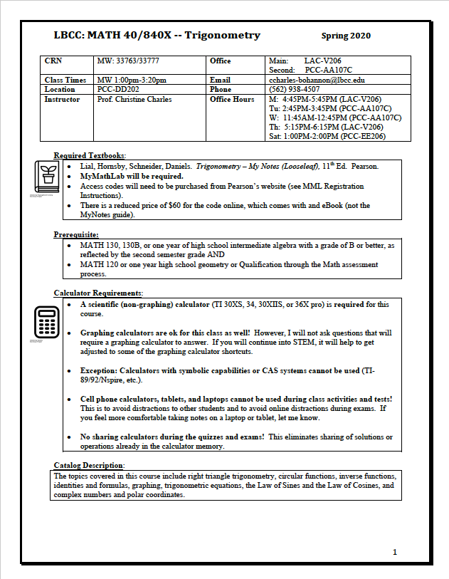
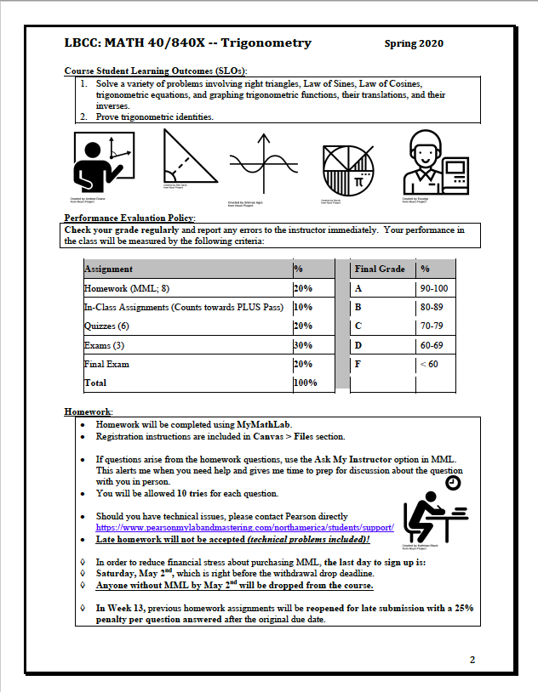
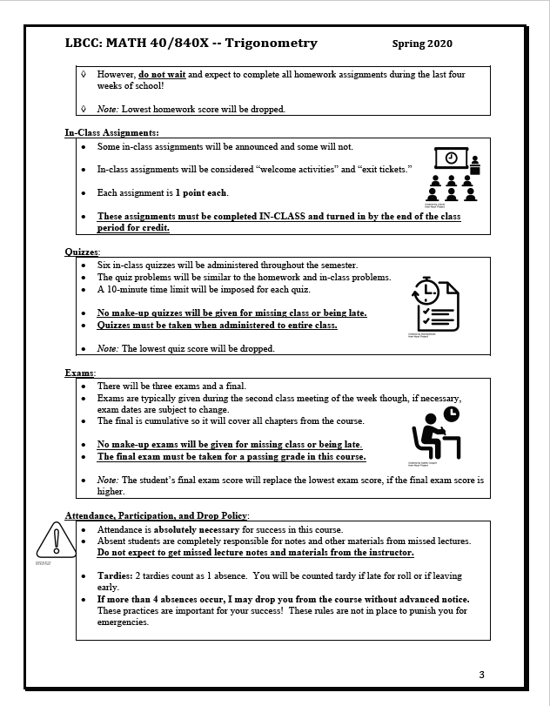
Equitized syllabus for MATH 40: Trigonometry
Compartmentalized syllabus designed to be more welcoming to students!
Pictures galore!
More clearly explained policies

Slide 18
ANAT 1: Human Anatomy Syllabus
Prior to Cultural Curriculum Audit

Slide 19
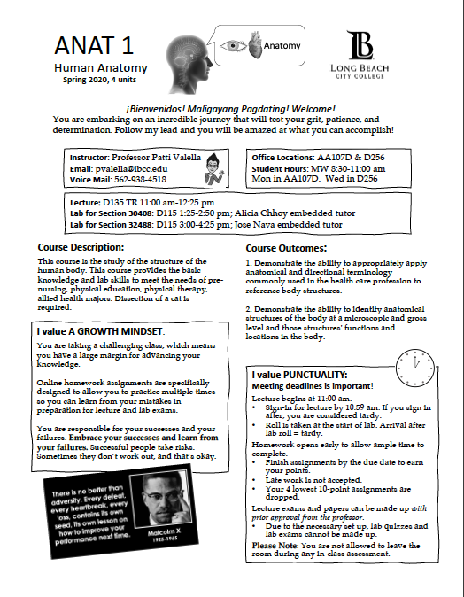
ANAT 1: Human Anatomy Syllabus
After Cultural Curriculum Audit

Slide 20
Grading and Feedback
How equitable is your grading?
How to use ”blind grading” in Canvas
The Wise Feedback Model
Educational Shame

Slide 21
Deliverables required of faculty
COR Analysis: An analysis of the current Course Outline of Record including any recommended changes, if applicable
Equitized Syllabus: A revised course syllabus with substantive changes to some or all of the following aspects of the course: course content (readings, topics, etc), classroom activities, assignments, grading structure, language, class policies
Transparent Assignments: Two or more new or revised assignments using the “transparent assignment protocol”
Active Learning Activities: An explanation of two or more newly designed active learning activities
Highlights Powerpoint: A short powerpoint presentation highlighting the changes you made to your class
Sharing with the Campus: Participants should be willing to share their curriculum audit work at other venues such as the Curriculum Committee meetings, Academic Senate meetings, or Flex events. Faculty are encouraged to share with their departments.

Slide 22

POLSC 1: Introduction to Government
Curriculum Cultural Audit
September 2019
Dr. Jerome Hunt

Slide 23
How can we make the course more relevant to our student population?
NEW READINGS FOR POLSC 1:
Transition to a groundbreaking book, “American Government in Black and White,” that helps shed light on the sobering reality of race relations in and throughout US history.
This book has the very real potential of opening student’s eyes to the exigencies of race and ethnic justice in the United States.
McClain, Paula D. and Steven C. Tauber. “American Government in Black and White,” Fourth Edition. 2019 Oxford University Press

Slide 24
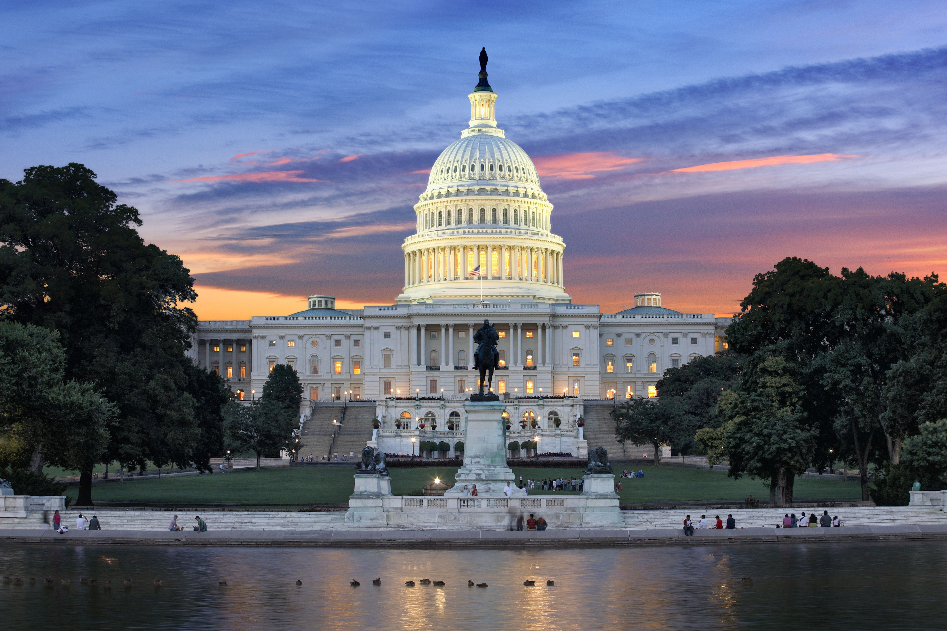
Student Hours for POLSC 1
STUDENT HOURS COUPON
Redeem this coupon at your first visit to any of my student office hours to receive two extra credit points
Your Name: ____________________________________________________________ Your Class: ___________________________________________________________________
Reason for coming:
To prep for the exam or review the study guide.
To find out about material missed due to absence.
To discuss transfer, degrees, or other goals.
To find out more about majoring in Political Science.
To discuss a recent grade or your current total points.
To discuss an upcoming assignment.
To discuss political ideas that interest you.
For a snack.
Not sure, but two points sounds good to me!
Other.
“Claim Your Education.”
My Office: T2367
Student Hours:
Tuesday & Thursday 4:10pm-6:10pm;
Wednesday 1:00pm-2:00pm; (Virtual Student Hour—Skype: Jerome.huntphd);
& By appointment
+2
Points

Slide 25
Making our assignments transparent
Providing students with rubrics that will be used to grade their papers and other assignments helps them to better understand the aspects that must be present to succeed and to also know what is expected of them in our classes.
Explaining the skills that will be developed along with the purpose of the assignment itself will benefit students understand faculty intention.
Each student will receive feedback as to why their received the grade they did.
As the Art Department originally posited, asking for student volunteers to search databases for research articles in class will help students feel more at ease in the process while improving their ability to navigate LBCC and other relevant databases. This type of transparency should help mitigate student anxiety as well.

Slide 26
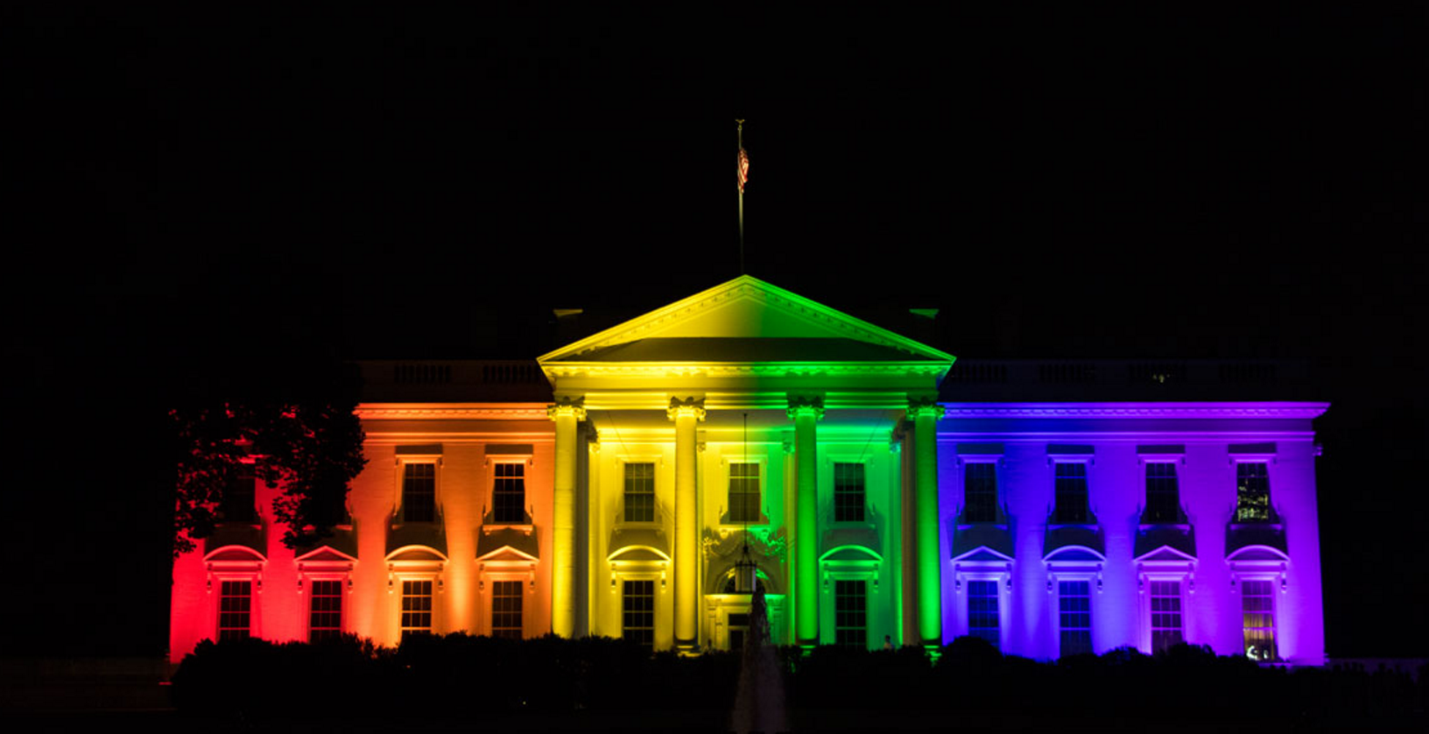

Assignment Revision
Public Opinion Piece
Assignment Details:
This particular assignment is designed to improve your writing and critical thinking skills. In addition, the opinion piece provides you with the opportunity to conduct a critical analysis about an issue that is currently impacting our government and your specific race, ethnic, gender, sexual orientation, gender identity, age, disability, or religious group—i.e. abortion, legalization of marijuana, voting rights, criminal justice reform, gun control, immigration reform, student loan debt, LGBTQ+ rights, gentrification, etc. The aforementioned list is just a sample list of topics. You are free to choose a topic from the list provided or select another topic not mentioned here. Your opinion piece should be factual and speak from your prospective and be a minimum of 1,000 words, but no more than 1,500 words. A minimum of 5 sources are required and they should be hyperlinked in your opinion piece.
Revisions to Assignment:
Previously this assignment called for students to select an issue that is impacting our government. The revision now calls for students to not only select an issue impacting our government, but to examine it from their background (i.e. race, ethnicity, gender, sexual orientation, age, disability, or religious group) and to speak from their prospective. This change will allow students to be able to research and write about an issue impacting them personally as well as practically apply the concepts discussed in class and the readings.

Slide 27


Assignment Revision
Campaign Ad
Assignment Details:
This assignment is designed to improve your critical thinking skills and help you be able to practically apply the material that you have learned throughout the course. You are to work in groups of no more than 8 students and create a campaign ad for one of the potential presidential nominees. The campaign ad should inform your fellow students about the candidate your group has selected and where they stand on the issues your group feel are important this election cycle. The ad should be compelling and through. It can be presented via social media or video. Ads are to be 7 to 10 minutes in length. A campaign ad rubric will be provided on the course website.
Revisions to Assignment:
The major change that I have made is for students select the issues they feel are important in this election cycle. Previously, students had to just select a candidate and create a generic ad about the person. However, allowing students to select the issues they feel are important and then examine them from the lens of a candidate they select will allow them to see not only how easy it is to find out information about candidates and what they stand for, but it provides them with the opportunity to see how these issues impact our society and them personally. Furthermore, this examination will allow the students to utilize current technology and experience in developing a messaging campaign.

Slide 28

Making the syllabus more student friendly
Allowing students to “see themselves” in the images and graphics used in the syllabus is hugely beneficial to our students and allows them to feel more at home while taking the course!
Pictures and images can be a great way to make a point or start a debate or conversation, so each image on our syllabi is now intentionally placed with extra sensitivity to and awareness of our incredible diversity at LBCC which should be studied and celebrated!

Slide 29
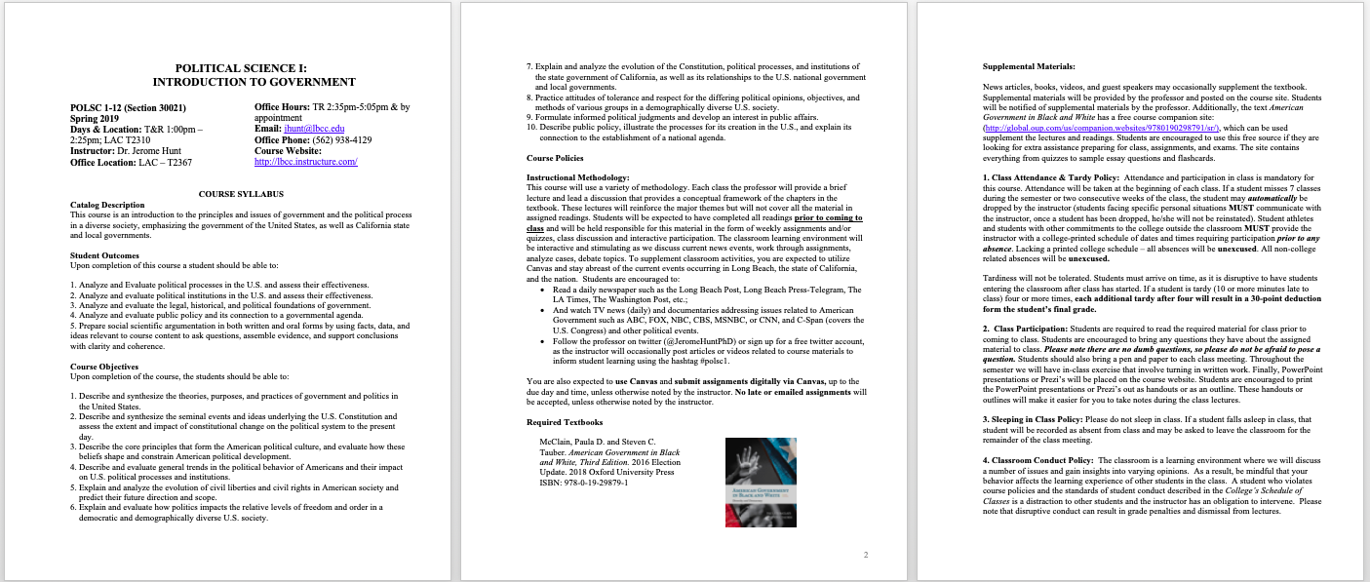
Making the syllabus more student friendly
Prior to Curriculum Cultural Audit

Slide 30
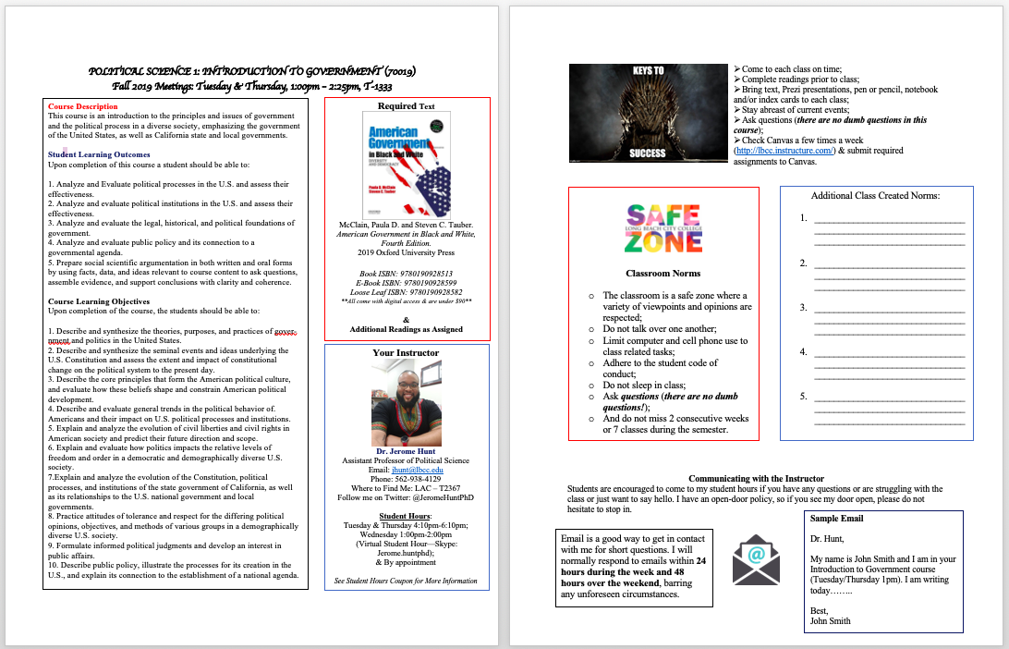
After the Curriculum Cultural Audit

Slide 31
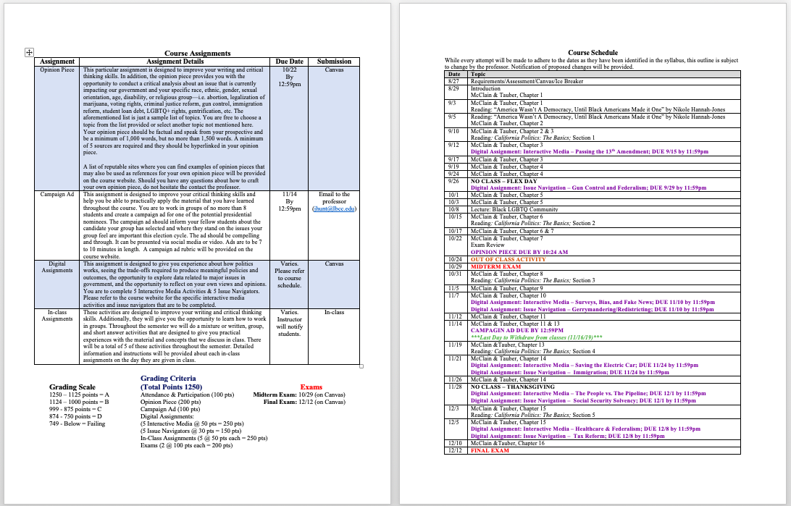
After the Curriculum Cultural Audit

Slide 32

Alternatives to mandating the submission of papers in hard-copy
Not every student has access to a computer or laptop let alone a printer at their residence, and it also remains difficult for many students to physically get to and access the computer labs on campus. Therefore, not mandating a physical hard copy is one significant means by which to encourage greater student equity.
In order to lessen the stress that accompanies completing college assignments and to create a more equitable experience in the classroom, assignments will be accepted via Canvas and other accessible electronically submitted means.
Printing out handouts for students and bringing them to class for the students will alleviate their need to find and utilize printers and instead will allow them to focus on the assignment at hand.

Slide 33
Disciplines represented by participants in the cultural curriculum audits (so far)
Anthropology
Architecture
Art History
Biology
Chemistry
Child Development
Communication Studies
Computer Science
Computer Office Studies
Counseling
Economics
Fashion
Graphic Design
History
Library Science
Mathematics
Physics
Political Science
Psychology
Reading
Sociology
Studio Arts

Slide 34
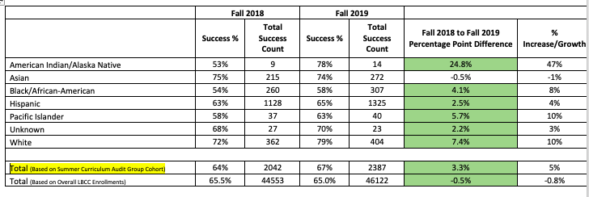
While overall success rates at LBCC went down from Fall 2018 to Fall 2019 by a .5 percentage point, the Summer Curriculum Audit Group Cohort success rates went up by 3.3 percentage points.

