Slide 1
Fostering Innovation: Constructing a Learning Environment
Dolores Davison, Foothill College
Sanya Soyemi, Mt. San Jacinto College
Fabiola Torres, Glendale College
Joe Perret, Pierce College

Slide 2
Learning Environment House Keeping
Identify and Partner with the Community Stakeholders for Success
Create Needs Assessment and Get Sponsors Sign-off
Get Buy-in from Key Stakeholders to Ensure Success
Construct a Learning Environment Roadmap
Communicate Your Plan to the User Community
Provide On-going Updates

Slide 3
Environment Preference
Create a Physical Environment that Supports Student Learning
  Create well-lit and dimly-lit areas in the building
  Use screens, plants and furniture for instant oasis
Provide Opportunities for Students to Move Around
  Areas for discussion and rest
  Provide informal furniture arrangements with soft chairs and pillows for comfort

Slide 4
Environment Preference
Establish Listening Areas
  Provide sound proof areas for students who need sound
  Designate quiet study areas for those that need silence
Display Climate and Alert Information
  Temperature awareness
  Weather information
  Campus alert information

Slide 5
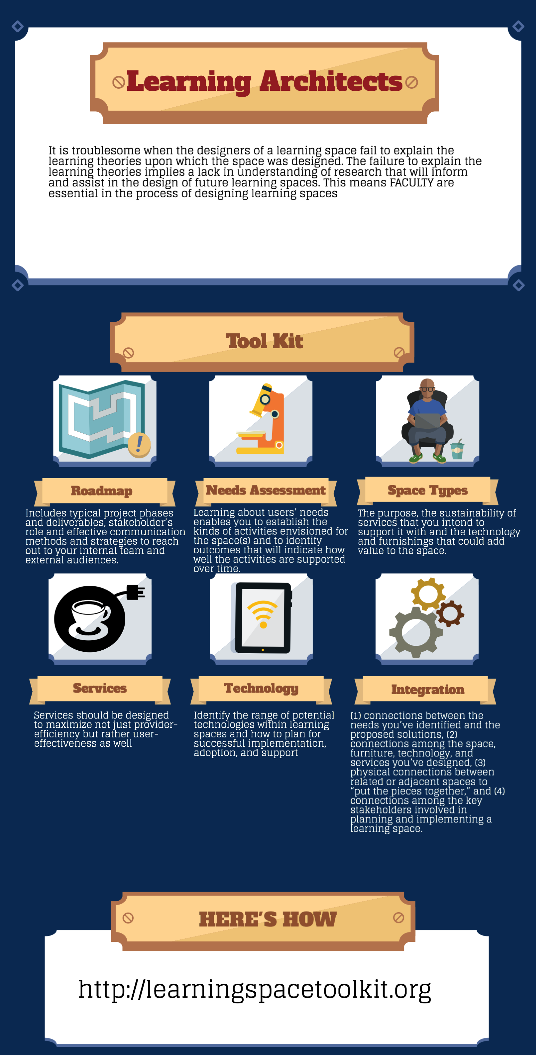
Glendale’s Tool Kit

Slide 6
More Information

Slide 7
More Information
Dolores Davison (davisondolores@foothill.edu)
Joe Perret (PerretJD@piercecollege.edu)
Sanya Soyemi (asoyemi@msjc.edu)
Fabiola Torres (fabiolatorres@mac.com)
Thank you!

