Slide 1
Contextualized Noncredit Curriculum for CTE
Cheryl Aschenbach, Lassen College
L.E. Foisia, Mount San Antonio College

Slide 2
CTL Basics
Contextualized Teaching and Learning (CTL) is an instructional strategy designed to link the learning of basic skills (math, English, ESL) with academic or occupational content
Focuses teaching and learning directly on concrete applications in a specific career context of interest to students

Slide 3
Using CTL: Formats
Stand-alone classroom practices
Academic classes with embedded CTE “Infused academic” – skills building with CTL, relevance of skills, and opportunities for students to engage
CTE courses with embedded basic skills instruction “Infused occupational” – vocational focus, integrating academic skills with occupational content
Courses contextualized for meta-majors
*Resource: Contextualized Teaching and Learning: A Faculty Primer, a joint product of RP Group, BSI, ASCCC, and Bay Area Workforce Funding Collaborative

Slide 4
Using CTL: Formats
Team models
Linked courses or learning communities
Team teaching or integrated academic and occupational courses
Connected courses, shared goals
Context for delivery
Collaboration between instructors and student
*Resource: Contextualized Teaching and Learning: A Faculty Primer, a joint product of RP Group, BSI, ASCCC, and Bay Area Workforce Funding Collaborative

Slide 5
What are the pros and cons for these models?

Slide 6
Using CTL: Central Components
Faculty Collaboration – faculty should be collaborating on many aspects of CTL including program design, curriculum development, resource acquisition, and assessment of practices
Curriculum/Instructional Material Development – moving from traditional texts and activities to an authentic, contextualized approach requires new materials; time and support is needed
Relevant Context – all CTL is based on relevant context. Faculty might choose one, develop context with students, or offer options based on career or educational interests
Interactive Teaching – engaging interactive activities may include team work, peer to peer review, real-world data collection and problem solving, experiences with community partners, authentic assessments, and reflective essays
*Resource: Contextualized Teaching and Learning: A Faculty Primer, a joint product of RP Group, BSI, ASCCC, and Bay Area Workforce Funding Collaborative

Slide 7
Using CTL: Central Components
Professional Development – may focus on better understanding of course content to exploring how to use CTL
Institutional Support – vital to success and sustainability of CTL, especially linked courses. May include administrative backing for new course creating, release time for professional and curricular development, sharing of faculty across departments, flexible scheduling, and more
Continuous Improvement – ongoing reflection and revision is necessary due to the integrated nature of CTL. Course and program modifications are a natural part of CTL
Improved Outcomes – most common improved outcomes include increased student engagement, motivation, and self-esteem as well as quantitative measures of improved course completion, GPA, performance in college-level work, and employment
*Resource: Contextualized Teaching and Learning: A Faculty Primer, a joint product of RP Group, BSI, ASCCC, and Bay Area Workforce Funding Collaborative

Slide 8
Examples

Slide 9
I-BEST: Integrated Basic Education Skills Training
Initially a demonstration project in 10 WA CCs (2004)
Designed to reach students with limited English proficiency seeking the skills that lead to higher wage and higher skills jobs
Classroom teams of English as a second language (ESL)/adult basic education (ABE) instructors and professional-technical instructors, who co-teach an integrated course of language and vocational skills training at the same time
Shifted traditional teaching ESL within context of family & citizenship (social environment) to teaching students how to learn language and college study skills within context of and along with workforce education
Resource: http://www.highereducation.org/reports/Policy_Practice/IBEST.pdf

Slide 10
I-BEST
Now a nationally recognized instructional model that boosts students' basic skills in reading, writing and math while they pursue a certificate in a career/technical program.
Used at some California Community Colleges as part of AEBG efforts
Traditional FTES apportionment model does not allow for compensation for two faculty in the classroom at the same time
AEBG funds can be used to pay one of the two instructors

Slide 11
Mt. SAC School of Continuing Education
Existing models of noncredit contextualized courses

Slide 12
English for Special Uses (ESU)
Advanced level ESL students
Contextualized curriculum
Concurrently or supplemental to credit
Easily tailored to different subjects

Slide 13
Welding
ESU for Welding
+
Introduction to Welding
Beginning Arc Welding
Intermediate Arc Welding
Optional
Certification Exam
Print Reading/Computations
and / or
Certification Prep

Slide 14
Pass Rates and Next Semester

Slide 15
Biology Basic Skills
Reading
Contextualized reading skills to prepare students for biological lab and lectures
Study Skills
Study plan for managing time wisely
Interpreting graphs and diagrams
Analyzing text
Memorization techniques
Test taking techniques for exams
Lack of reading and critical thinking skills by credit biology students

Slide 16
Biology Basic Skills (BBS)

Slide 17
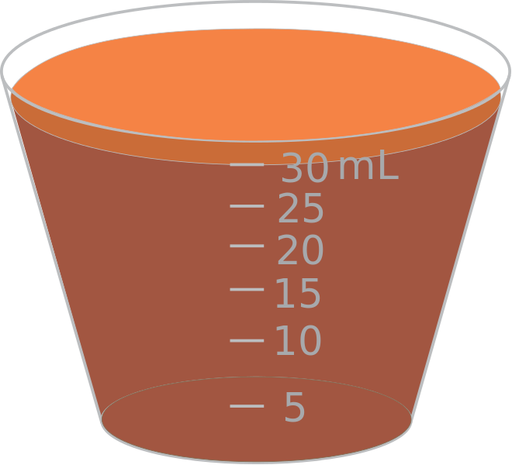
Transitional Math for Healthcare
Basic skills improvement for credit health care career programs
Contextualized basic skills math course
4-week pre-requisite (Nursing)
92% of students increased their score on average by 25%
12-week co-requisite (Psych tech)
56% of students are at/above the 8th grade math level post tutoring testing vs 24% of students at/above 8th grade level pre tutoring

Slide 18
Noncredit CTE Readiness (SWP Project Round 1)
Noncredit CTE Readiness Project seeks to develop contextualized, short-term noncredit courses to better prepare students to enter college and be successful in credit CTE coursework. Examples of contextualized noncredit courses are Math for Health Careers, Vocational ESL, and pre-CTE coursework.
Prepare students to be college ready in CTE credit coursework by decreasing the skill gap
Engagement into Guided Pathways (local integration)
Regional collaboration among adult education/ noncredit programs
Develop noncredit contextualized basic skills bootcamps through curriculum development
Notes:
L.E. marketing

Slide 19
Noncredit Readiness Courses
Contextualized Courses
Reading & Writing
Regional Collaboration
Held regional faculty work group meetings to review the curriculum
Math
English for Special Uses
Career Development
Computer Skills
Worked with colleges to develop contextualized courses
Notes:
LE- option 2 - Noncredit courses are those that some colleges had either requested we work with their faculty to create.
Helping to build capacity

Slide 20
Pre-Apprenticeship Certificate
Intro to Trades 1
Intro to Trades 2
Career Development
Introduction to the various building and construction trades
Essential topics related to various building and construction trades:
Career preparation, assessment, and interest inventory
Math for College & Career Readiness
Contextualized math course
Overview and history of the trades and unions
Basic components of a blueprint
Green construction
Financial literacy
Construction health and safety
Prepares students for successful transition to college, apprenticeships, and employment
Preparation for entrance into the apprenticeship programs and construction industry
Exploration of career fields and employment opportunities
Resume writing, cover letter, interview skills, and employment portfolio
Internet for use in career exploration
Notes:
Mad & LE

Slide 21
Additional Ideas

Slide 22
Contact Us:
Cheryl aschenbach caschenbach@lassencollege.edu
L.E. Foisia lfoisia@mtsac.edu

Slide 23
Resources
Contextualized Teaching and Learning: A Faculty Primer (ASCCC Paper, Spring 2009) In association with the Academic Senate for California Community Colleges, Center for Student Success/RP Group, Basic Skills Initiative, Bay Area Workforce Funding Collaborative, and funded by the California Community Chancellor’s Office. http://asccc.org/papers/contextualized-teaching-learning-faculty-primer
Facilitating Student Learning Through Contextualization (Dolores Perin, February 2011) A resource published by the Community College Research Center. http://ccrc.tc.columbia.edu/media/k2/attachments/facilitating-learning-contextualization-working-paper.pdf
The Theory and Application of Contextualized Teaching and Learning in Relation to Programs of Study and Career Pathways (Kalchik & Oertle, September 2010) Article published by the Office of Community College Research and Leadership at University of Illinois. http://files.eric.ed.gov/fulltext/ED513404.pdf

Slide 24
Resources
Contextual Learning - CORD Center for Occupational Research and Development (CORD) is a national nonprofit dedicated to leading change in education. It is committed to supporting educators who use contextual teaching strategies. This section of the CORD Web site offers general information about contextual teaching and learning, research papers, and descriptions of contextual materials developed by CORD. http://www.cord.org/contextual-teaching-and-learning/
Contextualized Teaching and Learning Overview: Students and Faculty Talk (Video – Career Ladders Project, December 2010) Key CTL issues are illustrated using interviews with faculty and students. https://www.youtube.com/watch?v=BuRKVjyLEVI

