Slide 1
Cooperative Work Experience/Internships
Marie Boyd, ASCCC CTEL Committee, Chaffey College
Dolores Davison, ASCCC Secretary, Foothill College
Career and Noncredit Education Institute
May 3, 2018, Westin South Coast Plaza

Slide 2
Outcomes For This Session
Review various forms of Cooperative Work Experience Education (CWEE)
Review Title 5 and CWEE
Review Strong Workforce Priorities and the CTE Guided Pathways Tool Kit
Review how CWEE fits within a CTE Guided Pathways – Possible ways to form Internship opportunities

Slide 3
Contextualized Learning
General Cooperative Education Experience
Occupational Cooperative Education Experience
Internships
Service Learning
Clinical Experience
Field Experience
Mentoring
Job shadowing: an initial experience where the individual follows a regular employee through a day to gather information on the job and the work setting; Typically unpaid;
Work Study
APPRENTICESHIPS – Labor Code, division 3 and the California Apprenticeship Council
Field Experience
Mentoring
Job shadowing: an initial experience where the individual follows a regular employee through a day to gather information on the job and the work setting; Typically unpaid;
Work Study
APPRENTICESHIPS – Labor Code, division 3 and the California Apprenticeship Council
Various Types of
Cooperative
Work Experience
Notes:
I would like Craig to double check that accuracy of my statement here: Of these different types of Cooperative Work Experience Education, which are specifically mention in Title 5, Chapter 6, Curriculum and Instruction?
General Cooperative Education Experience
Occupational Cooperative Education Experience
Internships are not called out specifically in T5, Chapter 6.
Clinical Experience isT5 , for nursing..
Apprenticeships are Labor Code, Division 3
The others: Service Learning, Field Experience, Mentoring/Job shadowing and “work study” are not referenced in Title 5 Chapter 6.
While the link to the booklet, Work-Based Learning Handbook may be dated, I find it to be the most straightforward.
There are several other resources which will be listed at the end of this presentation.

Slide 4
Title 5 and Work Experience (WE) §55250 - 55257
Responsibilities of the District, College, Student, and Employer
Responsibilities of the District:
Approved Plan Required; Requirements of the Plan; types of Cooperative Work Experience; Laws/Rules Pertaining to Minors in WE; Funds for WE for Students with Developmental Disabilities; WE Involving Apprenticeships; WE Outside the District; Wages & Workers’ Compensation; College Credit and Repetition; District Services; Records
Responsibilities of the College:
College-defined Student Qualifications; Work Experience Credit; Retention of a WE Coordinator; Retention of WE Instructors; Retention of Adequate Clerical Assistance; Retention of Adequate Instructional Services
Responsibilities of the Student:
Student Qualifications; Student Responsibilities;
Responsibilities of the Employer and Job Learning Stations:
Learning Station Criteria; Employers’ Records;
Notes:
Distribute my Title 5 document

Slide 5
Strong Workforce
The goals of Doing What Matters for Jobs and the Economy:
to supply in-demand skills for employers -
create relevant career pathways and stackable credentials
promote student success and
get Californians into open jobs
HOW?
Give Priority for Jobs and the Economy
Make Room for Jobs and the Economy
Promote Student Success
Innovate for Jobs and the Economy

Slide 6
Milestones incorporating CC CWEE!

Slide 7
Strong Workforce CTE Guided Pathways Tool Kit:
Element One: Build Cross-Agency Partnerships
Element Two: Identify Industry Sector and Engage Employers
Element Three: Design Education and Training Programs
Element Four: Identify Funding Needs and Sources
Element Five: Align Policies and Programs
Element Six: Measure System Change and Performance

Slide 8
Element One: Build Cross-Agency Partnerships
HOW?
Engage Cross-Agency Partners and Employers
Partner Contact Information
Governance Structure
Asset Map Worksheet
Pre-Partnership Checklist
Existing Partnership Checklist
Establish a Shared Vision, Mission, Goals, and Strategies
Define the Roles and Responsibilities of All Partners
Develop a Work Plan and/or Memorandum of Understanding for the partnership
Notes:
Think about doing the Sector Strategies Organizational Self-Assessment – make copies – I will

Slide 9
Element Two: Identify Industry Sector and Engage Employers
HOW?
Conduct Labor Market Analysis to Target High Demand and Growing Industries
Labor Market Analysis
Data and Resource Guide for Identifying Target Industry Sectors
Survey and Engage Key Industry Leaders from Targeted Industries and/or Sector Partnership (Assessment Tool)
Clarify Role of Employers in the Development and Operation of Programs
Identify Existing Training Systems within Industry and the Natural Progression and/or Mobility (Career Ladders/Lattices)
Identify the Skill Competencies and Associated Training Needs (Employer Needs Guide)
Sustain and Expand Business Partnerships (Matrix of Employer Engagement Activities within a Partnership)

Slide 10
Element Three: Design Education and Training Programs
HOW?
Identify and Engage Education and Training Partners
Identify Target Populations, Entry points, and Recruitment Strategies
Review, Develop, or Modify Competency Models with Employers and Develop and Validate Career Ladders/Lattices
Develop or Modify programs to Ensure They Meet Industry Recognized and/or Postsecondary Credentials
Analyze the state’s and Region’s Education and Training Resource and Response Capability
Research and Promote work-based Learning opportunities Within Business and Industry
Develop Integrated, Accelerated, Contextualized Learning Strategies
Provide Flexible Delivery Methods
Provide Career Services, Case Management, and Comprehensive Supportive Services.
Provide Employment Assistance and Retention Services

Slide 11
Element Four: Identify Funding Needs and Sources
HOW?
Identify the Costs Associated with System and Program Development and Operations
Identify Sources of Funding Available from Partner Agencies and Related Public and Private Resources and Secure Funding
Develop Long-term Sustainability Plan with State of Local Partners

Slide 12
Element Five: Align Policies and Programs
How?
Identify State and Local Policies Necessary to Implement Career Pathways Systems
Identify and Pursue Needed Reforms in State and Local policy
Implement Statutory and Administrative Procedures to Facilities Cross-Agency Collaboration.

Slide 13
Element Six: Measure System Change and Performance
How?
Define Desired System, Program, and Particular Outcomes
Identify the Data Needed to Measure System, Program and Participant outcomes
Implement a Process to Collect, Store, Track, Share, and Analyze Data
Design and Implement a Plan for Reporting System and Program Outcomes

Slide 14
Establishing Internships
Which part of establishing Internships have you found to be the most confusing or time-consuming on your campus?
Responsibilities of the District
Responsibilities of the College
Responsibilities of the Student
Responsibilities of the Instructor

Slide 15
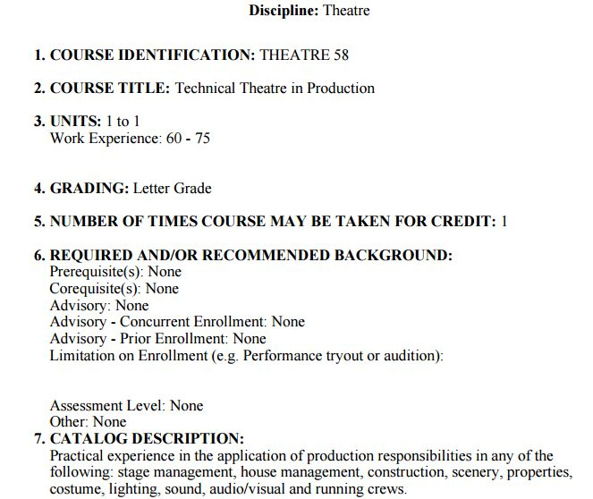
Critiquing a CWEE Course Outline of Record from Sunshine College

Slide 16
8. CONTENT (Scope and Description of Content):
A. Assignment to production and performance responsibilities
1. Grip or stage hand
2. Flyman or stage hand
3. Automated scenery operator
4. Prop master
5. Electrician
6. Deck electrician
7. Light board operator
8. Moving light operator
9. Follow spot operator
10. Audio Technician
11. Audio Board Operator
12. Mic Technician
13. Costume Technician
14. Dresser
15. Wardrobe
16. Costume Laundry
B. Preparation for production including necessary theatrical techniques.
1. Scenery
2. Costumes
3. Lighting
4. Audio
5. Properties
6. Make Up
7. Hair
8. Wigs
9. Special effects
10. Projections
11. Promotional
C. Appropriate tools to fulfill production requirements for performance.
D. Basic technical theatre terminology.
E. Collaborative responsibilities with the director, designers, and crew supervisors.
F. Basic skills in running a production.
G. Creation, maintenance or construction of basic production elements.
H. Proper use and basic understanding of appropriate tools to fulfill production requirements for performance which may include the following areas:
1. Carpenter and/or painter - Construction and implementation of scenery and properties required for the production.
2. Stitcher, cutter, draper - Construction and implementation of costumes required for the production
3. Makeup technician -Construction and implementation of make-up required for the production.

Slide 17
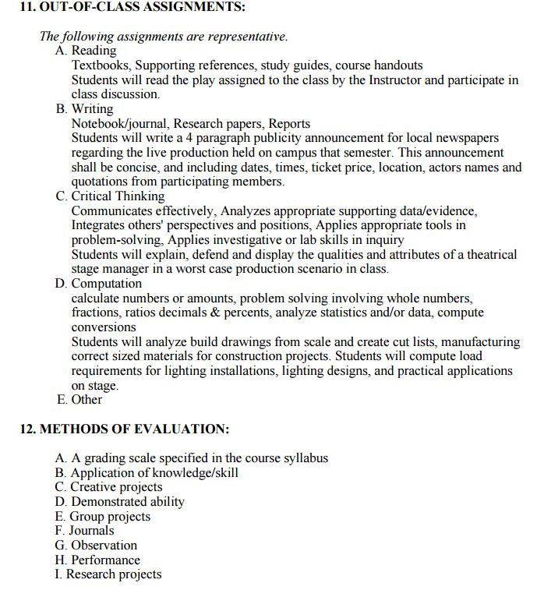

Slide 19
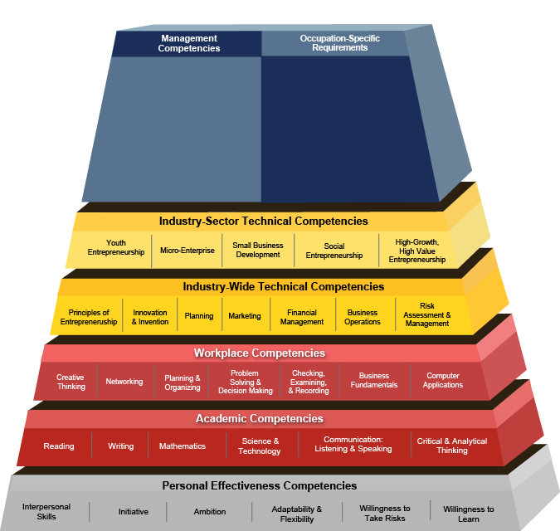
Building an Internship from: Competency Model Clearinghouse
Pre-requisite Courses
Work Site Requirements:
Content on the COR
Pre-requisite Courses
EXAMPLE: Entrepreneurship from
https://www.careeronestop.org/CompetencyModel/competency-models/entrepreneurship.aspx

Slide 20
Coming Soon!
RESOLUTION 13.05S18 ASCCC White Paper on Career and Technical Education, Cooperative Work Experience, Internship, and Apprenticeship Programs
Whereas, apprenticeship programs are regulated by federal labor laws and are primarily funded by labor unions and/or industry;
Whereas, Career and Technical Education (CTE), Cooperative Work Experience (CWE), and internship programs are regulated by California Education Code and primarily funded by public funds; and 41 Section 504, the Americans with Disabilities Act, and California Government Code section 1135 et. seq. 42 California Title 5 Code of Regulations, §§56000-56076 (DSPS) 43 California Education Code, §§67310-13 and 8485028
Whereas, CTE, CWE, internship programs, and apprenticeship programs are often conflated, and no current clear guidelines exist for the use of best practices for setting up these various programs;
Resolved, That the Academic Senate for California Community Colleges develop a paper that clearly explains and differentiates Career and Technical Education, Cooperative Work Experience, internship, and apprenticeship programs, including their regulations, funding models, and overall guiding principles, and bring the paper to the Spring 2019 Plenary Session for approval.

Slide 21
Resources
Chancellor’s Office. Cooperative Work Experience Education. http://extranet.cccco.edu/Divisions/WorkforceandEconDev/CareerEducationPractices/CoopWorkExperienceEduc.aspx
California Statewide System Advisory Committee on Work-Based Learning and Student Employment. http://cacareerbriefs.com/wp-content/uploads/new-handbook-1.pdf
U. S. Department of Labor. Competency Model Clearinghouse. Careeronestop. https://www.careeronestop.org/CompetencyModel/careerpathway/cpwreviewsamplepaths.aspx
Darche, S., Nayar, N., Reeves, K., Work-Based Learning in California. West ED, 2009 http://www.connectedcalifornia.org/downloads/WBLReport.pdf

Slide 22
FOLLOW-UP!
As promised, here are some follow-ups:
1. Q: Where are “faculty responsibilities” listed in the Internship outline document I distributed?
A: In the attempt to make this outline fit on one page, I abbreviated the outline GREATLY! Consequently, some material was minimized. The “faculty responsibilities” were listed under 2.5 and 2.6 of the fuller document. I will send this fuller outline to be attached with the PP of the presentation.
2. Q: Can Internships be offered on a noncredit basis?
A: At the Fall 2017 plenary, 7.04 F17 was passed (https://asccc.org/sites/default/files/Resolutions%20Packet%20F17%20Saturday%2011-4-2017%20Final.pdf) which calls for consultation with the Chancellor’s Office: Resolved, That the Academic Senate for California Community Colleges work with the California Community Colleges Chancellor’s Office and other system partners to identify and eliminate state-level barriers to providing internship opportunities for students enrolled in noncredit courses and programs.
Needless to say, this has not happened yet with the Chancellor’s Office.
3. Some of you asked abut that colorful chart I passed out towards the end of the session. It was to be an exercise in building an Internship by filling in the blanks on your sheet, using the model on slide 19 as a guide. Have fun with this back at your college.
It was very nice to share the afternoon event with you all discussing Internships.
Marie Boyd
Chaffey College

