Slide 1
Delivering via Correspondence: Regulations, Local Standards, and Considerations

Slide 2
Presenters
Lake Tahoe Community College
Michelle Risdon
Vice President of Instruction
Shane Reynolds
Director, Incarcerated Students Program
Lassen Community College
Dana Armeson
Correspondence Coordinator
ASCCC
Cheryl Aschenbach
Secretary

Slide 3
Description
Some California community colleges have been delivering instruction within prisons and jails via correspondence for many years, while other colleges have been forced by COVID-19 to shift from in-person delivery to correspondence. Explore considerations for managing and delivering instruction via correspondence, from accreditation to financial aid, effective processes, communication with institutions, and training for faculty. Also review proposed title 5 language for correspondence education.

Slide 4
Correspondence Education
While some colleges regularly engage in asynchronous instruction, often called correspondence education, for courses run in prisons and jails, synchronous instruction with in the jail or prison environment has been increasing across the system…until COVID-19
While most our our colleges’ courses transitioned to distance education, most courses run in prisons and jails could not due to the lack of technological infrastructure and due to security concerns.
As a result, colleges not previously engaged in correspondence education are now having to figure it out.
We’re here to help!

Slide 5
Correspondence Education
Text One-Way Instruction (e.g. correspondence) education is less than one percent of all California community colleges FTES, yet the impact is significant on the incarcerated students who are enrolled in college programs.
Seven colleges code these courses as Text One-Way Instruction in MIS, while others may use other coding categories like Delayed Instruction, or Video One-Way
California community colleges – Total FTES 2018-2019 | 1,177,180.99
Delayed Instruction | 1,556.91
Text one-way (e.g. newspaper, correspondence) | 3,821.75
Video one-way (e.g. ITV, video cassette, etc) | 1,882.29

Slide 6
What our students are saying
“The higher learning comes as a personal goal that I never thought I would achieve or even try. Even though I'm incarcerated, it does not mean I don’t want to better myself to become a better member of society upon my release.”
“It gives those locked up an opportunity to turn their lives around and focus on becoming a productive member of society.”
“Supports our educational goals and assists students with books and materials, which would keep many students from obtaining an education any other way.”

Slide 7
Lake Tahoe Community College’s Approach to Inmate Education

Slide 8
Starting with the “Why”-- LTCC
LTCC believes in reducing barriers to promote access to quality education.
We believe our Enhanced One-On-One approach provides an opportunity for students to foster success within.
Our Incarcerated Students Program began Spring 2015.
Due to COVID-19, we have had to make some notable alterations to the program.
Notes:
Sinek, S. Start with Why: How great leaders inspire everyone to take action.

Slide 9
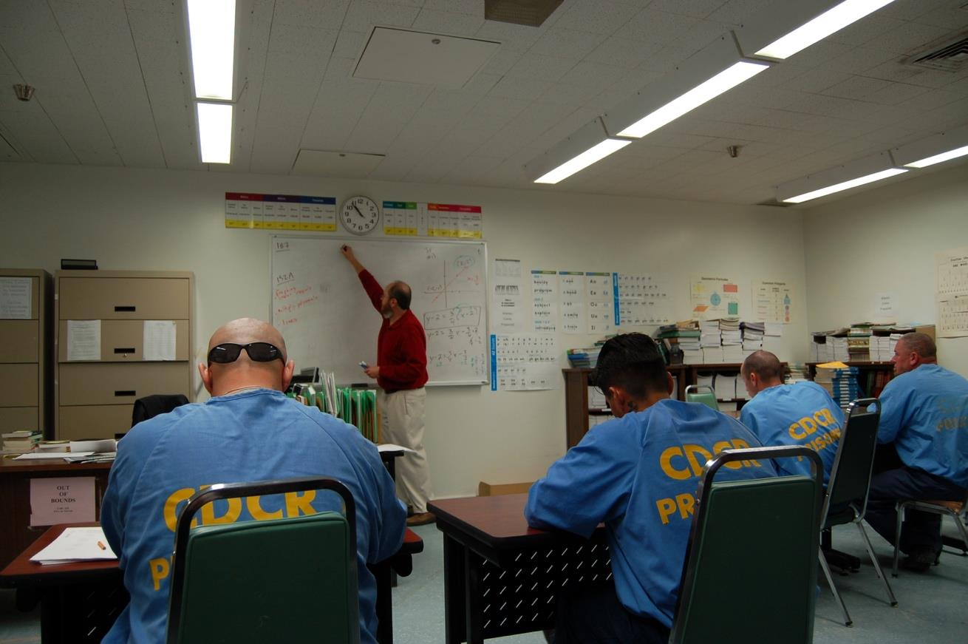
How It Works at LTCC
Most students receive a fee waiver by qualifying for the California Promise Grant. The entirety of the course materials are provided to students by LTCC. There are no costs to the student for textbooks nor the material to complete their work.
Advantages of LTCC’s quarter system:
Typically, fewer courses per term
Complete courses in a shorter period
Greater flexibility in choosing a schedule that works with students’ educational goals.

Slide 10
How It Works in Collaboration with CDCR
In the middle of each quarter, students receive registration forms for next quarter.
Once students indicate they want to continue their studies, the next set of class modules are prepared for distribution.
Students receive modules and begin the upcoming quarter shortly after finishing the previous set of classes.
The entire degree can be completed in 10 quarters depending on the student's circumstances and the number of courses completed each term.

Slide 11
What Is Our Enhanced One-on-One Approach?
The Enhanced One-on-One model prioritizes individualized student experiences.
It focuses on supporting faculty to provide regular and meaningful feedback while maintaining the same quality and standard of instruction offered through other modalities.
It is based on responding to the core ideals of social justice, valuing the humanity of this unique student population, and providing students the educational opportunities and the support they need to access their potential and achieve their educational goals.
Notes:
Providing educational opportunities through:
Tutoring sessions
Individualized feedback for each student
Bi-weekly administrative/faculty presence
Video-broadcasted supplemental course lectures
Personalized registration
Office hour/counseling request documents/hotline
Other student success support efforts
The Enhanced One-on-One model enriches student’s potential to succeed.

Slide 12
Effective Practices Values
Students First and Quality Instruction
Organization and Tracking
Focus on feedback
Provide progress updates
Humanize students
Embrace student course evaluations
Stay flexible
Demonstrate commitment to students
Maintain instructional standards
Foster community
Avoid over-familiarity
Communicate when students need support
Notes:
- Track everything, assignments in and assignments out
- Use clear and concise communication. There needs to be light at the end of the tunnel, and that tunnel needs to be as direct and transparent as possible
- Replicate face-to-face interactions in every letter, homework assignment, and course exercise. This is our chance to let the students know who you are and what a college education at LTCC is all about. Furthermore, while the students are not always interacting with you in a face-to-face setting, they are quite aware of the level of an instructor’s commitment to the class, and the evaluations show this.
-Remember that the detail and quality of your written communications with the students is the foundation of your instruction; that is where you are doing all of your teachings in the course. Your communication is at the heart of all student learning in the course- this is the essence of the Enhanced One-on-One model.

Slide 13
Effective Practices

Slide 14
Effective Practices Administrative
Integration, Collaboration, and Flexibility
Integration with strategic enrollment management and schedule planning
Investment in faculty engagement
Delivery of course material simultaneously (excluding exams)
Detailed tracking systems
Clarity of forms (working closely with Enrollment Services and Counseling)
Dedicated Enrollment Services staff
Dedicated Registration Specialist on the ISP team
Course / Program evaluations for continuous improvement
Notes:
Integration of your ISP is paramount for the success of your program and imperative for your students. One-off course/instructor assignments in an ad-hoc way will undermine your goals as a college of serving incarcerated populations. The totality of your organization needs to believes in your program, and you are the advocates!

Slide 15
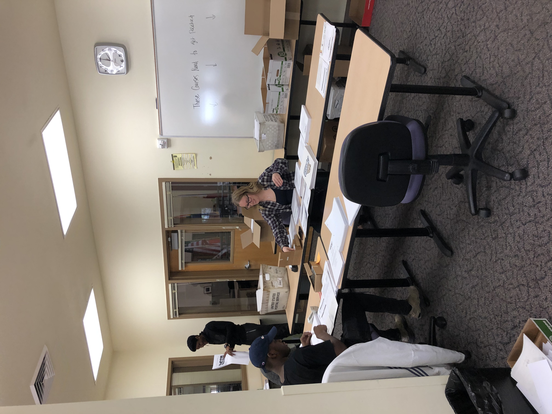
Effective Practices Student Support
Communication and Consistency
Individualized education plan combined with a guaranteed three-year schedule
Student Handbook – clear, concise, and complete
Tutoring – regular interaction
Counseling Forms/Faculty Office Hours Forms
Dedicated Counselor
Transcript Delivery/Collaboration with outside colleges
Thorough responses to students/strong rapport
Communication with family as appropriate
Books, calculators, pencils, and paper provided

Slide 16
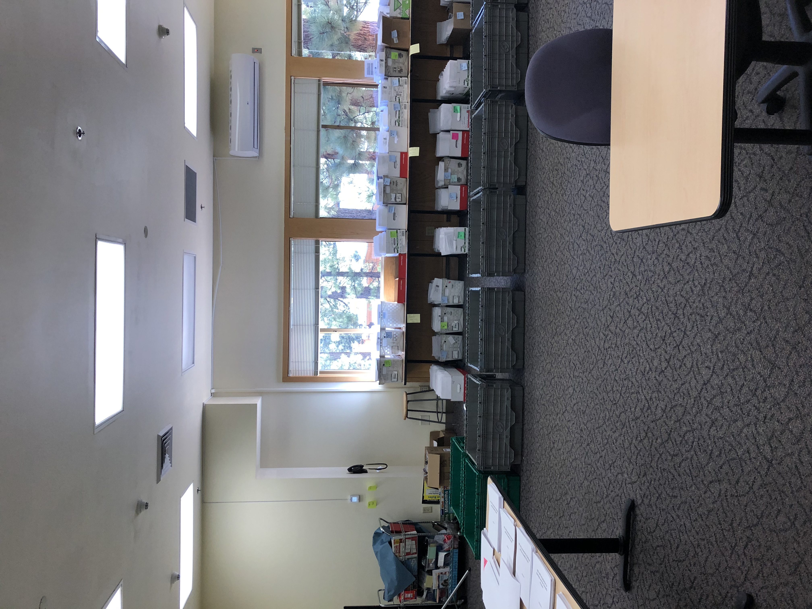
Effective Practices Instruction
Supportive and Inclusive
Steering Committee
Faculty meetings to gather input
Faculty Handbook and Corrections Training
Support navigating two worlds of corrections and CA community college
Accommodating and flexible with instructor needs
Regular communication
Course development support
Travel opportunities for tutoring
Marco Polo app

Slide 17
How Are We Adjusting?

Slide 18
COVID-19 Hurdles
How are we removing the hurdles:
Consistent communication
Decreasing turnaround time by scanning course material and all office hour forms to our faculty
Send feedback quickly to Education Coordinators
Knowing Education Coordinator’s schedule allows us to send emails the day before their shift with inquiries
Consistent positive regard for our students in all communication
Midterm and Final redesign
Communication, Collaboration, Consistency
No student contact
Increased turnaround times
Decreased presence on prison grounds and the college
Increased vulnerability for our students
Quarantining materials
Testing limitations

Slide 19
What our students are saying
“The higher learning comes as a personal goal that I never thought I would achieve or even try. Even though I'm incarcerated, it does not mean I don’t want to better myself to become a better member of society upon my release.”
“It gives those locked up an opportunity to turn their lives around and focus on becoming a productive member of society.”
“Supports our educational goals and assists students with books and materials, which would keep many students from obtaining an education any other way.”

Slide 20
Remember what we all are building

Slide 21
Chancellor’s Office & 5C Actions Specific to Correspondence Education

Slide 22
Proposed Title 5 Regulations
Previous changes to Title 5 §55204 removed correspondence as an approved method of instructor-student contact for distance education
Effectively removed correspondence education as an approved method of distance education
Consistent with federal CE & DE definitions
In 2019-2020, title 5 §58003.1 and §58009 were updated to add correspondence education as an approved delivery method for apportionment
5C developed proposed regulations within title 5, chapter 6, subchapter 3. Alternative Methodologies
Establish correspondence education as an alternative method of instruction
Define standards and requirements for colleges utilizing correspondence
Proposed sections modeled after regulations for distance education (§ §55200-55210)

Slide 23
Proposed Title 5 Regulations
Title 5 55260 (Proposed) Definition and Application: Correspondence Education
Correspondence Education means education provided through one or more courses by an institution under which the institution provides instructional materials, by mail or electronic transmission, including examinations on the materials, to students who are separated from the instructor. Interaction between the instructor and student is limited due to separation, but is as regular and substantive as possible despite limitations, and should be initiated by both the student and the instructor. Correspondence courses are typically self-paced although a regular cycle of assignment submissions and delivery of feedback should be established for facilitated learning. Correspondence is not distance education.

Slide 24
Proposed Title 5 Regulations
Title 5 55264 (Proposed) Instructor Contact: Correspondence Education
In addition to the requirements of section 55002 and any locally established requirements applicable to all courses, district governing boards shall ensure that:
Any portion of a course conducted through correspondence education includes regular effective asynchronous contact between instructor and students to facilitate learning through an established cycle of assignment submissions and delivery of substantive feedback conducted at regular intervals as determined by local processes. Students participating in courses conducted through correspondence education shall also have access to the instructor and to student support services, including counseling, library services and research assistance, and tutoring or learning support, via mail, email, telephone, or in-person dependent on local practice. Regular effective contact is an academic and professional matter pursuant to sections 53200 et seq.

Slide 25
Proposed Title 5 Regulations
Title 5 55266 (Proposed) Separate Course Approval: Correspondence Education
If any portion of the instruction in a new or existing course is to be provided through correspondence education, an addendum to the official course outline of record shall be required. In addition to addressing how course outcomes will be achieved in a correspondence education mode, the addendum shall at a minimum specify how the portion of instruction delivered via correspondence education meets:
(a) Regular and effective contact between instructors and students constructed to document and facilitate the progression of learning as referenced in title 5, section 55264, and…

Slide 26
Memorandum ES 20-15
Emergency Guidance for Correspondence Education (April 14, 2020)
Clarification on correspondence education policies and expectations for spring 2020 transitions and Summer/Fall planning
Guidance for regular effective asynchronous contact between instructors and students
Progression of learning through established cycle of submissions and feedback
Access to instructor and to student support services
Established DE and CE as the options for transitioning away from in-person instruction
Guidance memo and federal regulations should be used until state approved regulations are adopted (expected later in 2020)
Recommendation for course addendum for correspondence education

Slide 27
Memorandum ES 20-15
Emergency Guidance for Correspondence Education (April 14, 2020)
Distinctions between the DE and CE
Synchronous & Asynchronous in DE; Asynchronous in CE
Peer-to-peer interactions in DE; none in CE
Instructor-paced & consistent in DE; student-paced w/ individual limitations in CE
Substantive interactions in DE; limited interactions in CE
Both require availability of support services
Both require faculty proactively developing a progression of learning with feedback

Slide 28
Memorandum ES 20-22
Emergency Temporary Correspondence Education Blanket Addendum for Prison/Jail Courses (June 10, 2020)
Colleges needing more time to locally approve course addendum for correspondence education specific to courses offered in prisons and jails may request temporary blanket addendum for correspondence education for fall 2020
Instructions for submission request
Due August 1, 2020
*Note: ACCJC approval is needed for programs offering 50% or more correspondence education

Slide 29
References & Resources
References:
Sinek, S. Start with Why: How great leaders inspire everyone to take action.
Resource links:
Corrections to College Facebook page: https://www.facebook.com/CorrectionsToCollegeCA
Corrections to College: https://correctionstocollegeca.org/
Vison Resource Center
CCCCO Memos relevant to prisons, jails, and on-campus programs: https://correctionstocollegeca.org/resources?category%5B%5D=cccco-memos
CCCCO COVID-19 Resources: https://www.cccco.edu/About-Us/Chancellors-Office/Divisions/Communications-and-Marketing/Novel-Coronavirus/co-communications-to-colleges
Striving for Success: The Academic Achievements of Incarcerated and Formerly Incarcerated Students in California Community Colleges, (January 2020)

Slide 30
Questions? Thank you!

