Slide 1
Counseling and Student Services for Guided Pathways
Randy Beach, ASCCC Executive Committee Marie Boyd, ASCCC CTE Leadership Committee, Chaffey College
2018 ASCCC Career and Noncredit Education Leadership Institute May 3-5, 2018 Westin South Coast Plaza

Slide 2
Description
Just as the Student Success and Support Program (SSSP) fundamentally altered the counseling world, the Strong Workforce movement has fundamentally changed Career Technical Education within the California Community College System. The newest movement on the California Community College scene is the Guided Pathways. While SSSP, Strong Workforce, and Guided Pathways are three separate movements, their goals are the same for our students and faculty, including CTE Counselors: reduce time and cost to completion, coach every student for success, improve college readiness, enhance student learning, develop structured pathways to in-demand careers and employers, engage more adult learners, and close achievement gaps of under-resourced learners. Join us as we discuss these dynamic times for Counseling and Student Services from the Guided Pathways framework.
2018 ASCCC Career and Noncredit Education Leadership Institute Westin South Coast Plaza

Slide 3
What Brings You Here?
What do you hope to learn today? What are you struggling with locally?
2018 ASCCC Career and Noncredit Education Leadership Institute Westin South Coast Plaza

Slide 4
The Pathways Projects
American Association of Community Colleges Project (nationwide-Mt. Sac, Irvine Valley, Bakersfield and now Santa Monica)
CA Foundation Project (20 colleges were selected)
CCCCO Award program (all colleges eligible)
Major push from the California Community Colleges Chancellor’s Office to advocate and fund Guided Pathways-style reforms
Recent legislation and system changes supportive of reforms associated with Guided Pathways (AB 705, CAI, AB 19, BSI/Equity/SSSP integration)
2018 ASCCC Career and Noncredit Education Leadership Institute Westin South Coast Plaza

Slide 5
The ASCCC Position on Guided Pathways
F15 9.12 Support Local Development of Curricular Pathways
To “urge local academic senates and colleges to create formal processes and policies that require the local academic senate, in consultation with its curriculum committee, to evaluate and endorse any proposed curricular pathways offered by an external organization before such a program is institutionalized”
Be mindful of the potential, but insistent on the purview of faculty
Governance structures should be respected and utilized
2018 ASCCC Career and Noncredit Education Leadership Institute Westin South Coast Plaza

Slide 7
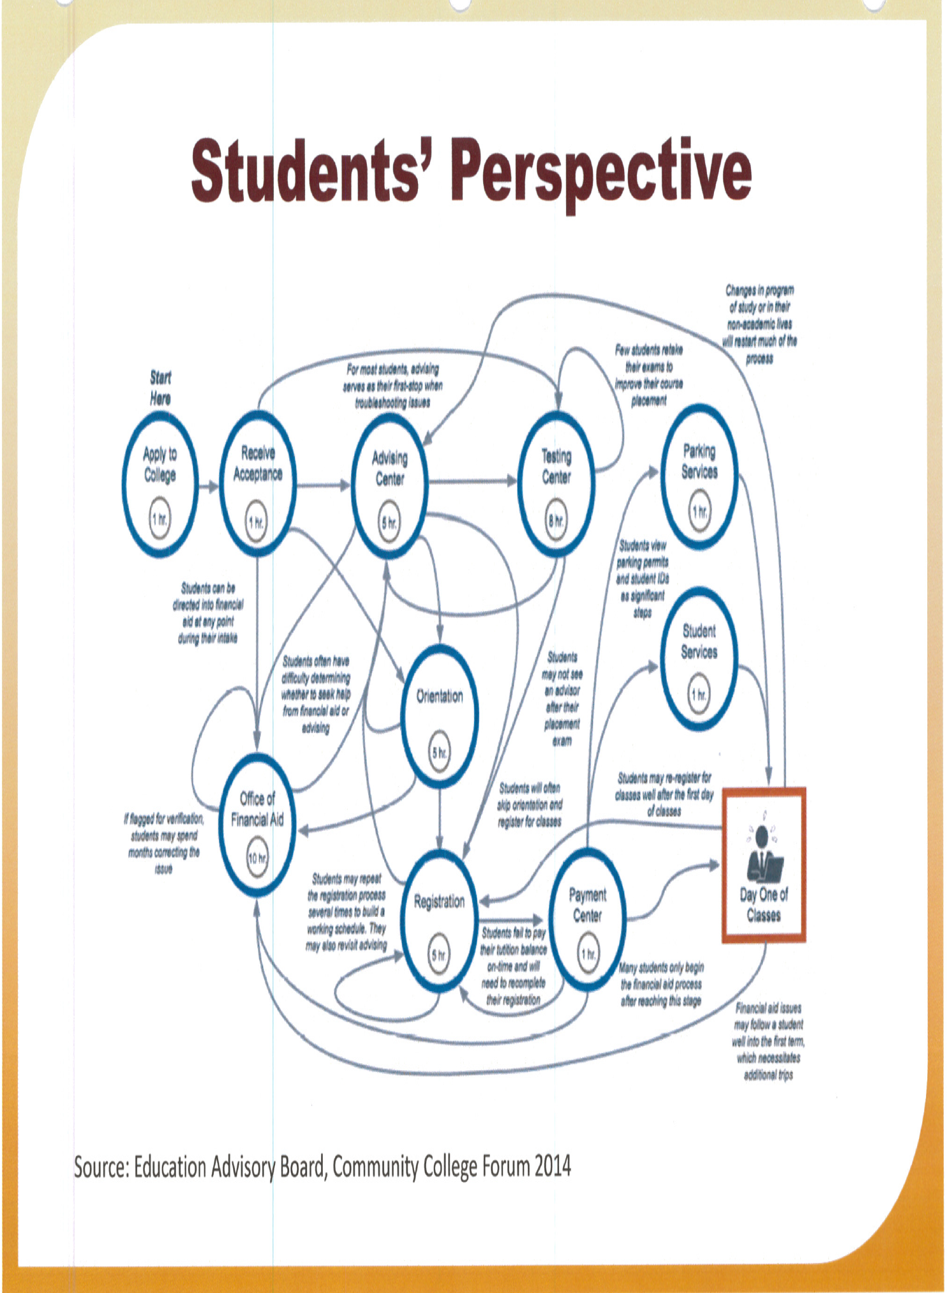

Slide 8
Which Student Services Are Involved?
Easier question is “Which ones are NOT?”
Counseling
Admissions and Application Process
Assessment
Financial Aid
Outreach
Transfer Centers
Tutoring and Supplemental Learning
Others?
2018 ASCCC Career and Noncredit Education Leadership Institute Westin South Coast Plaza

Slide 9
The Four Pillars of GP and Student Services
2018 ASCCC Career and Noncredit Education Leadership Institute Westin South Coast Plaza

Slide 10
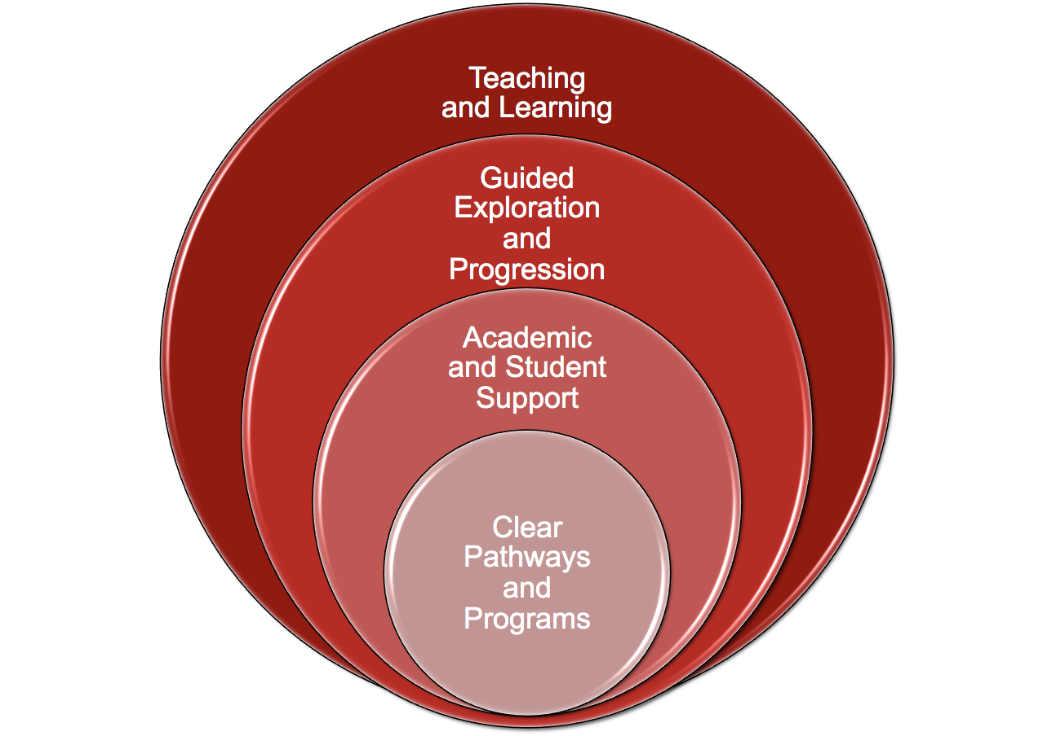
2018 ASCCC Career and Noncredit Education Leadership Institute Westin South Coast Plaza

Slide 11
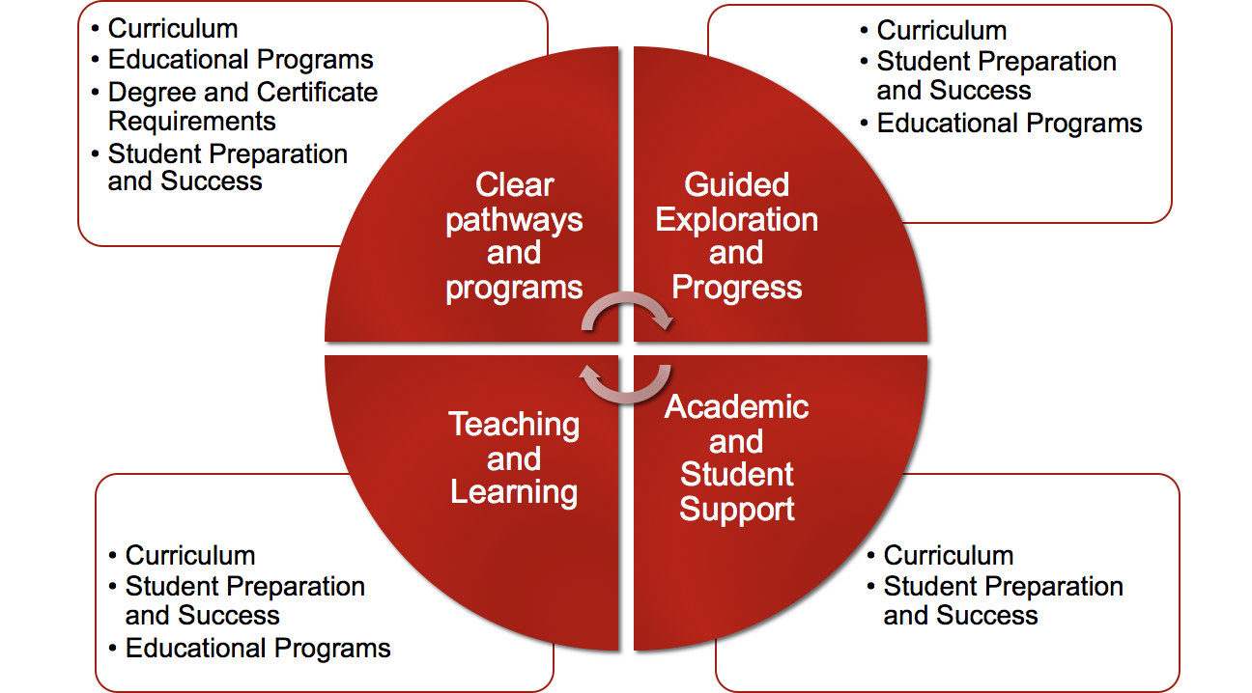

Slide 12
Clarify the Path: Begin with the End
Create the shortest path of courses the students will take from their first day of attendance to their graduation by designing curriculum with the end goal of their program’s outcomes in mind
Requires discussion across traditional discipline boundaries and sacred cows
Considers Employment and further education opportunities targeted by each program in the beginning
Makes sense of general education
Introduces the concept of “Meta Majors”
AACC, “Guided Pathways: Planning, Implementation, Evaluation.” Diagram. https://www.aacc.nche.edu/wp-content/uploads/2017/09/PathwaysGraphic462017.pdf

Slide 13
Clarify the Path: Student Services
Collaborate with program faculty to identify appropriate transfer or career-oriented outcomes to drive curriculum to identify areas of interest (meta majors)
Help identify courses in the general education pattern that align with program outcomes or goals
Transfer Centers, Career Centers, Specialty Counseling (Athletics, CTE programs)
Relies on dialog across all faculty groups
AACC, “Guided Pathways: Planning, Implementation, Evaluation.” Diagram. https://www.aacc.nche.edu/wp-content/uploads/2017/09/PathwaysGraphic462017.pdf

Slide 14
Enter the Path: Choosing and Entering
Helping students choose and enter a pathway
Established where students enter the pathway in the most effective ways possible
Requires alignment and cooperation with high schools
Thoughtful planning early on; Asking different questions around “What do you want to be when you grow up”
Dual Enrollment, Multiple Methods Assessment Project (MMAP), Acceleration, Noncredit, non-academic foundation skills
AACC, “Guided Pathways: Planning, Implementation, Evaluation.” Diagram. https://www.aacc.nche.edu/wp-content/uploads/2017/09/PathwaysGraphic462017.pdf

Slide 15
Enter the Path: Student Services
Expanded and early Career Counseling
Career counseling coursework linked to areas of interest
Use of multiple measures to assess students’ needs
First-year experiences to help students explore the field and choose a major
Full program plans based on required career/transfer exploration
Contextualized, integrated academic support to help students pass program gateway courses
K–12 partnerships focused on career/college program exploration (Outreach)
AACC, “Guided Pathways: Planning, Implementation, Evaluation.” Diagram. https://www.aacc.nche.edu/wp-content/uploads/2017/09/PathwaysGraphic462017.pdf

Slide 16
Stay on the Path: What To Do When Life Happens
Intentional monitoring of students progress along the pathway and intrusive interventions that redirect the students back onto the pathway when “life happens” (SSSP, Equity, BSI)
Counseling and Advising
Technology (EPI, Early Alert, e-SEP, Degree Works, Starfish, GradesFirst)
Scheduling to ensure students can find the courses they need when they need them
AACC, “Guided Pathways: Planning, Implementation, Evaluation.” Diagram. https://www.aacc.nche.edu/wp-content/uploads/2017/09/PathwaysGraphic462017.pdf

Slide 17
Stay on the Path: Student Services
Work with discipline faculty to identify student habits relevant to their course-taking habits
Ongoing, intrusive counseling intervention strategies
Systems for students to easily track their progress
Systems/procedures to identify students at risk and provide needed supports
Capacity to help students redirect and change their goals without amassing significant numbers of units.
AACC, “Guided Pathways: Planning, Implementation, Evaluation.” Diagram. https://www.aacc.nche.edu/wp-content/uploads/2017/09/PathwaysGraphic462017.pdf

Slide 18
Ensure Learning
Learning outcomes are clearly defined for each of the college’s programs and for the courses in those programs
Outcomes designed to prepare students for employment and further education
Outcomes are clear, measurable, and assessed regularly and results used to improve instruction and program/institutional effectiveness
Students internalize the content they’ve learned in their courses by participating in group projects, internships and other applied learning experiences
AACC, “Guided Pathways: Planning, Implementation, Evaluation.” Diagram. https://www.aacc.nche.edu/wp-content/uploads/2017/09/PathwaysGraphic462017.pdf

Slide 19
Ensure Learning: Student Services
Enhanced or supplemental instruction practices to support project-based learning, collaborative learning, and other applied learning experiences
Embedded counseling-counselors developing stronger relationships with program faculty to bring students across the finish line
Collaboration with library faculty, faculty involved in tutoring and supplemental instruction to maximize meta-cognitive skills
Systems/procedures for the college and students to track mastery of learning outcomes that lead to credentials, transfer, and/or employment
AACC, “Guided Pathways: Planning, Implementation, Evaluation.” Diagram. https://www.aacc.nche.edu/wp-content/uploads/2017/09/PathwaysGraphic462017.pdf

Slide 20
Student Services and Pathways Funding
Currently colleges require to integrate planning
Separate requirements in CEC and title 5 regulations must be build into single plan (BSI/Equity/SSSP)
Plans developed in consultation with students, staff, administrators, faculty, Academic Senate, and members of the community as appropriate.
Plans must be adopted by your local governing board of the community college district and submitted to the CCCCO by December 1, 2017.
Guided Pathways grant language calls for integration of BSI/Equity/SSSP/AEBG, other grant programs
2018 ASCCC Career and Noncredit Education Leadership Institute Westin South Coast Plaza

Slide 21
Next Steps
Assert faculty leadership and purview in 10 + 1 areas
Determine planning and design structures that put faculty heavily involved in decision-making
Talk to students; find out where they need help
Look to GP for inspiration, not an off-the-shelf model
Be cautious of faculty taking sides and pointing fingers
Keep students’ needs at the forefront
2018 ASCCC Career and Noncredit Education Leadership Institute Westin South Coast Plaza

Slide 22
Resources
ASCCC Website - http://asccc.org
Contact the ASCCC – info@asccc.org
Application for Statewide Service - http://asccc.org/content/application-statewide-service
ASCCC Publications - http://asccc.org/publications
ASCCC Events - http://asccc.org/calendar/list/events
ASCCC Services - http://asccc.org/services#
Disciplines List and MQs - http://asccc.org/disciplines-list
2018 ASCCC Career and Noncredit Education Leadership Institute Westin South Coast Plaza

Slide 23
Thank you!
Questions

