Slide 1
Course Sequencing and Program Mapping 2018 Curriculum Institute Riverside, California
Daniel Keller, Dean of Curriculum and Instructional Support Services, Los Angeles Community College District
Thais Winsome, Curriculum Chair, Mission College

Slide 2
Overview
What is a Program Map?
How does course sequencing inform the Program Map?
Five Design Principles for Developing Program Maps
The Role of Curriculum
Discussion

Slide 3
Program Maps Defined
Educational program: defined in title 5, section 55000(m) as "an organized sequence of courses leading to a defined objective, a degree, a certificate, a diploma, a license, or transfer to another institution of higher education."
Program Map
A progression of courses to complete the program; may be term-by-term or unit based
Provides a clear understanding of award requirements
Serves as a planning document to assist students in completing the required courses
Successful program mapping is all about identifying the needs of your students and your college and then developing effective maps to meet those needs.

Slide 4
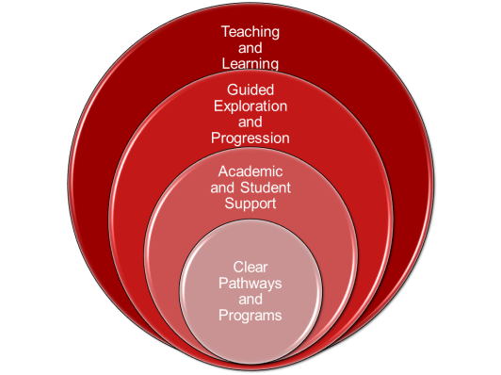
Program Maps and Course Sequencing form the core of Guided Pathways

Slide 5
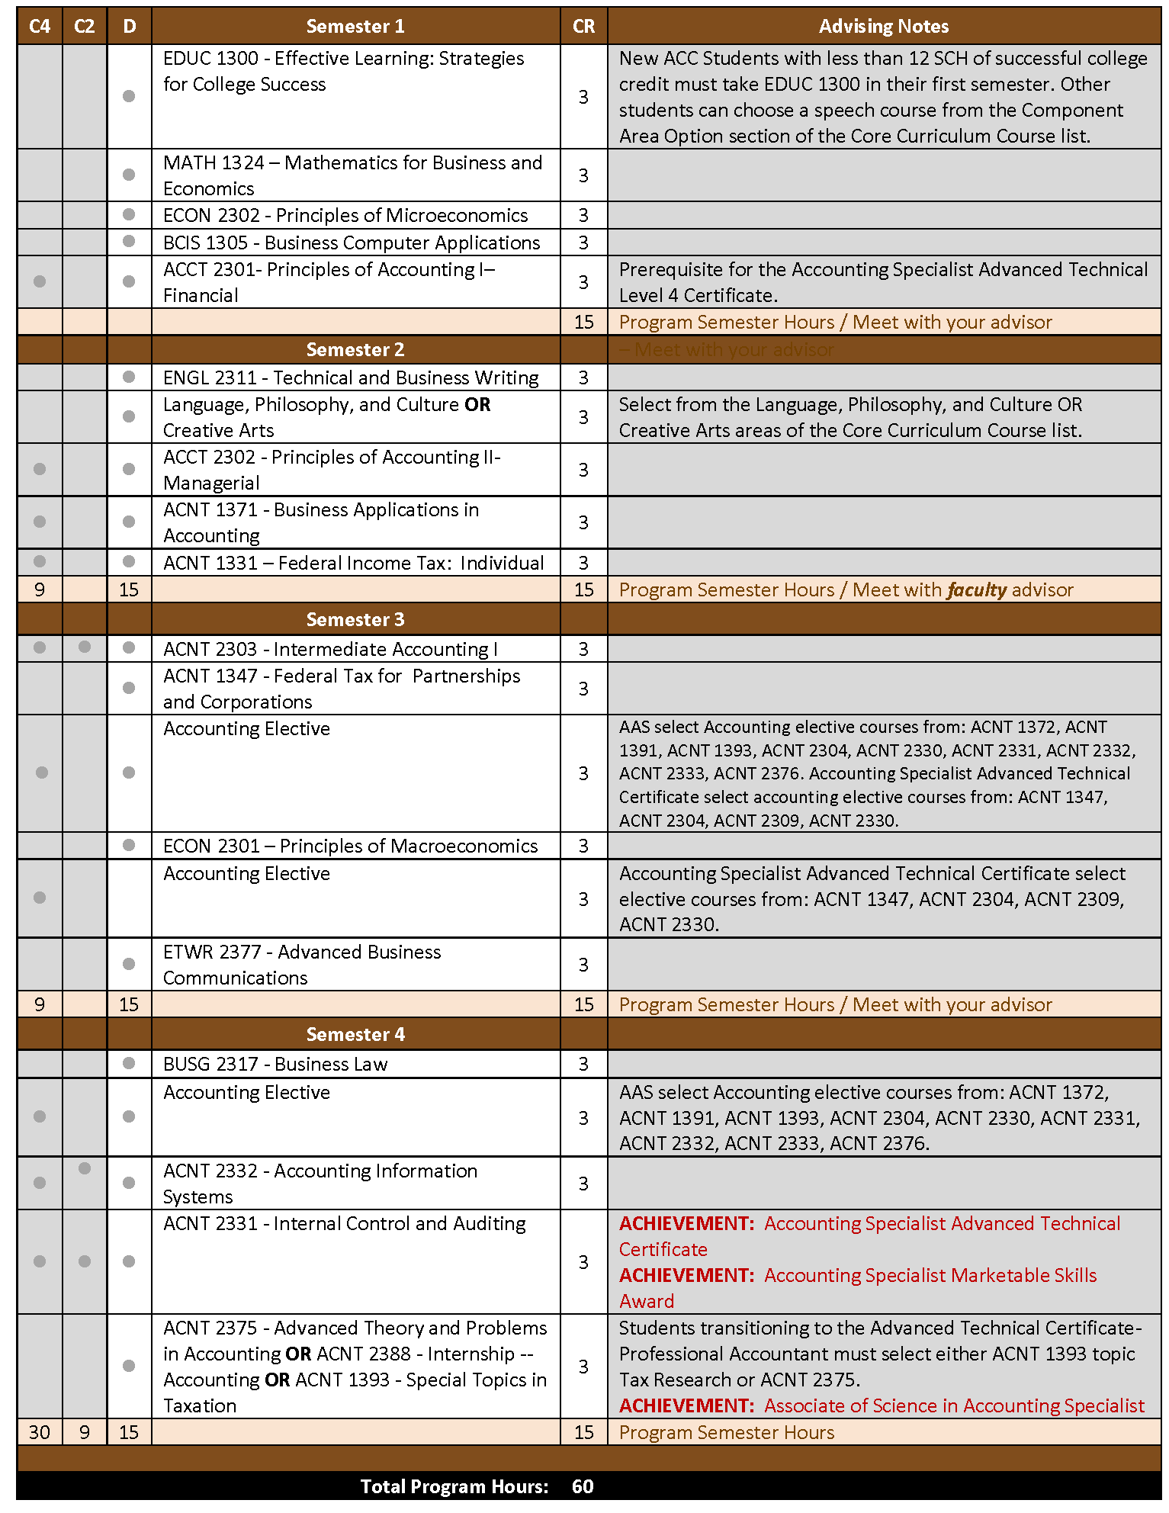
Sample Program Map
Advising Notes
clarify elective choices
Identify milestones
Courses needed to achieve certificates and the degree are shown within the program map (C2, C4 and D)
Accounting Specialist, Austin City College
Notes:
We could distribute the full program map as a handout

Slide 6
How does Course Sequencing Inform the Program Map?
Well….how about Accreditation, for starters?
Standard II.A.5: The institution’s degrees and programs follow practices common to American higher education, including appropriate length, breadth, depth, rigor, course sequencing, time to completion, and synthesis of learning. The institution ensures that minimum degree requirements are 60 semester credits or equivalent at the associate level, and 120 credits or equivalent at the baccalaureate level.
Standard II.A.6: The institution schedules courses in a manner that allows students to complete certificate and degree programs within a period of time consistent with established expectations in higher education.

Slide 7
Course Sequencing is essential in Developing Program Maps
The most comprehensive program map in the world is useless if the student can’t follow it
Effective Course Sequencing
Clarifies the linear progression of core courses in the program
Is mindful of relationships between courses in related areas
Workload issues
e.g. is Organic Chemistry + Cell/Molecular Biology + Calculus + GE elective really feasible?
Possible synergy between courses
e.g. Organic Chemistry and Cell/Molecular Biology taken together can reinforce learning in both courses
gives the student a reasonable expectation that the courses identified on the map for a particular term will be available to the student on days/times that don’t conflict with other courses
Includes electives and GE

Slide 8
Five Design Principles for Program Mapping
“Reverse Engineering” – start with the outcome
Review the program outline and align with outcomes
Transfer – how well does the program facilitate transfer to major feeder schools?
AD-Ts: do existing GE offerings allow for rapid completion of degree requirements?
CTE – how well is the program aligned with the local labor market? Does the program prepare the student for immediate employment in the field?
Programs with both degrees and certificates
can students earn certificates along the way that improve job opportunities while they pursue the higher-level degree?
Notes:
Questions From Jobs for the Future

Slide 9
Five Design Principles for Program Mapping
In-depth analysis of courses & course sequencing
Can the curriculum be streamlined?
Are prerequisites reasonable and validated?
What GE courses best support the program?
Notes:
Questions From Jobs for the Future

Slide 10
Five Design Principles for Program Mapping
Develop a clear understanding of your students
Demographics, goals, post-college placement
Data, data and more data
Answers may dismay – but continue on anyway!
Retrospective analyses before (and after) mapping
Success/retention – who leaves and when?
Course-taking behavior
Common and/or popular GE courses – why are they taking those and not others?
“swirlers,” moving between nearby colleges to complete requirements?

Slide 11
Five Design Principles for Program Mapping
Engage the college community in the discussion
Students
Curriculum and Articulation officers
Counselors
Faculty in related or prerequisite disciplines (e.g. Math for Accounting)
GE Faculty
Administration
Classified staff associated with the program
Where appropriate, include the larger community
Local employers
University partners
Notes:
Questions From Jobs for the Future

Slide 12
Five Design Principles for Program Mapping
Align faculty ideal with student reality
How many students actually followed the map?
If they didn’t follow the map, were there common bottlenecks or stepping-off points?
What process do you have in place to make changes?

Slide 13
Key Considerations
Maximize the use of “stackable” certifications
Where applicable, develop “bridges” to facilitate movement between programs
e.g. common core courses for programs in related disciplines
Encourage exploration and innovation!

Slide 14
Tough Questions - Scheduling
Effective course sequencing requires that courses be scheduled on days/times that allow students to follow the map
So… who bites the bullet on scheduling?
How do you plan to have this discussion at your college?

Slide 15
Tough Questions – Part-time Students
Most program maps are designed for full-time students
but 60-70% of our students are part-time students
Prior to 2017 weren’t even included in federal reporting (e.g. IPEDS)
Removing college-level barriers to enrollment is not sufficient
To close equity gaps, we must serve our students where we find them
Could benefit most from program maps and course sequencing that maximizes their limited time
Program maps need to be developed specifically for the part-time student
Targeted course sequencing
Advising specific to their needs

Slide 16
Where does curriculum fit into all this?
Everywhere!
The curriculum committee is the one group that is probably going to know more about what everybody else is doing
New courses and revisions of existing courses will require expertise
Changes to prerequisites, addition of supplemental instruction, etc.
Coordination with articulation
Coordination/liaison with Senate, instructional support office, local governing board

Slide 17
The 10+1 and Guided Pathways
Clear pathways and programs
Curriculum
Guided Exploration and Progress
Curriculum
Academic and Student Support
Curriculum
Teaching and Learning
Educational Programs
Degree and Certificate Requirements
Student Preparation and Success
Student Preparation and Success
Educational Programs
Student Preparation and Success
Educational Programs
Student Preparation and Success
Curriculum
Grading Policies

Slide 18
Resources
https://www.caguidedpathways.org/resources/
https://aacu.org/diversitydemocracy/2017/fall/bailey
Data and Suggestions for Part-time students
https://go.civitaslearning.com/community-insights
https://www.insidehighered.com/views/2018/04/30/helping-part-time-students-complete-college-opinion

Slide 19
Thank you!
Daniel Keller
Thais Winsome
info@asccc.org

