Slide 1
Credit and Noncredit Collaborations for a Stronger Workforce
Wendy Brill-Wynkoop – College of the Canyons L.E. Foisia – Mt. San Antonio College
Shannon Rider – Mt. San Antonio College

Slide 2
Noncredit College and Career Readiness
A Strong Workforce project that seeks to expand the capacity among the Los Angeles Region community college noncredit CTE programs. Accomplishing this will significantly contribute to the Strong Workforce Program’s purpose of producing a middle - skilled workforce.
Prepare students to be college ready in CTE credit coursework by decreasing the skills gap
Regional collaboration among adult education/ noncredit programs
Develop noncredit courses through curriculum development
Engagement into Guided Pathways (local integration)

Slide 3
How did we create these collaborations?
Participate in regional consortium meetings
Visit college partners (ongoing)
Collaborate with Deputy Sector Navigators
Found faculty champions – noncredit and credit faculty
Formed community of practice
Attended CTE faculty meetings & professional development events
Provided customized presentations – mirrored courses, noncredit curriculum, etc.
Approached by CTE faculty for support
Notes:
Shannon 1, 2, and 3
L.E. 4-7

Slide 4
Noncredit Readiness Courses: Examples from the Consortium
Contextualized Courses
Regional Collaboration
Reading & Writing
Math
English for Special Uses (ESU)
Career Development
Computer Skills for Workplace
Held regional faculty work group meetings to review the curriculum
Worked with colleges to develop contextualized courses and Pre-CTE courses
Notes:
L.E.

Slide 5
Contextualized Math for Healthcare
Contextualized math examples that led to improvement for credit health care career programs
Contextualized math course
Covered dosage calculations, measurements, decimals, percent, proportions, and fractions
4-week pre-requisite (Math for Nursing)
92% of students increased their score on average by 25%
Notes:
L.E.

Slide 6
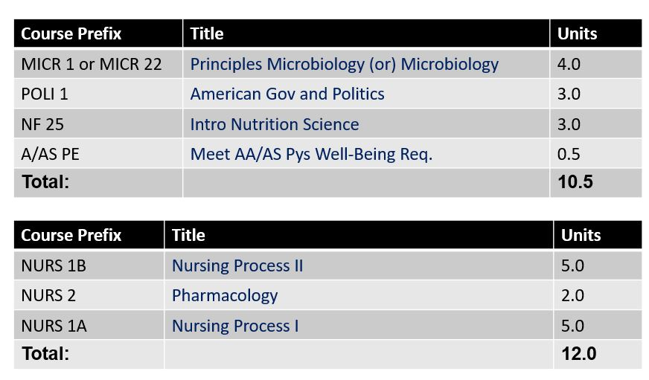
How Contextualized Courses Fit into Guided Pathways: Nursing, AS
Fall Term 3
Noncredit Support
Spring Term 3
Notes:
L.E.

Slide 7
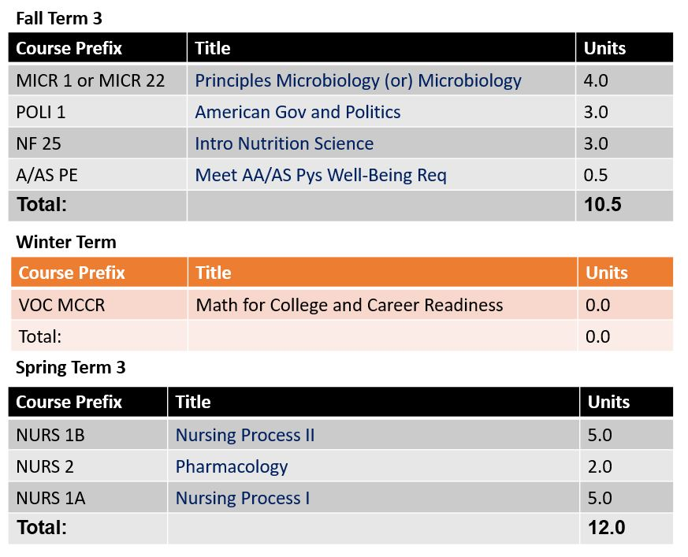
Integrate Noncredit into Guided Pathways
Offer course before Pharmacology course
Notes:
L.E.

Slide 8
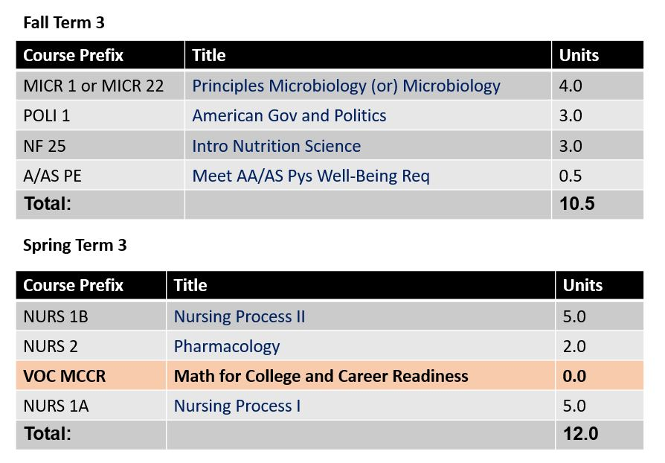
Offer course concurrently with Pharmacology course
Notes:
L.E.

Slide 9
Contextualized ESL: Welding
Contextualized for Welding
+
Introduction to Welding
Beginning Arc Welding
Intermediate Arc Welding
Optional
Certification Exam
Print Reading/Computations
and / or
Certification Prep
Notes:
L.E.

Slide 10
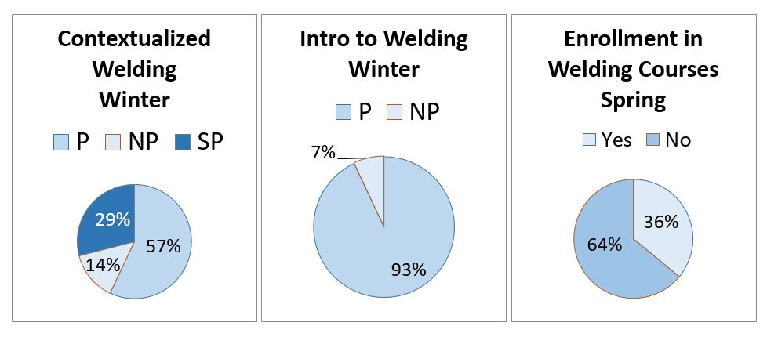
Pass Rates and Next Semester
Notes:
L.E.

Slide 11
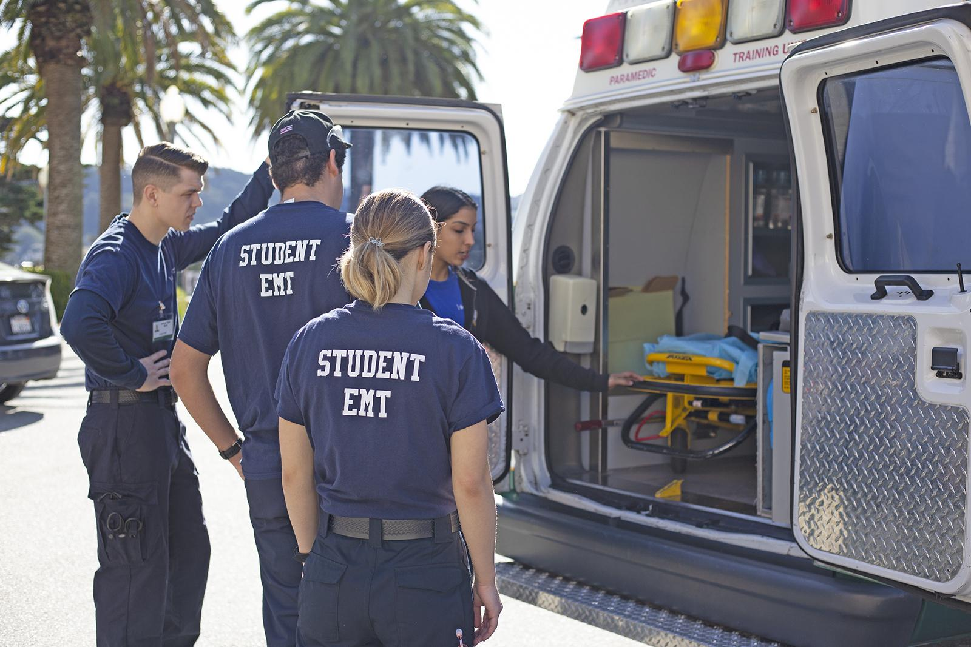
Contextualized EMT Support Course
Approached by EMT faculty to develop a support course to help students write a research paper
Test taking strategies, annotating a text, vocabulary strategies, note taking
Contextualized VOC: RWCCR
Librarian workshop to help with research

Slide 12
Noncredit Curriculum Training
Goal: Bring credit and noncredit faculty together to collaborate on creating noncredit courses that would support and prepare students for credit CTE courses.
Topics of the training included:
Overview of the noncredit curriculum process
Noncredit supports for career education
Mirrored courses
Developing and writing noncredit curriculum
Noncredit practitioners - data, accountability, and pathway design
Notes:
L.E.

Slide 13
Noncredit Supports
When noncredit supports are implemented, they can assist in strengthening bridges to credit CTE and employment.
Prep
for
CTE
Disciplines
Noncredit
pathways &
on-ramps to
credit
CTE
Career
Exploration
Workforce
Agencies
Mirrored
Courses
credit CTE & Employment
Notes:
Shannon

Slide 14
Noncredit Support Example: Tool Use and Field Service
Noncredit CTE coursework can be a bridge to ensure preparedness for credit CTE courses
Tool Use and Field Service Fundamentals teaches students how to operate and handle specific equipment in a variety of CTE disciplines
Enrollment in this type of noncredit CTE course has the potential to increase credit CTE course success
Notes:
Shannon

Slide 15
Allied Health Convening: Exploring Noncredit Pathways to Credit
FREE Event on June 7 at Quiet Cannon in Montebello from 9am - 2:30pm
Supporting student success in the health sector by exploring noncredit pathways to credit
Guest Speaker: Dr. Manuel Pastor
4 contact hours of CE credit
See Eventbrite for more details: https://www.eventbrite.com/e/allied-health-convening-exploring-noncredit-pathways-to-credit-tickets-60722465529

Slide 16
Melissa Moreno
Vice President
School of Extended Learning
https://csi.cccbadges.org/
Skill based
Flipped classroom
Marketed classes to employers
Pay increase upon completion

Slide 17
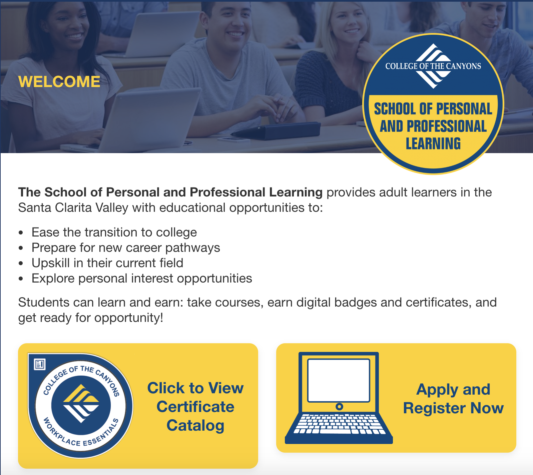
https://coc.cccbadges.org/

Slide 18
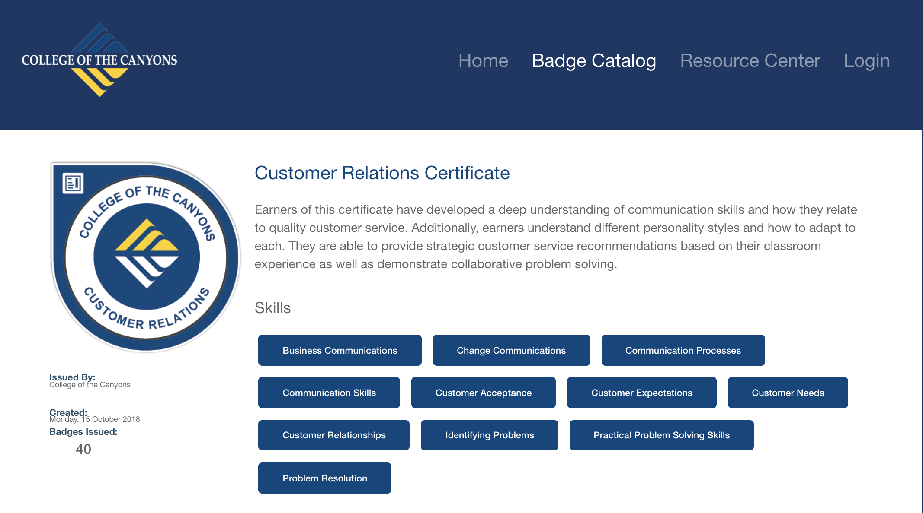

Slide 19
PROPOSAL TITLE:
SCCRC PROJECT IN COMMON #3
Career Strategist Badge
DESCRIPTION: Pilot a cohort of CTE students from 3 colleges in the region - Santa Barbara City College, College of the Canyons and Ventura College. These students will be required to attend 3 short Career Skills Institute courses to attain a "Career Strategist" Badge. The short courses will integrate 4 lessons of New World of Work, and students will be required to complete a LInkedIn profile and join their college "group" on LinkedIn. LinkedIn will provide 2 years of follow on data to help capture outcomes in job & skill acquisition, education acquisition and job change.

Slide 20
SCCRC Regional Career Strategist Workshops

Slide 21
Regional Shared Curriculum
NC.CSKL 009 Personalized Career Planning (8 hours)
This course focuses on the assessment of individuals strengths, interests, values, personality and abilities in the context of career and education planning. Students will improve decision making skills by exploring their own decision making styles and applying specific decision making models to their career planning process.
NC.CSKL 010 Strategic Job Search (8 hours)
This class is designed to help students develop and implement a strategic career and job search plan. Students will learn about sources of occupational information and how to utilize this information in the career planning and job search process.
NC.CSKL 011 LinkedIn for Business (8 hours)
Participants learn how to effectively utilize LinkedIn, the world’s most popular business-oriented social media networking platform, to develop business through relationship marketing. Students will learn techniques for optimization of company profile, development of content that engages a target audience, building a professional brand, and marketing a company. The course also explores strategies for showcasing credentials, obtaining business advice, reconnecting with former colleagues, and connecting with businesses around the globe, utilizing LinkedIn.

Slide 22
Questions?
Wendy Brill-Wynkoop: wendy.brill@canyons.edu
L.E. Foisia: Lfoisia@mtsac.edu
Shannon Rider: srider@mtsac.edu
Thank you!
Notes:
Add Carolyn and Mariella

